Slide 1
Exploring Bioluminescence in Aquatic Animals

Slide 2
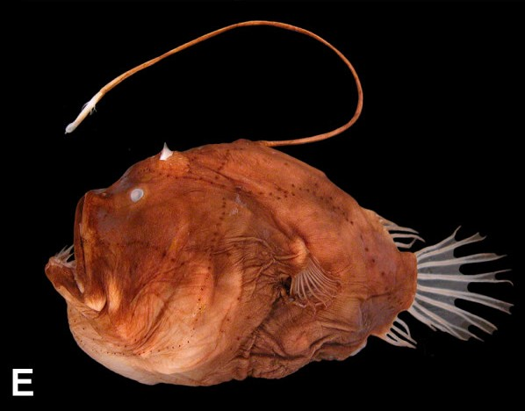
Exploring Bioluminescence
Deep-Sea Anglerfish Expressing Bioluminescence
Student Packet

Slide 3
Question: Why do some aquatic organisms express bioluminescent properties?
Research Notes

Slide 4
Bioluminescent Organism:_______________________
*Be sure to review how your chosen organism uses bioluminescence using the Bioluminescent Organism Cards
Plan your Prototype Design

Slide 5
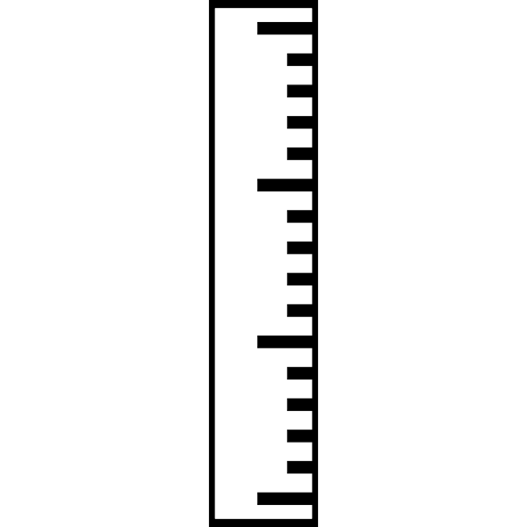
Claim - Evidence - Reasoning
What is it?
Claim (The Answer)
The claim is a statement you believe to be true that solves a scientific question or problem.
Evidence (The Proof)
The evidence is the research or data you gathered, including observations, investigations and any other information.
Reasoning (The Why)
The reasoning shows how the evidence answers the question or solves the problem.

Slide 6
Question: How does bioluminescence help your aquatic organism survive in the incredibly harsh conditions of the deep sea?
Claim
Evidence:
Evidence:
Evidence:

Slide 7
Question: Why do some aquatic organisms express bioluminescent properties?
Reasoning
How does your evidence justify your claim?

Slide 8
Scoring Rubric
 | 0 | 1 | 2 | Points
Claim | Does not make a claim or makes an incorrect claim. | Makes an authentic claim but appears to be vague or incomplete. | Makes an accurate and complete claim.
Evidence | Does not provide evidence, or only provides incorrect evidence that does not support the claim. | Provides appropriate but unsatisfactory evidence to support claim. | Provides appropriate and sufficient evidence to support the original claim.
Reasoning | Does not provide reasoning, or only provides reasoning that does not link evidence to the claim. | Repeats evidence and links to some scientific principles. | Provides accurate and complete reasoning that links evidence to claim.

