Slide 1
The Amazing Hydrogel

Slide 2
Outline
Introduction and Motivation, Pre-Assessment: 15min
Hydrogel preparation: 20 min
Wrap up discussion and Post-Assessment: 15 min

Slide 3
Learning Objectives
Create a hydrogel using the crosslinking process (chelation)
Understand and explain the chelation of a polymer using the ionic crosslinking process by exchanging a monovalent metal cation (Na⁺¹) with a divalent metal cation (Ca⁺²)
Explain what a hydrogel is and its different uses and applications

Slide 4
Polymers and Hydrogels in everyday life
Have you used hydrogels before? Chances are you have. If you are wearing a contact lens, you are using a hydrogel; how about a hydrogel hand sanitizer? A hydrogel is likely keeping a baby’s bottom dry.
You are probably a frequent user of hydrogels, but do you know the science behind them?

Slide 5
Polymers and hydrogels in everyday life
Hydrogels are hydrophilic, or water-loving, polymers that are capable of absorbing and retaining a lot of water while also making a substrate for other materials, such as other polymers, minerals (nanoparticles), or other compounds.
There are even 3D printable hydrogels that show promise in knee surgery!

Slide 6
Polymers and hydrogels
Polymers are a class of natural or synthetic substances composed of very large molecules, called macromolecules, which are multiples of simpler chemical units called monomers. Polymers make up many of the materials in living organisms and are the basis of many minerals and man-made materials.
Hydrogels are hydrated, polymeric networks that exhibit higher elasticity and strength and can be blended with other materials for endless applications

Slide 7
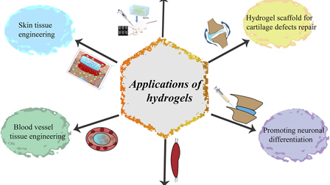
Hydrogel applications in medicine

Slide 8
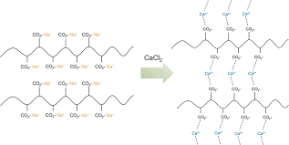
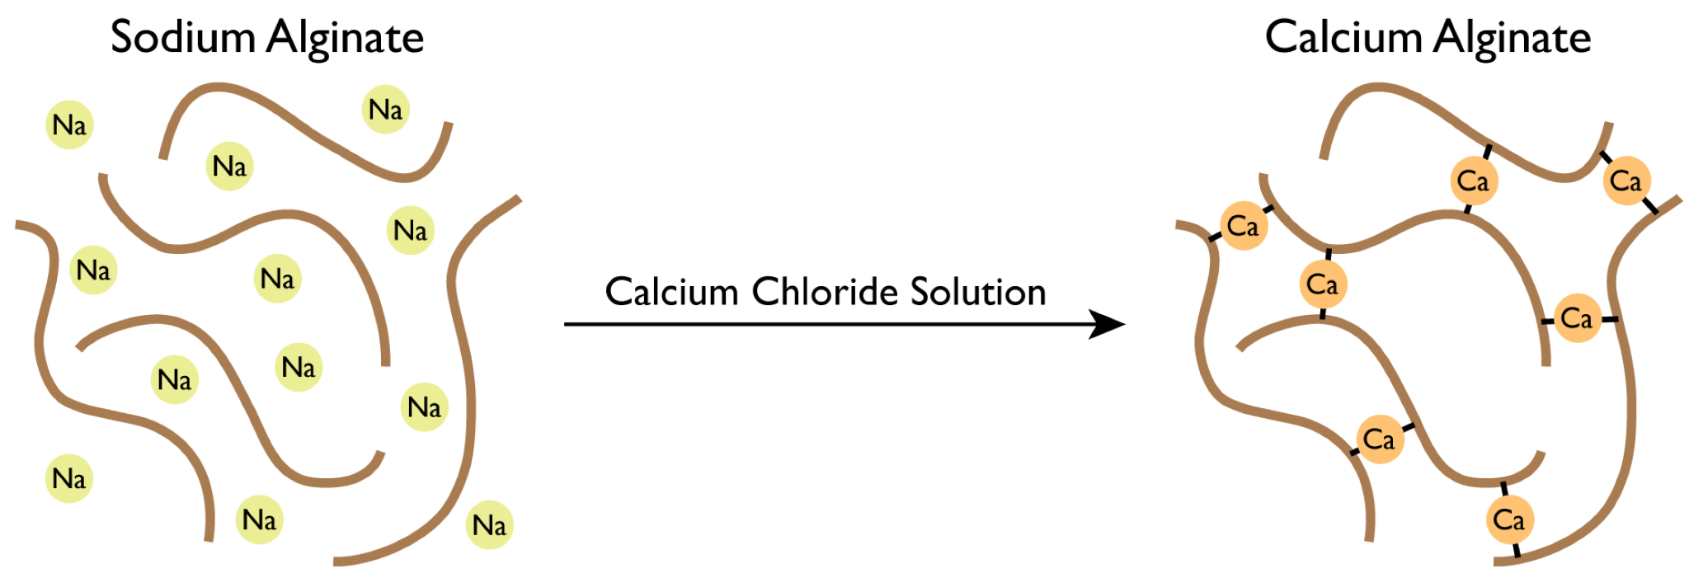
We are going to create alginate-based hydrogels by ionic crosslinking

Slide 9
Engineering Connection
Hydrogels are hydrated, polymeric networks that exhibit high elasticity and strength. Sodium alginate (SA) is a natural hydrophilic biopolymer typically obtained from marine brown macroalgae, suitable for making hydrogels due to its cross-linking ability, biocompatibility, chelating ability, water solubility, bio absorbency and low cost.

Slide 10
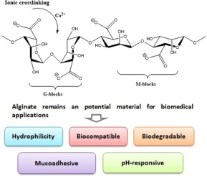
Alginate-based hydrogels

Slide 11
Pre-Assessment Worksheet

Slide 12
Hydrogel Activity
Hydrogel preparation: 20 minutes
Solutions:
Sodium alginate (SA) solution in distilled water a 1% w/v concentration
Calcium chloride 0.1M, 0.05M and 0.02M

Slide 13
Activity (20 minutes)
Follow the Activity Worksheet for crosslinking the alginate solution with calcium chloride solutions and then answer the questions.

Slide 14
Wrap Up (15 minutes)
Post-Assessment Worksheet
Recap and discussion led by teacher
Reflection

Slide 15
Recap and discussion
What is a hydrogel?
What happens during ionic crosslinking?
What do you think about uses of hydrogels?

Slide 16
Reflection
What did you learn today?
What was difficult?
What could you have done differently?

