Slide 1
The Mystery of the Contaminated Water- Who killed Dr. Clearwater?

Slide 2
Day 1

Slide 3
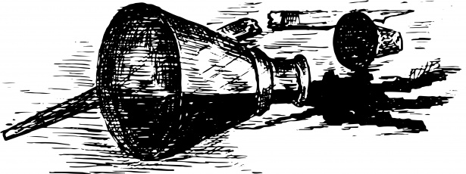
THE MYSTERIOUS DEATH OF DR. CLEARWATER

Slide 4
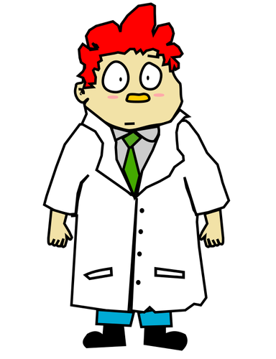
Meet Dr. Noolan Courage
On day 296 of their research experience, Dr. Courage went to see Dr. Clearwater. Upon knocking at the door and hearing no answer, he entered the room and found Dr. Clearwater dead…

Slide 5
OUR SUSPECTS

Slide 6
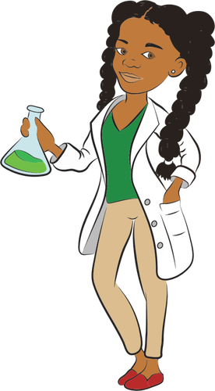
Dr. Kristeena Crowfurd
Specializes in bacteria research. She was very upset with Dr. Clearwater because one of his papers had been published before hers.

Slide 7
Dr. Leena Specktacle
Specializes in microorganisms (not bacteria). She had a couple of rough encounters with Dr. Clearwater because he kept stealing candy from her personal candy stash.

Slide 8
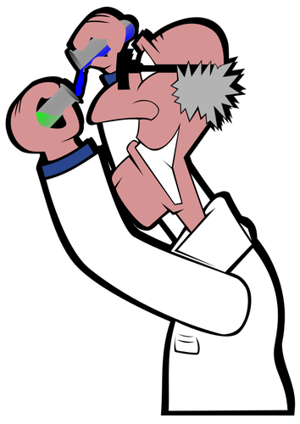
Dr. Ripple Mistales
Specializes in chemicals - especially phosphates. Dr. Clearwater and Dr. Mistales went to the same university and apparently Dr. Clearwater had dated Dr. Mistales’ sister and had broken her heart.

Slide 9
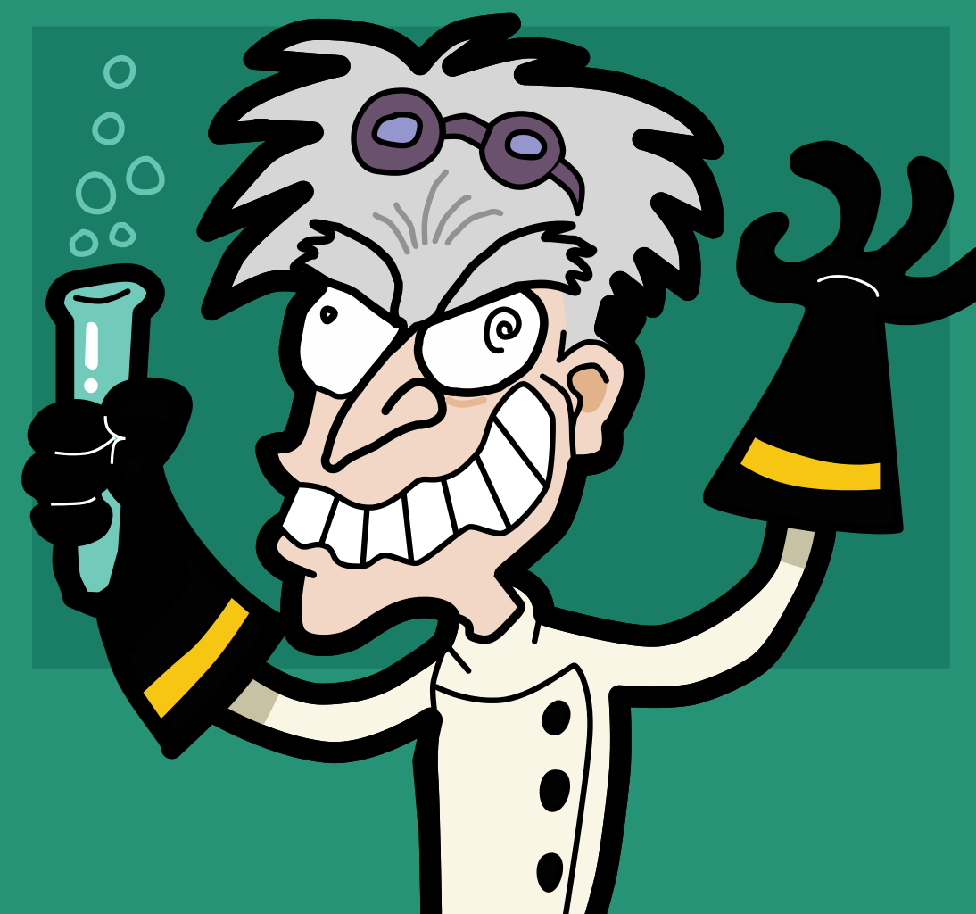
Dr. Sheerluck Molmes
Specializes in chemicals - especially nitrates. He is very open about not liking Dr. Clearwater. He shared that there is something annolying about how Dr. Clearwater chews his food.

Slide 10
Dr. Noolan Courage
Specializes in aquatic plants. He doesn’t seem to have a motive, but he has always felt intimidated by Dr. Clearwater, and also by every person in the research team.

Slide 11
THE PROBLEM
While examining Dr. Clearwater’s room, Dr. Specktackle found a glass of what seemed to be water near the body of Dr. Clearwater. Could this mean that Dr. Clearwater was poisoned?
The contents of the glass were put in a closed lid container to be analyzed later.
Dr. Mistales brought up an interesting fact: What if the whole water supply is compromised with whatever it is that killed Dr. Clearwater?
Dr. Molmes instructed everybody to not drink the water until it could be properly examined. Luckily, the lab has a couple of boxes of soda pop that can be used, but eventually water will be needed.

Slide 12
YOUR JOB
Dr. Molmes has called upon all of you to help in the case. He has requested for each team to take a sample of the water supply and to create a protocol in order to analyze the contents of the water. And maybe, we can figure out if one of our PIs is responsible for Dr. Clearwater’s death and the contamination of our water supply.

Slide 13
Goal of the Activity
Our different groups will be creating a protocol for the analysis of our evidence/water sample.
But before we get started… WHAT IS A PROTOCOL?
Lets Share!!

Slide 14
BY DEFINITION
A protocol, is known by many as a ‘procedure’, its developed and used by scientists in an experiment.
Protocols can come in many ways and forms, but they must be written in a way that the replication of the experiment is successful.
Protocols can be found everywhere, not just in labs…. And you have probably used some before!
Ever shop at IKEA? Think of their instructions to put together a piece of furniture
Watch a tutorial on TikTok or YouTube?
Followed an online recipe to make something?

Slide 15
Engineering Design Process

Slide 16
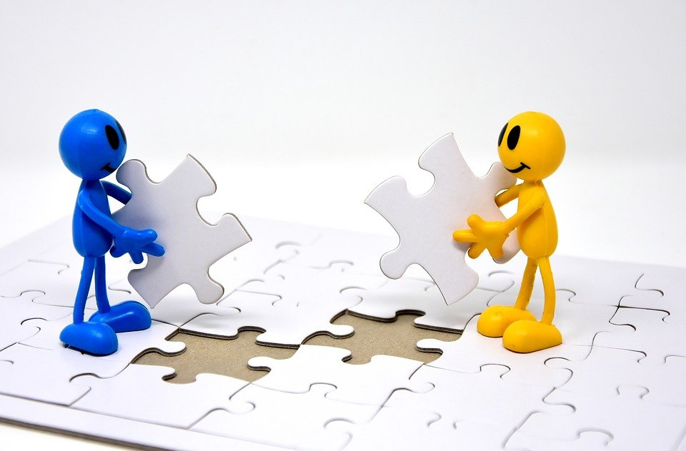
Step #1: ASK
With your group, complete Step 1 of your Student Handout Part 1.

Slide 17
Step #2: RESEARCH
With your group, research what kinds and types of pollutants and contaminants can be found in water. Also, research what tests are used to test for each water pollutant/contaminant.
Record your research in Step 2 of your Student Handout Part 1.

Slide 18
Day 2

Slide 19
Step #2: RESEARCH (continued)
What did you find out?

Slide 20
Constraints
Dr. Molmes only has the following materials available:
pH tablets
Phosphate tablets
Nitrate tablets
Coliform tablets
Microscopes & petri dishes for bacterial growth and identification of microorganisms

Slide 21
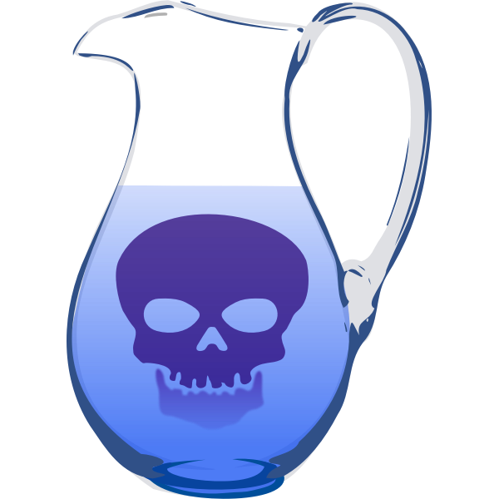
Step #3: BRAINSTORM
Use your research to make a list of pollutants/contaminants that could be found in the water samples.
Write these in your handout.

Slide 22
You are ready to begin!
Design a protocol that you will follow to analyze the evidence (water sample). Don’t forget:
What materials do you need? Be specific (i.e. test tubes, flasks, petri dishes, pipettes, etc)
For step-by-step instructions, make it specific: as if someone else will have to follow them without your guidance.
Think about data collection and control samples!
Other considerations:
What PPE do you need to wear/use?
What precautions should you take when handling the evidence so it doesn’t contaminate you or itself?
Record these in your student handout

Slide 23
Day 3

Slide 24
Get your PIs approval
When you have completed your protocol, get it approved by your PI.
Once its approved, put your protocol in a poster format for our Gallery Walk. Your PI will give you the poster materials once approved.
You have 15 minutes to complete this task.

Slide 25
Gallery Walk time!
Take your time to look at the protocols developed by other groups. What are some changes/improvements you will make to your protocol to make it better?
Make these edits on the original protocol with a different color pen.

Slide 26
Day 4

Slide 27
Let’s put your protocol to the test
Its time to try it out and see if its works. Using your protocol and the materials provided in class, test your water sample to check for its contents.
Things to consider:
How will you present your data?
How will you ensure that you don’t accidentally contaminate the sample?
Include any notes or adjustments you make through this process in your original protocol.

Slide 28
What you will turn in:
After you run your experiment, use the ‘Lab Notebook Paper’ found in your case file in order to write down:
Your final version of your protocol
Data that you gathered after testing the water
Analysis of the results
Conclusion of the experiment- Who could have contaminated the water?
In order to identify a killer, crossreference the list of suspects and their specialists to the contaminants found in your water sample.

Slide 29
Were you able to figure out who killed Dr. Clearwater?

