Slide 1
Recycle Home Toilet Water

Slide 2
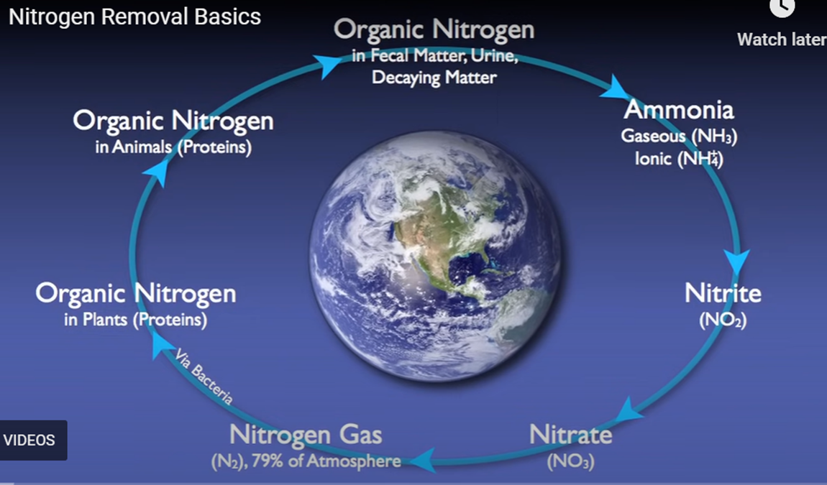
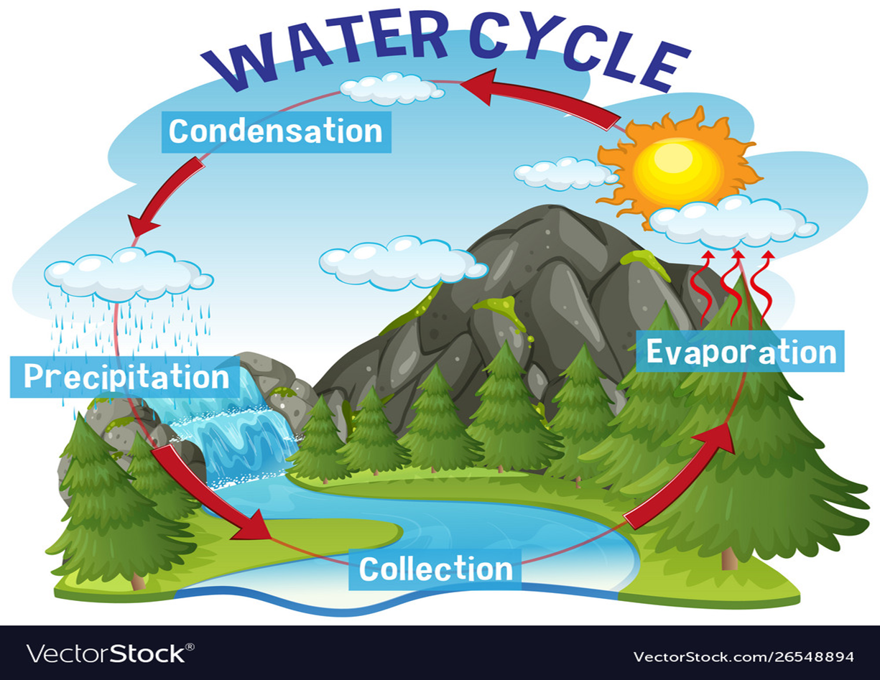
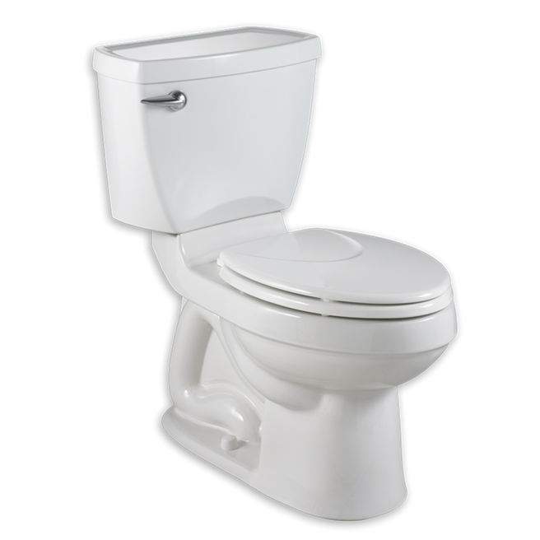
Nitrogen & Water Cycle: Real World Connection The nitrogen and water cycles are natural phenomena. The key for successful recycling of organic waste and water is to replicate the efficiency at which nature does it so that it benefits all of us. We must also remember to treat our water supply as a precious limited resource. This whole planet is going through a major water crisis. We need to think about innovative ways in which we consume our water.
Nitrogen and water on Earth.

Slide 3
Homemade Wastewater Treatment
Flushing the toilets is one of the most wasteful actions that we take, which wastes the most water in our homes. Today, 35.8% of the world’s population still lacks access to any proper sanitation facilities. Most of the waste-water that flush toilets create – more than 80% worldwide – ends up going directly back into the environment into untreated open sewers. First of all, let’s take a look at how wastewater treatment plants work.
Photos should be a
square like this.
How could we recycle toilet water to be used more than once for toilet use?

Slide 4
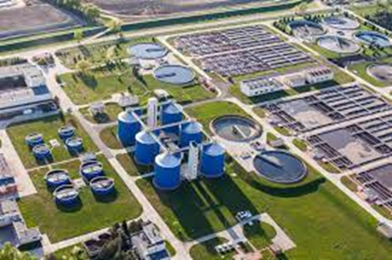
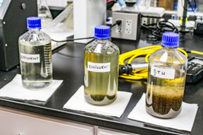
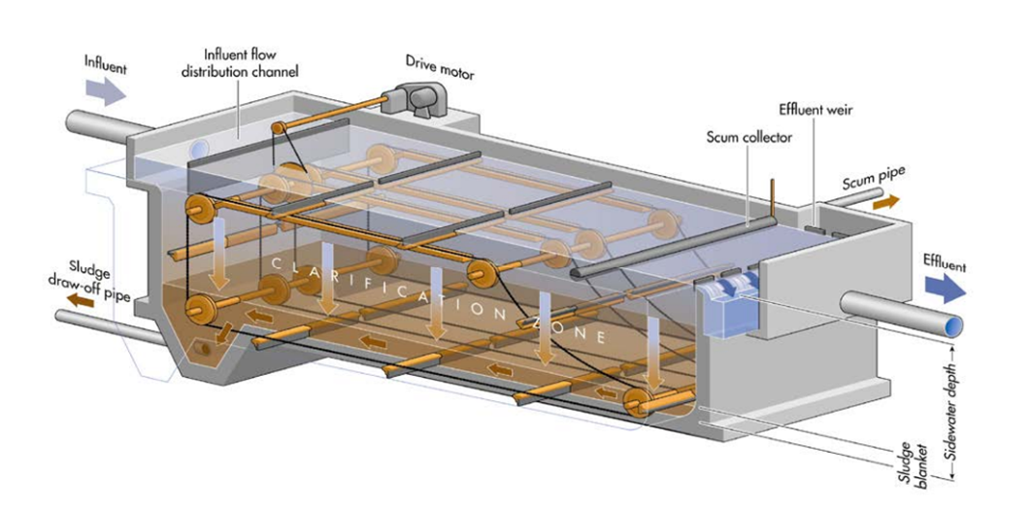
Wastewater Treatment Plant
How Do Wastewater Treatment Plants Work?
https://youtu.be/FvPakzqM3h8
Influent
Effluent
Dirty Sludge Settles
Clarifier is one of the steps in treating wastewater.

Slide 5
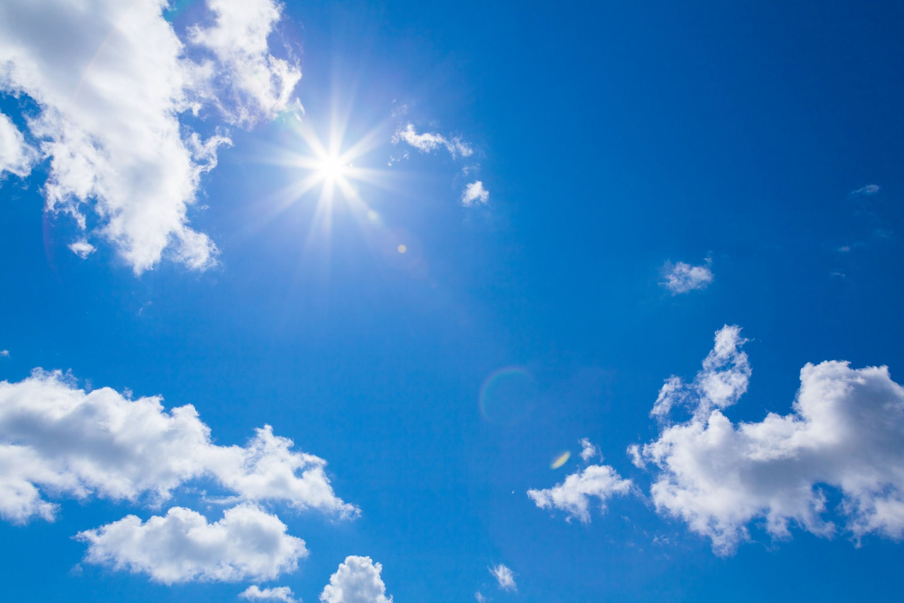
Nitrogen Removal Basics Using Hungry Bacteria
https://youtu.be/BosHU4ARR9w
NH₄⁺ + O₂ H⁺ + H₂O + NO₂⁻ + E
NO₂⁻ + O₂ NO₃⁻ + E N₂
ammonium
oxygen
acid
water
nitrite
Nitrogen gas
nitrite
oxygen
nitrate

Slide 6
Civil Engineering Our Wastewater
Pretreatment
Bar Screens
Grit Chamber
Primary Clarifiers (multiple)
Remove very large objects (Step Ladder)
Remove particles of sand and rock (Vortex Method)
Settling Velocity
Flow rate should be less than settling velocity.
Effluent is free of solids larger than 10 uM
Effluent is ALL organic matter
Secondary Treatment
Filter
UV
Aeration Basin
Secondary Clarifiers (multiple)
Disinfection Process
Cl₂
Effluent H₂O
Bubblers with Waste & Returned Activated Sludge
Returned Activated Sludge settles and removes more solids and larger biological particles
85% solids removed from Effluent Water.
O₃
Aerobic Digestion
This Photo by Unknown Author is licensed under CC BY-NC

Slide 7
Activity Embedded (Formative) Assessment Discussion: wastewater treatment plants must monitor the bacterial sludge content, oxygen, nitrogen, acidity (pH) and the solids content. Adjustments must be made depending on the situations caused by environmental factors. Steps are in place to make those adjustments.
Photos should be a
square like this.
Monitoring Waste Water

Slide 8
Activity Embedded (Formative) Assessment Process Question Place the following processes for treating wastewater in the correct order: Secondary Clarifier Bar Screens Aeration Basin Grit Chamber Disinfection Primary Clarifier
Photos should be a
square like this.
There are various processes that are used to treat sewer water.

Slide 9
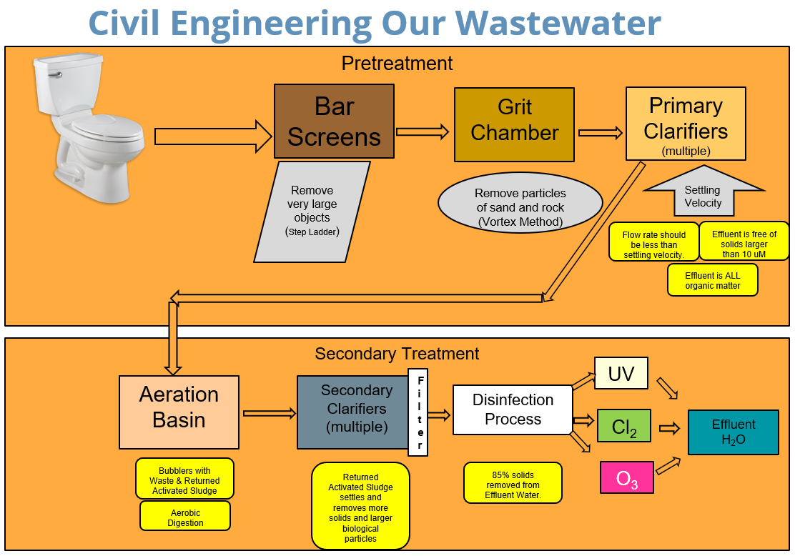
Photos should be a
square like this.
There are various processes that are used to treat sewer water.

Slide 10
Sketching
Please sketch and design your home wastewater treatment device. Students are to form groups of three. Each group will sketch and design the device setup. Each group will clearly write their device’s water- cleaning process. It should cover all phases of treating blackwater.
Photos should be a
square like this.
Sketching a model that demonstrates recycling of wastewater.

Slide 11
Data Table
What parameters would you test throughout the process of your wastewater and include in your data table? Each student group will create a data table that will show relevant data that would be necessary to demonstrate device efficiency.
Photos should be a
square like this.
Setting up your data table.

Slide 12
Engineering
Each student group will construct their home wastewater treatment model using the materials at their station. Construction: Each group will engineer their design by building their device using the materials at their station. *If you need more materials, you may ask the teacher for more supplies.
Photos should be a
square like this.
Engineering a model that demonstrates recycling of wastewater.

Slide 13
Peer Review & Rubric Scale
Peer Review: Groups, please exchange your papers. One person stays behind and will explain their group’s design to the other two members of the other group. Rubric Scale: Using a rubric scale, rate the other group’s design and model. This will be constructive criticism. Does this group explain why their design shows the best way to recycle wastewater? Why or why not?
Photos should be a
square like this.
Offering and receiving constructive criticism.

Slide 14
Class Discussion What worked and what problems were found, room for improvement, and important takeaways? You have already learned about water recycling in a treatment plant and in nature. What do you see and how do both processes compare and contrast at the atomic and nanoscale? How does the chemistry of the nitrogen and water cycle relate to the engineering design of your home blackwater recycling model.
How can engineering improve upon this invention?

Slide 15
Citations
The Conversation. The world needs more toilets – but not ones that flush. March 21, 2017. theconversation.com/the-world-needs-more-toilets-but-not-the-ones-that-flush-74007.

