Slide 1
Protective Fashion!: Beach Edition

Slide 2
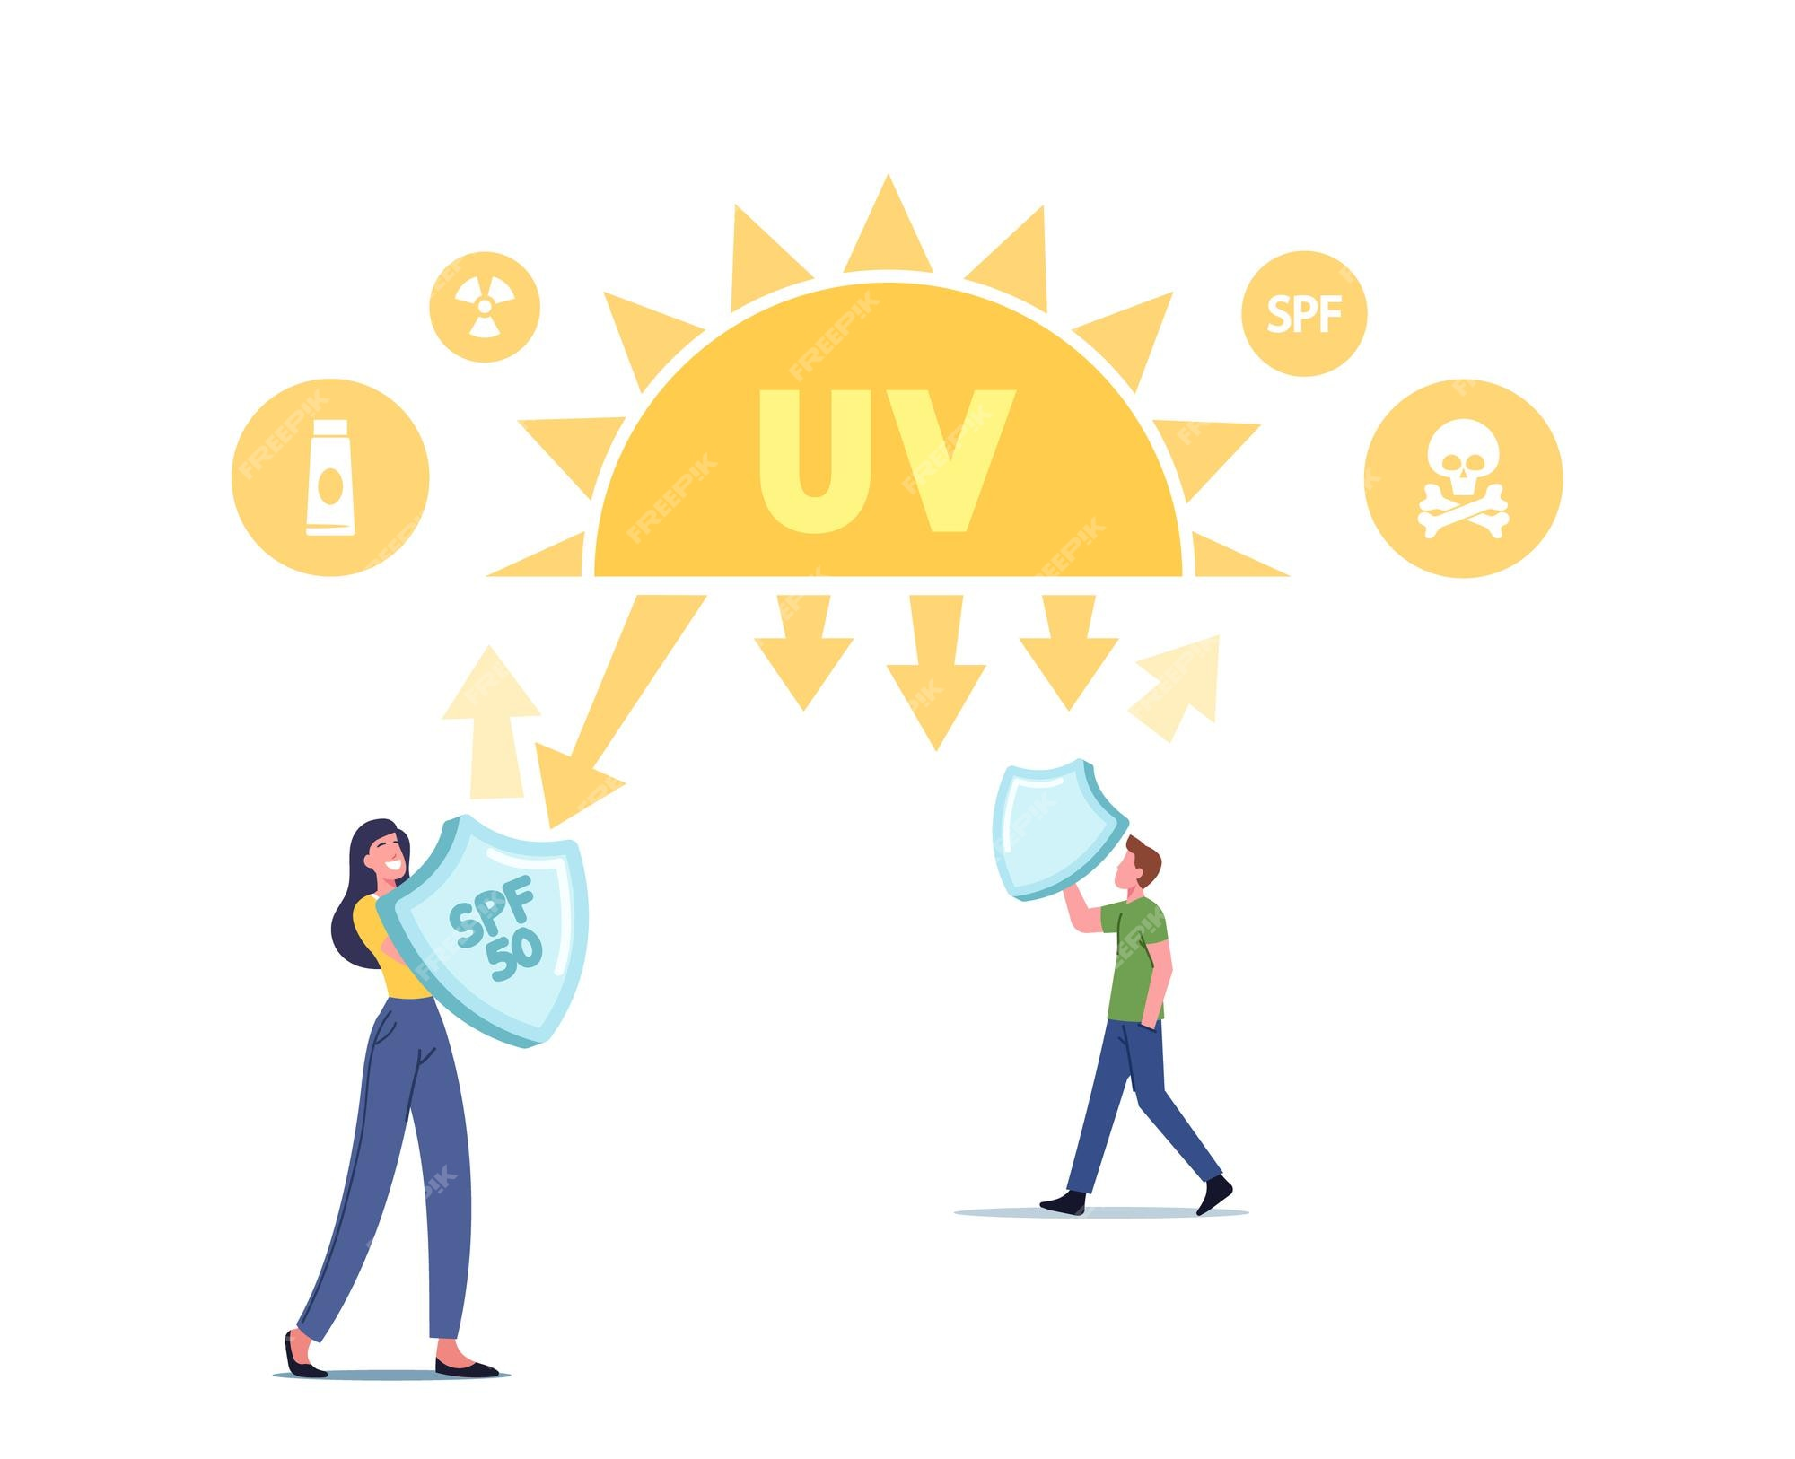
Phenomenon
What fabric provides the best (and coolest) ultraviolet (UV) radiation protection from the sun?
Photos should be a
square like this.
Learning Objectives
Describe what UV radiation is.
Understand the impacts of UV radiation on the human skin.
Observe differences in skin reactivity to different fabrics.
Design clothing that protects human skin from UV radiation.

Slide 3
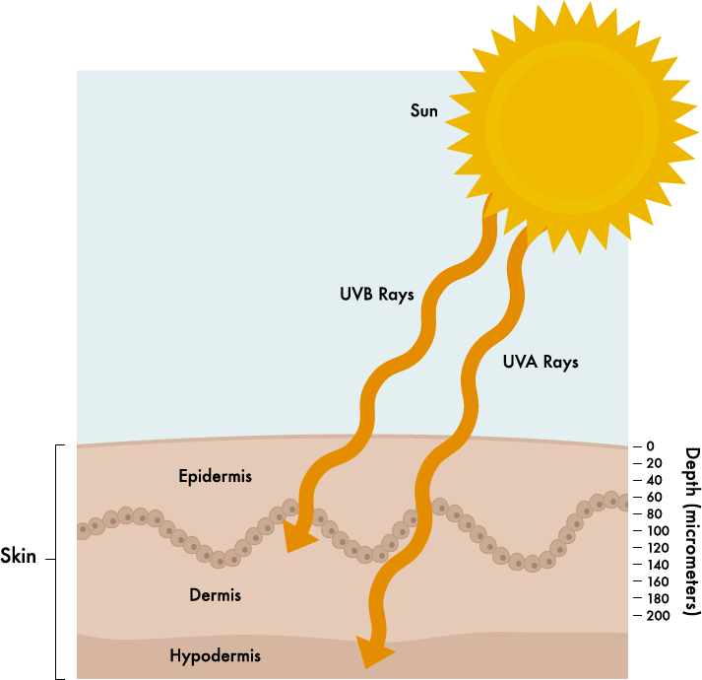
Lesson Launch & Discussion
Let’s watch the video “Sun and Skin,” and then answer the following question on your sticky note: Besides wearing sunscreen, how can people take preventive measures against skin cancer at the beach?
Paste your sticky note on the whiteboard.
UV Radiation and Skin Cancer

Slide 4
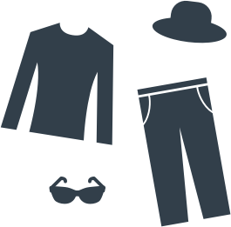
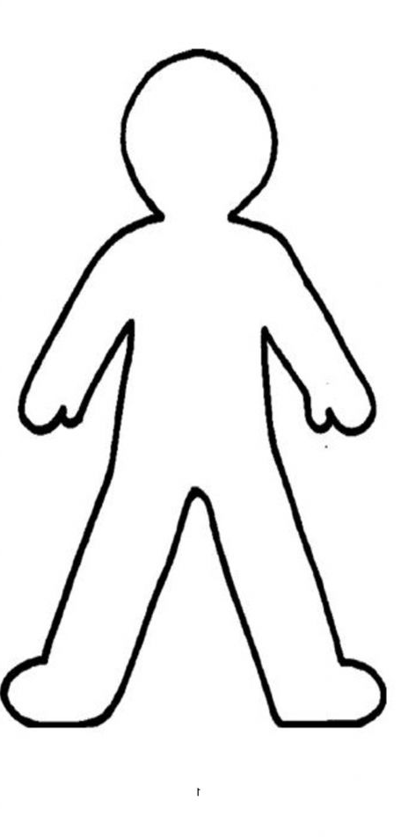
Procedure: Design Sun-Safe Outfits!
Question 1: How does UV light interact with skin without protective clothing?
Experiment 1: Control Group
Question 2: Does the amount of sun protection change with different clothing fabrics? Experiment 2: Unbleached cotton fabric Experiment 3: White satin/silk fabric Experiment 4: Denim fabric
Experiment 5: Corduroy fabric
Materials 1 large box 7 sheets photoluminescent paper unbleached cotton fabric white satin/silk fabric denim fabric corduroy fabric scissor UV flashlight ruler dark marker or sharpie timer
Design the nicest, safest beach outfit!
After completing the control experiment, your group will follow the procedure in your handout to test different fabrics. Be sure to write down your observations and measurements.
Group Roles (can be rotated)
Role 1: Draw a large person-shape on the sun-sensitive paper.
Role 2: Design the outfit (cut the fabrics).
Role 3: Weigh the fabrics at the scale/keep time.
Role 4: Shine the UV flashlight on the person-shape for the allotted time.
Everyone: Record metrics and observations agreed upon by group.

Slide 5
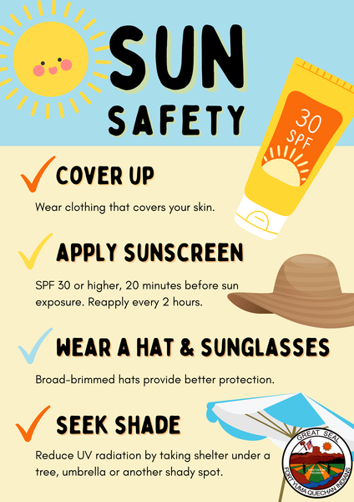
Post-Procedure Analysis: Which fabric works best?
Experiment 1: Control Group Describe the penetration of UV light from the unclothed side of the paper cut-out. Experiments 2-5 Describe the penetration of UV light versus the control penetration of UV light. 1. Which fabric type would be the coolest fabric to wear to the beach? 2. Which fabric type would be the best at protecting from UV radiation? 3. Which fabric type would be the coolest and best UV radiation protection?

