Slide 1
Bayou Design Challenge

Slide 2
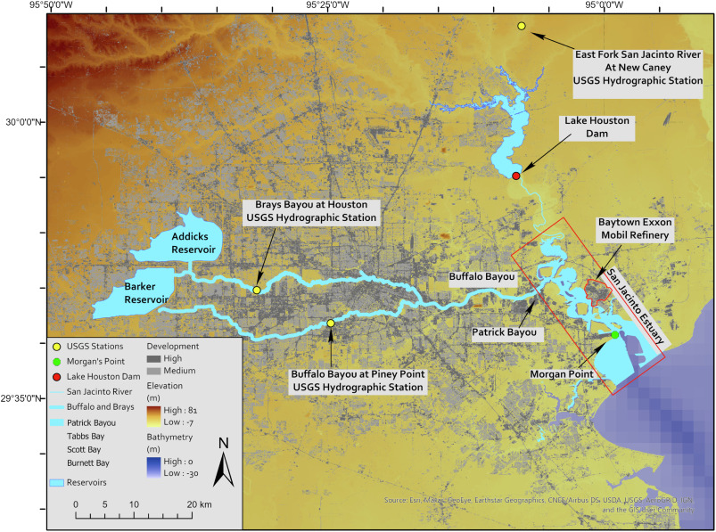

Slide 3
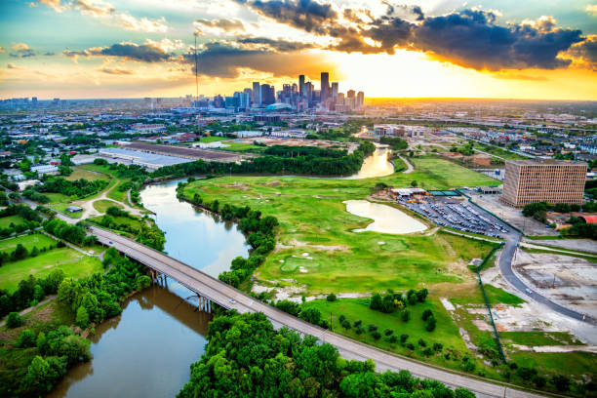
Buffalo Bayou before Hurricane Harvey

Slide 4
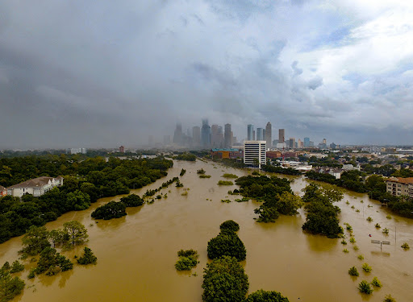
Buffalo Bayou during Hurricane Harvey

Slide 5
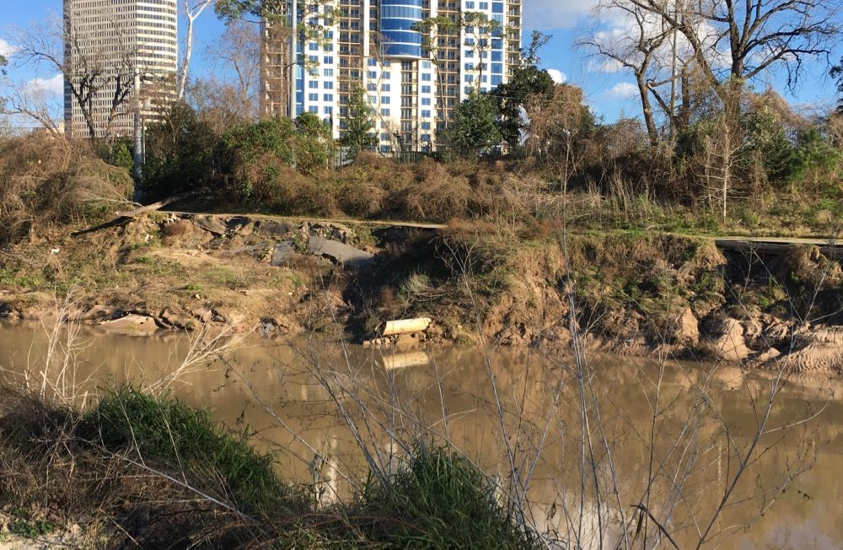
Buffalo Bayou after Hurricane Harvey

Slide 6
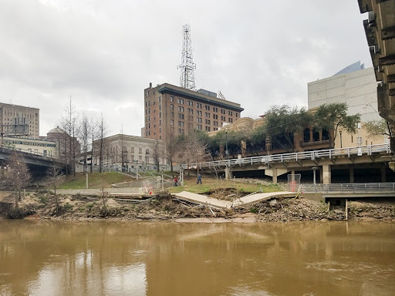
Buffalo Bayou

Slide 7
Goal:
Design and build a bayou model that reduces sediment transport in a bayou.

Slide 8
Steps:
Plan your design.
Predict and measure.
Build and test.
Analyze results.

Slide 9
Reflection Questions:
Why is it important to control sediment movement in bayous and rivers? How might this help the environment and communities?
2. What engineering skills did you use in this
challenge?

