Slide 1
Machine Learning for Kids Tutorial

Slide 2
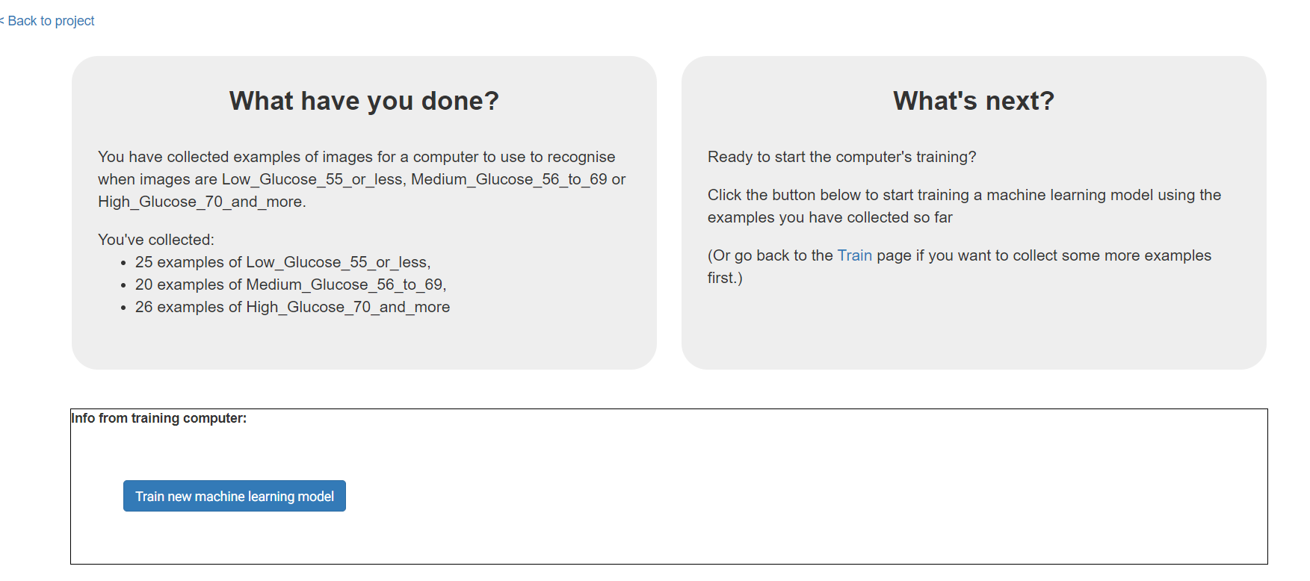
Use the ML4K Tutorial adapted from Scratch 3 to recognize food instead of books.

Slide 3
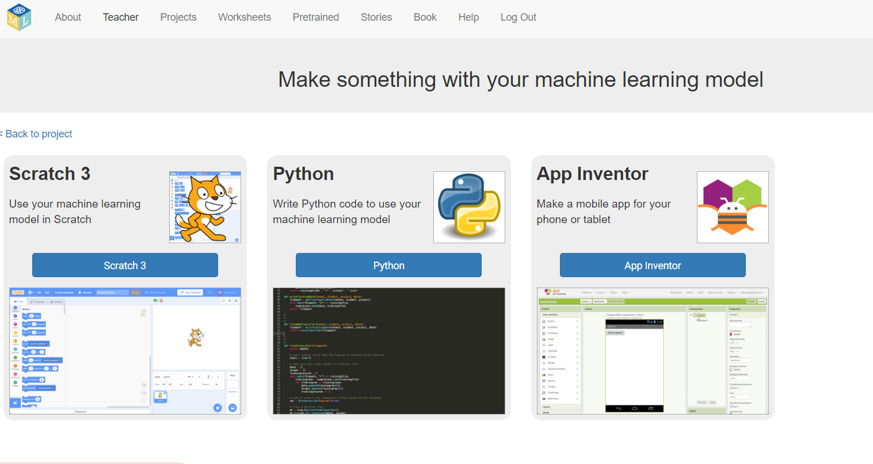

Slide 4
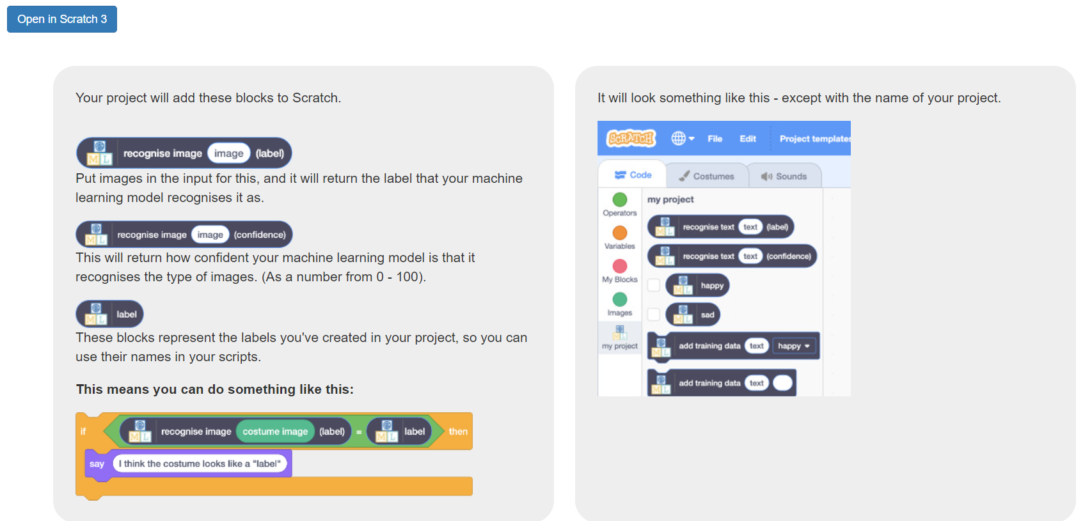

Slide 5
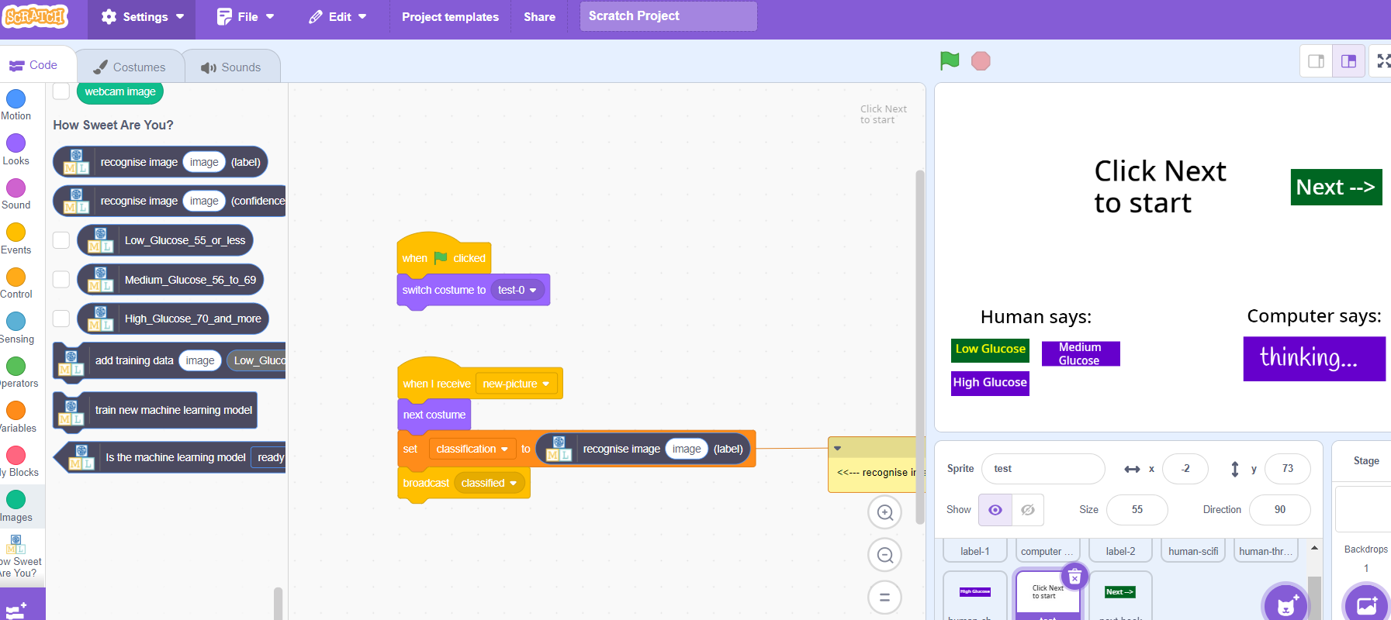
In Test sprite, add "new picture" and "recognize image."

Slide 6
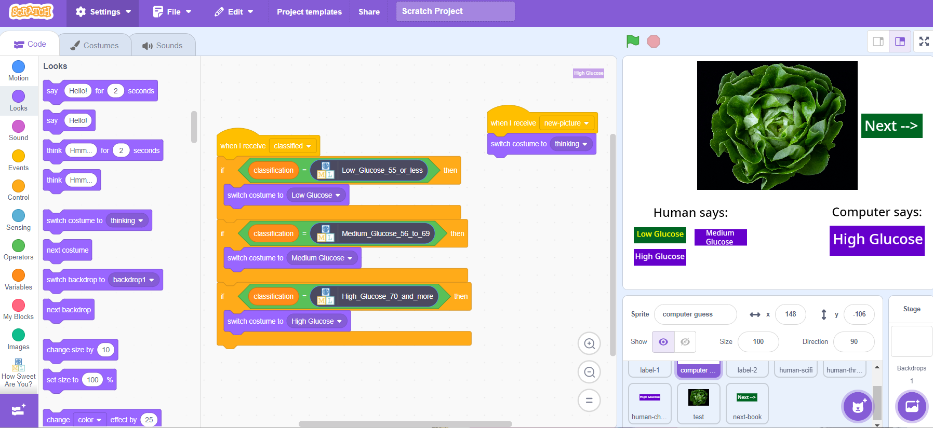
Code inside Test sprite.

Slide 7
Teachable Machine
Tutorial

Slide 8
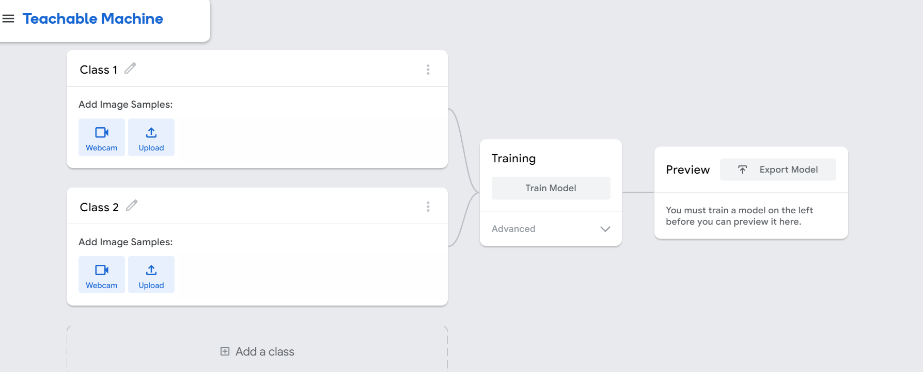
https://teachablemachine.withgoogle.com/train/image
Notes:
https://teachablemachine.withgoogle.com/train/image
Find pics in SPLASH https://unsplash.com/images/food/fruits

Slide 9
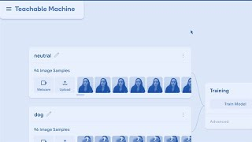
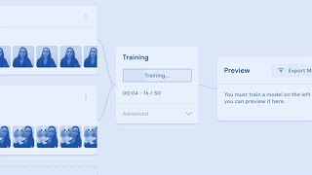
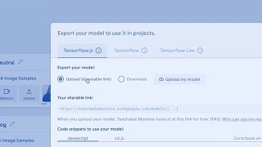
Step 1: Gather data
Step 2: Train the model
Step 3: Export

Slide 10
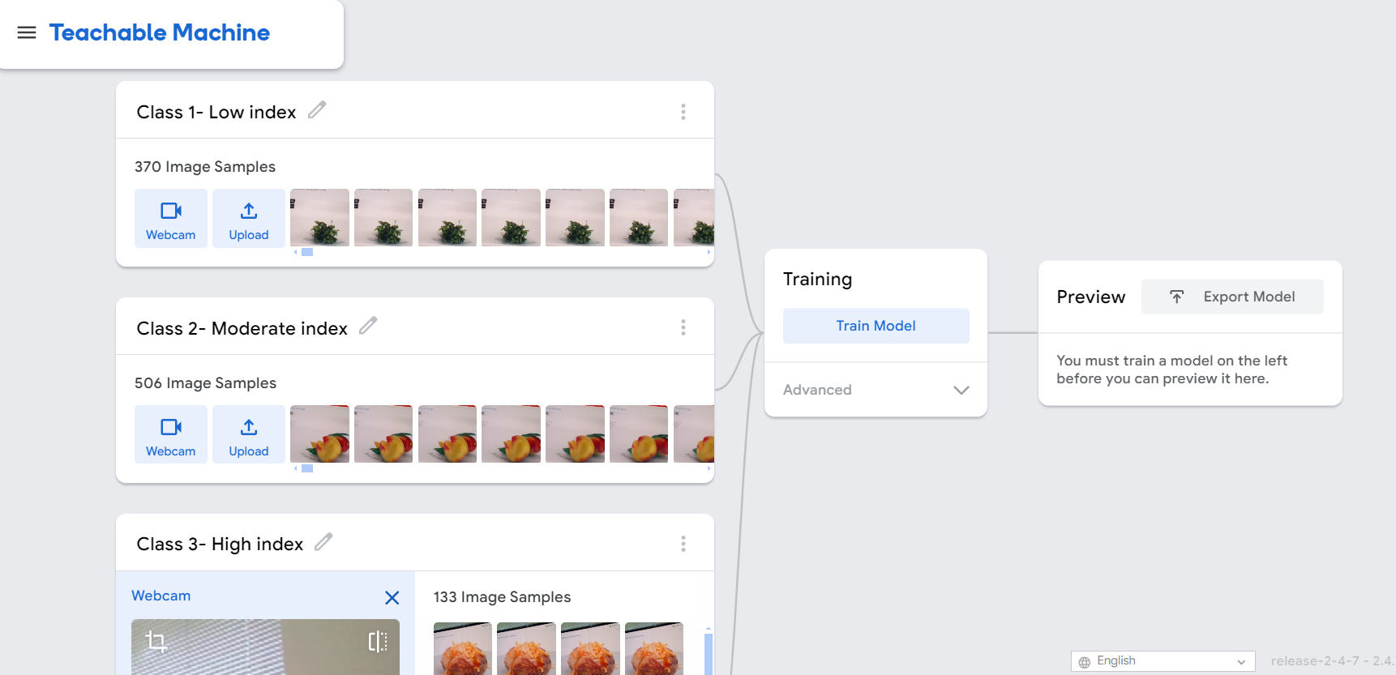
Other categories - Example (See GI Datasheet.xlsx)

Slide 11
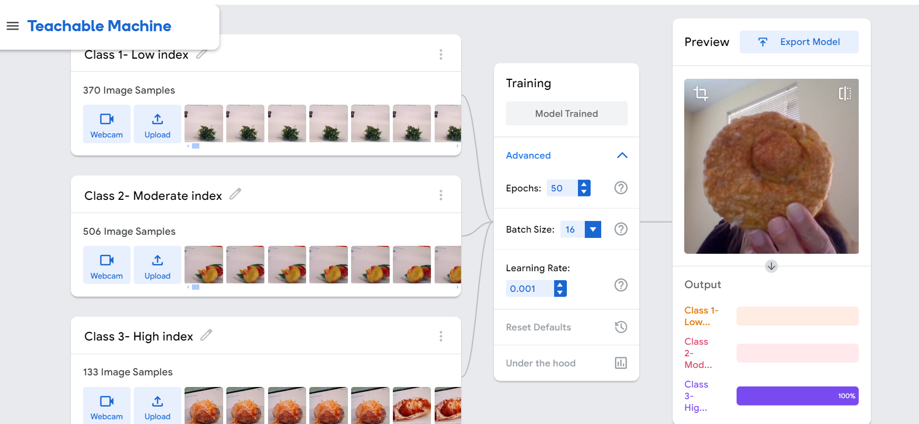
I used 3D images online to build the database. I showed TM real food and was able to visually categorize it!

Slide 12
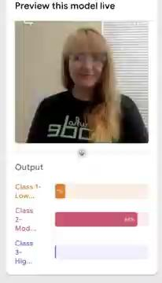
This is the Teachable Machine in action!

Slide 13
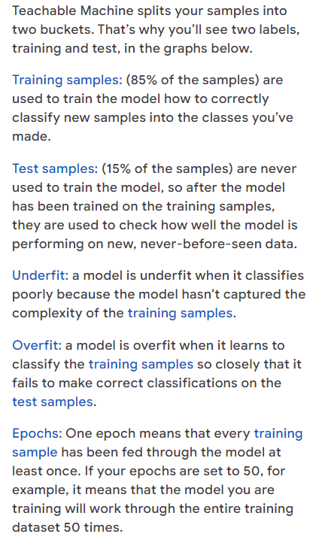
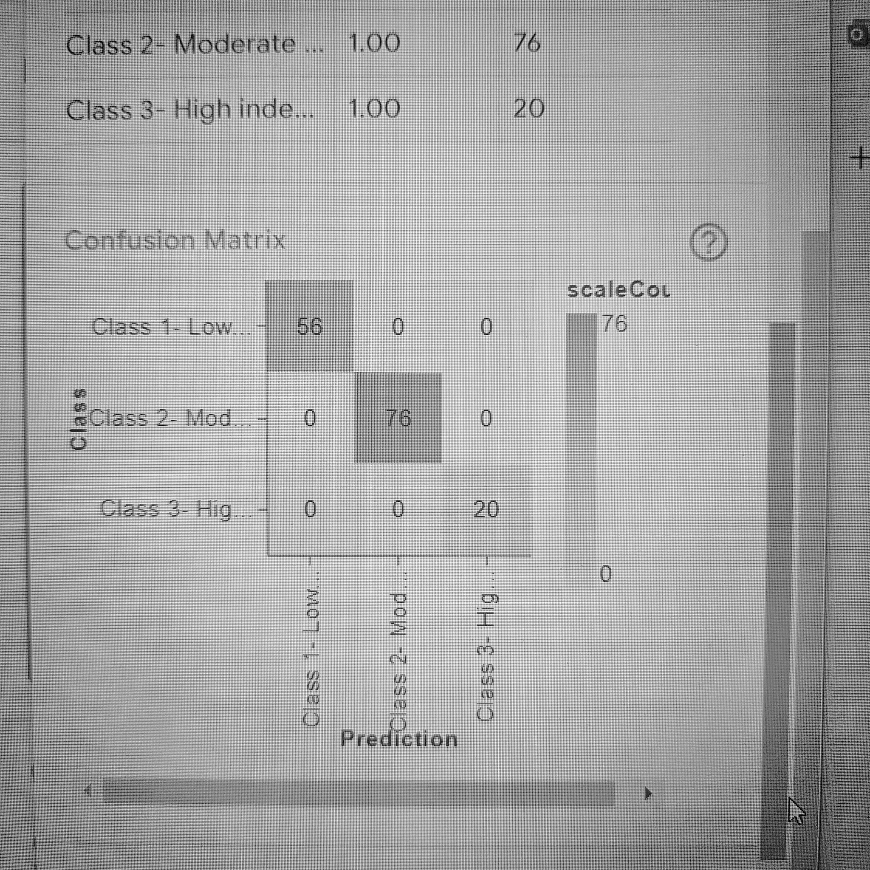

Slide 14
<div>Teachable Machine Image Model</div>
<button type="button" onclick="init()">Start</button>
<div id="webcam-container"></div>
<div id="label-container"></div>
<script src="https://cdn.jsdelivr.net/npm/@tensorflow/tfjs@latest/dist/tf.min.js"></script>
<script src="https://cdn.jsdelivr.net/npm/@teachablemachine/image@latest/dist/teachablemachine-image.min.js"></script>
<script type="text/javascript">
// More API functions here:
// https://github.com/googlecreativelab/teachablemachine-community/tree/master/libraries/image
// the link to your model provided by Teachable Machine export panel
const URL = "./my_model/";
let model, webcam, labelContainer, maxPredictions;
// Load the image model and setup the webcam
async function init() {
const modelURL = URL + "model.json";
const metadataURL = URL + "metadata.json";
// load the model and metadata
// Refer to tmImage.loadFromFiles() in the API to support files from a file picker
// or files from your local hard drive
// Note: the pose library adds "tmImage" object to your window (window.tmImage)
model = await tmImage.load(modelURL, metadataURL);
maxPredictions = model.getTotalClasses();
// Convenience function to setup a webcam
const flip = true; // whether to flip the webcam
webcam = new tmImage.Webcam(200, 200, flip); // width, height, flip
await webcam.setup(); // request access to the webcam
await webcam.play();
window.requestAnimationFrame(loop);
// append elements to the DOM
document.getElementById("webcam-container").appendChild(webcam.canvas);
labelContainer = document.getElementById("label-container");
for (let i = 0; i < maxPredictions; i++) { // and class labels
labelContainer.appendChild(document.createElement("div"));
}
}
async function loop() {
webcam.update(); // update the webcam frame
await predict();
window.requestAnimationFrame(loop);
}
// run the webcam image through the image model
async function predict() {
// predict can take in an image, video or canvas html element
const prediction = await model.predict(webcam.canvas);
for (let i = 0; i < maxPredictions; i++) {
const classPrediction =
prediction[i].className + ": " + prediction[i].probability.toFixed(2);
labelContainer.childNodes[i].innerHTML = classPrediction;
}
}
</script>
Notes:
code behind it!

Slide 15
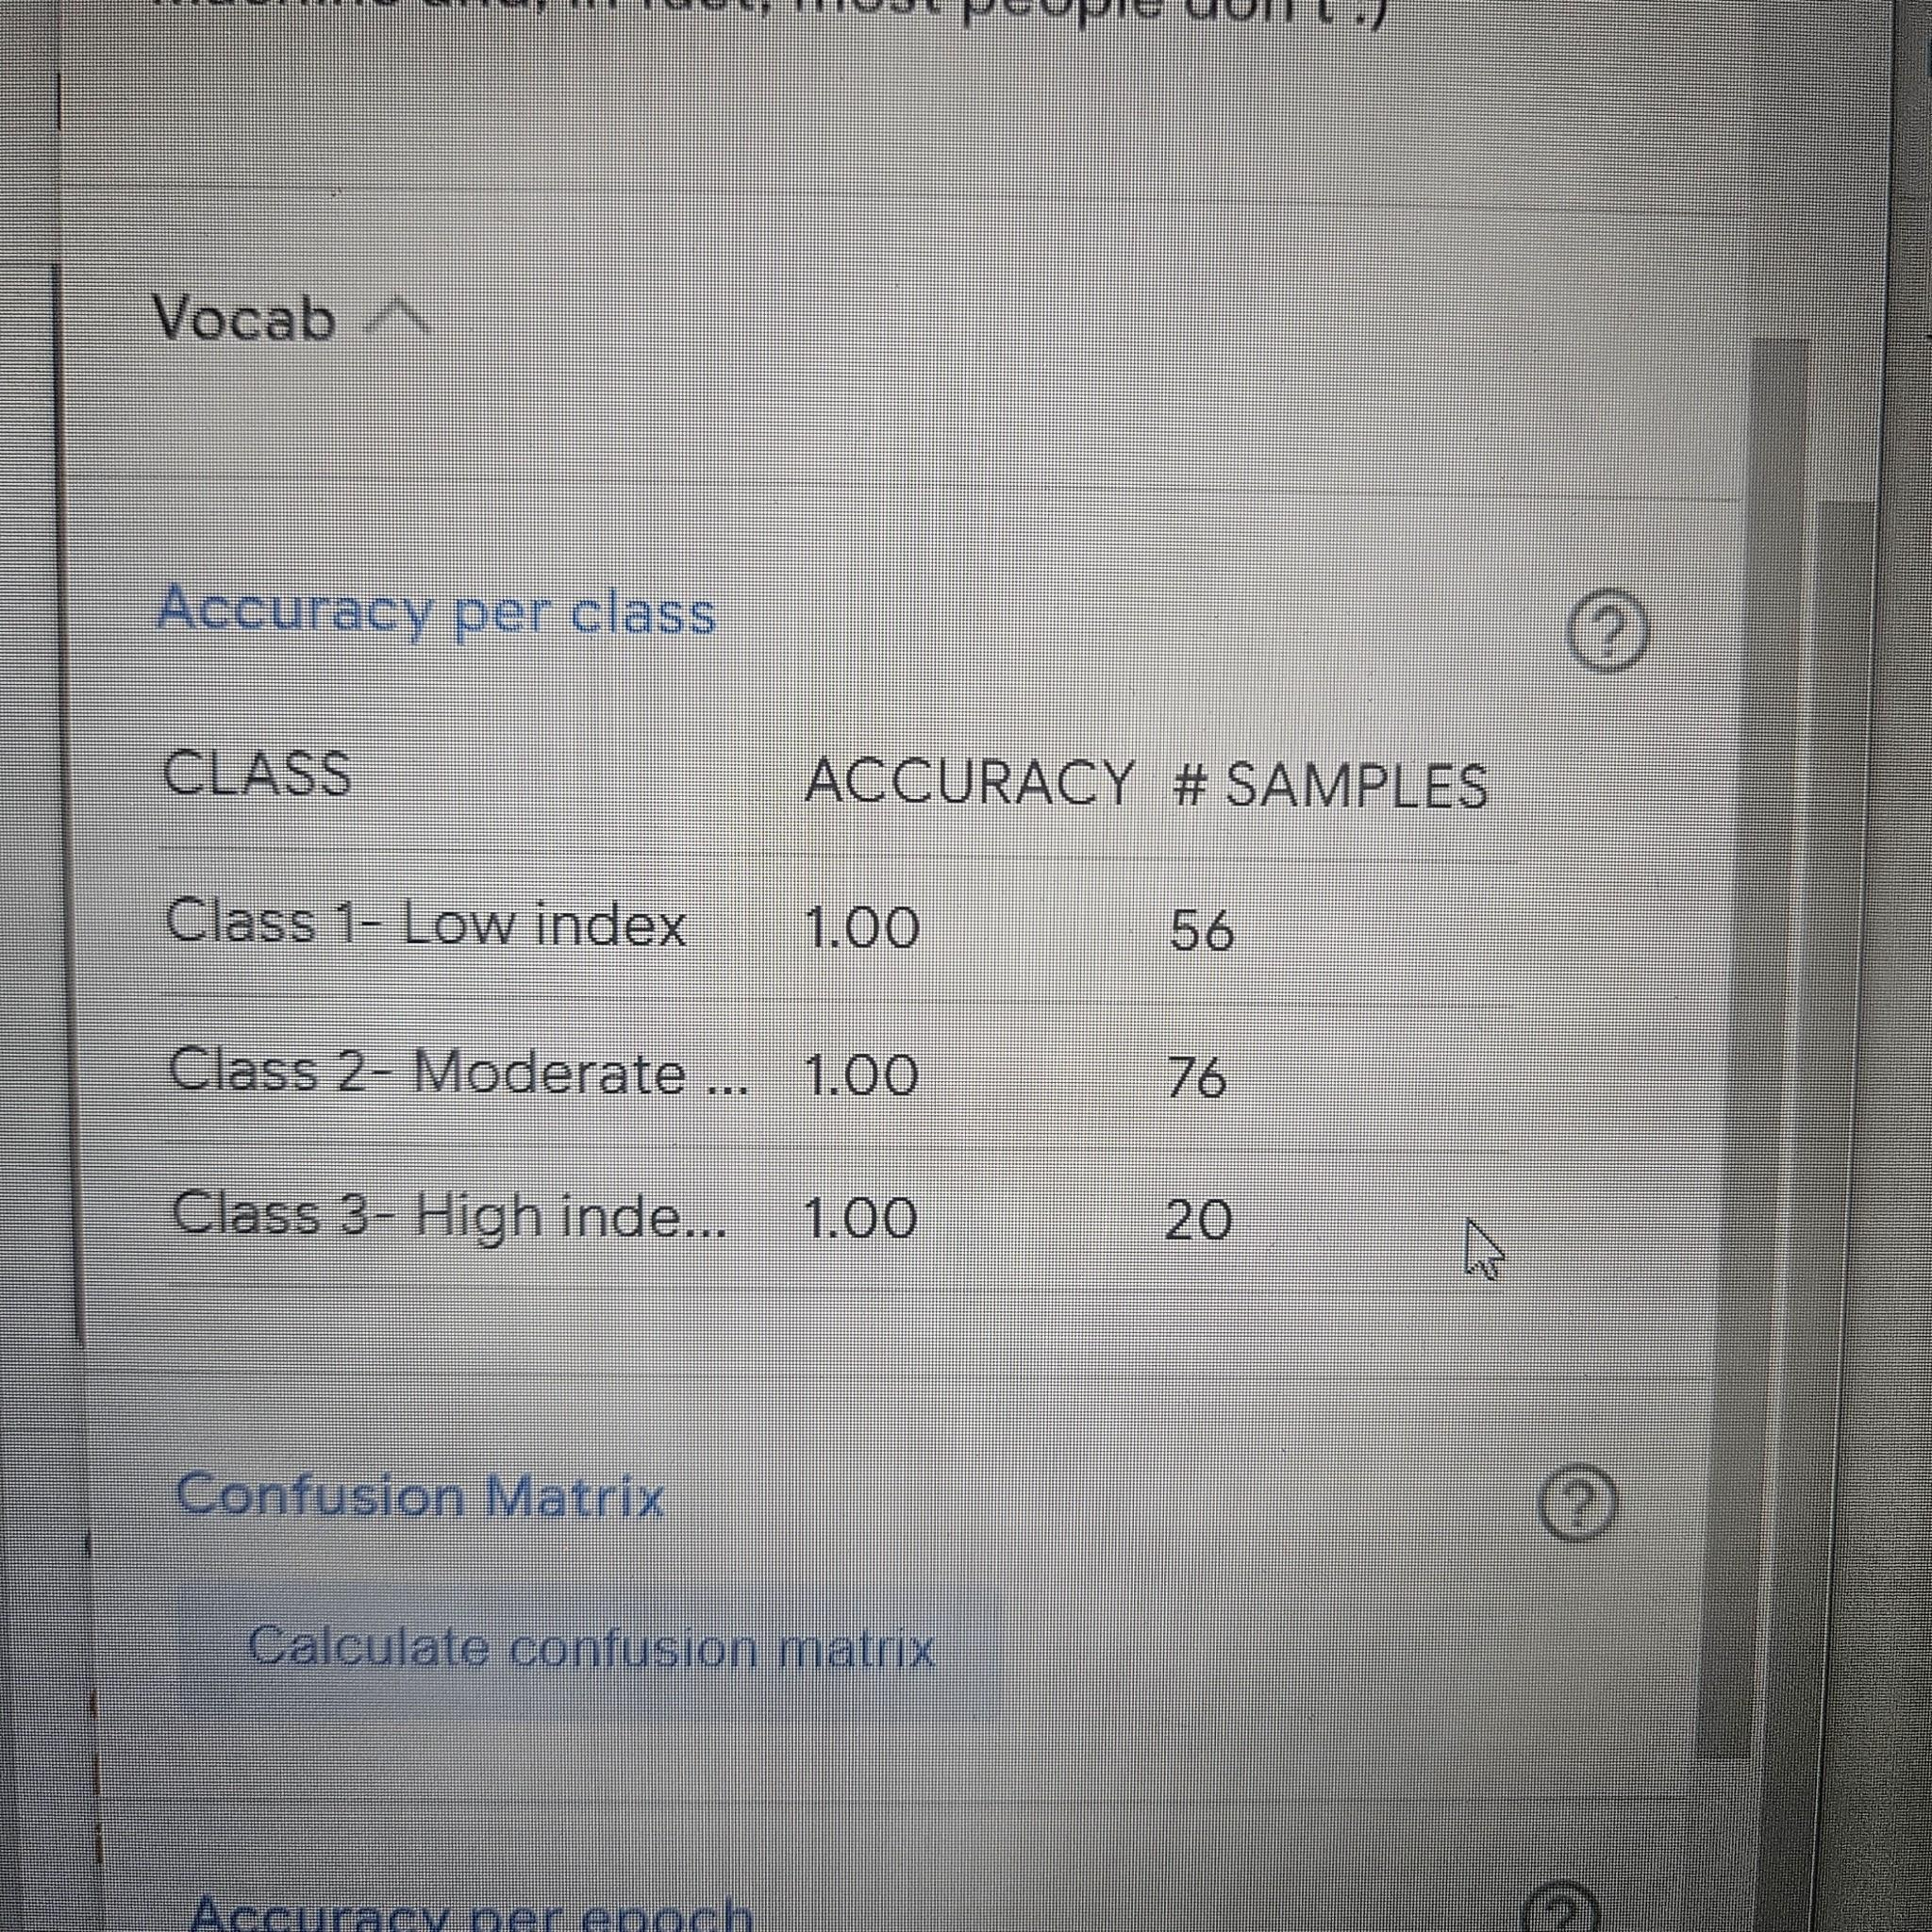
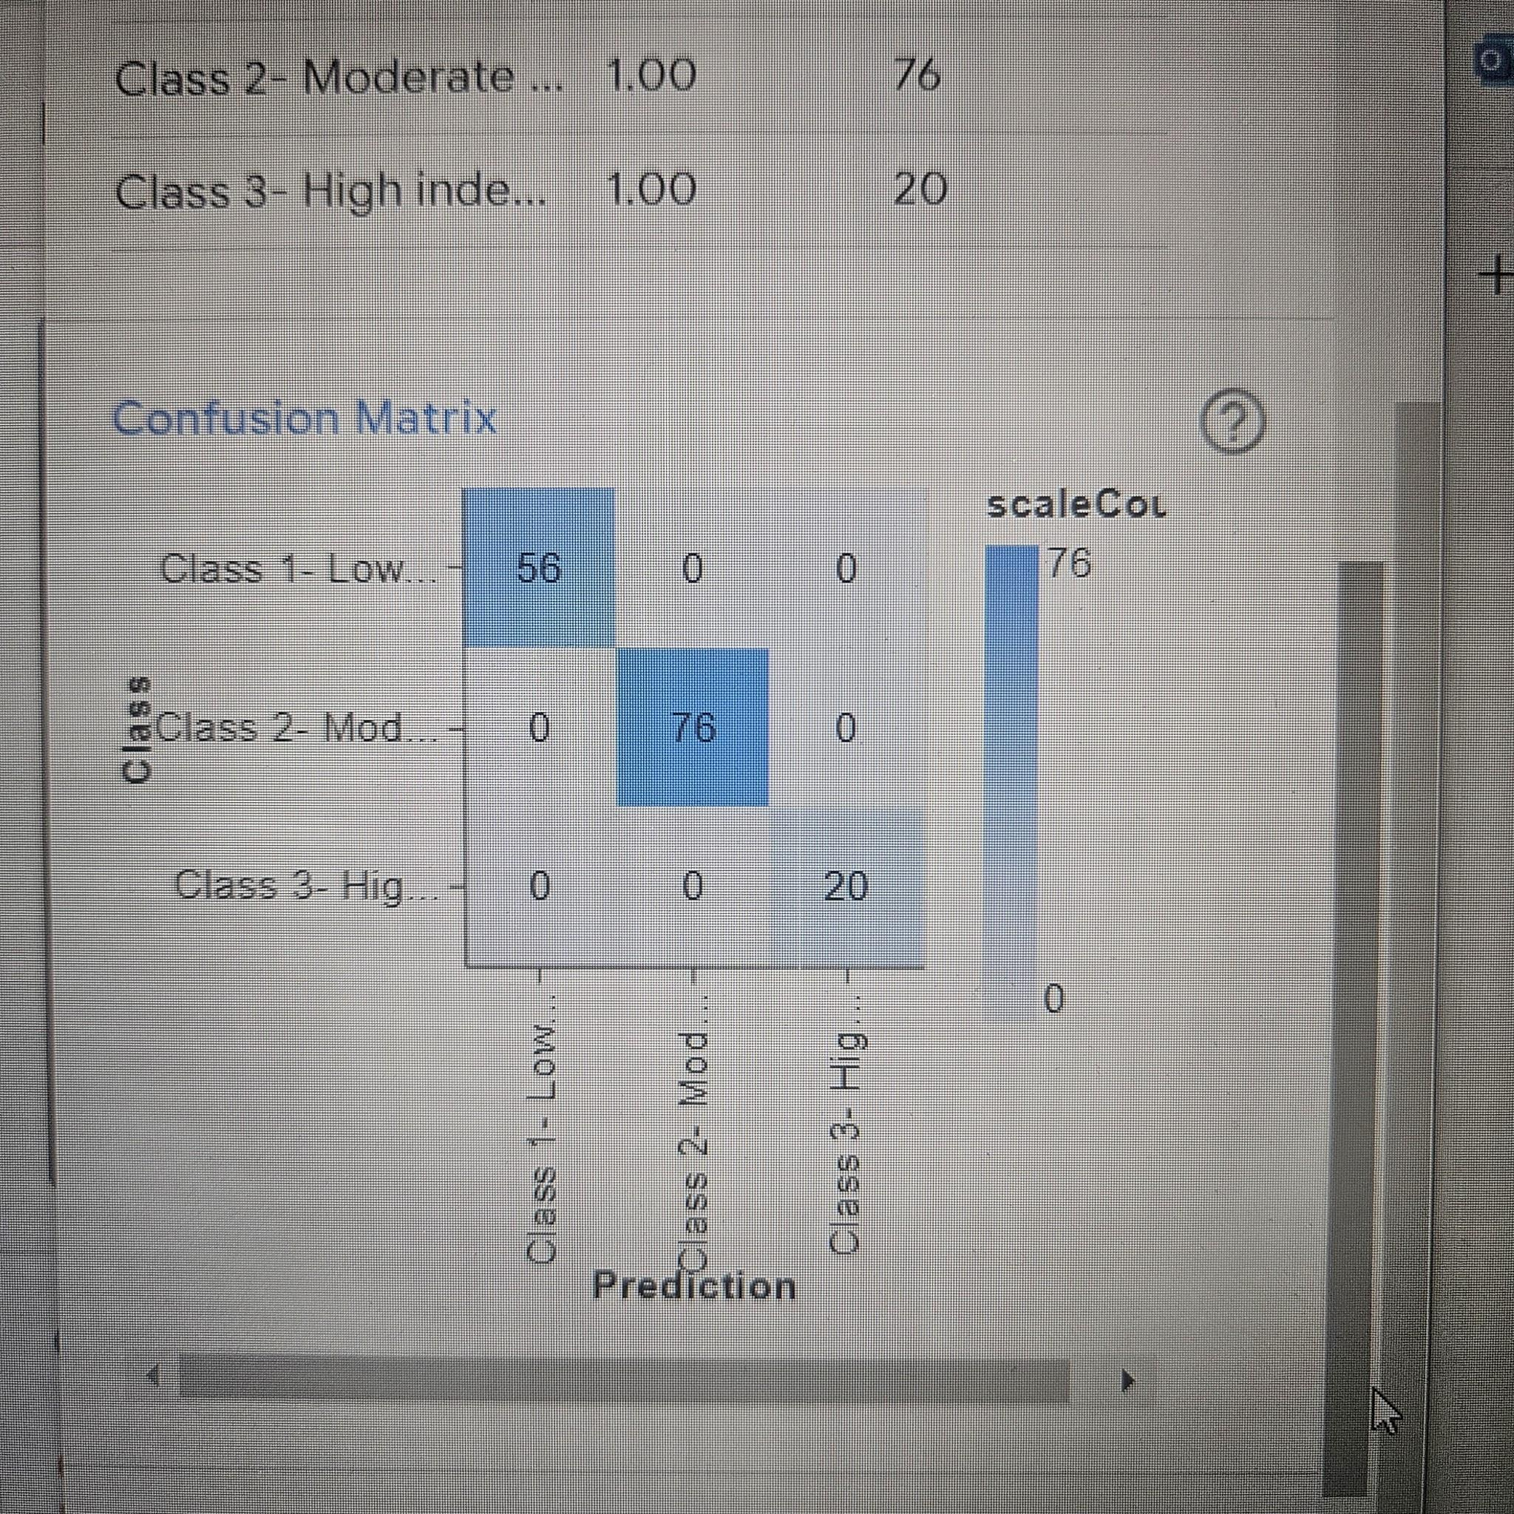

Slide 16
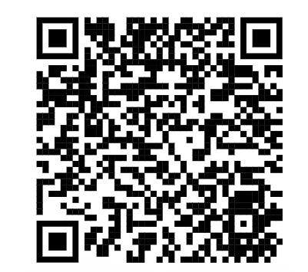
Scan and use this model!
https://tinyurl.com/FoodModel

