Slide 1
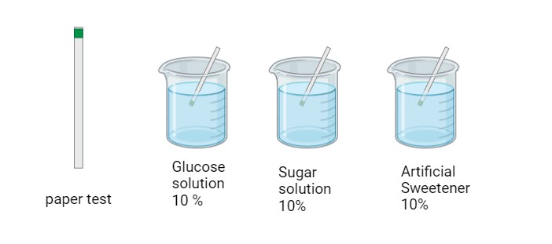
Which solution do you think will react with a higher number in the paper test? Why?
What trends do you think you will see in this experiment?
Which solution will react less? Why?
What questions do you have about this experiment?

Slide 2
Using the results of the solutions you created, draw a picture and explain what happened.
Solution of ______ | Solution of ______
Solution of ______ | Solution of ______

Slide 3
Use these questions to guide your reflection/process. You may add drawings, pictures, etc.
What do I need my machine learning model to do? What is its purpose?
What block codes do I need?
What tutorials can help me figure out the code I need?

