Slide 1
Preventing Microplastics from Getting into Humans

Slide 2
Think:
How might plastics affect human health?
Write your response on your handout.
Notes:
5 min to read/write
5 min class discussion of student responses

Slide 3
1
INTRODUCTION: Microplastics
What are they? Are they harmful?

Slide 4
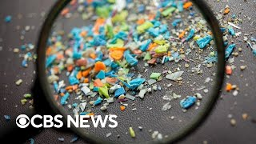
Watch & Keep This Question in Mind:
What surprised you most about what you just watched?
Notes:
4:11 min video

Slide 5
About Microplastics
What are microplastics?
Plastic particles <5 mm formed from breakdown of larger plastics or manufactured for products.
How do they enter the environment?
Through industrial waste, sewage, plastic litter, synthetic fabrics, tire wear, and air.
How do they affect human health?
Can enter bloodstream, accumulate in organs, disrupt hormones, and transport harmful chemicals.
Notes:
3 min

Slide 6
2
CHALLENGE
What can we do about microplastics?

Slide 7
Current situation & problems
Current Situation
Problems
Plastic waste breaks down in the environment.
Microplastics
Get released into the environment
Harmful Chemicals
Get released into the environment
So, what can we do to prevent microplastics from getting into the body?
Get into Humans
No way to remove from humans once absorbed.
Notes:
3 min
Hopefully they say that we can filter them out

Slide 8
A few current filters
Mechanical
Carbon or Activated Charcoal
Reverse Osmosis
Physical barriers
Adsorbs contaminants
Forces water through semipermeable membrane
Notes:
Mechanical filters remove microplastics by physically trapping particles as water passes through a material with small openings, such as mesh, fabric, or membrane. These filters act like a sieve, blocking particles larger than the pore size while allowing clean water to flow through. Mechanical filters are commonly used in water treatment plants, aquariums, and even in washing machines to catch synthetic fibers. The effectiveness of a mechanical filter depends on the size of its pores—finer filters can capture smaller microplastics but may clog more easily or slow down water flow.
A carbon or activated charcoal filter removes contaminants from water through a process called adsorption, where particles stick to the surface of the carbon. While these filters are mainly used to remove chemicals, odors, and organic compounds, they can also trap some microplastics—especially if the plastic particles are small enough to be adsorbed or caught in the tiny pores of the carbon. Activated charcoal is highly porous, which increases its surface area and makes it effective at capturing a wide range of pollutants. However, it's most effective when used alongside other filtration methods, like mechanical filters, to improve microplastic removal.
A reverse osmosis (RO) filter is a highly effective filtration system that removes contaminants, including microplastics, from water by forcing it through a semi-permeable membrane. This membrane has extremely tiny pores—typically around 0.0001 microns—that allow only water molecules to pass through while blocking larger particles like microplastics, bacteria, and many dissolved substances. Reverse osmosis is commonly used in household drinking water systems and in industrial water purification. While it provides very clean water, RO systems can be expensive, produce wastewater, and require regular maintenance to stay effective.

Slide 9
Your challenge
Design a filter that can remove the microplastics from the provided plastic solution.

Slide 10
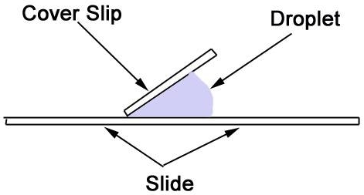
Plastic solution
What is it?
Simulates microplastics in water
Mixture of water and plastic glitter particles made out of polyethylene terephthalate (PET)
About PET plastic
PET is non-biodegradable and can harm the environment if not disposed of properly.
PET can release chemicals into food or beverages stored in it.
How to observe it?
Make observations by looking at it in the provided cup.
Create a wet mount and look at it under a microscope.
I will help you with this!
Notes:
5 min to read and show how to set up a wet mount

Slide 11
Filter design steps
01
Review
04
Explain
Materials provided
Chosen materials and placement on handout
02
Design
05
Get Filter Approval
Filter with your group
Call me over to get your filter approved
03
Draw & Label
IMPORTANT
.
Filter on handout
Notes:
1 min to read slide, 10 min to design filter

Slide 12
Build & test your filter
01
Gather
Send up one group member to gather needed materials - clean up any messes you make!
02
Build
Make your filter according to how you designed it.
Build & Test Filter
03
Test
Complete the “Test Your Filter”
section of handout.
04
Improve
Complete the “Improve Your Filter”
section of handout.
Notes:
1 min to read slide, 15 min to build and test filter

Slide 13
Improve Your Filter
Complete the “Improve Your Filter” section of your handout:
If we had significantly more time and if you could acquire any material you feel your filter could benefit from, then what improvements could you make if you could redesign and remake your filter?
Notes:
3 min

Slide 14
CLEAN UP
Throw away filters, cups, and trash
Return unused materials
Tidy up area

Slide 15
3
EVALUATE & PRESENT

Slide 16
Present your filter
Share the following:
Brief description of your filter components and the layers
How effective your filter was (or was not)
What improvements you would propose for your filter
Notes:
20 min to present total

Slide 17
Answer the two final questions on your handout:
What are microplastics?
Why might particle size be important in filtration?
Final Thoughts
Notes:
3 min

