Slide 1
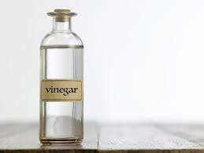
Vinegar
Chemical Name: Acetic Acid Solution
Common Concentration: 4-10% Acetic Acid (most commonly 5% for household use)
Appearance: Clear, colorless liquid
Odor: Strong, pungent smell characteristic of vinegar
pH: 2-3 (acidic)
Solubility: Fully soluble in water
Cleaning Uses
Warnings
  It is effective for cleaning windows, mirrors, countertops, and floors.
  It helps remove limescale and mineral deposits.
  It acts as a natural deodorizer (masks odors).
.
  Eye Contact: May cause irritation. Flush with water if vinegar gets into the eyes.
  Skin Contact: Prolonged exposure may cause irritation or dryness. Wash with soap and water.
  Inhalation: Vinegar vapors may cause mild irritation to the respiratory tract. Ensure proper ventilation.
  Ingestion: Safe in typical culinary amounts. Ingesting large amounts may cause gastrointestinal discomfort.
Environmental Impact
Storage and Handling
Keep in a cool, dry place. Ensure the container is tightly sealed when not in use.
Avoid direct contact with eyes or skin in large quantities. Use gloves for extended exposure to undiluted vinegar.
Vinegar is a non-hazardous material in household concentrations and does not require special disposal methods.
  Biodegradability: Vinegar is readily biodegradable and environmentally friendly at household concentrations.
  Eco-toxicity: Nontoxic to aquatic and terrestrial life in standard amounts.

Slide 2
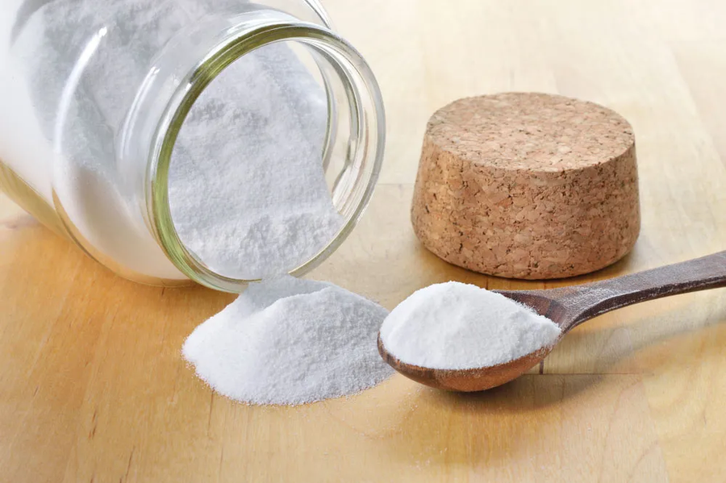
Sodium Bicarbonate
Chemical Formula: NaHCO₃
Common Names: Baking soda, bicarbonate of soda, sodium hydrogen carbonate
Appearance: White crystalline powder
Solubility in Water: Moderately soluble
pH in solution: Basic (around 8.3)
Cleaning Uses
Warnings
  It effectively cleans surfaces, removes odors, and acts as a gentle abrasive cleaner.
  Ingestion: Generally safe in small quantities, but large amounts may lead to electrolyte imbalance, nausea, and gastrointestinal discomfort.
  Inhalation: Inhalation of large amounts of powder may irritate the respiratory system.
  Skin Contact: Generally safe, but prolonged contact may cause mild irritation.
  Eye Contact: May cause irritation and redness.
Environmental Impact
Storage and Handling
Sodium bicarbonate is generally considered environmentally safe. It is not known to cause significant environmental harm, as it dissolves in water and breaks down naturally.
Store sodium bicarbonate in a tightly closed container in a cool, dry, well-ventilated area.
Avoid breathing dust and prolonged contact with your skin, eyes, and clothing.

Slide 3
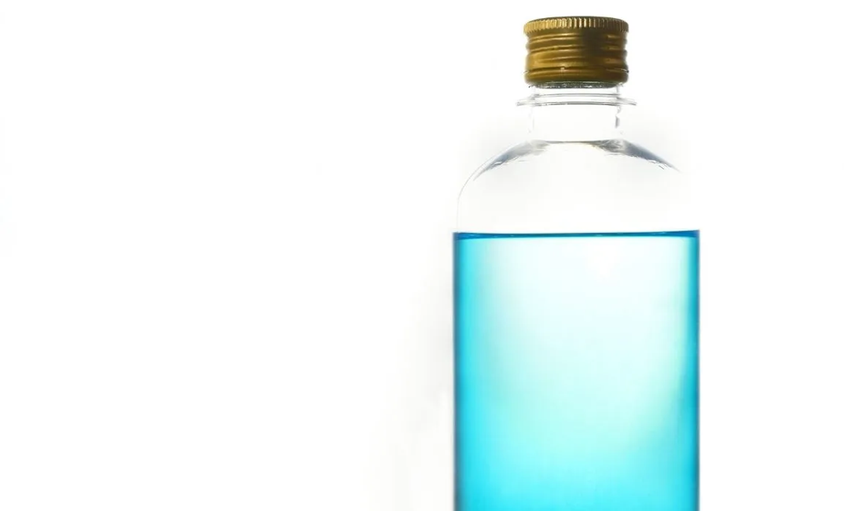
Isopropyl Alcohol
Chemical Name: Isopropanol, 2-Propanol
Common Concentration: 60 - 70%
Appearance: Clear, colorless liquid
Odor: Pungent alcoholic odor
Solubility: Fully soluble in water
Highly flammable.
Cleaning Uses
Warnings
  Kills bacteria and viruses on surfaces like countertops, keyboards, and doorknobs.
  Ideal for cleaning phone screens, keyboards, and other electronics without leaving residue.
  Effective at dissolving adhesive residue from stickers and tape on glass, plastic, and metal.
  It can help lift ink and other stains from fabric and other surfaces.
  Air Freshener: Mixed with essential oils and water, it can serve as a homemade air freshener.
  Highly Flammable: Rubbing alcohol is extremely flammable and can ignite easily.
  Ensure proper ventilation when using it in small or enclosed spaces.
  Harmful if ingested.
  Use gloves if handling large amounts or if your skin is sensitive.
  Rubbing alcohol can cause significant irritation or injury if it comes into contact with the eyes.
  It can irritate the skin.
  Vapors can cause drowsiness, dizziness, or other effects on the central nervous system if inhaled in large amounts.
Storage and Handling
Environmental Impact
  Handling: Avoid breathing vapors. Use in well-ventilated areas and keep away from ignition sources.
  Storage: Store in a cool, well-ventilated area away from heat sources and direct sunlight. Keep the container tightly closed.
Do not pour rubbing alcohol down drains or dispose of in large quantities due to its potential environmental impact.

Slide 4

Lavender Essential Oil
Main constituents:
  Linalool: Calming and relaxing properties.
  Linalyl acetate: Contributes to soothing effects.
  Camphor: Low concentration, gives a slightly woody scent.
  Terpinen-4-ol: Antimicrobial and antifungal properties.
Derived from the flowering tops of the lavender plant (Lavandula angustifolia) through steam distillation.
Cleaning Uses
Warnings
  Antimicrobial properties: Lavender oil contains compounds that prevent the growth of bacteria, mold, and fungi.
  Skin sensitivity: Dilute before applying to avoid irritation.
  Allergic reactions: Test a small area of skin for sensitivity.
  Internal use: Not safe unless advised by a healthcare provider.
Environmental Impact
Storage and Handling
  Sustainable cultivation, though overharvesting may deplete wild populations.
  Biodegradable and nontoxic, but large-scale extraction can strain local ecosystems.
  Store in a dark, airtight glass container to protect against light and heat.
  Keep in a cool, dry place, away from children and pets.

Slide 5
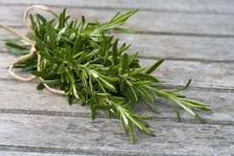
Rosemary Essential Oil
Main constituents:
  1,8-Cineole (Eucalyptol): Boosts mental clarity and has respiratory benefits.
  Camphor: Stimulates circulation and provides a warming effect.
  α-Pinene: Anti-inflammatory and uplifting aroma.
  Verbenone: Supports skin regeneration (in some varieties).
Extracted via steam distillation from the leaves of the rosemary plant (Rosmarinus officinalis).
Cleaning Uses
Warnings
  Rosemary oil can help kill bacteria, viruses, and fungi that cause infection.
  Rosemary oil can help remove grease, grime, and stains.
  Skin irritation: Must be diluted to prevent adverse reactions.
  Nontoxic: Rosemary oil is nontoxic, biodegradable, and safe for humans and pets.
Environmental Impact
Storage and Handling
  Often sustainably cultivated but requires substantial water resources.
  Biodegradable and nontoxic, but ensure waste management during distillation.
  Store in a tightly sealed glass bottle in a cool, dark place.
  Keep away from heat, sunlight, and moisture.

Slide 6

Lemon Essential Oil
  Main Constituents: Citral (up to 75%), geraniol, limonene
  Extraction Method: Steam distillation from lemongrass leaves and stalks
Cleaning Uses
Warnings
  Antimicrobial and antifungal properties make it effective in DIY cleaning solutions.
  Insect repellent: Used as a natural insect deterrent in sprays or diffusers.
  Skin sensitivity: Known to cause irritation if used undiluted.
  Photosensitivity: Mildly photosensitive; avoid sun exposure after use on skin.
Environmental Impact
Storage and Handling
  Biodegradability: Biodegradable in small amounts, but can disrupt aquatic ecosystems if disposed of in large concentrations.
  Proper disposal: Avoid rinsing large quantities into waterways.
  Store in a dark, cool place to maintain potency, ideally in amber or cobalt glass.
  Always dilute before applying to the skin, as it is highly potent and can cause irritation.

Slide 7
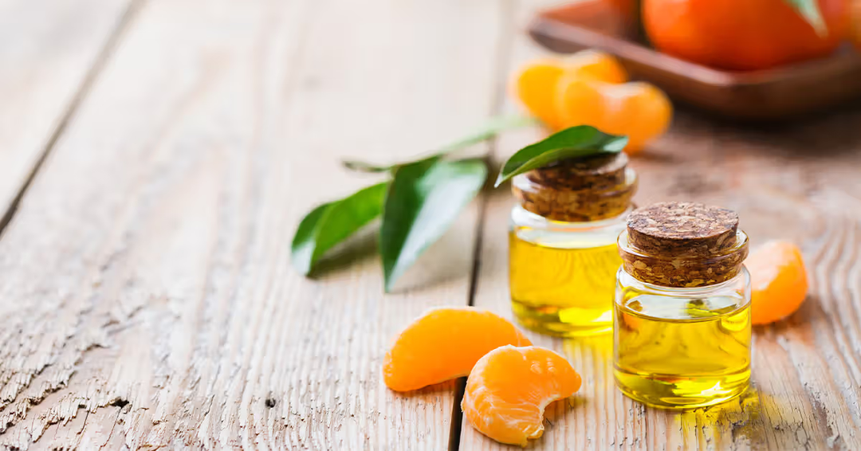
Orange
Essential Oil
  Main Constituents: Limonene (up to 90%), myrcene, alpha-pinene
  Extraction Method: Cold pressing of the orange peel
Cleaning Uses
Warnings
  Powerful natural degreaser and antimicrobial; often used in household cleaning.
  Photosensitivity: Increases skin’s sensitivity to sunlight; avoid sun exposure for 12–24 hours after use on skin.
  Skin sensitivity: May cause irritation if not diluted; dilute with a carrier oil before topical application.
  Ingestion warning: Not safe for ingestion in concentrated form without guidance from a medical professional.
Environmental Impact
Storage and Handling
  Biodegradability: Orange oil is biodegradable, but high concentrations can be harmful to aquatic organisms.
  Proper disposal: Avoid disposal in water systems; dilute with water for small amounts before rinsing down the drain.
  Store in a cool, dark place to protect from light, which can degrade the oil.
  Keep tightly sealed to avoid oxidation, which can reduce effectiveness.

Slide 8
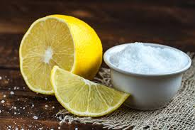
Citric Acid
  Chemical Formula: C₆H₈O₇
  Molecular Structure: Citric acid is a weak organic acid.
  Naturally found in citrus fruits like lemons, limes, and oranges. It is also produced industrially by fermenting sugars using strains of Aspergillus niger.
  pH: It is acidic, with a pH of ~3 in aqueous solutions.
Cleaning Uses
Warnings
  It is found in cleaning agents as a natural descaler and rust remover.
  Added to soaps and shampoos for removing minerals in hard water.
  Skin and eye irritation: Concentrated solutions can cause irritation to skin, eyes, and mucous membranes.
  Ingestion risks: Safe in moderate amounts, but excessive consumption can cause gastrointestinal discomfort or enamel erosion.
  Inhalation: can irritate the respiratory tract if inhaled.
Environmental Impact
Storage and Handling
  Citric acid is biodegradable and considered environmentally friendly. It does not accumulate in the environment and breaks down naturally into harmless substances.
  Aquatic impact: At high concentrations, it can temporarily affect aquatic life by altering pH levels.
  Store in a cool, dry place away from moisture and direct sunlight.
  Avoid direct contact with concentrated forms; use appropriate personal protective equipment (PPE).
  Ensure good ventilation in areas where citric acid is handled.

