Slide 1


Make It Clean! Engineering a Multipurpose Cleaning Product

Slide 2
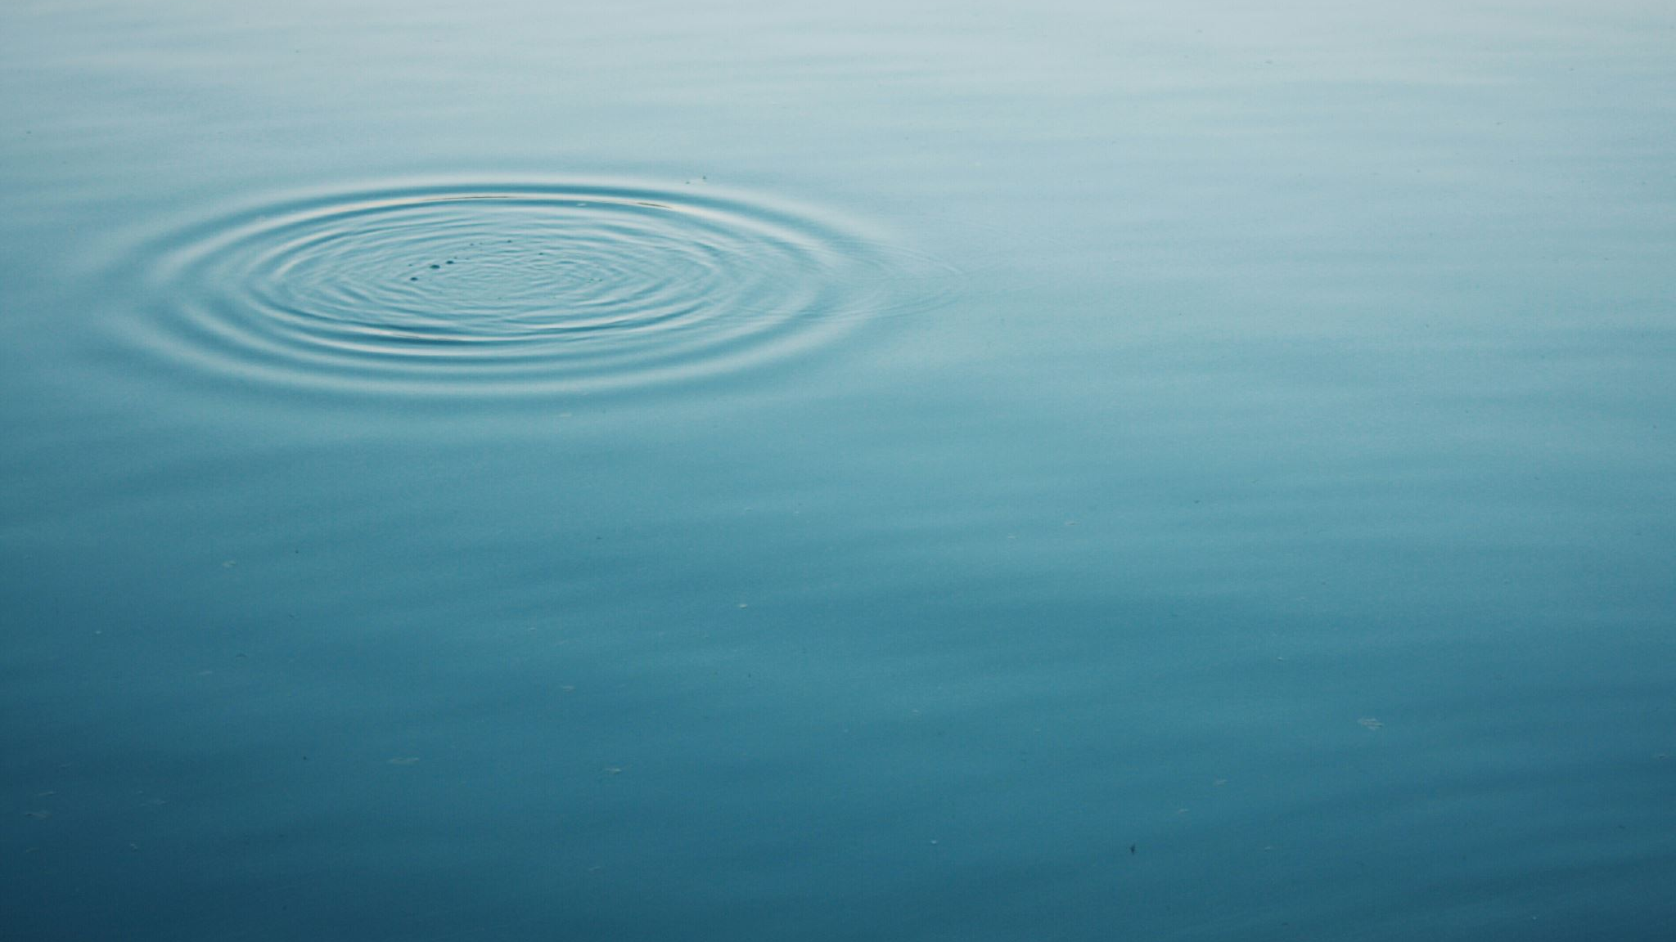
Why is water so important?

Slide 3
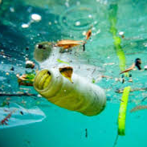
Ways we pollute water
Plastic
Oil
Chemicals from factories and homes

Slide 4
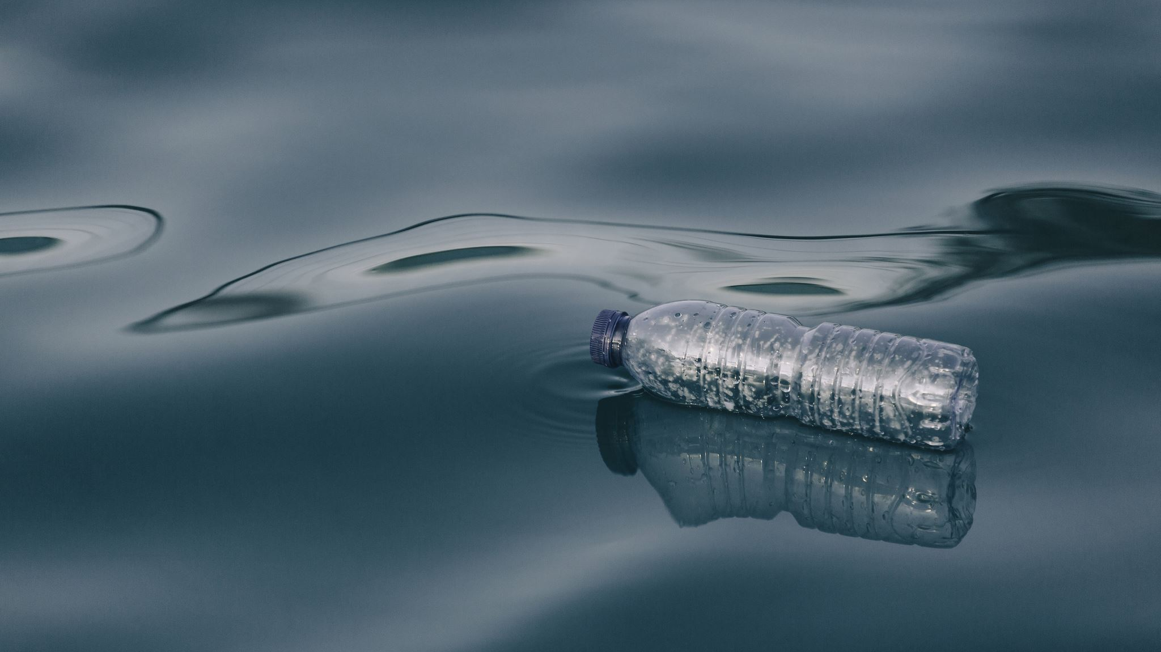
Chemicals polluting water

Slide 5
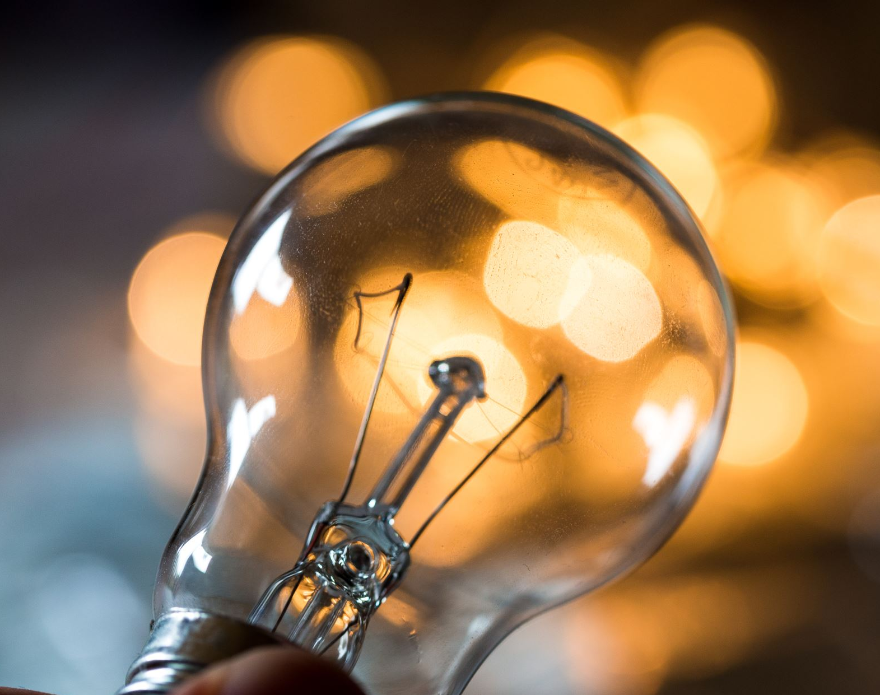
Can we find a solution to help solve this problem?

Slide 6
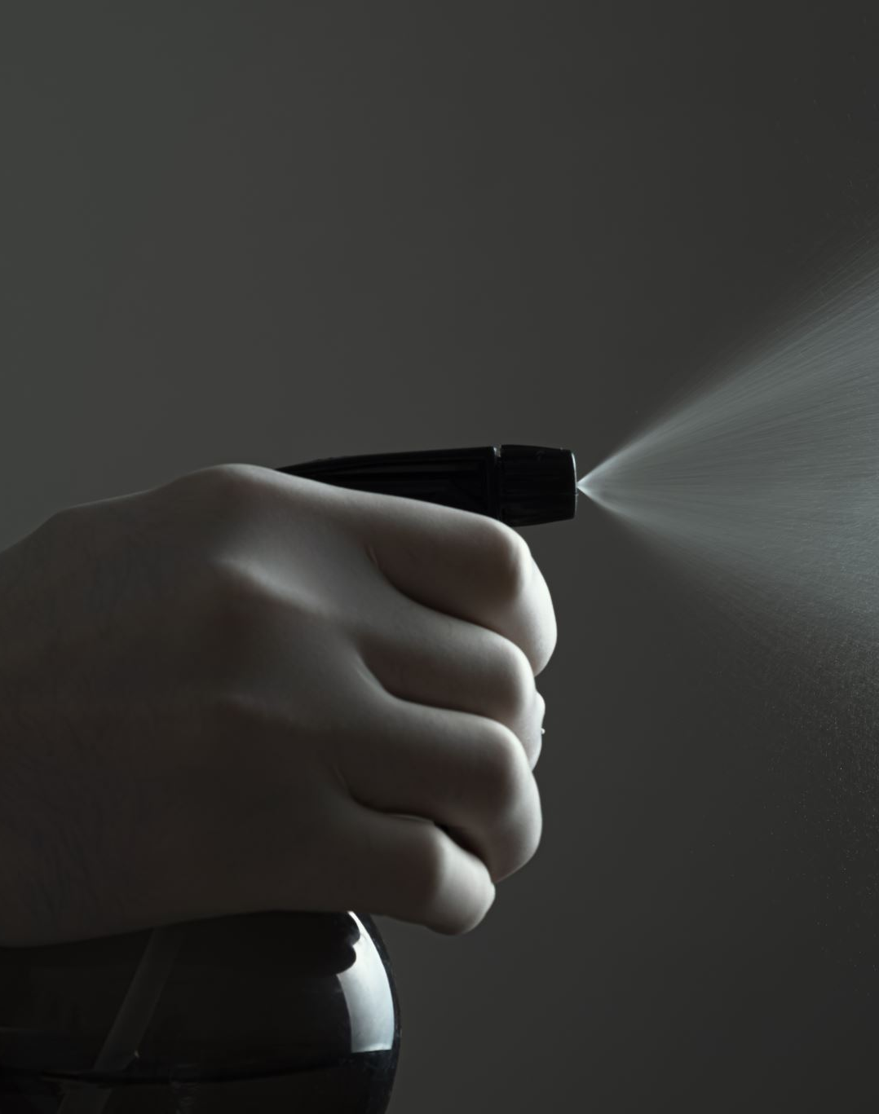
The Challenge
Design a unique cleaning product that is:
  Environmentally friendly.
  An effective cleaner.
  Affordable.

Slide 7
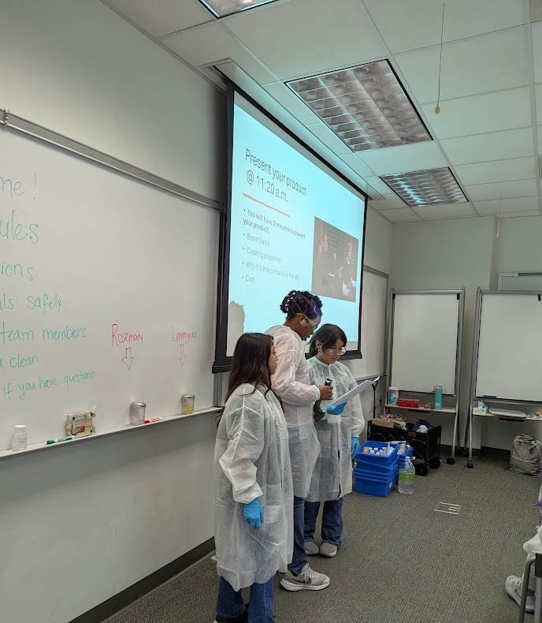
Present your product
You will have three minutes to present your product.
Brand name
Cleaning properties
Why it is environmentally friendly
Cost

