Slide 1
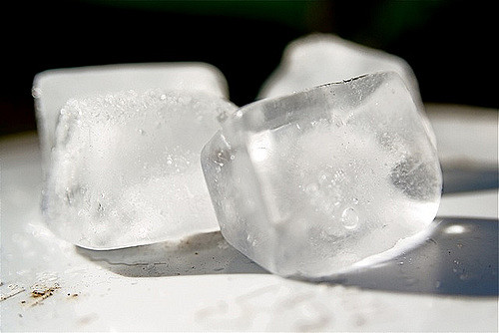
Keep Your Cool!
Build Your Own Cooler Activity

Slide 2

Scenario: your refrigerator just broke!
Your mom just made a huge pot of your favorite food. As you’re getting ready to put the leftovers away, your realize your refrigerator is broken! How do you store all that delicious food without letting it go to waste?

Slide 3
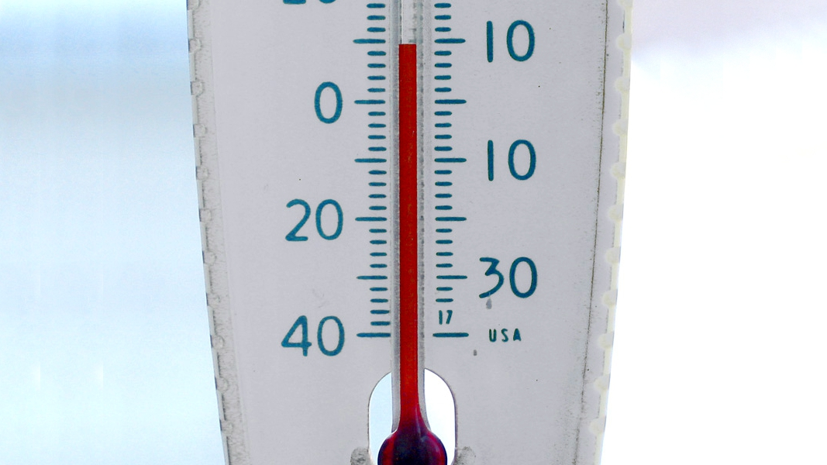
Safe Temperatures
Typical refrigerators operate at or below 4.5°C (40°F).
Perishable food and drink items must stay under specific temperatures so they remain safe to consume.

Slide 4
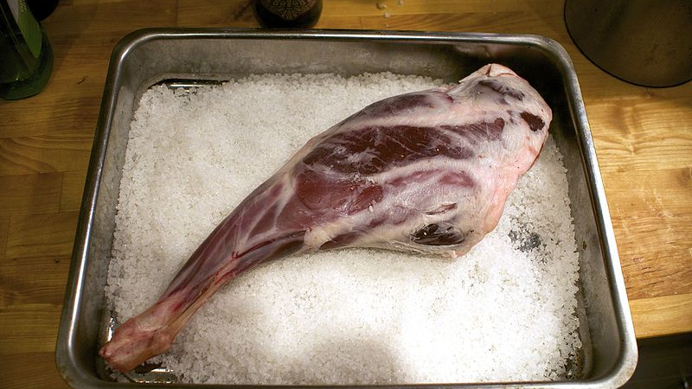
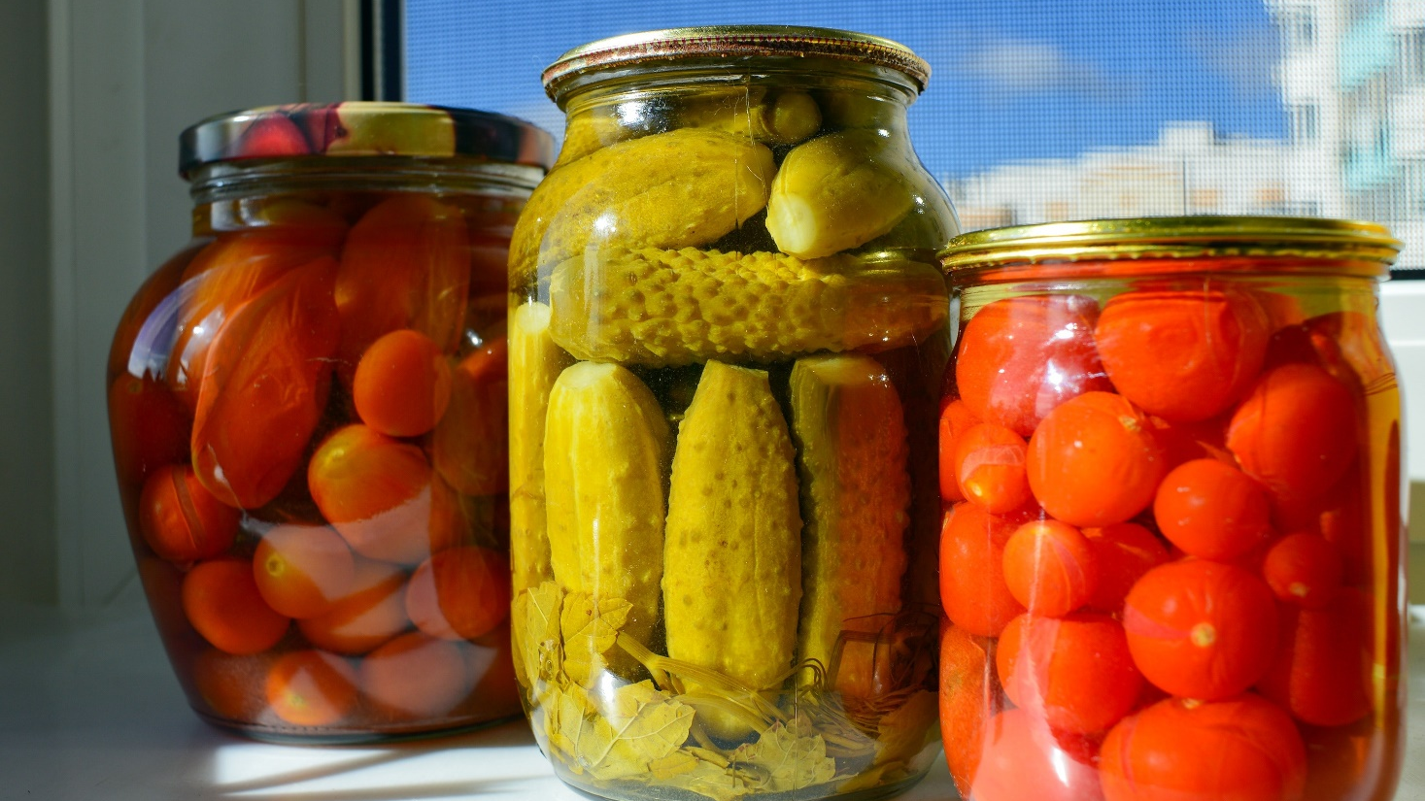
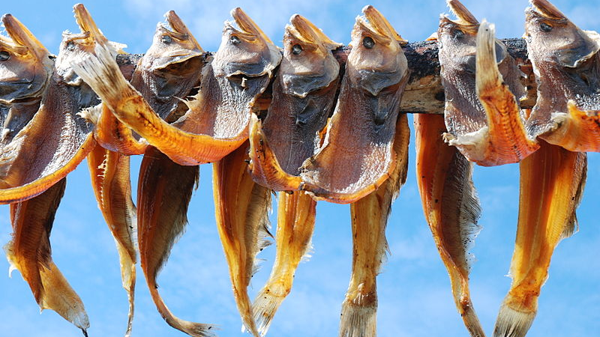
Before Refrigeration
Notes:
Before refrigeration, people would often use preservation methods to keep food from spoiling. These methods include salt curing (such as a leg of lamb), pickling (such as vegetables) or drying (such as fish).

Slide 5
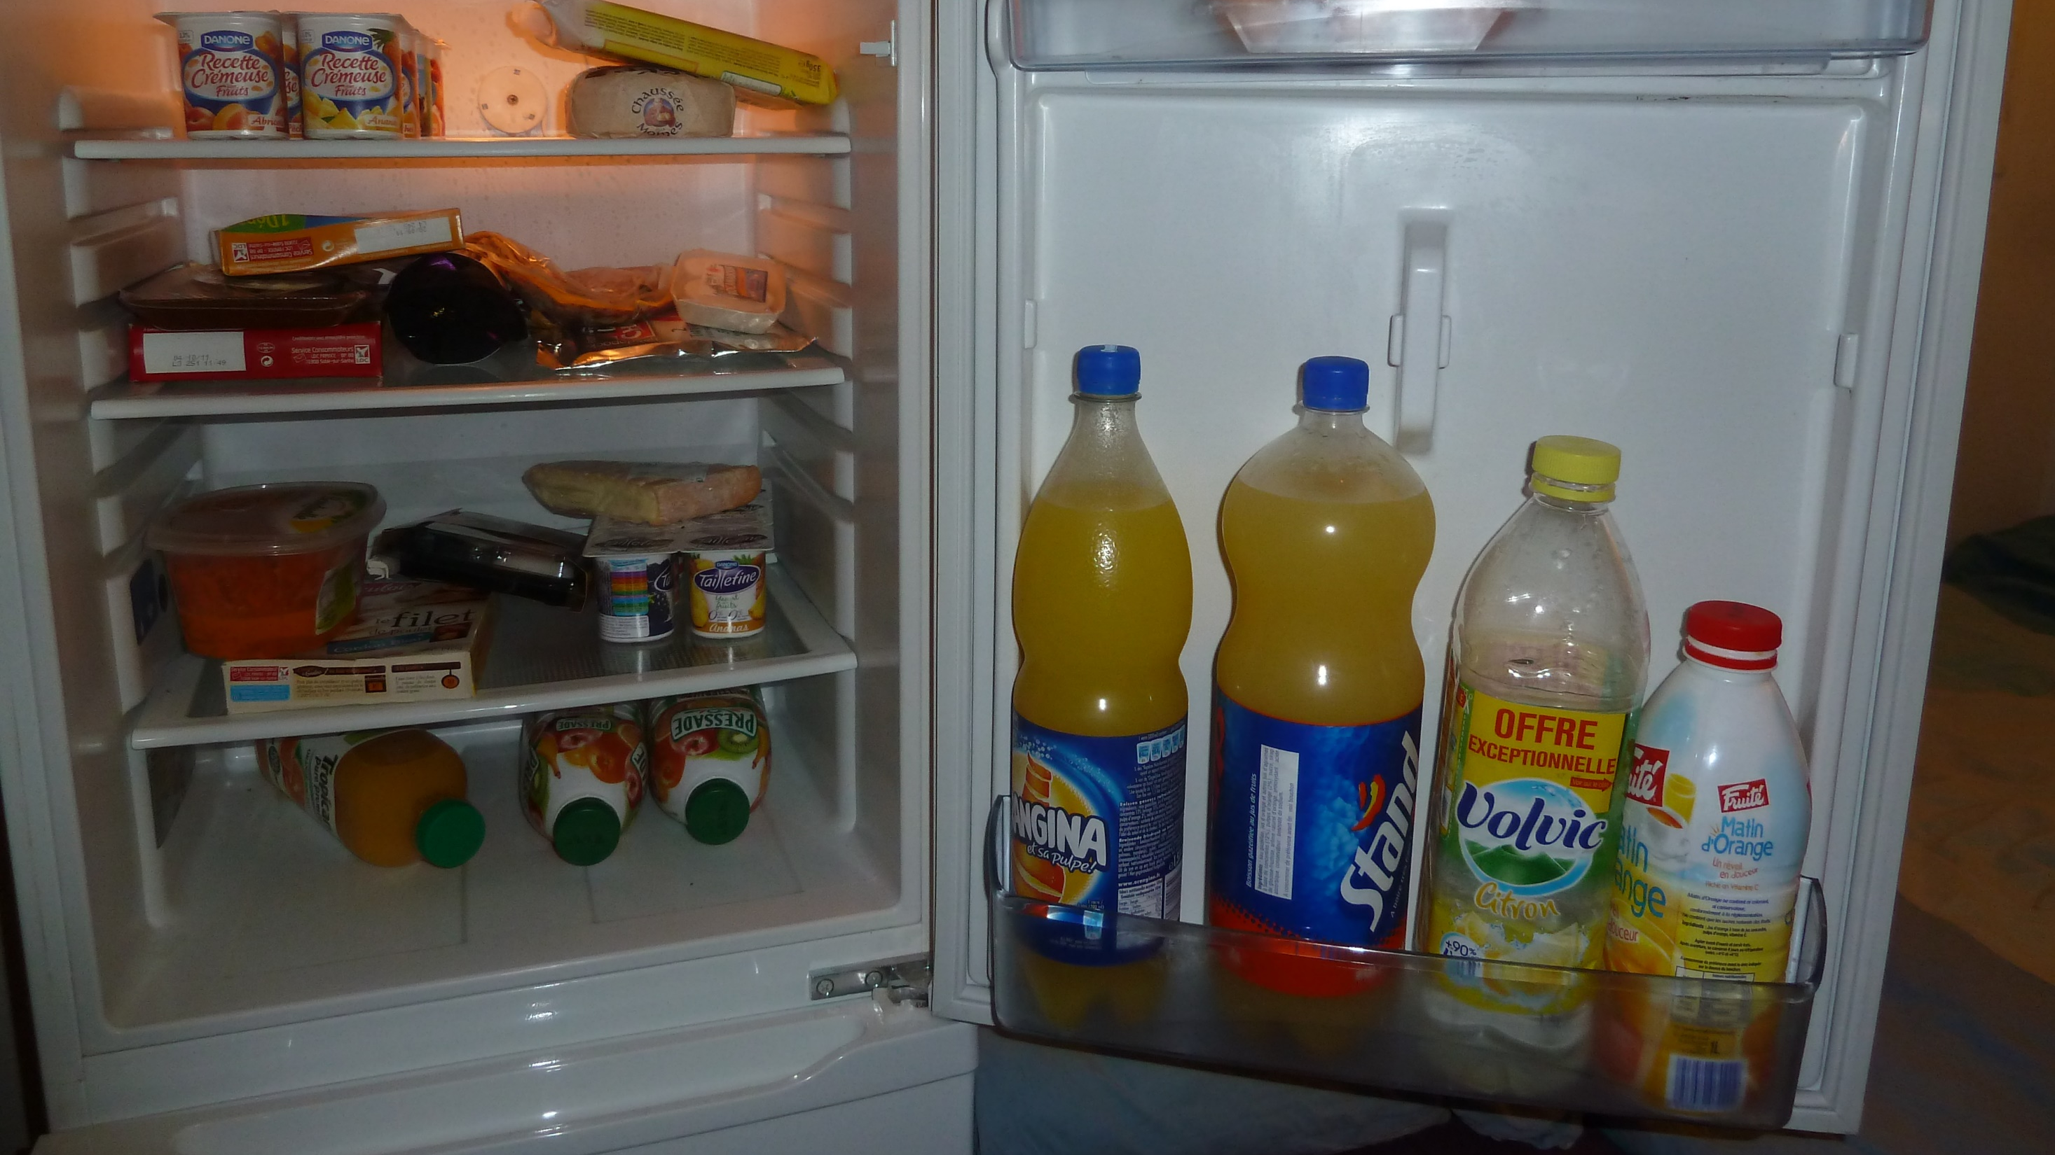
No Refrigerator?
Imagine if there is a loss of power or the refrigerator breaks down suddenly; what is another way you can keep food at safe temperature?

Slide 6

Build and Design a Cooler
Elements to Consider
Functionality
Weight
Ease of Cleaning
Portability
Style

Slide 7

Brainstorm

Slide 8


Slide 9


Slide 10

Discuss!

