Slide 1
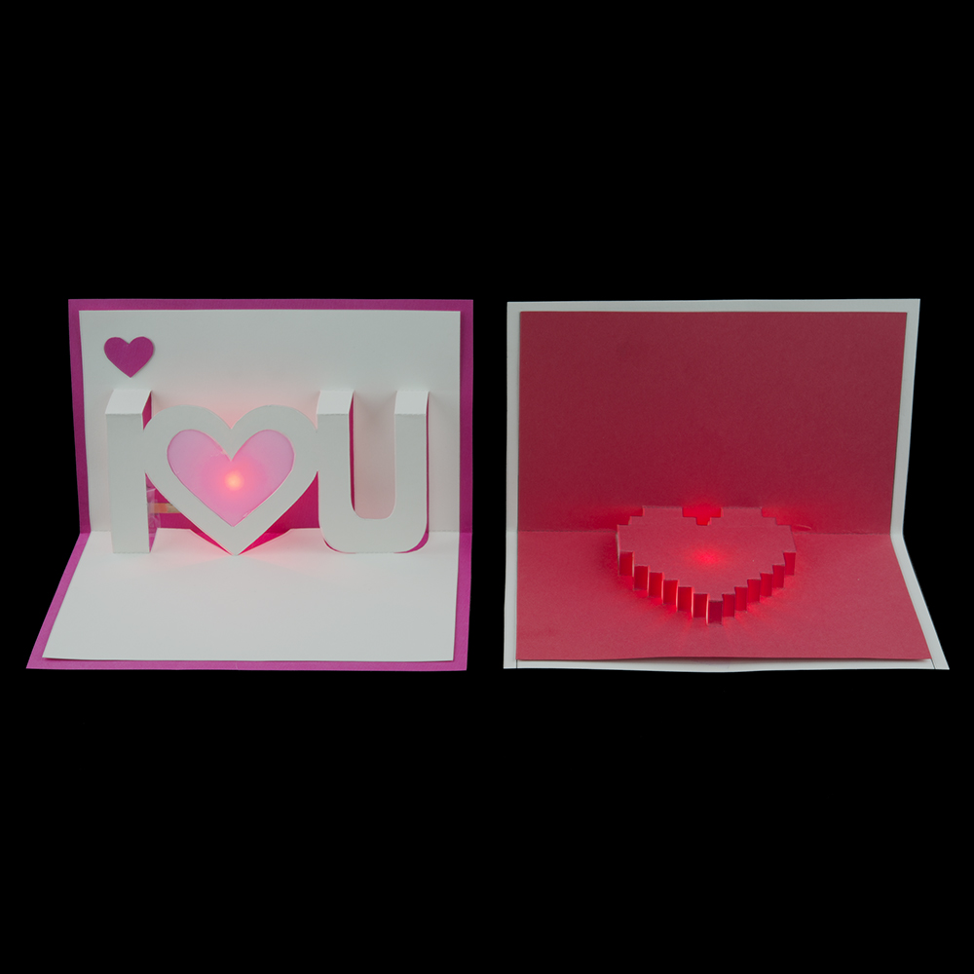
What we’re making today:
Light-Up Pop-Up Greeting Cards
Notes:
Making Light-Up Pop-Up Greeting Cards Presentation
Paper Circuits Greeting Cards activity, SparkFun Education and TeachEngineering.org
///
All image sources: SparkFun Education CC BY-SA 4.0 https://learn.sparkfun.com/resources/68

Slide 2
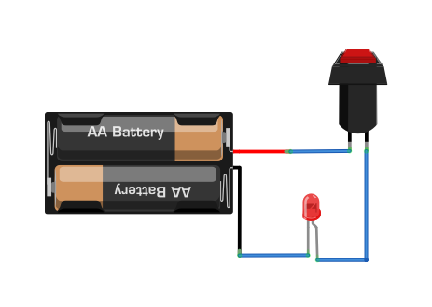
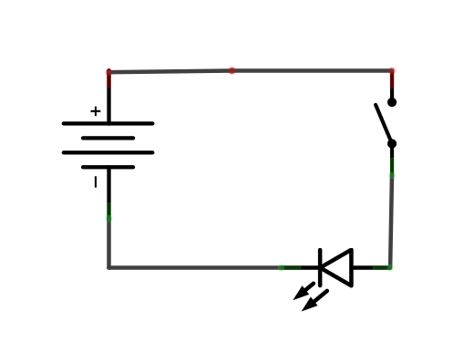
Basic Circuit
A circuit is the circular path that electricity flows through

Slide 3
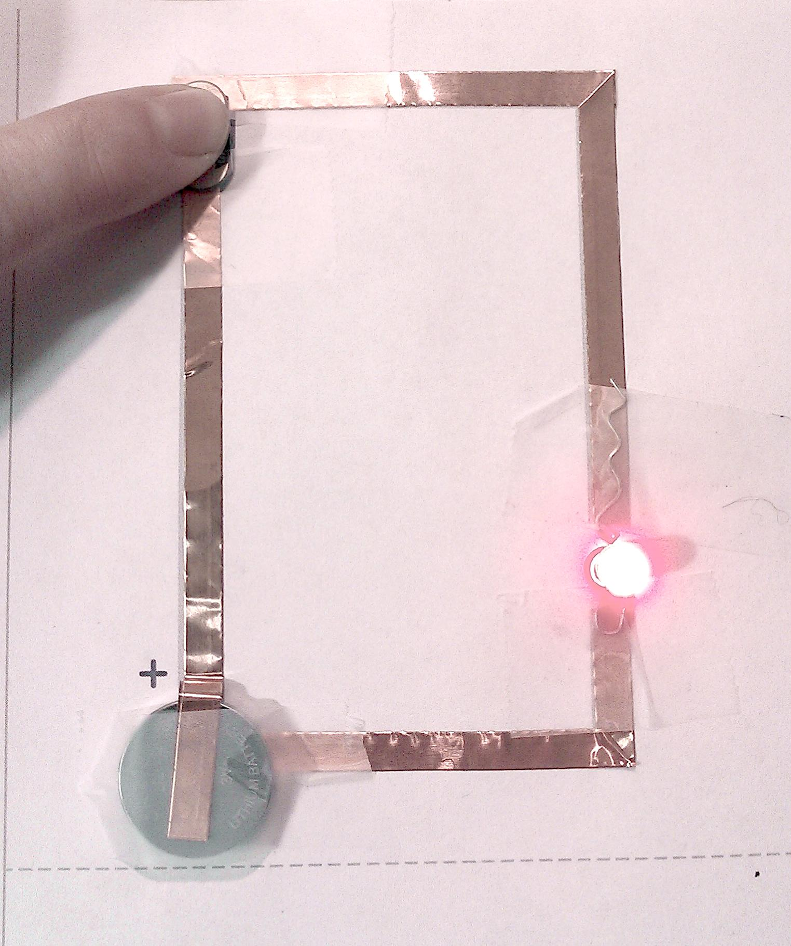
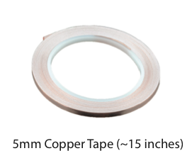
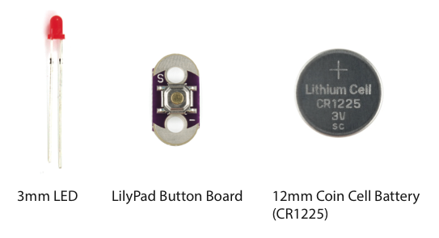
An example completed paper circuit
Supplies:

Slide 4

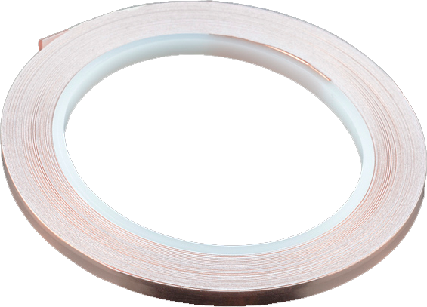
About Copper Tape
Pros:
Nice and conductive!
Peel and stick
Can use conductive paint to attach components to it
Can solder components to it
Cons:
Needs a continuous line so you must get creative when turning corners
Adhesive is NOT conductive
Can have sharp edges so be careful!

Slide 5
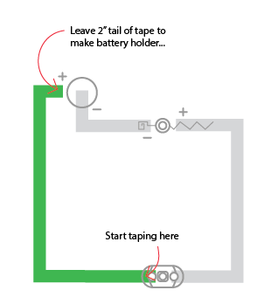
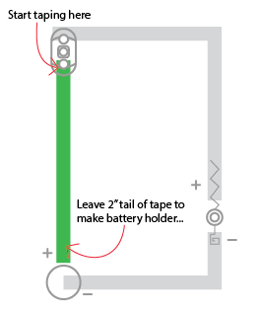
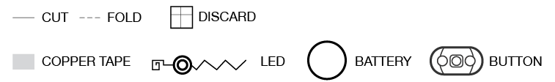
Let’s Get Started! Look at your template:
I U
Heart
⬅ ⬇ Look for these icons

Slide 6
Turning corners with the copper tape
FOLD FORWARD
FOLD
DONE!
It’s okay if your fold isn’t perfect — we just want to go around the corner without the tape breaking

Slide 7

Joining tape in case of breaks/tears
Overlap top side to top side
FOLD BACK
BREAK
FOLD
1/2 AGAIN
JOINING PIECE
Join pieces by touching the TOP SIDE of the copper tape to the TOP SIDE of each section
Secure with clear tape

Slide 8
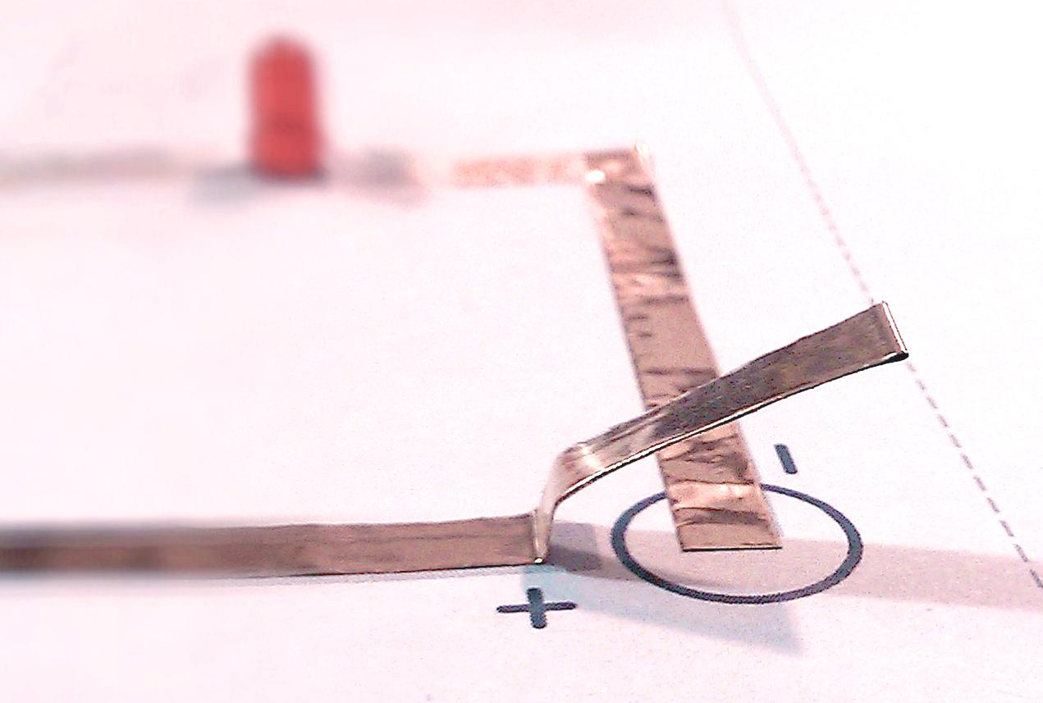
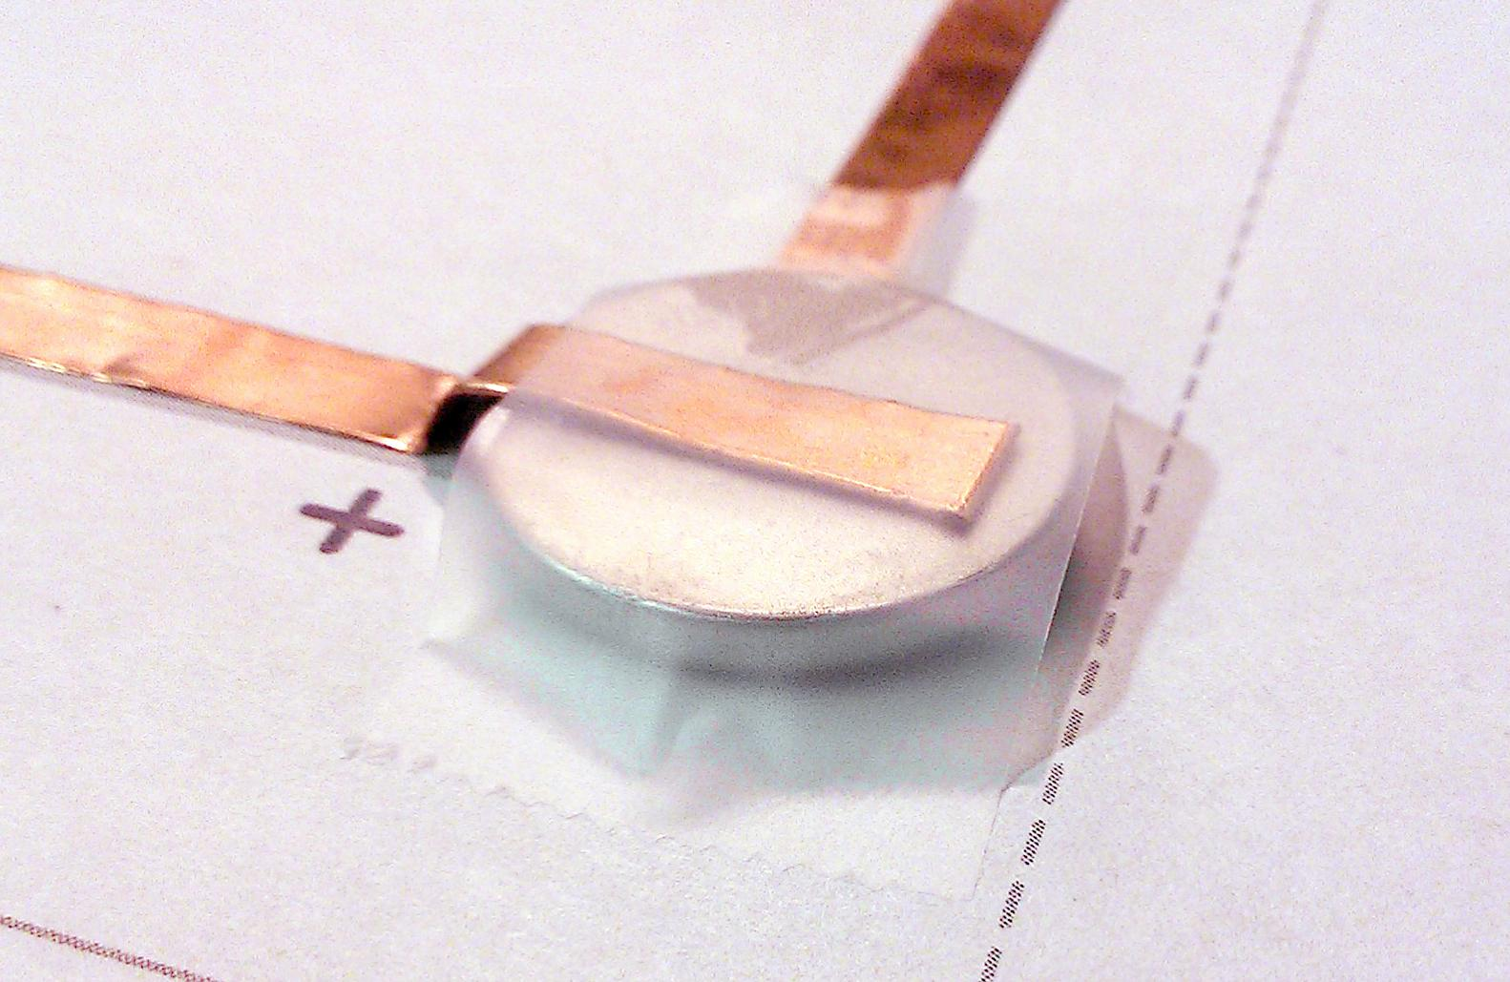
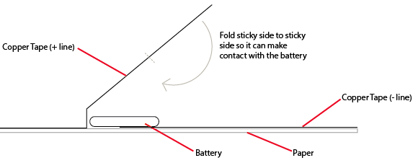
Making a Battery Holder
The side with the labels/writing is the top of the battery.

Slide 9
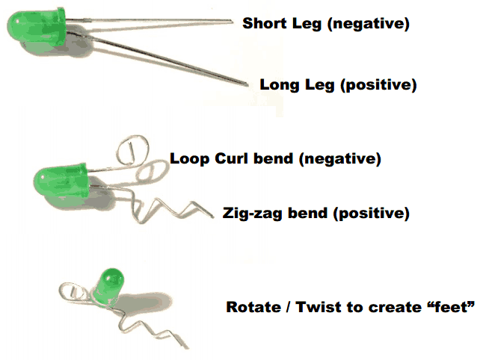
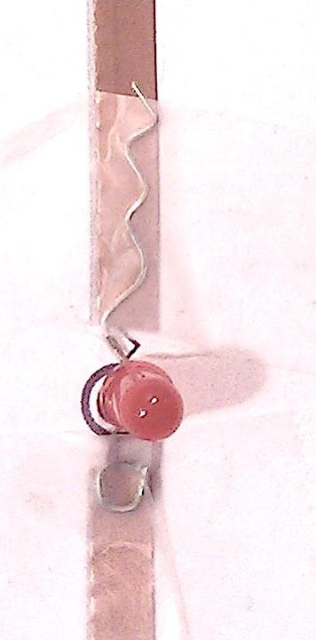
LEDs
Use clear tape to stick the LED to the copper tape
Make sure the + and - are aligned correctly

Slide 10
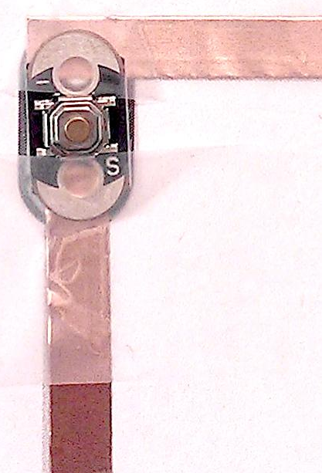
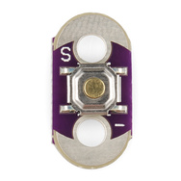
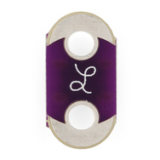
Add the LilyPad Button
Try not to tape directly over the push button
Keep to the pad ends
Conductive pads

Slide 11

Folding Tips
Cut some vellum that is a little bigger than the hole in the heart and paste/tape it behind the opening before you start folding
Push the bottom of the U or I letters down first and work your way up to the smaller folds

Slide 12
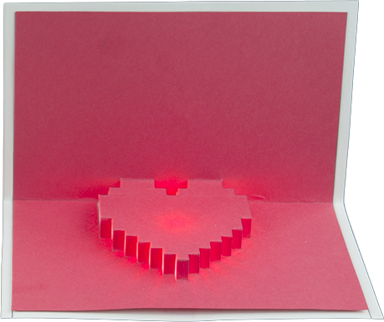
Folding Tips
This template is tricky and takes some patience to fold
Hang in there!
Hold the template upside down and start with the point of the heart
Use gravity to help you pull all the little folds up one by one

Slide 13
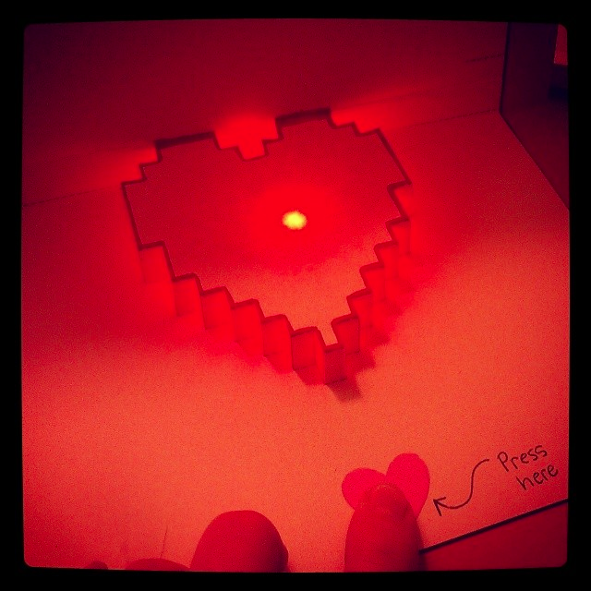
Add text or a symbol showing where to press
If you are mailing your card, mark the outside envelope “hand cancel” so the LED won’t get crushed by sorting machines :)
Press here ⬇

