Slide 1
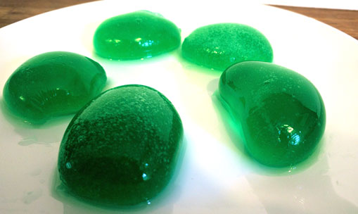
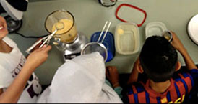
Edible Algae Models
Notes:
Edible Algae Models Presentation > Edible Algae Models Activity > TeachEngineering.org
///
Today we are going to make edible models of algae like the students you see in this photograph. The other photo is a close-up view of the algal models, which are made with water and food coloring, but we are going to use ______ juice (fill in the blank with the juice type purchased).
Image sources:
(fifth-graders doing the activity) 2016 Cristian Heredia, University of California Davis
(green algal models) 2016 Lauren Jabusch (author), University of California Davis

Slide 2
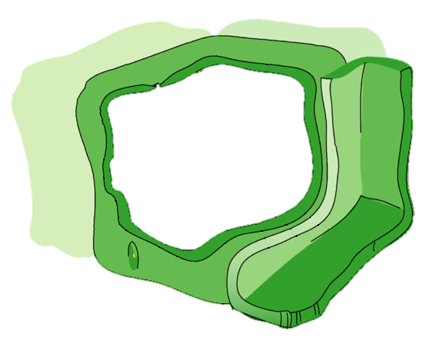
Review: What are the three parts of algae we can make into fuel?
Oil
Starch
(made of sugar)
Cell wall
(made of sugar)
Notes:
Let’s review what we remember/know about algae and biofuels. What are the names of the three parts of algae that can be made into fuel? Here’s a cartoon drawing of a plant cell. (click to advance animation) If we ignore the cell organelles, we see this simplified view of a plant cell. The parts of the algae that we can use to make into fuel are (click to advance) oil, (click) starch and (click) cell walls. Also remember that we need break apart the cell walls to get to the oils and starch, plus we can use the broken-down cell walls for fuel, too. (Teacher note: The depicted plant cell is shown with adjacent cells; algae can be single-celled or multicellular.)
Image source:
(cell diagram; cell wall is green) 2009 LadyofHats, Wikimedia Commons https://commons.wikimedia.org/wiki/File:Eukaryota_cell_strucutre.PNG

Slide 3
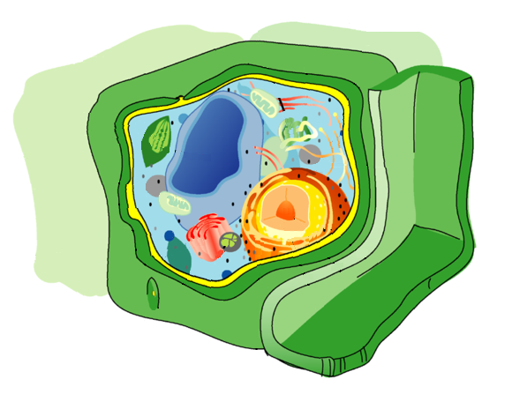
A structure made of sugar that surrounds and protects the cell
Cell wall
The sugars can be used to make more biofuel
Review
Notes:
Who remembers the definition for a cell wall? Talk with your neighbor about the definition of a cell wall. (Wait a few minutes.) The definition the cell wall is (click to reveal answer) a structure made of sugar that surrounds and protects the cell, and (click to reveal answer) its sugars can be used to make more biofuel. Biological engineers study algae to find ways to more easily make biofuel by opening its cell walls to get to the oil and starch, and by recycling the sugars of the cell wall into biofuel.
Image source:
(cell diagram; cell wall is green) 2009 LadyofHats, Wikimedia Commons https://commons.wikimedia.org/wiki/File:Eukaryota_cell_strucutre.PNG

Slide 4
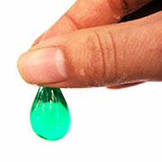
To mimic the cell wall and “goodies” inside the cell (lipid and starch), we are going to make sphere of juice that we can eat
Notes:
Today, we are going to build models of algal cells. We will be able to touch and feel the cell walls in our models.
See how the cell wall of the algal model protects the cell’s interior? That protection is important for the cells to live. Because the cell wall is such a tough materials to break down, biological engineers spend lots of time researching it.
Image source:
(fingers w model) 2016 Lauren Jabusch (author), University of California Davis

Slide 5
Just like the cell wall, the surface of the juice sphere is made of a polymer
This is a monomer
This is a dimer
This is a polymer
Notes:
What are polymers? Here are a few clues. (click to advance) First, this is a monomer. What does the prefix mono mean? One. (click) Next, we have a dimer. What does the drawing show? The prefix “di” means two. (click) Finally, we have a polymer. Discuss with your group or neighbor what you think polymer means.

Slide 6
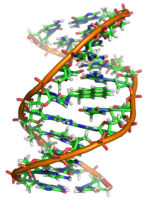
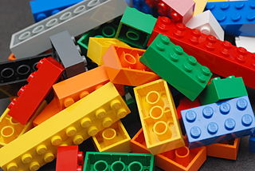
A large chemical made of repeating pieces.
Polymer
Examples include materials in the cell wall, DNA, protein and LEGO pieces
Notes:
Here is a scientific definition for a polymer. (click to reveal answer) A polymer is a large chemical made of many repeating parts. Just like we reviewed in the last slide, the prefix poly means many and mers are small, repeating pieces. (click to advance) Some examples include the cell wall, DNA, protein, and LEGO pieces. Can you think of any other examples? (Possible examples: Beads on a necklace, plastic molecules, etc.)
Image sources:
(DNA graphic) 2007 Zephyris, Wikimedia Commons GNUFD v1.2+ https://commons.wikimedia.org/wiki/File:Benzopyrene_DNA_adduct_1JDG.png
CC BY-SA 3.0
(LEGO pieces) 2007 Alan Chia, Wikimedia Commons CC BY-SA 2.0 https://commons.wikimedia.org/wiki/File:Benzopyrene_DNA_adduct_1JDG.png

Slide 7
Activity Background Information
—the materials we’re using—
The polymer we are using today is called sodium alginate.
It is made from algae (coincidentally) and is completely edible.
We can make a gel using the sodium alginate by exposing it to calcium lactate (also edible).
Notes:
Here is some background information on the materials we are using today to make edible cell models. (click to advance). (click to advance twice to show all the background information on the activity)

Slide 8
Steps for making the algae juice sphere models
Wash your hands
Put a scoop of the juice + sodium alginate mixture into the calcium solution
Wait about 30 seconds. Then use a strainer to remove the juice sphere from the calcium solution. Put it into the water to rinse.
Use a strainer to remove the juice sphere from the water. Make observations about your algal model and then eat it!
Notes:
This slide lists the steps for making the algae juice sphere models. Let’s go over the steps. (click to advance three times to display the steps)

Slide 9
After making your model cell, watch these videos.
➔ Then describe why the juice sphere is a model for an algal cell
Notes:
Teacher note: After all groups have finished the algae model-making activity and completed the worksheet, watch the nine- and six-second videos on this slide. Facilitate a class discussion, as described in the Assessment section. Consider going over the worksheet questions/answers as a class.)
Video sources:
(green algal models) 2016 Lauren Jabusch (author), University of California Davis

