Slide 1
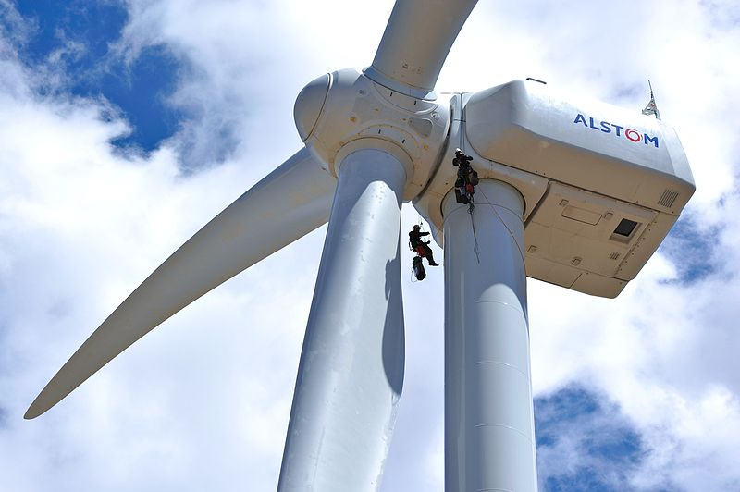
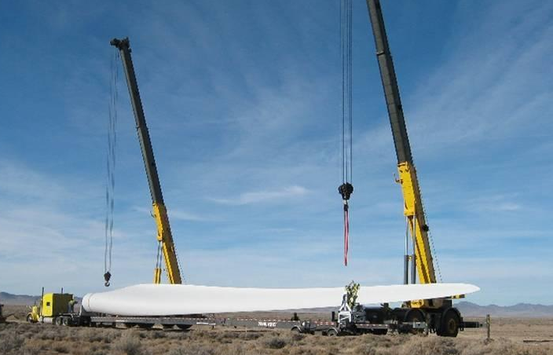
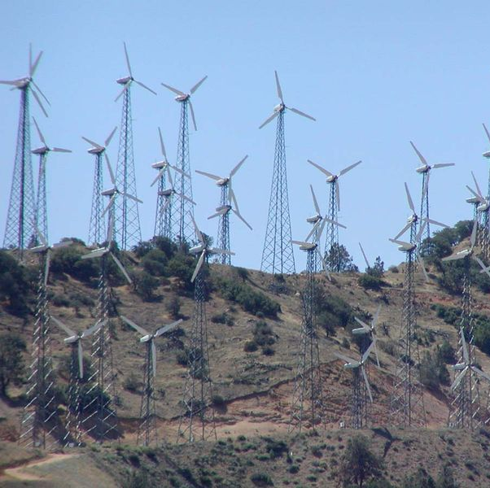
Wind Turbine Design
Photo by Stan Shebs
Notes:
Before we come to the scientists’ rescue with wind turbines, we need to learn how to build them.
How does a turbine work? How have wind turbines changed over time?
Fill in “Part 1: Introduction” of the worksheet as we go over this information.
///
Wind Turbine Design Presentation; Does It Cut It? Understanding Wind Turbine Blade Performance activity; TeachEngineering.org
///
Image sources:
(top R, man climbs Alstom turbine near Boulder CO) 2012 Energy.gov, Wikimedia Commons https://commons.wikimedia.org/wiki/File:Photo_of_the_Week-_July_20,_2012_(7652216320).jpg
(bottom L; blade with truck and cranes in UT; fiberglass blade is 145 feet long) Bureau of Land Management, U.S. Dept. of the Interior http://www.blm.gov/wo/st/en/res/Education_in_BLM/Learning_Landscapes/For_Teachers/teaching_resources/slide_show_wind_turbine.print.html
(bottom R; CA wind farm) 2001 Stan Shebs, Wikimedia Commons https://commons.wikimedia.org/wiki/File:Tehachapi_wind_farm_3.jpg

Slide 2
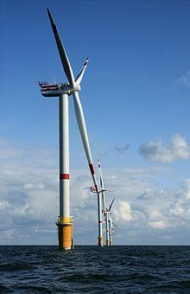
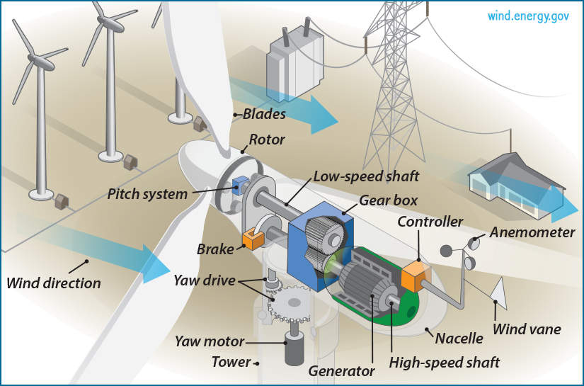
Wind Energy for Electricity
kinetic
Wind turbines convert ________ energy from the wind
into __________ energy.
electrical
The wind causes the blades to spin, which turns a rotor, activating an electric generator.
© Hans Hillewaert
Notes:
Wind turbines are machines that convert one type of energy from the wind, into another type of energy. What kind of energy does the wind have? What kind of energy do wind turbines convert that into? (Listen to some student responses). (Click to show the cutaway diagram of the different parts inside a turbine and bring attention to the two main aspects of energy conversion: 1) the kinetic energy of the wind transferring to the blades and turning them, and 2) the creation of electrical energy from the electrical generator.)
///
Image sources:
(photo wind turbines in North Sea near Belgium) 2008 Hans Hillewaert, Wikimedia Commons https://commons.wikimedia.org/wiki/File:Windmills_D1-D4_(Thornton_Bank).jpg
(diagram; inside a wind turbine) Office of Energy Efficiency & Renewable Energy http://energy.gov/eere/wind/inside-wind-turbine-0

Slide 3
Today we will work like engineers to design a wind turbine!
But first let’s do some research!
Look at the following examples of windmills and wind turbines and take note of their design details.
Notes:
(Read the slide text with emphasis.)
///
Image sources:
__waiting for author____

Slide 4
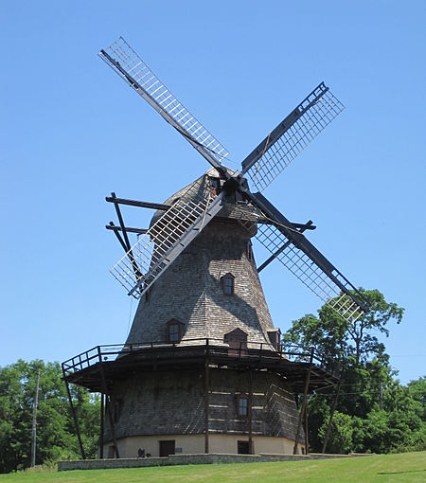
Dutch Windmill (1850s)
Pay close attention to the blades!
How many?
What material?
How shaped?
How angled?
How attached?
Notes:
What do you observe about this Dutch windmill?
How many blades does it have? What is it made of? How are they shaped?
///
Image sources:
(1850s Dutch windmill) 2010 Teemu008, Wikimedia Commons https://commons.wikimedia.org/wiki/File:Dutch_Mill_(5978131063).jpg

Slide 5
Farm Wind Water Pump (Early 1900s)
Notice any similarities or differences?
Notes:
Take a look at this windmill that pumps water.
How many blades does it have? What is it made of? How are they shaped?
How is this windmill similar to or different from the Dutch windmill?
///
Image source:
(water pumping windmill) 2008 Ben Franske, Wikimedia Commons https://commons.wikimedia.org/wiki/File:Water_Pumping_Windmill.jpg

Slide 6
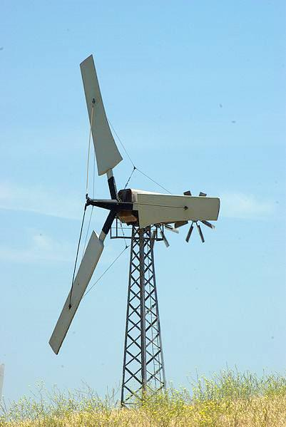
Altamont Pass (1980s) 100 kilowatt
Similarities?
Differences?
Notes:
Now let’s take a look at some electricity-generating wind turbines. The original wind turbines at the Altamont Pass Wind Farm (more than 4,000 wind turbines) in the Diablo Range of Northern California built in the 1980s were each capable of producing 100 kilowatts of power. (Source: https://en.wikipedia.org/wiki/Altamont_Pass_Wind_Farm)
How many blades does each turbine have? What do you think they are made of? How are they shaped?
How are these wind turbines similar to or different from the other windmills we have looked at?
///
Image source:
(photo of wind turbine in CA) 2008 David J. Laporte, Wikimedia Commons https://commons.wikimedia.org/wiki/File:Altamont_Pass_Wind_Farm_2758355435.jpg

Slide 7
1.5 Megawatt Turbine (2005)
Similarities??
Differences??
Notes:
This 1.5 megawatt turbine has been operating in Edithburgh, Australia, since 2005.
How have the turbine blades changed?
///
Image source:
(photo of wind turbine) 2005 Scott Davis, Wikimedia Commons https://commons.wikimedia.org/wiki/File:Wattle_Point_windmill.jpg

Slide 8
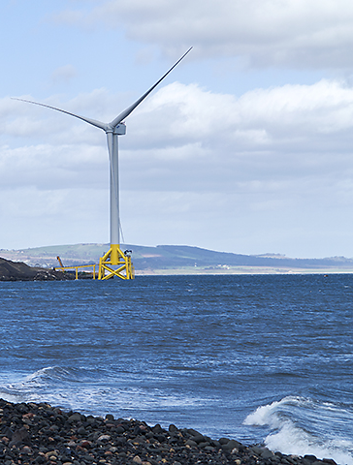
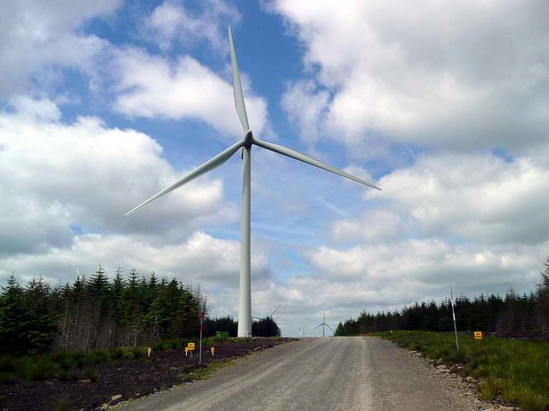
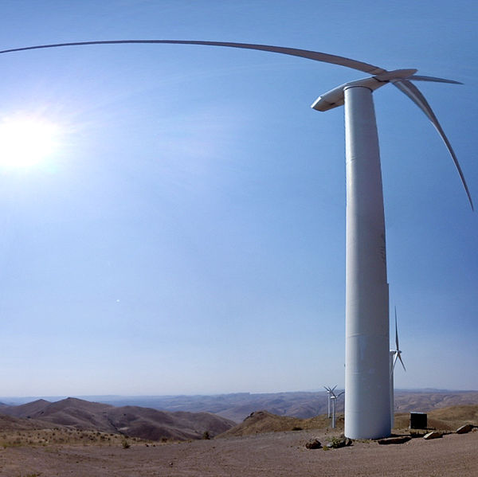
3-7 Megawatt Turbines (Now)
Similarities??
Differences??
Photo by Gordon Brown
Photo by William Starkey
Notes:
Currently, we have turbines that can produce up to 7 megawatts of power. How have the turbine blades changed?
///
Image sources: (L to R)
(wind turbine by water) 2014 William Starkey, Wikimedia Commons https://commons.wikimedia.org/wiki/File:Fife_coast_at_Buckhaven_-_geograph.org.uk_-_3928290.jpg
(wind turbine by trees) 2009 Gordon Brown, Wikimedia Commons https://commons.wikimedia.org/wiki/File:Wind_turbines_at_Whitelee_-_geograph.org.uk_-_1352241.jpg
(wind turbine by mts in OR) 2012 Bureau of Land Management, U.S. Dept. of the Interior, Wikimedia Commons https://commons.wikimedia.org/wiki/File:Lime_Wind_01_(8080647711).jpg

Slide 9
How big are wind turbines?
Look at how they have changed over time…
Photo by Gordon Brown
1600-1800
1900’s
1970-1985
1990-2005
2014
Notes:
Let’s go over everything we’ve seen so far.
Look at how the blades have changed over time.
Keep this in mind when you are designing your own blades.
///
Image sources: (L to R)
(1850s Dutch windmill) 2010 Teemu008, Wikimedia Commons https://commons.wikimedia.org/wiki/File:Dutch_Mill_(5978131063).jpg
(water pumping windmill) 2008 Ben Franske, Wikimedia Commons https://commons.wikimedia.org/wiki/File:Water_Pumping_Windmill.jpg
(photo of wind turbine in CA) 2008 David J. Laporte, Wikimedia Commons https://commons.wikimedia.org/wiki/File:Altamont_Pass_Wind_Farm_2758355435.jpg
(photo of wind turbine) 2005 Scott Davis, Wikimedia Commons https://commons.wikimedia.org/wiki/File:Wattle_Point_windmill.jpg
(wind turbine by trees) 2009 Gordon Brown, Wikimedia Commons https://commons.wikimedia.org/wiki/File:Wind_turbines_at_Whitelee_-_geograph.org.uk_-_1352241.jpg

Slide 10
How are you going to design your turbine blades?
You can test…
Number of blades
Size and shape
Stick placement
Blade angle
Notes:
How are you going to design your turbine blades? As a team, you can choose to test any of the following variables: number of blades, size and shape of the blades, stick placement on the blades, and the blade angle.
///
Image sources:
__waiting for author____

Slide 11
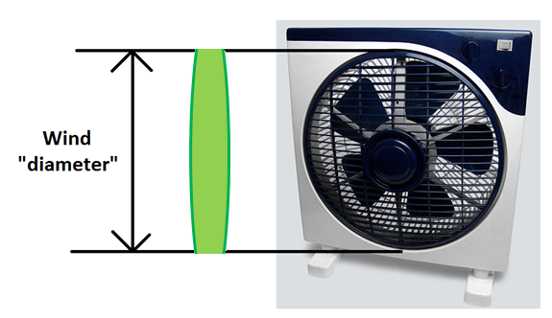
How Many Blades and What Size?
While the minimum is 1 blade, for balance it is best to have at least 2 blades.
The maximum is 6 blades.
Bigger blades collect more energy, but are harder to spin.
Blades that are larger than the wind diameter collect no energy at the tips!
Notes:
How many blades will you put on your turbine? How many are needed?
///
Image sources:
(fan) 2007 Jorge Barrios, Wikimedia Commons {PD} https://commons.wikimedia.org/wiki/File:Ventilador_Electrico_Piso.jpg
(composite image) 2016 Alexander Kon, RESOURCE GK-12 Program, College of Engineering, University of California Davis (author; used with permission)

Slide 12
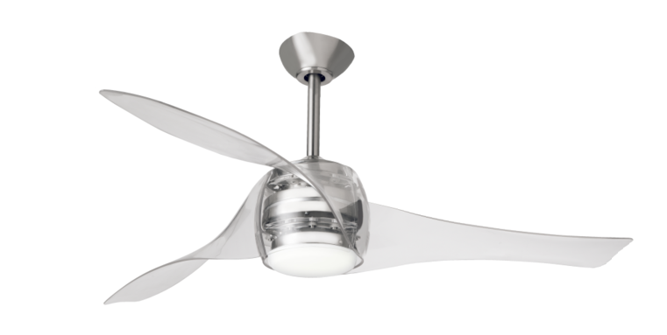
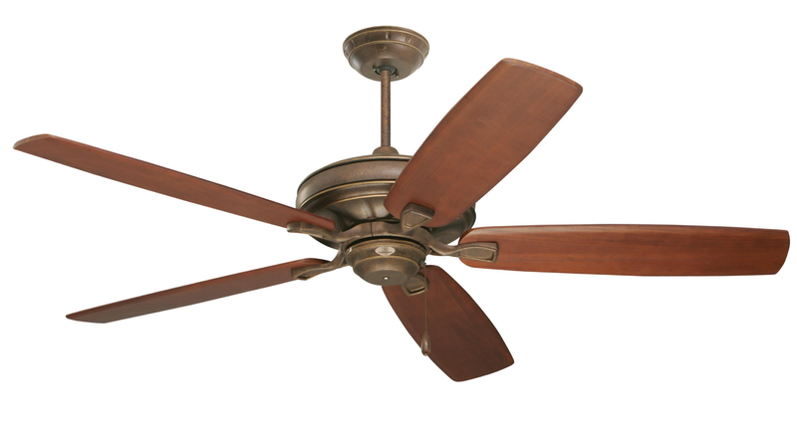
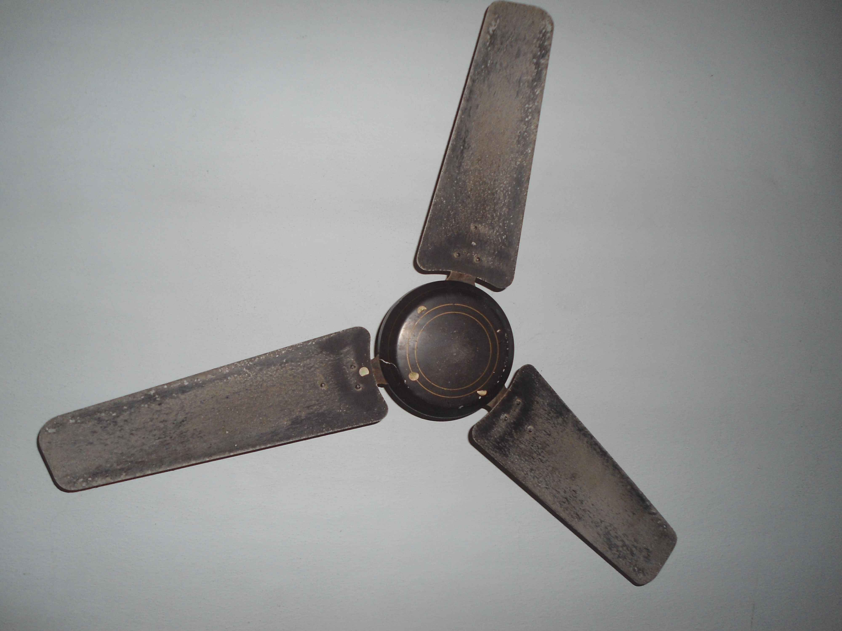
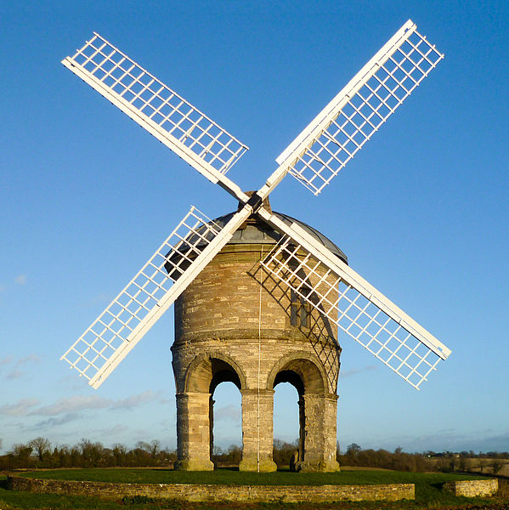
Blade Shape and Stick Placement
Flat or curved?
Middle or edge?
Notes:
What shape will your blades be? Will they be flat or curved?
Where will your place the stick relative to the blade? In the middle? On the edge?
///
Image sources:
(top L) 2015 Antonio Mette, Wikimedia Commons https://commons.wikimedia.org/wiki/File:Ventilatore_a_soffitto_(3).png
(top R) 2016 Buluvantilaotr, Wikimedia Commons https://commons.wikimedia.org/wiki/File:Artemis_yass%C4%B1_(hunter_tavan_vantilatoru_tavan_pervanesi_sessiz_vantilator_guclu_vantilator_kaliteli_vantilator_pervanem).png
(bottom L) 2012 Adityamadhav83, Wikimedia Commons https://commons.wikimedia.org/wiki/File:An_Old_model_three_blade_ceiling_fan.JPG
(bottom R, windmill) 2012 DeFacto, Wikimedia Commons https://commons.wikimedia.org/wiki/File:Chesterton_Windmill,_Chesterton.jpg

Slide 13
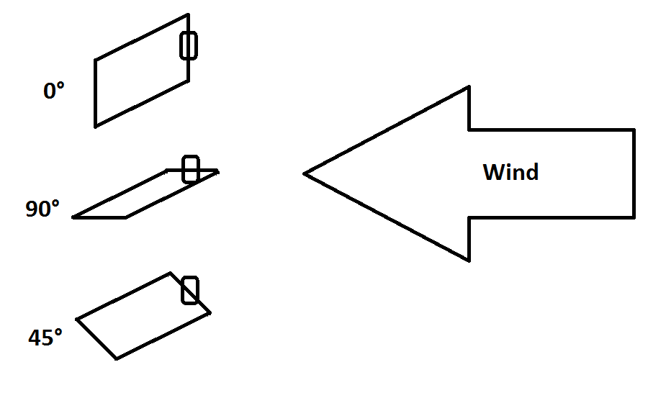
Blade Angle
Think about what will transfer the most energy!
Notes:
What angle is the best to put your blades into the turbine?
What angle will transfer the most energy from the wind to the turbine?

