Slide 1
Exploring Energy: What Is Energy?
exploding water heater video
Notes:
What Is Energy? Presentation
Exploring Energy: What Is Energy? lesson > TeachEngineering.org
Show students the 4-minute Mythbusters video (website link on the slide)
https://www.youtube.com/watch?v=jbreKn4PoAc

Slide 2
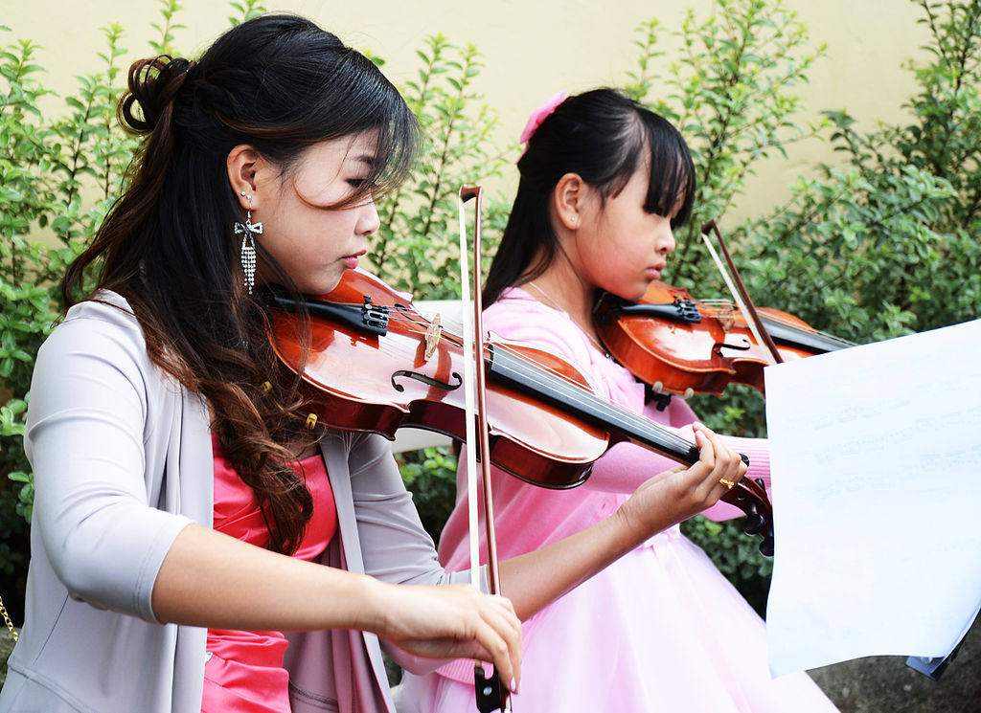
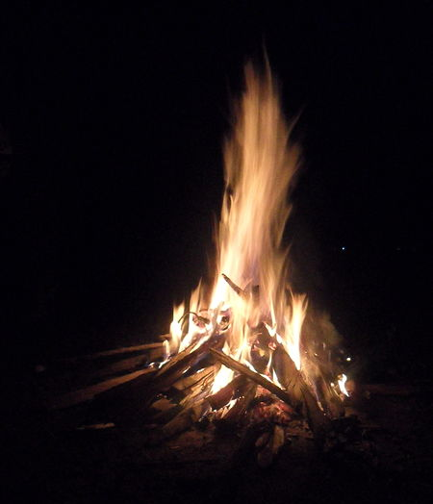
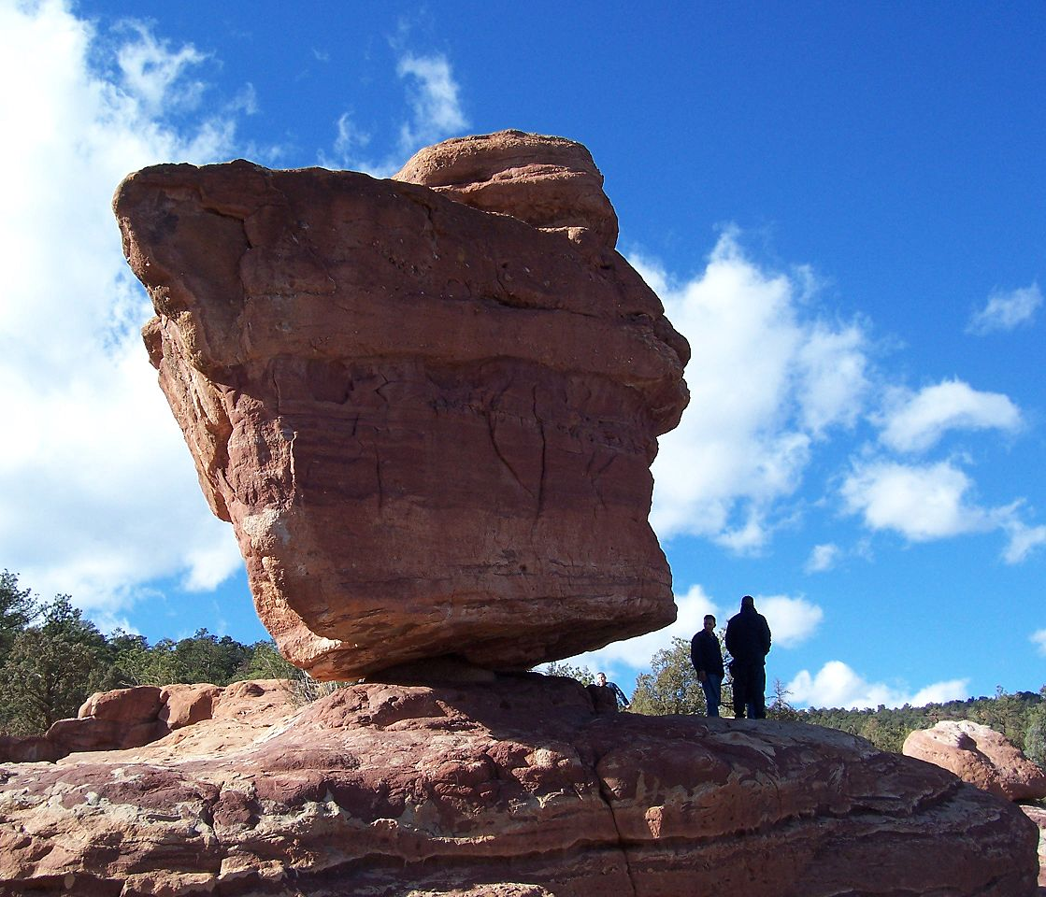
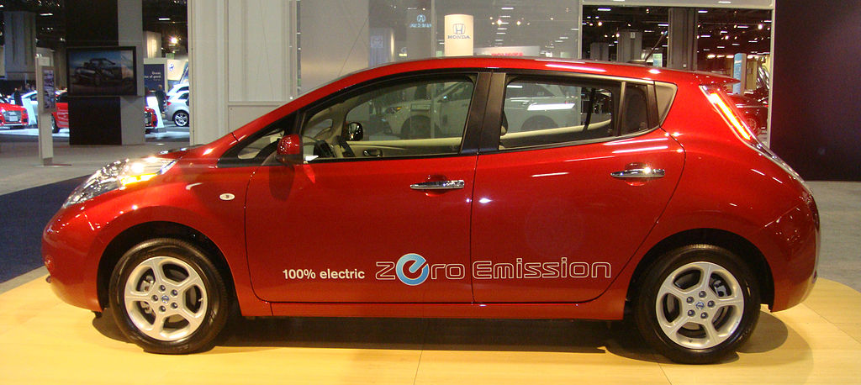
Which of these items have energy? What is your evidence?
Energy: The ability to make things happen. Motion, heat, light and sound are clues that energy is present.
Notes:
Lesson script
Go through each image and have students discuss and describe evidence of energy.
Image sources:
(apples) 2007 Scott Bauer, USDA, Wikimedia Commons http://commons.wikimedia.org/wiki/File:Apples.jpg
(girls playing violins) 2012 Ashishlohorung, Wikimedia Commons http://commons.wikimedia.org/wiki/File:Girls_playing_violin_at_a_wedding_ceremony.jpg
(burning wood) 2010 Violetbonmua, Wikimedia Commons. http://commons.wikimedia.org/wiki/File:Burning_wood.jpg
(Nissan Leaf electric vehicle) 2011 Mario Roberto Duran Ortiz, Wikimedia Commons http://commons.wikimedia.org/wiki/File:2011_Nissan_Leaf_WAS_2011_1040.JPG
(balanced rock) 2005 EvanS, Wikimedia Commons http://commons.wikimedia.org/wiki/File:Balanced_Rock.jpg

Slide 3
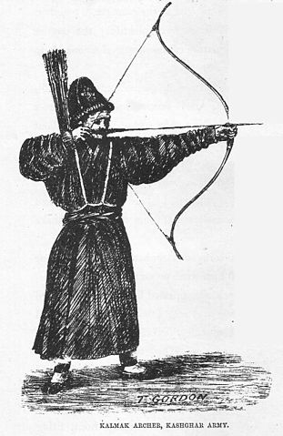
Does the pulled bow have energy?
Notes:
Lesson script
Image source: (a Kalmak archer) 1876, Thomas Edward Gordon, Wikimedia Commons http://commons.wikimedia.org/wiki/File:Kalmak_archer.jpg

Slide 4
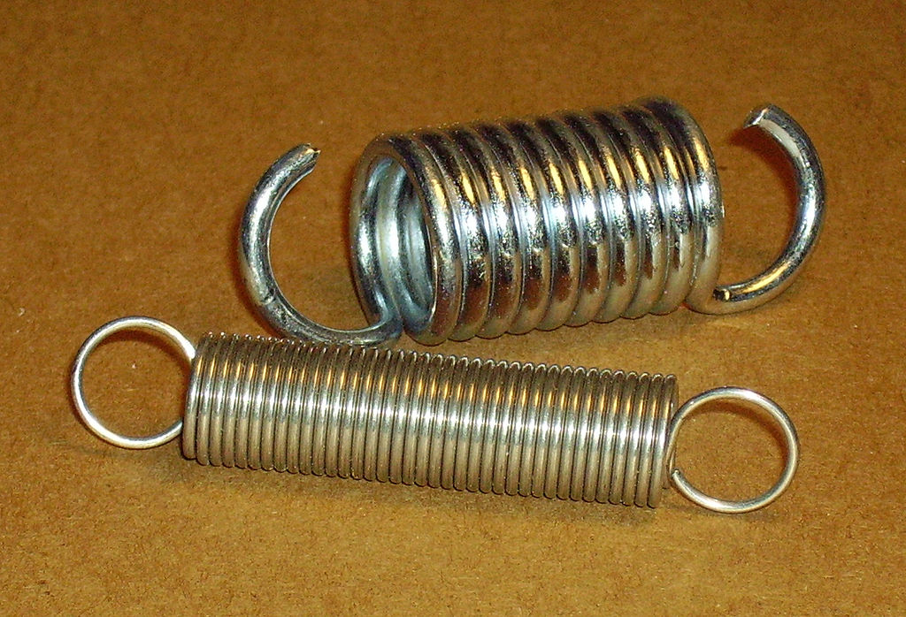
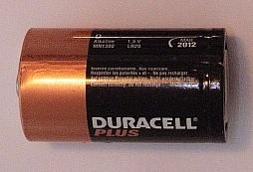
What do each of these have in common in terms of energy?
What type of energy is present?
Potential Energy: Energy that is stored.
What are other examples of potential energy?
Notes:
Lesson script
Examples shown are compressed springs, chemical batteries and expanded elastic balloons.
What does it mean when a teacher says, you have a lot of potential? It means that you can do something that you are not currently doing.
Image sources:
(l2 springs) 2006 QZ10, Wikimedia Commons
http://commons.wikimedia.org/wiki/File:Springs_009.jpg
(Duracell battery) 2009 Bela Nemeth, Wikimedia Commons http://commons.wikimedia.org/wiki/File:Duracell_Battery.png
(purple balloon) 2008 AJ, Wikimedia Commons http://commons.wikimedia.org/wiki/File:Purple_toy_balloon.svg

Slide 5
What type of energy does the moving arrow have?
How is this energy different than when the bow was pulled back?
Notes:
Image source (arrow) 2008 Pearson Scott Foresman, Wikimedia Commons http://commons.wikimedia.org/wiki/File:Arrow_(PSF).png

Slide 6
What do each of these have in common in terms of energy?
What type of energy is present?
Kinetic Energy: Energy of motion.
Synonyms for kinetic are active and lively
What are other examples of kinetic energy?
Notes:
Examples shown are kids running on a field as they play soccer and a race car traveling around a track.
Image sources:
(kids playing soccer) 2005 Derek Jensen (Tysto), Wikimedia commons http://commons.wikimedia.org/wiki/File:Youth-soccer-indiana.jpg
(white race car) 2008 AngMoKio, Wikimedia Commons http://commons.wikimedia.org/wiki/File:Porsche_race_car_Verschuur_amk.jpg

Slide 7
Energy Transfer
Energy can be transferred from one type to another type.
kinetic energy
potential energy
Notes:
Lesson script
Where does all the energy go once it hits the ground? Other types of energy!
Image sources:
(a Kalmak archer) 1876, Thomas Edward Gordon, Wikimedia Commons http://commons.wikimedia.org/wiki/File:Kalmak_archer.jpg
(arrow) 2008 Pearson Scott Foresman, Wikimedia Commons http://commons.wikimedia.org/wiki/File:Arrow_(PSF).png

Slide 8
Which has more potential energy?
The blue ball is higher up, so it has more potential energy.
Notes:
Lesson script
“I want everyone in the class to give me a thumbs-up if you think the ball on the right has more energy, and a thumbs-down if you think the ball on the left has more energy.”
Why is it potential energy? (stored energy)
More specifically (more advanced), energy stored in an object’s height is gravitational potential.

Slide 9
Who has more kinetic energy?
Tanya - 3 miles per hour
Tamara - 6 miles per hour
Tamara has more kinetic energy.
Notes:
Lesson script
Why is it kinetic energy? (energy of motion)
Image source (running girl) Microsoft clipart at http://office.microsoft.com/en-us/images/results.aspx?qu=running&ex=1#ai:MC900347265|

Slide 10
Which has more potential energy?
spring 1
Spring 2 is more compressed, so it has more potential energy.
10 lbs
spring 2
100 lbs
Notes:
Lesson script
Why is it potential energy? (stored energy)
Note: These are assumed to be identical springs; spring 2 is compressed under more weight.
More specifically (more advanced), energy stored in a compressed spring is elastic potential energy.

Slide 11
Which has more energy?
The balls are at exactly the same height.
Both balls have the same amount of potential energy.
The blue ball has more kinetic energy.
Notes:
Lesson script
The blue ball has more kinetic energy, but they both have the same amount of potential energy

Slide 12
How is the energy transferred?
All potential
A little kinetic, a lot of potential
Some kinetic, some potential
All kinetic
Notes:
Lesson script
Where does all the energy go once it hits the ground? Other types of energy! (Motion, heat, light and sound)

Slide 13
Write a description of what happened in the exploding water heater video.
Use the concepts we learned today:
energy
potential energy
kinetic energy
transfer of energy
Notes:
Lesson script
Assign as a group or individual assessment activity (written homework).
By the end of this lesson, students should be able to explain that the Mythbusters put energy into the water heater by connecting it to the electrical outlet. When the temperature and pressure in the water heater increase, they build up its potential energy. When the water heater explodes, the potential energy is converted to kinetic energy.
Additional information:
By the end of this unit, students should be able to explain more details of the video, such as the forms of energy present. For the teacher, the following is a detailed explanation of what happens in the video: The MythBusters put electricity into the water heater. That electricity is transferred to thermal energy by the heating element. Thermal energy builds up in the water heater (potential energy), causing an increase in the temperature of the water and an increase in the pressure inside the water heater. The Mythbusters disabled the safety valve that prevents a normal water heater from building up too much pressure. The boiling temperature of water increases as pressure goes up. At atmospheric pressure (14.7 psi), water boils at 100 °C, but at 332 psi, the maximum pressure shown in the video, water remains liquid up to 219 °C. When the water heater bursts and the pressure drops suddenly from 332 psi to 14.7 psi, the water is 119 °C above its boiling point. The superheated water boils suddenly and violently as much of the water is converted to steam. The steam expands out from the water heater (kinetic energy), sending the water heater and pieces of the surrounding shack flying (also kinetic energy). It also creates a loud noise; sound is another form of energy.

