Slide 1
Forces and Newton’s Third Law

Slide 2
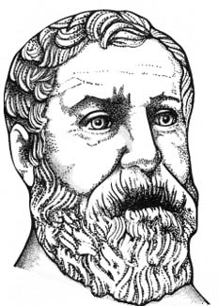
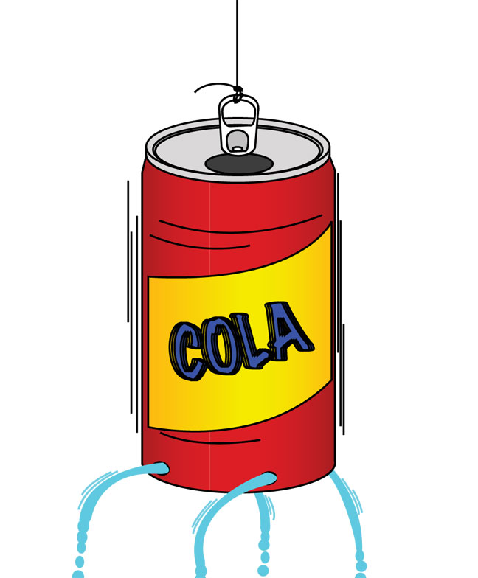
Newton’s Third Law of Motion For every action, there is an equal and opposite reaction.
Hero’s Engine DEMO
Notes:
Introduce Newton’s third law of motion. Then demonstrate the soda can Hero’s Engine. Or the alternative scooter demo.
Hero’s engine (5 minutes: Poke 4 holes around bottom rim of soda can using a nail. Use nail to angle each hole left or right (same for all holes). Tie a string to the tab. Fill with water. Hold up by the string and watch it spin.)
Alternative scooter demo: Have a student sit on a scooter and throw a basketball to another student. The reaction from the throw is evidenced by the student’s backward movement on the scooter.
Image sources:
The head of Hero of Alexandria: 1688 Pneumatics, Wikimedia Commons http://commons.wikimedia.org/wiki/File:Hero_of_Alexandria.png
A diagram of Hero’s engine: 1876 Knight's American Mechanical Dictionary, Wikimedia Commons http://commons.wikimedia.org/wiki/File:Aeolipile_illustration.png
Soda can diagram: NASA http://www.nasa.gov/pdf/153414main_Rockets_Pop_Can_Hero.pdf

Slide 3
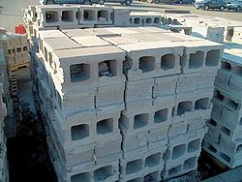
Newton’s Third Law of Motion
For every action, there is an equal and opposite reaction.
The block’s weight pushes on the ground
The ground pushes back on the block
Notes:
Forces come in action-reaction pairs.
Make the connection that the force of the ground on the block is the normal force discussed earlier in Day 2.
Image source:
A stack of concrete blocks: 2006 Justanother, Wikipedia Commons http://commons.wikimedia.org/wiki/File:Concreteblocks.jpg

Slide 4
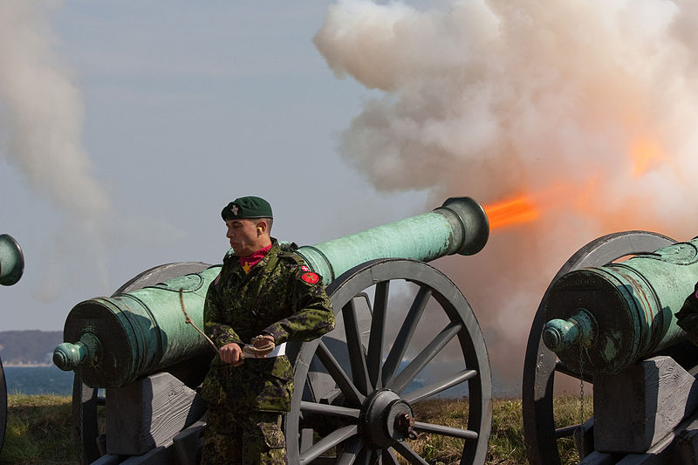
Examples of Newton’s Third Law
Identify several action-reaction force pairs in the photograph.
The cannon exerts a force on the cannon ball, and the cannon ball exerts an equal and opposite force on the cannon.
Notes:
Ask students to identify the action-reaction force pairs in the image.
Newton’s third law explains the recoil of projectile weapons such as cannons and guns. A fun tie in is a scene from Wall-E in which the robot uses the fire extinguisher as a propulsion system (the reaction force causes the robot to move). Another good third law/recoil example is a garden hose dancing around the yard.
Image source:
A cannon firing with flames and smoke: 2009 David Brandt, Wikimedia Commons http://commons.wikimedia.org/wiki/File:Cannon_Fire.jpg

Slide 5
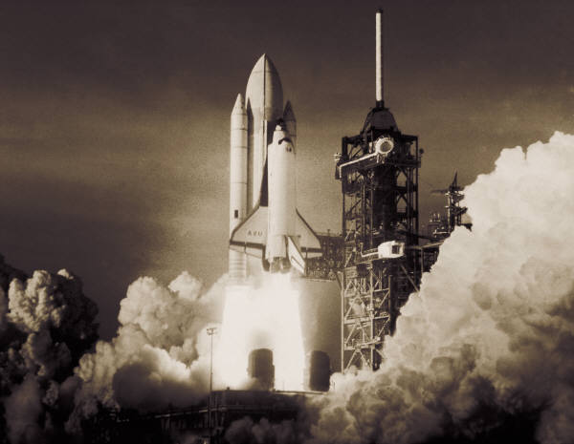
Examples of Newton’s Third Law
Identify several action-reaction force pairs in the photograph.
The space shuttle exerts a force downward, and the reaction force pushes it upward.
Notes:
Ask students to identify the action-reaction force pairs in the image.
Image source:
A space shuttle launching: Microsoft clipart http://office.microsoft.com/en-us/images/results.aspx?qu=space+shuttle&ex=1#ai:MP900289276|

Slide 6
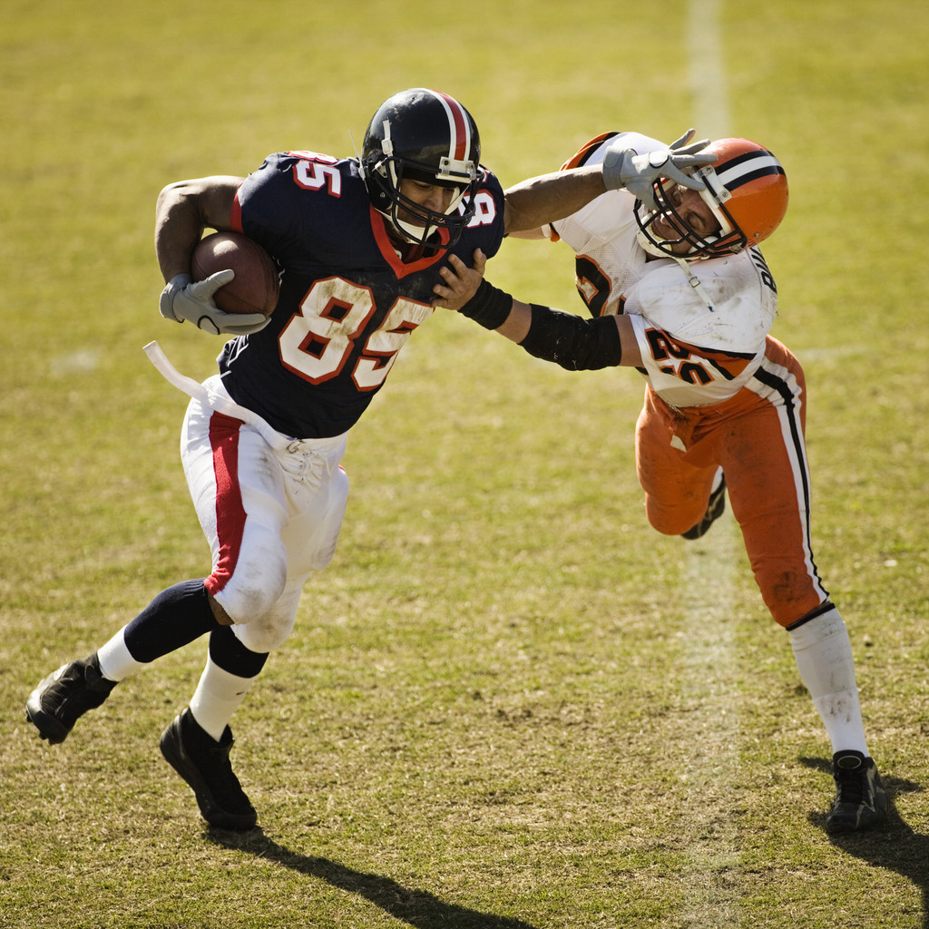
Examples of Newton’s Third Law
Identify several action-reaction force pairs in the photograph.
Notes:
Many action-reaction pairs are evident in this picture! Such as: a pair for hand-helmet, hand-shoulder, ball-hand, shoe-ground, etc.
Challenge the students to come up with as many of these action reaction force pairs as possible.
Image source:
A football player runs with a ball while another player tackles him: Microsoft clipart http://office.microsoft.com/en-us/images/results.aspx?qu=football&ex=1#ai:MP900430588|

Slide 7
Concept Review
1. ______________ is an object’s resistance to changing its motion.
2. Applying an unbalanced ___________ to an object causes it to ______________.
3. Based on Newton’s first law, if no forces are acting on an object, its ____________ will not change.
4. From Newton’s second law, an object’s acceleration depends on the object’s ________ and the strength of the ______________ _______ acting on it.
5. Newton’s third law: For every action there is ________________________________________.
Inertia
force
accelerate
velocity
mass
unbalanced
force
an equal and opposite reaction
Notes:
Review slide for concepts from all three lessons in the unit.
Next, conduct the associated activity, Sliding Textbooks.
Then administer the final quiz for the unit.

