Slide 1
TAKE A SEAT! MINIMIZING PRESSURE AND OPTIMIZING COMFORT IN SCHOOL CHAIRS
STEP – BY – STEP HOW TO BUILD THE SENSOR

Slide 2
Materials Needed:
Building Your Capacitance Sensor
3 pieces of wax paper
3 pieces of tin foil
1 clear sheet protector
2 paperclips
A marker
A ruler
Clear tape
A pair of scissors

Slide 3
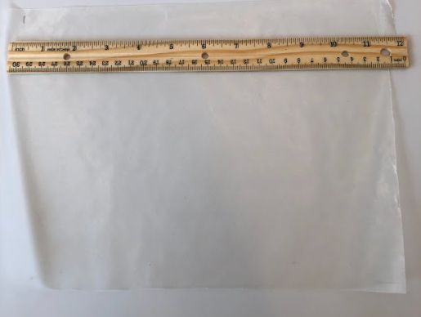
STEP 1
Building Your Capacitance Sensor
Use the ruler to measure and mark a roughly 29 cm x 21.5 cm (11.5 in x 8.5 in) rectangle on each piece of wax paper using a marker.

Slide 4
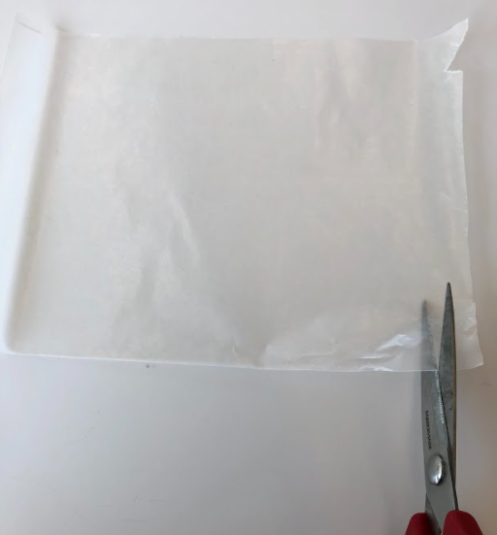
STEP 2
Building Your Capacitance Sensor
Cut out each wax paper rectangle and set them to the side.

Slide 5
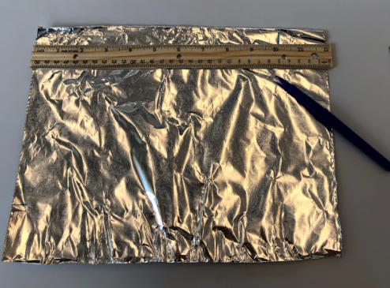
STEP 3
Building Your Capacitance Sensor
Use the ruler to measure and mark a roughly 25 cm x 18 cm (10 in x 7 in) rectangle in one piece of tin foil.

Slide 6
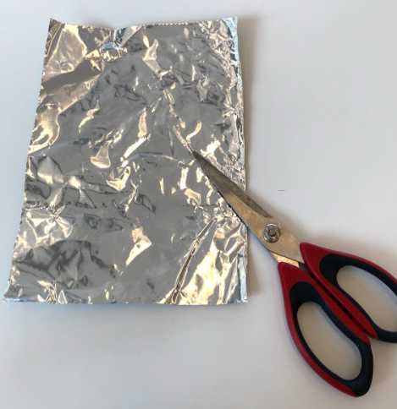
STEP 4
Building Your Capacitance Sensor
Cut out the tin foil rectangle and set to the side.

Slide 7
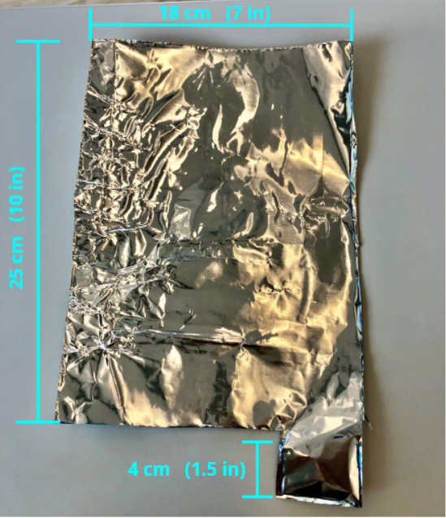
STEP 5
Building Your Capacitance Sensor
Use the ruler to measure and mark the remaining 2 pieces of tin foil in the shape of a “rectangle with a tail” that measures roughly 25 cm x 18 cm (10 in x 7 in) with the tail sticking out about 4 cm (1.5 in) from the rectangle).

Slide 8
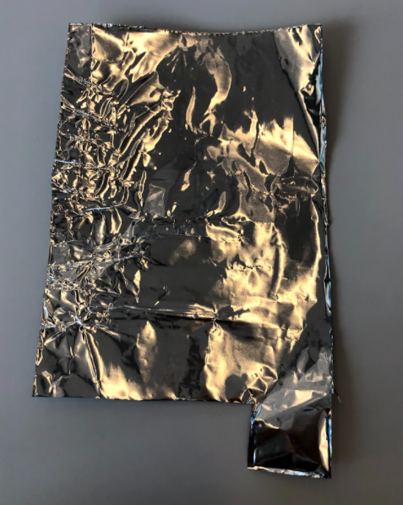
STEP 6
Building Your Capacitance Sensor
Cut out both of the pieces of tin foil and set to the side.

Slide 9
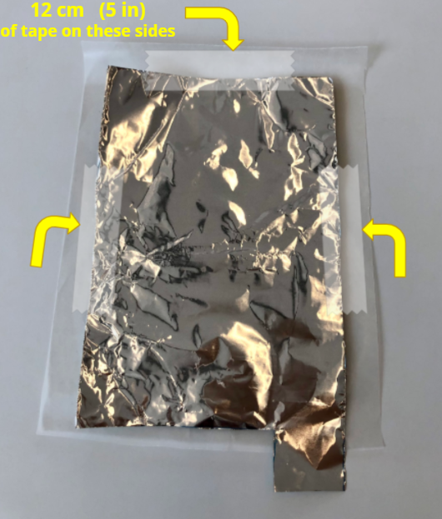
STEP 7
Building Your Capacitance Sensor
Place the first piece of tin foil with a tail in the middle of one of the pieces of wax paper. Use about 12 cm (about 5 inches) of tape to tape down the 3 sides that do NOT have the tail.

Slide 10
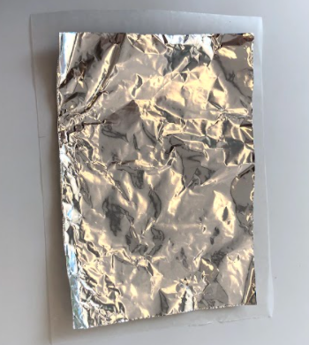
STEP 8
Building Your Capacitance Sensor
Place the rectangular piece of tin foil in the middle of one of the pieces of wax paper. Use about 12 cm (about 5 inches) of tape to tape down 3 of the sides, leaving one side untapped.

Slide 11
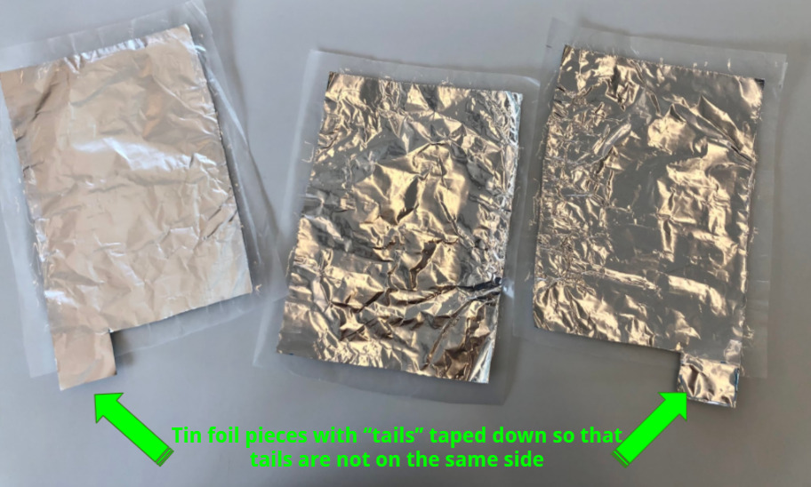
STEP 9
Building Your Capacitance Sensor
Place the second piece of tin foil with a tail in the middle of one of the other pieces of wax paper. The tail should be on the opposite side of the other piece of tin foil with the tail. Use another 12 cm (about 5 inches) of tape to tape down the 3 sides that do NOT have the tail.

Slide 12
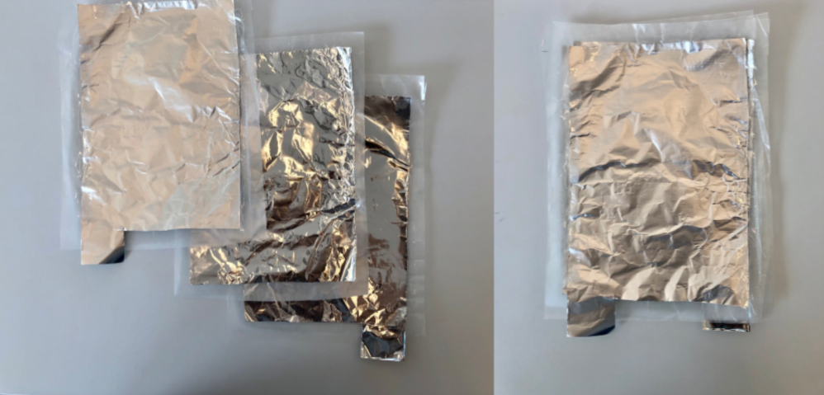
STEP 10
Building Your Capacitance Sensor
Stack each tin foil/wax paper onto each other as such: On the bottom should be one of the pieces of tin foil with the tail, in the middle should be the rectangular piece of tin foil, on the top should be the other piece of tin foil with the tail.

Slide 13
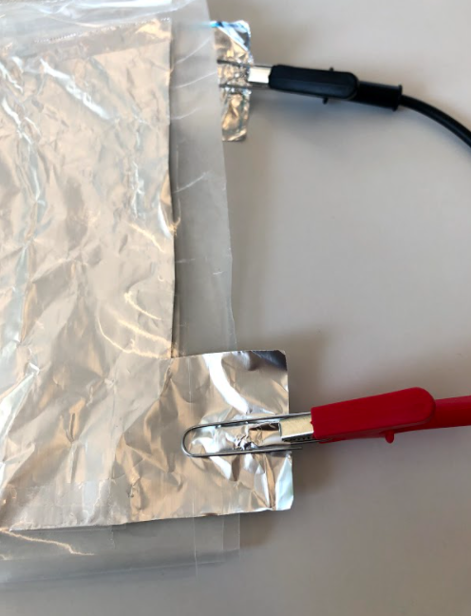
STEP 11
Building Your Capacitance Sensor
Place a paper clip on each of the tails of the tin foil only.

Slide 14
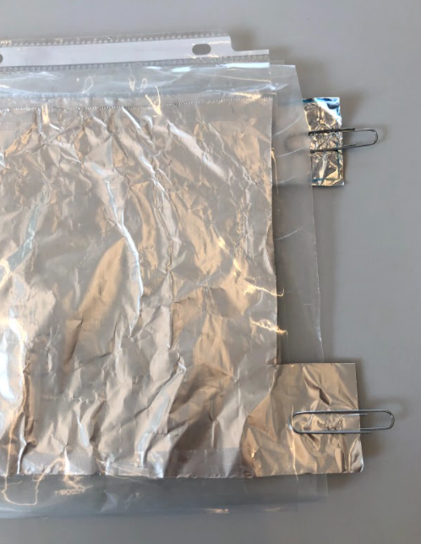
STEP 12
Building Your Capacitance Sensor
Place all of the sheets of tin foil and wax paper into the clear sheet protector, with the tin foil tails sticking out of the slot at the top.

Slide 15
Materials Needed:
Testing Your Capacitance Sensor
2 alligator clips – 1 red and 1 black
1 digital multimeter that measures capacitance in nanofarads (nF)

Slide 16
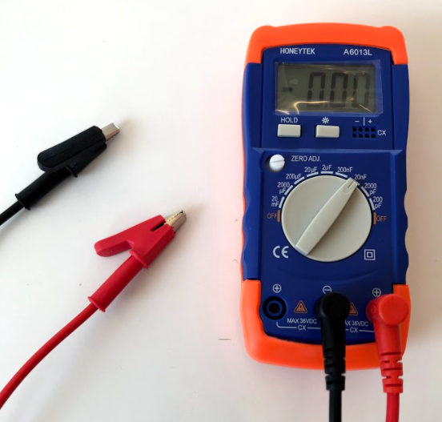
STEP 1
Testing Your Capacitance Sensor
Plug your alligator clips into your digital multimeter and turn the multimeter on to read capacitance in nanofarads (nF).
If using the capacitance meter, turn the dial to read 20 nF (more accuracy) or 200 nF (less accuracy).

Slide 17
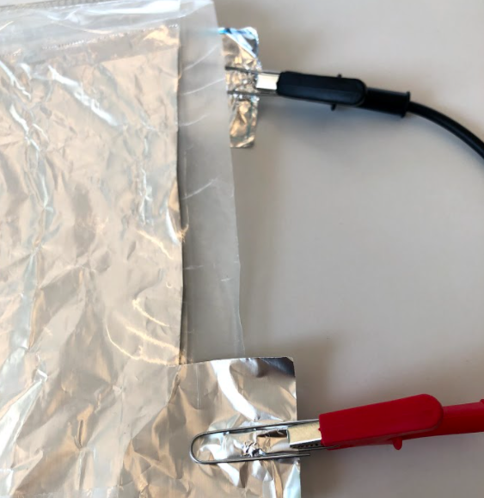
STEP 2
Testing Your Capacitance Sensor
Attach one alligator clip to one paper clip and the other alligator clip to the other paper clip.
You will likely see a reading in the 0.3 – 0.8 nF range. This value includes the capacitance in the wires and the meter.

Slide 18
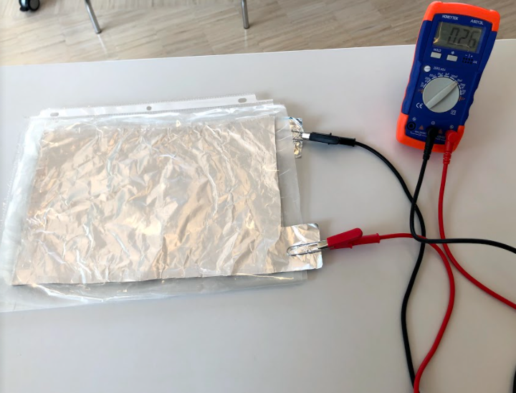
STEP 3
Testing Your Capacitance Sensor
Record the capacitance value you see without anything on the sensor.

Slide 19
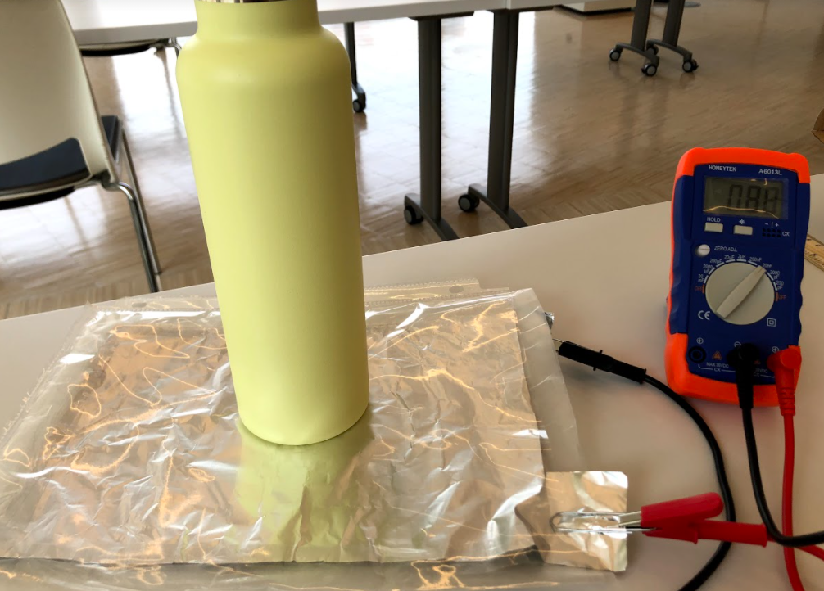
STEP 4
Testing Your Capacitance Sensor
Place an object onto the sensor you should see the reading increase. Record the capacitance you see.

Slide 20
STEP 5
Testing Your Capacitance Sensor
Capacitance of Water Bottle
Initial Capacitance of Sensor | 0.26 nF
Final Capacitance with Bottle on Sensor | 0.88 nF
Capacitance “Pressure” of Water Bottle | 0.88 nF – 0.26 nF = 0.62 nF
To find the capacitance of that object, subtract the final reading – initial reading.

Slide 21
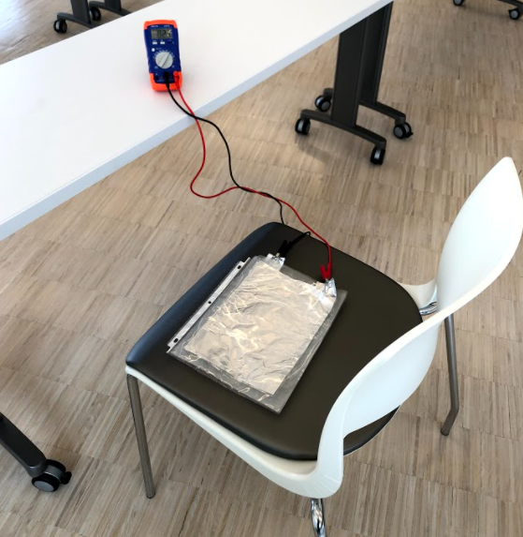
STEP 6
Testing Your Capacitance Sensor
To use your capacitance sensor to measure the pressure of sitting, set it up in the middle of a chair. Make sure the alligator clips and multimeter are away from the sitting individual.

