Slide 1
What is an ECG?

Slide 2
Background: The Heart
The heart is responsible for pumping blood throughout the body
The heart contains two atria and two ventricles
Right atrium: receives deoxygenated (used) blood from the body
Right ventricle: pumps deoxygenated blood to the lungs, where the blood is oxygenated
Left atrium: receives oxygenated (“new”) blood from the lungs
Left ventricle: pumps oxygenated blood into the body

Slide 3
Background: The Heart
https://upload.wikimedia.org/wikipedia/commons/thumb/e/e0/Heart_diagram-en.svg/1524px-Heart_diagram-en.svg.png

Slide 4
Background: The Heart
Did you know the heart runs on electricity?
The electrical signals that flow through the heart regulate two important rhythms:
Heart rate: how fast is the heart beating?
Cardiac muscle coordination: which heart muscles are moving, and when do they move?
We can measure the electrical activity in the heart to ensure that there are no abnormalities or diseases of the heart

Slide 5
The Electrocardiogram (ECG)
An ECG (electrocardiogram) is a test used to measure the electrical activity of the heart
ECGs can measure
Time intervals
This allows medical professionals to see how long it takes for the electrical wave to pass through the heart
And the amount of electrical activity in the heart
This allows cardiologists to see if certain parts of the heart are being overworked

Slide 6
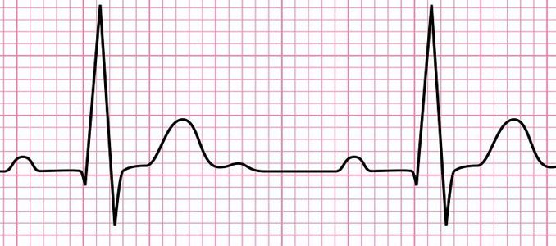
Parts of an ECG
An ECG can be broken up into three main parts:
The P wave
The QRS Complex
The T Wave

Slide 7
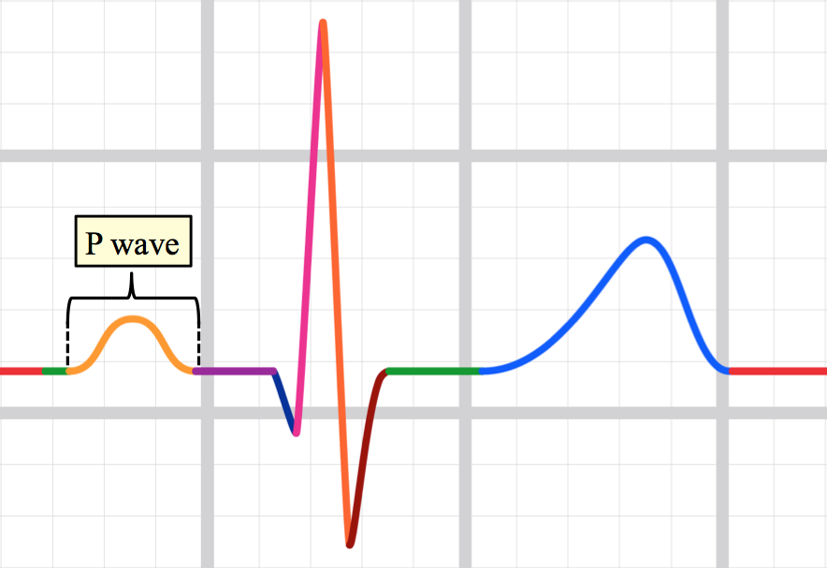
Parts of an ECG: P Waves
P waves are the first waves in an ECG waveform
These waves represent the depolarization of both the right and left atria

Slide 8
Parts of an ECG: QRS Complex
The QRS complex is the series of waves that represent the depolarization of the right and left ventricles of the heart
This depolarization also corresponds to the contraction of the ventricular muscles
The Q wave is the first downward deflection following a P wave
The R wave is an upward deflection following the Q wave
The S wave is a downward deflection following the R wave

Slide 9
Example: QRS Complex

Slide 10
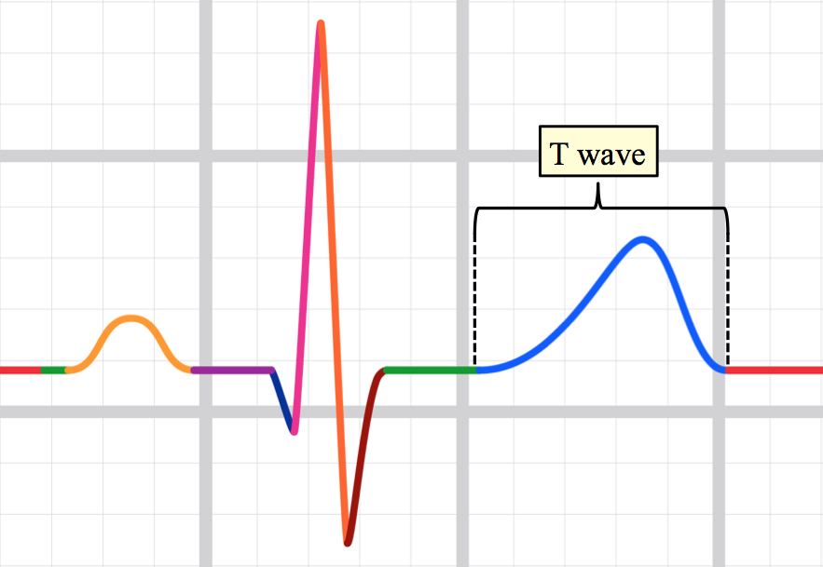
Parts of an ECG: T Waves
T waves follow the QRS complex and represent the repolarization of the ventricles

Slide 11
Example: ECG Waveforms

