Slide 1
Brain Processing and Senses

Slide 2
Part 1

Slide 3
Introduction
Do all animals have the same senses?
Do humans use their senses for the same reasons animals do?
Do you think all animals’ bodies process sensory information the same way?
How do animals and humans detect, process, and use information about the environment?
Do you know the system that animals use to process sensory information in their brains?
What are some of the ways animals' senses are the same as or different from humans?
You use your senses every day and you might not even be aware of it.

Slide 4
Introduction (CONT)
Has anyone here ever caught a ball?
Think about the steps involved in catching a ball.
What is the first step?
What’s the next step?
Next step? You react.
The last step? Your body performs the task your brain told it to do, and you caught the ball.
What is "reaction time," and how does it help an animal survive?
What is an instinct?

Slide 5
Reaction time experiment
Make sure everyone has a partner.
Watch this video to show you an example.
Supplies each partnership needs:
ruler
pencil
Brain Processing and Senses Worksheet
calculator (optional)
Make a prediction on what you think your fastest time will be, as well as your slowest time, and record them on your worksheet.

Slide 6
10 Trials
Each person will need to complete 10 ruler drop trials and record them on the worksheet in centimeters. If you fail to catch the ruler, redo the drop until you catch it.
After completing all 10 trials, use the reaction time chart to find the distance for each trial and then write down the reaction time that correlates in seconds next to it.
Look at your reaction times over your 10 trials and analyze the changes, if any, across them.

Slide 7
Analyzing data terms
Mean (“Average”): Add up all the numbers and then divide by how many numbers there are.
Median (“Middle Number”): Order numbers from lowest to highest. Identify the middle number, or the average of the two middle numbers.
Range (“Highest Minus Lowest”): Subtract the lowest value from the highest value.
Mode (“Most Often”): Identify the number that occurs the most often. (There might be more than one.)
Outlier (“Out There”): A value in a set that is very far away from the other values. (There might not be one.)

Slide 8
Mean
Mean: Write each reaction time on a line below.

Slide 9
Median
Median: Write the reaction times from lowest to highest. If the number in the ( ) is the same, then that is your median, if the numbers are different, add them up and divide by 2.

Slide 10
Range
Range: Write the highest reaction time first and the lowest reaction time second. Then subtract them to find the range.

Slide 11
MODE
Mode: Write the number(s) that come up the most times. If each number only comes up once, you won’t have a mode.

Slide 12
Outlier
Outlier: Write the number that is very far away from the other values. You might not have one.

Slide 13
Class Data
Everyone is going to give their mean one at a time, and then the class is going to create a line plot with the data.
Your mean should be between 0.05 and 0.25 seconds. If it isn’t, then you need to recalculate it.

Slide 14
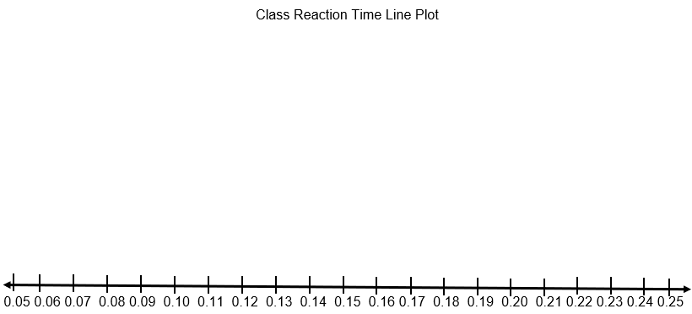
Line Plot

Slide 15
Class Mean
Class Mean: Add up all the students’ means and divide by how many students there are to find the class mean.

Slide 16
Class Median
Class Median: Use the Class Reaction Time Line Plot to help you find the mean. Start by putting a dot next to the lowest number X and then one next to the highest number X. Continue this until you have one number left, or two different numbers. If you have one number left, that is your class median. If you have two numbers left, add them up and divide by 2 to find the class median.

Slide 17
Class Range
Class Range: Write the highest reaction time first and the lowest reaction time second. Then subtract them to find the range.

Slide 18
Class MODE
Class Mode: Write the number(s) that come up the most times. If each number only comes up once, you won’t have a mode.

Slide 19
Class Outlier
Class Outlier: Write the number that is very far away from the other values. You might not have one.

Slide 20
After experiment
Were your predictions true for your fastest and slowest times? Explain.
Are there differences between any of your trial times?
Why do we perform the experiment more than once?
If your time decreased—meaning it took you less time to catch the ruler—what does that mean?
Why was the ruler caught in the middle (after a lag period) rather than at the end (instantaneously)?
What causes this delay?
What had to happen in your body for you to catch the ruler?
How can your reaction time be improved?

Slide 21
Part 2

Slide 22
videos
Watch one or more of these videos:
BrainPop Nervous System- https://www.brainpop.com/health/bodysystems/nervoussystem/movie
Generation Genius Brain Processing of Senses https://www.generationgenius.com/videolessons/senses-video-for-kids
A Journey Through Your Nervous System https://www.youtube.com/watch?v=VAEmxt78bBI

Slide 23
Group Discussion
Get in groups of four.
Discuss what was taking place in your bodies as you tried to catch the ruler.
Create an explanation on your worksheet with your group. You may use words, drawings, or a combination of both.
Each group will share their thoughts with the whole class to create a class explanation about how their bodies and brains worked together to catch the ruler.

Slide 24
Group Brainstorm
Get in a new group of four.
Brainstorm some common actions you do in your lives that are triggered by information coming in from your senses.
Name at least 10 different actions and identify the sense or senses that received the information.
Beside each action and its senses, list how that action helps with survival in the classroom, at home, on the playground, and other places you spend time.
Write this down on the worksheet.

Slide 25
3D Model
With a new group of 4, you are going to create a 3D model showing how the sensory network is involved in receiving, transmitting, and responding to input from senses.
Sketch a diagraph of the 3D model you plan to build.
You will need to label the model with the following words: information, receptors, perception/memory, and action.
Possible items you can use to build: electronics exploration kit, magnetic building sticks, Legos, wood building planks, building blocks, interlocking disks, building set, Play-Doh.
Your diagram will need to be approved before you can start building.

Slide 26
Part 3

Slide 27
Videos
Watch one or more of the videos about brain protection:
BrainPop https://www.brainpop.com/health/diseasesinjuriesandconditions/concussions/movie
Mystery Science Mini Lesson https://mysteryscience.com/mini-lessons/football-helmets
Protect your Brain https://www.youtube.com/watch?v=nYR2j9oQGPs

Slide 28
Protecting the brain
Why?
Your brain is in charge of your body and controls everything that you do.
When?
We should protect our brain whenever riding a bicycle, in-line skating, skateboarding, or playing contact sports.
Where?
Outside or in sports situations.
Who?
Everyone!
How?
By wearing a helmet!

Slide 30
ask
What is the problem?
The brain needs protecting from head injuries (wrecks, hits, falls, etc.)
What do we want to design?
A helmet to protect the brain (egg)
Who is it for?
Students (egg)
What do we want to accomplish?
Protect the brain from injury

Slide 31
ask
What are the project requirements and limitations?
Limitations
Two to three class periods
Supplies given
Requirements
The egg (brain) must not crack when dropped from different heights up to 5 feet.
What is our goal?
Create a “helmet” to protect the egg (brain) from cracking using the supplies given and within three class periods.

Slide 32
research
These resource are available for research if needed:
https://www.youtube.com/watch?v=4nvhVv5uNI0
https://www.healthychildren.org/English/safety-prevention/at-play/Pages/bicycle-helmets-what-every-parent-should-know.aspx
https://helmets.org/howmade.htm
https://www.cdc.gov/heads-up/media/pdfs/helmets/headsup_helmetfactsheet_bike_508.pdf?CDC_AAref_Val=https://www.cdc.gov/headsup/pdfs/helmets/headsup_helmetfactsheet_bike_508.pdf

Slide 33
imagine
Get in a group of 4.
Bring your research together and write down as many ideas and solutions that your group might want to explore.

Slide 34
plan
Must have majority of the group members agree on which solution you would like to move forward with.
Make sure everyone in the groups gets suggest an option.

Slide 35
create
You may use any of these items to make your prototype: cardboard, egg cartons, pipe cleaners, rubber bands, straws, yarn, string, tape, newspaper, bubble wrap, cotton balls, sponges, pom poms, feathers, popsicle sticks, clay.
If there are other things that you would like to make your prototype out of that aren’t listed above, ask to see if it is possible.

Slide 36
test
Try dropping your egg from different heights ranging from 1 foot to 5 feet.
Write down your results and discuss with your team and analyze what works and what you need to improve.

Slide 37
improve
As a group, discuss how you want to improve your prototype. Make revisions and continue to test until you have a final product.

