Slide 1
What Is Electromyography (EMG)?

Slide 2
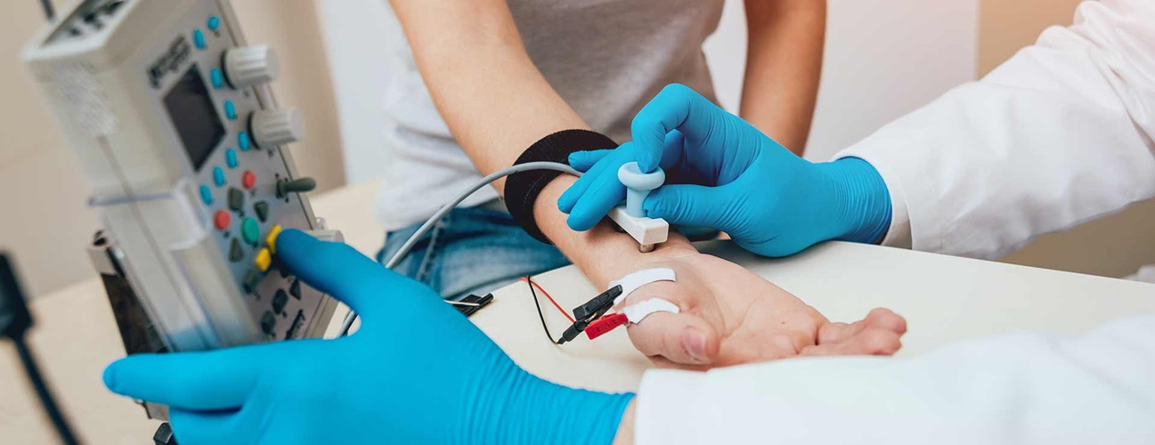
What is an EMG?
EMG stands for electromyography, which is an electrodiagnostic technique for evaluating and recording the electrical activity produced by skeletal muscles.
We use them to assess the health of muscles and the nerve cells that help control them.
In an EMG procedure, small needles called electrodes are inserted into a patient’s muscles in order to measure the electrical activity.
https://www.hopkinsmedicine.org/health/treatment-tests-and-therapies/electromyography-emg

Slide 3
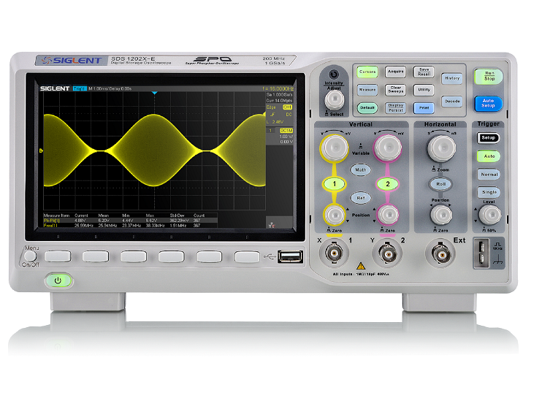
What does an EMG measure?
Your muscles move when (electrical) nerve signals from your brain tell them to work. An EMG is used to measure how well your muscles respond to these signals.
The electrodes in an EMG device are used to measure the electrical activity caused at different levels of muscle contraction: rest, slight contraction, and forceful contraction.
This activity is then displayed on a monitor called an oscilloscope in the form of waves.
https://www.amazon.com/Siglent-Technologies-SDS1202X-Oscilloscope-Channels/dp/B07PVZMV16

Slide 4
EMG Waves
The size and shape of a wave, which represents an action potential, gives information about how the muscle responds to nerve stimulation.
A healthy muscle will show no electrical activity during rest, meaning it will not show any signs of an action potential. It will only show electric activity when the muscle moves or contracts.
When you contract your muscle more forcefully, more and more muscle fibers are activated, making more action potentials.

Slide 5
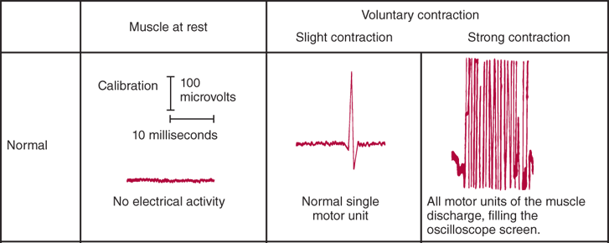
EMG Waves
Here, you can see how the activity of a normal muscle is represented.
Each blip, or wave, represents the firing of an action potential by a motor neuron.
https://neurology.mhmedical.com/data/books/1844/demyer8_ch7_f021.png

Slide 6
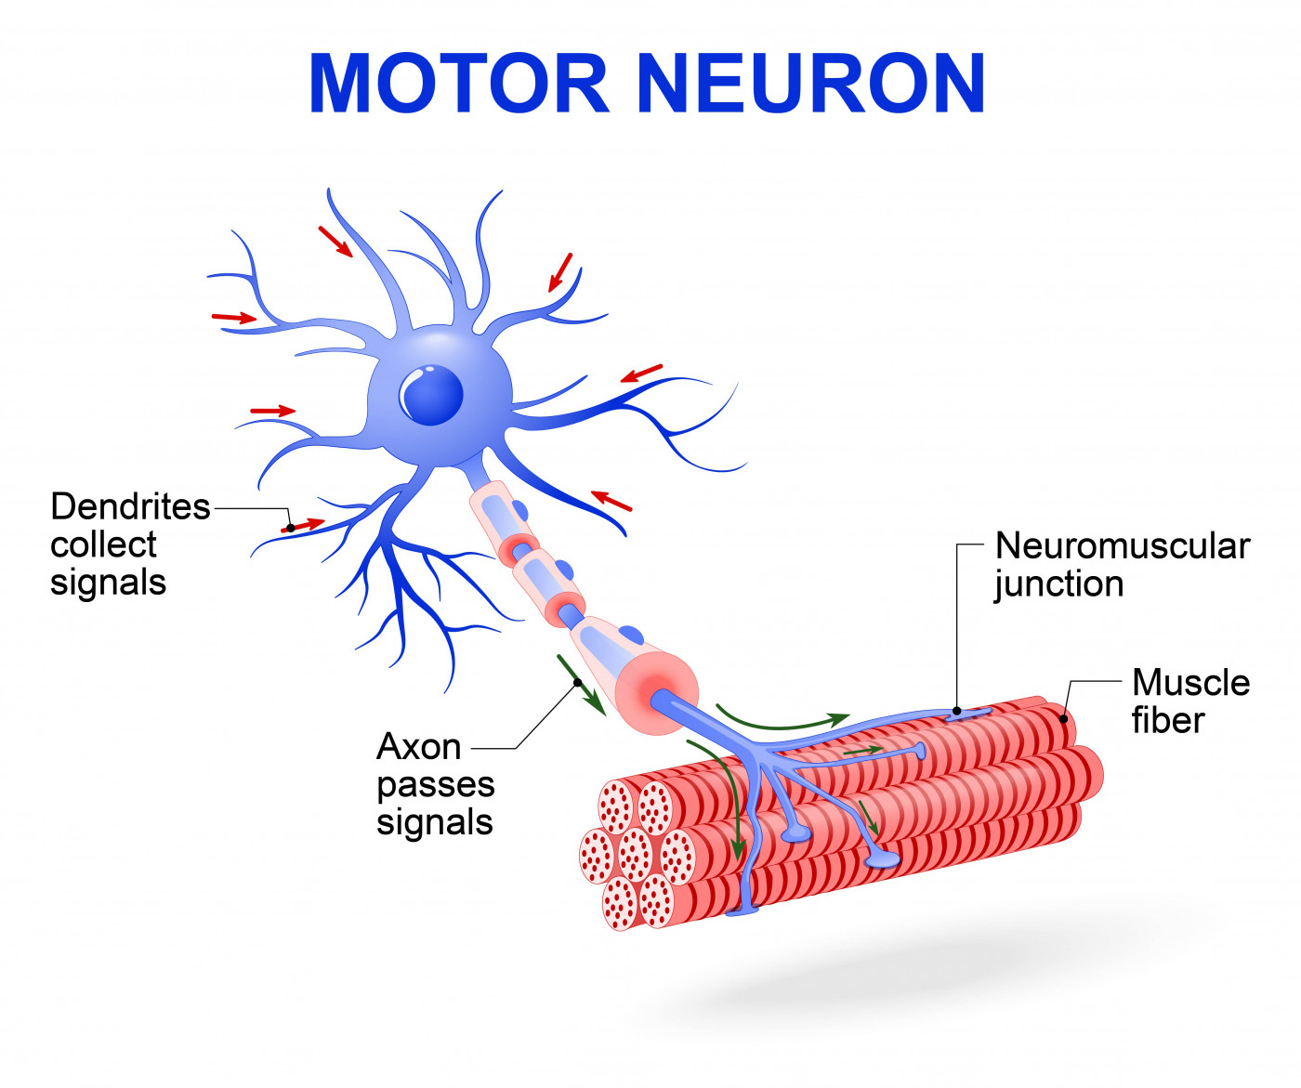
What is a motor neuron?
A motor neuron is a neuron that carries information from the central nervous system to the muscles throughout our bodies.
They are specialized cells that enable us to move by relaying information from our brains to our muscles in the form of electric signals called action potentials, such as when to contract and move.
https://smanewstoday.com/2017/09/12/sam-research-may-get-boost-from-study-using-skin-cells-to-create-human-motor-neurons

Slide 7
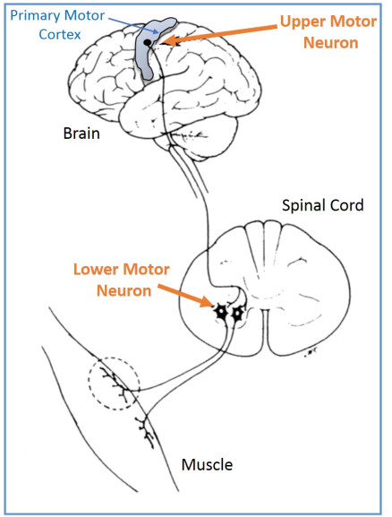
Motor Neurons
There are two primary types of motor neurons:
Upper motor neurons, originating in a region of our brains called the motor cortex, send electrical signals (action potentials) to lower motor neurons.
Lower motor neurons are attached to our muscles and act as direct messengers to tell them to start contracting.
https://impremedia.net/diagram-of-motor-neurone

Slide 8
EMG and Motor Neurons
These electrical signals, generated in motor neurons in the brain and sent out to our muscles, are what EMG devices measure and record in order to monitor the activity of muscles.
With the help of EMG, scientists are beginning to discover new information about how movement is wired in our brain and bodies, and how it can help detect neuromuscular disorders.

