Slide 1
THE BRAIN AND THE NERVOUS SYSTEM ARE A COMPUTER

Slide 2
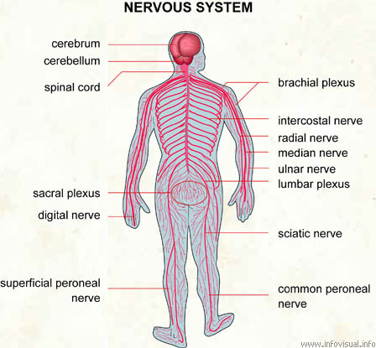
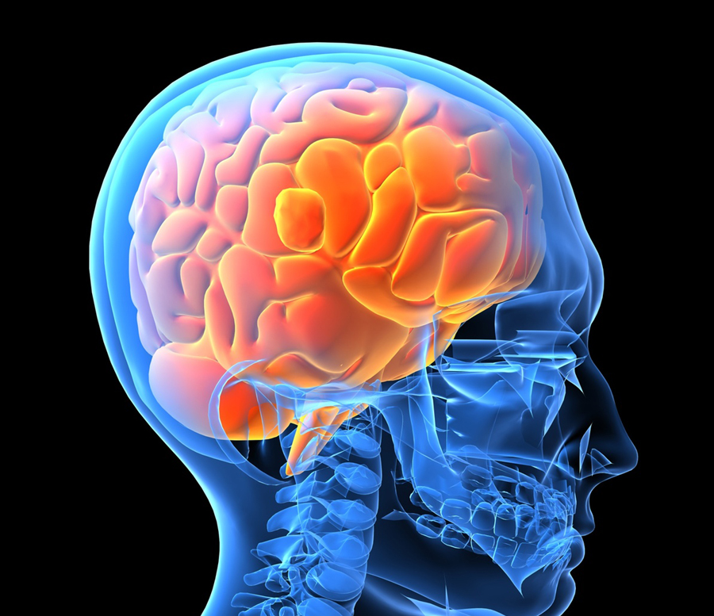
LEARNING OBJECTIVES
A review of how a human compares to a robot, to set the context for the lesson.
Comparisons of the human brain with the robot computer.

Slide 3
DAY 1 PRE-ASSESSMENT SHEET
THE BRAIN IS A COMPUTER?
Describe how your brain helps you command your arm to pick up a glass of juice.
Your brain is the controller for your body. List four functions it performs.
Are there differences between a robot and a machine? Explain with at least two examples of each.

Slide 4
DAY 1 PRE-ASSESSMENT SHEET ANSWERS
THE BRAIN IS A COMPUTER?
Describe how your brain helps you command your arm to pick up a glass of juice.
Once your brain decides to pick up the glass, neurons in your motor cortex command the muscles in your hand to move appropriately and pick up the glass. In the process, your brain uses feedback from your eyes (such as whether it is going toward the glass, picking it up, etc.) and makes sure it is done as intended!
Your brain is the controller for your body. List four functions it performs.
Example answers: Breathing, pumping blood by controlling heart, walking, drawing, thinking, planning, memory, speaking, sensing, etc.

Slide 5
DAY 1 PRE-ASSESSMENT SHEET ANSWERS
THE BRAIN IS A COMPUTER?
Are there differences between a robot and a machine? Explain with at least two examples of each.
Robots are programmable devices (machines) that can take inputs about their environment (sensors) and use this information to decide (think, algorithm) on task and instructions, and exert forces (actuators, transducers, motors) that impact their surroundings in a physical way either in a simple or complex manner. Examples: unitree robot, autonomous vacuum cleaner.
Machines are devices (maybe programmable) that follow a specific set of instructions (specific, limited). Examples: washing machine, drying machine, blender, vending machine, etc.

Slide 6
DAY 1 PRE-ASSESSMENT SHEET ANSWERS
THE BRAIN IS A COMPUTER?
Differences and Similarities
Differences | Similarities
Autonomy: Robots generally have a higher degree of autonomy and can make decisions based on their programming and sensors. Machines typically follow a fixed set of instructions without adapting to their environment. | Both robots and machines are human-made devices designed to perform specific tasks or functions.
Complexity: Robots are usually more complex, often incorporating artificial intelligence, sensors, and advanced control systems. Machines can be simpler in design and function. | They both typically rely on some form of energy input (e.g., electricity, fuel) to operate.
Versatility: Robots are often designed to be more versatile and adaptable to different tasks or environments. Machines are typically specialized for specific functions. | Both can be programmed or configured to perform repetitive tasks with precision.
Interaction: Robots can often interact with their environment and, in some cases, with humans. Machines usually have limited interaction capabilities.
Notes:
https://www.quantamagazine.org/are-robots-about-to-level-up-20240814/

Slide 7
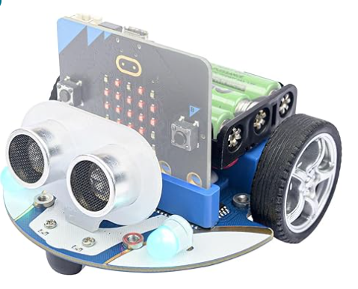
Micro:bit chip (brain/nervous system)
Color sensor (eyes)
Ultrasonic sensors (eyes/ears)
Tires (arms/legs)
Battery (food-energy source)
Notes:
Ask students if they know how any of the sensors might be used for different applications in the smartphone. Discuss a few of the applications.

Slide 8
OPTIONAL SLIDE TO SHOW MORE DETAILS
TOP VIEW
BOTTOM VIEW
Notes:
Ask students if they know how any of the sensors might be used for different applications in the smartphone. Discuss a few of the applications.

Slide 9
REVIEW: ELECFREAKS MINI CUTEBOT
Robots have three components:
Sensors are devices that allow robots to perceive the world.
Actuators are devices that produce motion or action.
Programs are sets of instructions for carrying out tasks.
Micro:bit chip (brain/nervous system)
Color sensor (eyes)
Ultrasonic sensors (eyes/ears)
Tires (arms/legs)
Battery (food-energy source)
Notes:
Ask students if they know how any of the sensors might be used for different applications in the smartphone. Discuss a few of the applications.

Slide 10
Cutebot kit
vs.
a Human
Micro:bit chip (brain/nervous system)
Color sensor (eyes)
Ultrasonic sensors (eyes/ears)
Tires (arms/legs)
Battery (food-energy source)
🡪DECISIONS/THINKING – computer (+ wires) vs. brain (nervous system)
🡪SENSING – robot sensors vs. human senses
🡪MOVEMENT – muscles vs. DC motors (hands/legs vs. wheels)
Notes:
Discuss a few of the applications.

Slide 11
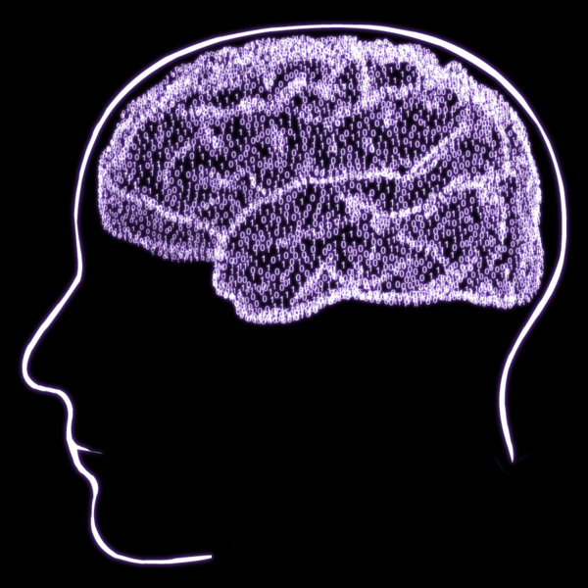
REVIEW: BRAIN AND COMPUTERS
Can you list some things that your brain does for you?
think, plan
memory
speech
move
balance, posture
feel emotions
breathing, heart rate, blood pressure
see, hear, feel, taste, smell

Slide 12
REVIEW: BRAIN AND COMPUTERS
Makes different types of decisions for you. For instance, it tells you when you are hungry.
Controls all your bodily functions, even without your knowing it! For instance, actions such as breathing, blinking, beating the heart, and many others (that you will learn later in biology), are all controlled subconsciously by the brain all the time.
Learns new things, such as riding a bicycle, swimming, languages, playing instruments, games or sports, and lots and lots of such skills.
Sensors provide continuous input to the brain through your eyes, ears, nose, skin, and mouth. It must “understand” what the sensors tell it and make decisions. For example, to run when you see a snake!
It does all this using about 100 billion neurons (humans) that talk to each other – right now we don’t really know how!

Slide 13
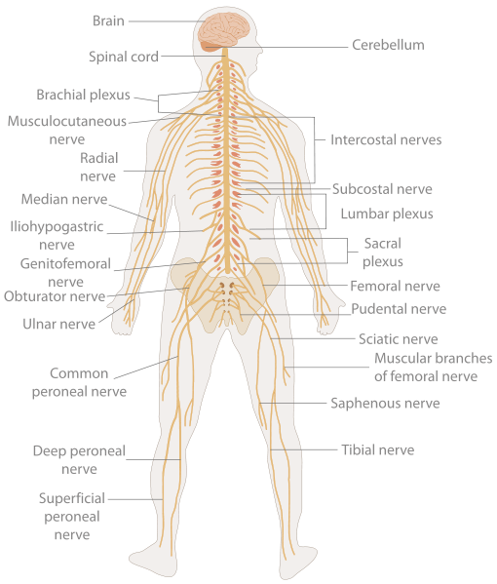
REVIEW: Human Nervous System
The nervous system is the set of wires (called nerves) that allow the sensors to talk to the brain, and the brain to talk to the muscles (think of it as a dual carriage highway).
Through one set of nerves, the sensors tells the brain what they sense.
Through another set of nerves, the brain tells the muscles to contract, causing the body to move.

Slide 14
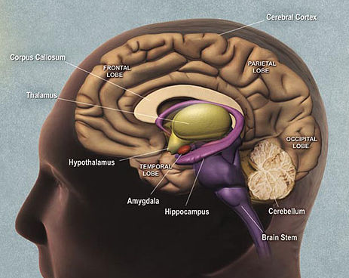
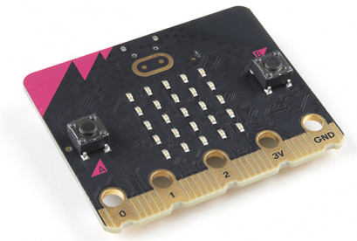
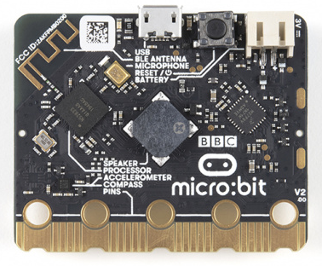
HOW DOES THE BRAIN WORK? (HUMAN COMPUTER)
The brain is the decision center of the body.
How does the brain and nervous system move our hands?
When a hot object is touched, the touch sensors are activated.
Nerves transmit information from the touch sensors to the brain.
The brain decides to move the arm back to protect the finger.
The brain sends signals along nerves to muscles to move the arm.
The muscles then move the arm.
(We will look at details later.)
Notes:
Discuss a few of the applications.

Slide 15
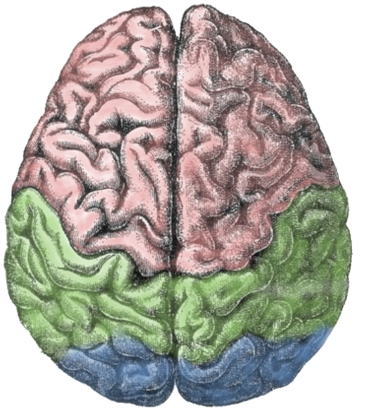
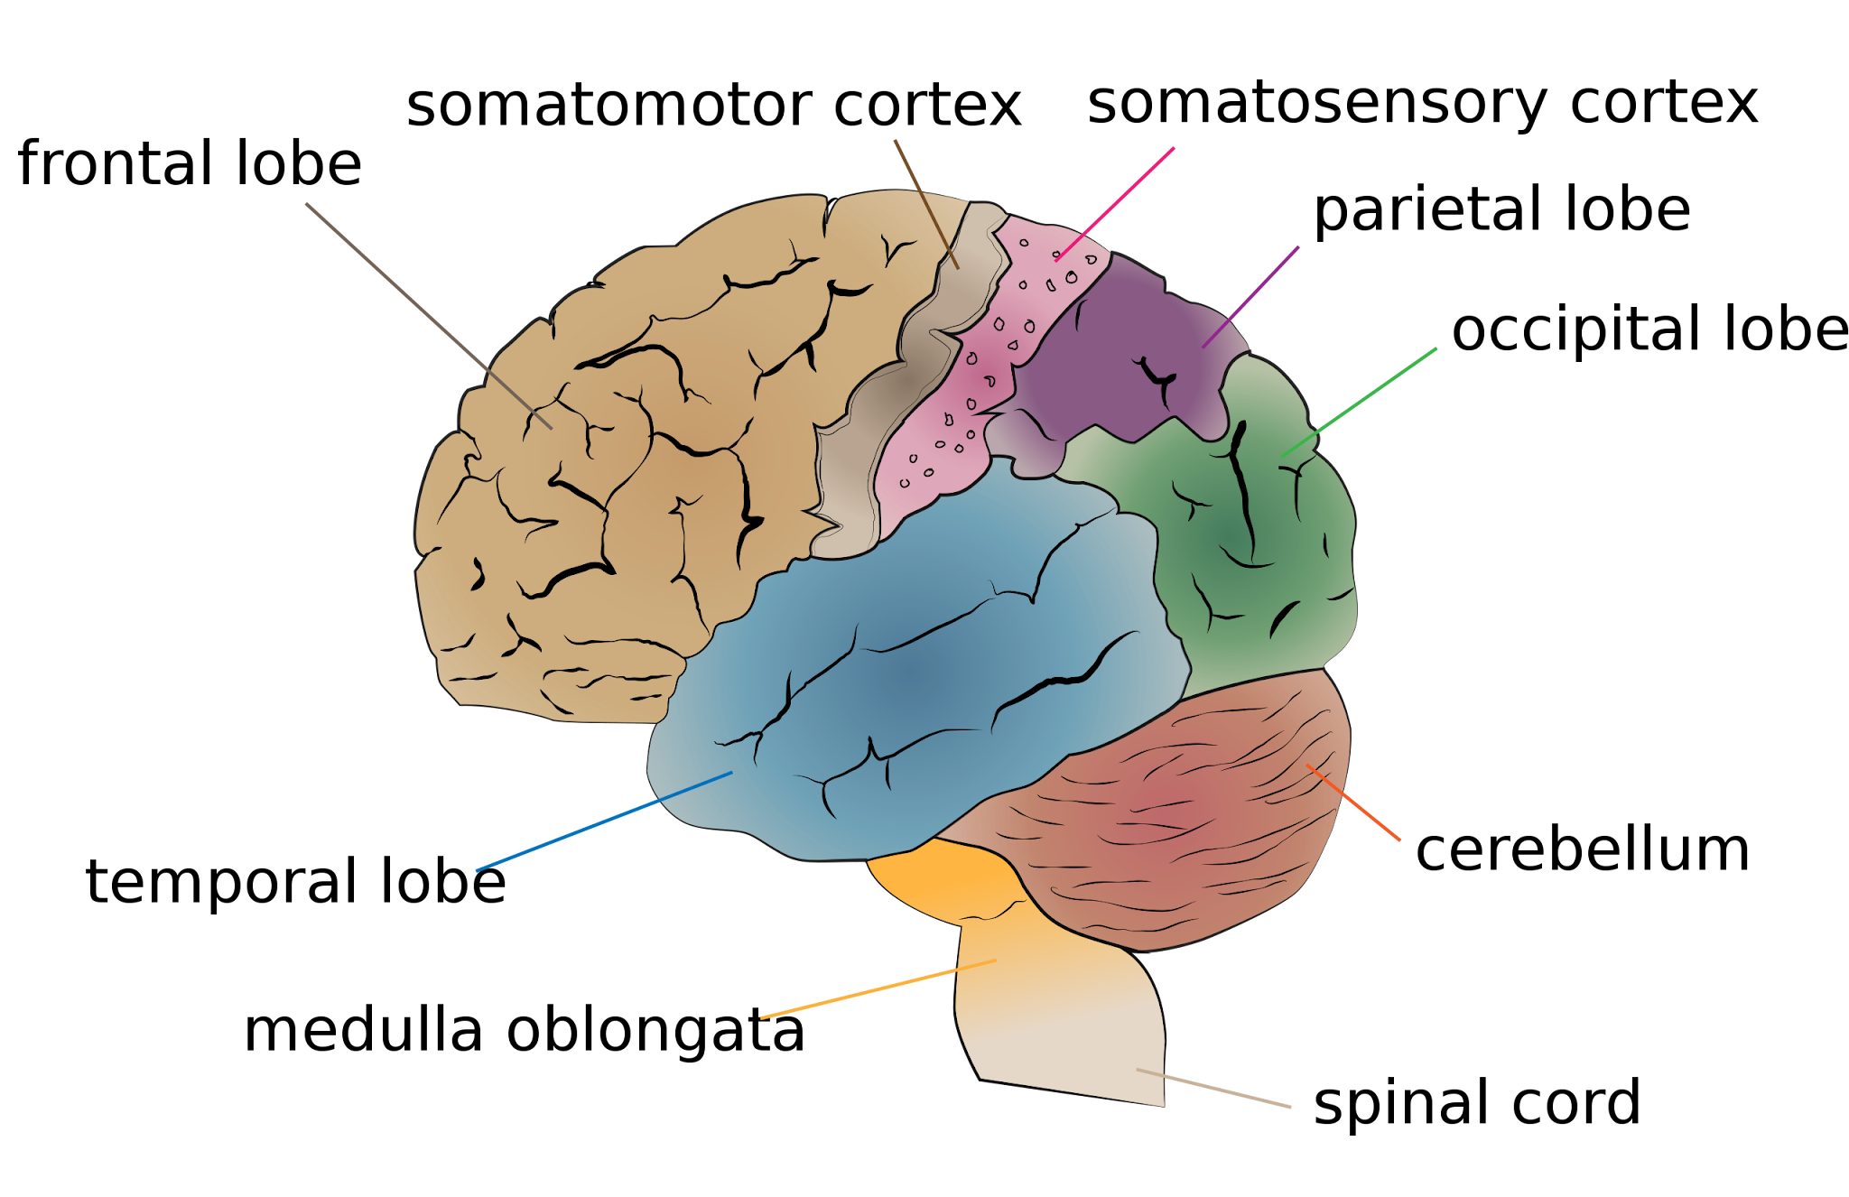
HOW DOES THE BRAIN WORK? (HUMAN COMPUTER)
The brain is the decision center of the body.
The human brain looks like a cauliflower and is about the same size.
It is divided into right and left hemispheres.
Human brains are divided into four lobes.
Left and Right Hemispheres of the Brain
The brain is not colored like this (usually it appears gray); color is added in the drawings just to distinguish the lobes.

Slide 16
Scale Models of Brains (and Sizes)
wild pig (left) bottlenose dolphin (middle) human (right)
~0.15kg 1.6 kg 1.4kg
Fun Fact: Dolphins have a relatively large brain compared to their body size, which is considered a sign of high intelligence.

Slide 17
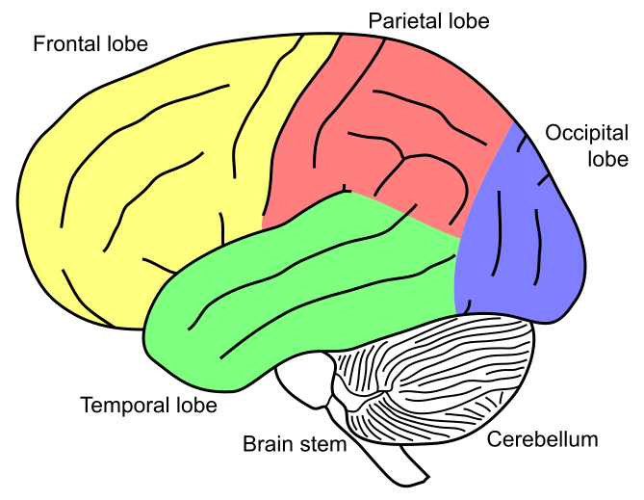
Four Lobes of the Brain
Check out details about the different lobes with a moving cursor at this website:
http://thebrain.mcgill.ca/flash/d/d_01/d_01_cr/d_01_cr_ana/d_01_cr_ana.html#1

Slide 18
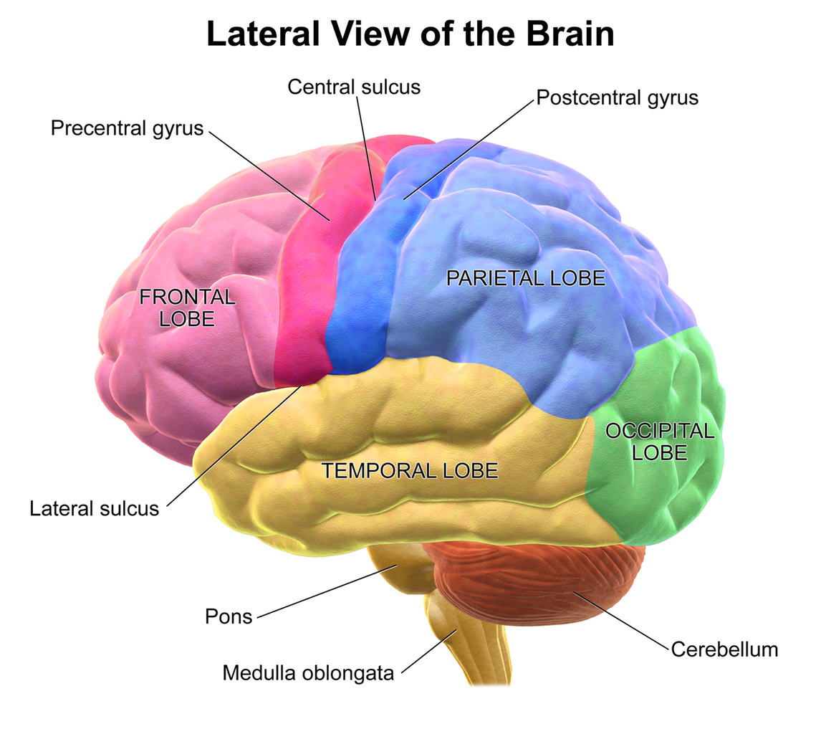
HUMAN BRAIN REVIEW
Frontal Lobe:
- Executive functions (planning, decision-making, problem-solving)
- Voluntary movement control
- Emotional regulation
- Personality
- Language production (Broca's area)
- Working memory
Parietal Lobe:
- Sensory information processing (touch,
temperature, pressure)
- Spatial awareness and navigation
- Mathematical calculations
- Language comprehension
- Body awareness
Temporal Lobe:
- Auditory processing
- Memory formation and storage
- Language comprehension (Wernicke's area)
- Emotion processing
- Visual recognition of faces and objects
Notes:
1. Frontal Lobe:
- Executive functions (planning, decision-making, problem-solving)
- Voluntary movement control
- Emotional regulation
- Personality
- Language production (Broca's area)
- Working memory
2. Parietal Lobe:
- Sensory information processing (touch, temperature, pressure)
- Spatial awareness and navigation
- Mathematical calculations
- Language comprehension
- Body awareness
3. Temporal Lobe:
- Auditory processing
- Memory formation and storage
- Language comprehension (Wernicke's area)
- Emotion processing
- Visual recognition of faces and objects
4. Occipital Lobe:
- Visual processing
- Color recognition
- Reading and visual comprehension
- Depth perception
5. Cerebellum:
- Motor coordination and balance
- Fine-tuning of movement
- Motor learning and memory
- Some cognitive functions (attention, language)
6. Brain Stem:
- Vital life functions (breathing, heart rate, blood pressure)
- Sleep-wake cycles
- Arousal and consciousness
- Relaying information between the brain and spinal cord
Each of these areas works in conjunction with others to perform complex tasks. The brain's ability to process information and control various functions relies on the intricate connections between these regions.
Would you like me to elaborate on any specific part or function?

Slide 19
HUMAN BRAIN REVIEW
Occipital Lobe:
- Visual processing
- Color recognition
- Reading and visual comprehension
- Depth perception
Cerebellum:
- Motor coordination and balance
- Fine-tuning of movement
- Motor learning and memory
- Some cognitive functions (attention, language)
Brain Stem:
- Vital life functions (breathing, heart rate, blood
pressure)
- Sleep-wake cycles
- Arousal and consciousness
- Relaying information between the brain and
spinal cord
Notes:
1. Frontal Lobe:
- Executive functions (planning, decision-making, problem-solving)
- Voluntary movement control
- Emotional regulation
- Personality
- Language production (Broca's area)
- Working memory
2. Parietal Lobe:
- Sensory information processing (touch, temperature, pressure)
- Spatial awareness and navigation
- Mathematical calculations
- Language comprehension
- Body awareness
3. Temporal Lobe:
- Auditory processing
- Memory formation and storage
- Language comprehension (Wernicke's area)
- Emotion processing
- Visual recognition of faces and objects
4. Occipital Lobe:
- Visual processing
- Color recognition
- Reading and visual comprehension
- Depth perception
5. Cerebellum:
- Motor coordination and balance
- Fine-tuning of movement
- Motor learning and memory
- Some cognitive functions (attention, language)
6. Brain Stem:
- Vital life functions (breathing, heart rate, blood pressure)
- Sleep-wake cycles
- Arousal and consciousness
- Relaying information between the brain and spinal cord
Each of these areas works in conjunction with others to perform complex tasks. The brain's ability to process information and control various functions relies on the intricate connections between these regions.

Slide 20
Lesson Recap-Post Assessment
Sketch a human brain and label the four lobes. Name at least one function for each of the lobes.
EXTENSION:
For the five parts of the brain in Slides 18 and 19, are there areas that overlap? If you had to represent the brain and the nervous system, what type of circuit would you use to describe it? Explain.
Revisit this idea with Slides 30-31. You can assign homework a reading material.
https://faculty.washington.edu/chudler/plast.html or
https://theconversation.com/what-is-brain-plasticity-and-why-is-it-so-important-55967

Slide 21
End of Day 1

Slide 22
DAY 2

Slide 23
SUMMARY SO FAR

Slide 24
LEARNING OBJECTIVES
You will create a program to tell the mini cutebot how to use its input (sensors) and outputs (actuators).

Slide 25
PRE-ASSESSMENT SENSORS
How does a sensor function?
Explain how sensors are important for our everyday life with examples.

Slide 26
SENSORS REVIEW
Explain and describe how a sensor functions.
Sensors are devices that measures a quantity of interest and sends (processes) this information so that an action/instruction/decision can be implemented. There are 2 types of sensors: Detect a stimulus (Type 1), and detect the quantity/value of a stimulus (Type 2). For example, Type 1 tells you whether a vibration was detected and Type 2 tells you the intensity/magnitude of the vibration.

Slide 27
SENSORS REVIEW
Explain how sensors are important for our everyday life with examples.
Just as our sensory organs provide information to our brain to help us function as humans, sensors provide useful information that allows us to make decisions that can aid and improve how we function as well as provide safety to things we may not directly see, feel, or know.
Example: Your smartwatch can monitor your heart rate or oxygen levels or body temperature.

Slide 28
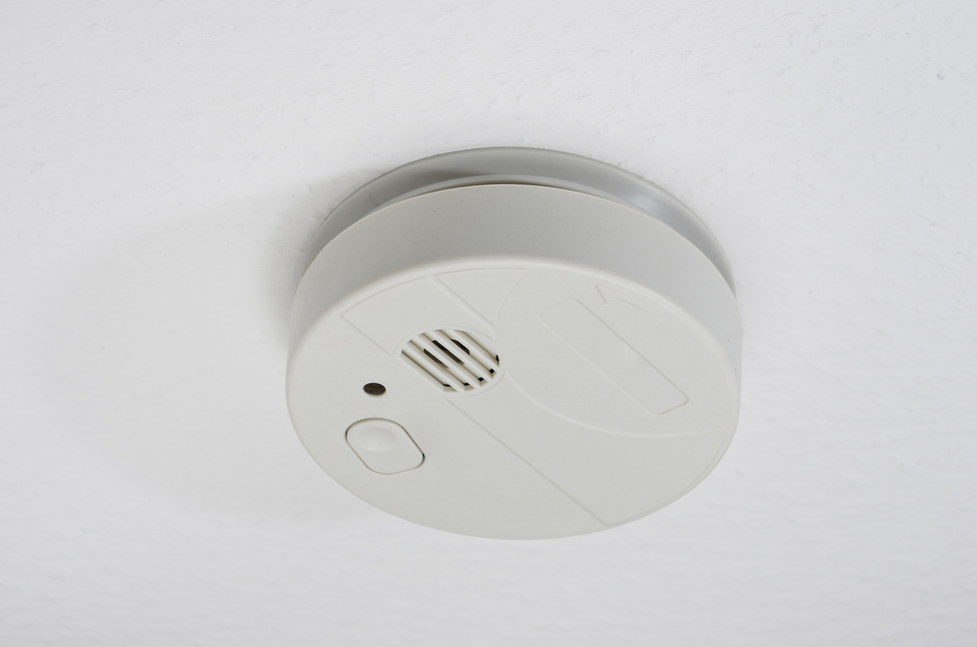
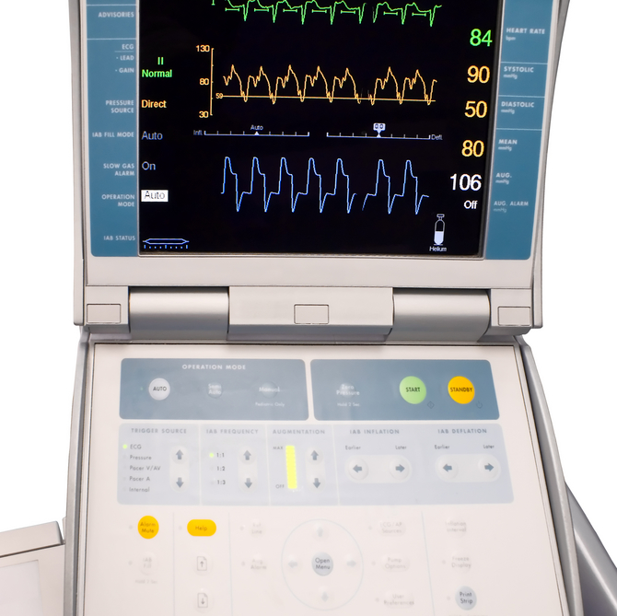
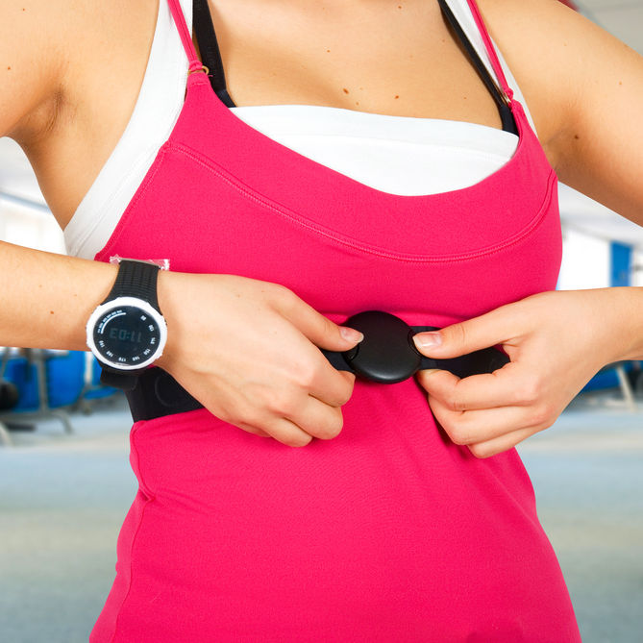
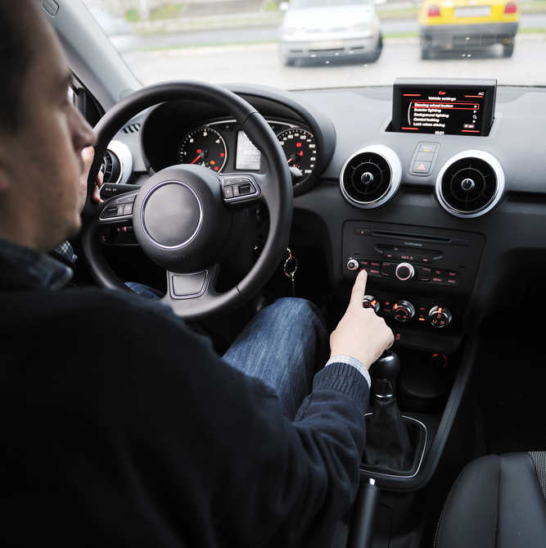
SENSORS REVIEW
Everyday life examples …
to monitor our health.
to monitor our performance.
to monitor our cars.
to monitor our buildings.

Slide 29
REVIEW: ELECFREAKS MINI CUTEBOT
Robots have three components:
Sensors are devices that allow robots to perceive the world. (INPUTS: 5 SENSES- touch, smell, taste, sight, sound)
Actuators are devices that produce motion or action. (OUTPUT: actions/reflexes)
Programs are sets of instructions for carrying out tasks. (BRAIN/NERVOUS SYSTEM)
Micro:bit chip (brain/nervous system)
Color sensor (eyes)
Ultrasonic sensors (eyes/ears)
Tires (arms/legs)
Battery (food-energy source)
Notes:
Ask students if they know how any of the sensors might be used for different applications in the smartphone. Discuss a few of the applications.

Slide 30
HUMAN SENSORS SIGNAL TRANSMISSION - For Teacher
When the sensors of the human body detect a stimulus, they send this information through the nervous system (like wires) to the brain. It has two main parts,
One is called the peripheral nervous system, which is a series of branches of single nerves. These are nerves that connect to every sensor in your body. They send signals to other nerves, which send signals to more nerves, until the signal reaches the second part of the nervous system: the central nervous system.
The central nervous system consists of your spinal cord and your brain. The spinal cord is made up of bundles of nerves that are surrounded by bones for protection. Once a signal from a sensor reaches the spinal cord, it is sent up the cord to the brain. The brain decides what to do based on the information received.
Human Nervous System
Notes:
This slide is to illustrate how the signals are transmitted throughout the nervous system. For the second activity, this information is very useful to explain how engineers can program a neural chip implant.

Slide 31
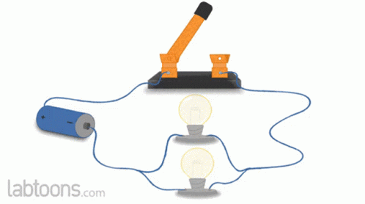
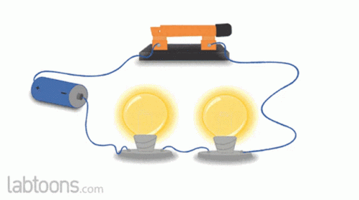
HUMAN NERVOUS SYSTEM - For Teacher
The nervous system is the set of wires (called nerves) that allow signal (neurons) flow in an electrical circuit. This circuit might be simple as how a flashlight works to how the lights in your house are connected (series and parallel circuits).
How can you relate this to how we function?
In another lesson, we see how engineers can use this to program neural chip implants or assisted technologies to help the impaired.
Notes:
The nervous system is like a circuit. We can use this to regulate or control or assist functions in the human body.

Slide 32
Activity Part I – For Teacher DAY 2
Split the students into pairs.
Mark four points on the ground – say on the corners of a 5-foot square. Space the points farther apart to increase degree of difficulty. (If this is a challenge, you could use an open gym and have a computer cart for the students.)
Have one person in each group close their eyes and have the other member direct the first around the room with verbal commands. (It is interesting to see who does not get confused by other team’s command.)
The goal is to become the first group to have the member with his/her eyes closed touch all four points, following the RULES on the next slide.
Notes:
The nervous system is like a circuit. We can use this to regulate or control or assist functions in the human body.

Slide 33
Activity Part I – Student Rules
The command-giving partner can only give commands that follow a specific format: The command must tell the partner to walk a certain number of steps in one direction.
Example: Move three steps to your right.
Example of incorrect command: Move a little to your right then turn slightly left and walk forward.
Why above command is incorrect: First, it specifies movement in multiple directions, instead of only one direction. Also, it doesn’t specify an exact number of steps to walk.
NO COMMAND CAN BE GIVEN WHILE THE PARTNER IS IN MOTION!! Commands can only be given after previous commands have been executed.
Notes:
The nervous system is like a circuit. We can use this to regulate or control or assist functions in the human body.

Slide 34
Activity Part II – For Teacher
First, ensure that each kit has all the parts supplied. See this link. It also has examples of programs you and your students can explore.
The micro:bits are purchased separately. See materials list in the document.
Familiarizing yourself with the kit and the micro:bit platform takes 15-30 minutes. Ensure that you are familiar with the basic process (see Slide 36).
The slides that follow assume that you did the precheck of all the supplied parts and have gone through the basics.
Students can easily follow and even exhibit proficiency with the micro:bit platform.
Always ask students to create a flowchart for their codes! Helps with troubleshooting.
Notes:
The nervous system is like a circuit. We can use this to regulate or control or assist functions in the human body.

Slide 35
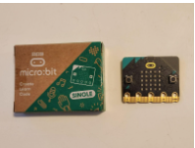
Activity Part IIa – For Students
Getting started
Step 1: Remove the cable from the plastic box and plug it into the computer.
Step 2: Remove the micro:bit from its cardboard package.
Step 3: Plug the cable into the top of the micro:bit. If the micro:bit is brand new, it will play sounds and flash lights in a special tutorial mode.
Step 4: Go to Pages 4-7 of the provided booklet in the ELECFREAKS kit.
Notes:
The nervous system is like a circuit. We can use this to regulate or control or assist functions in the human body.

Slide 36
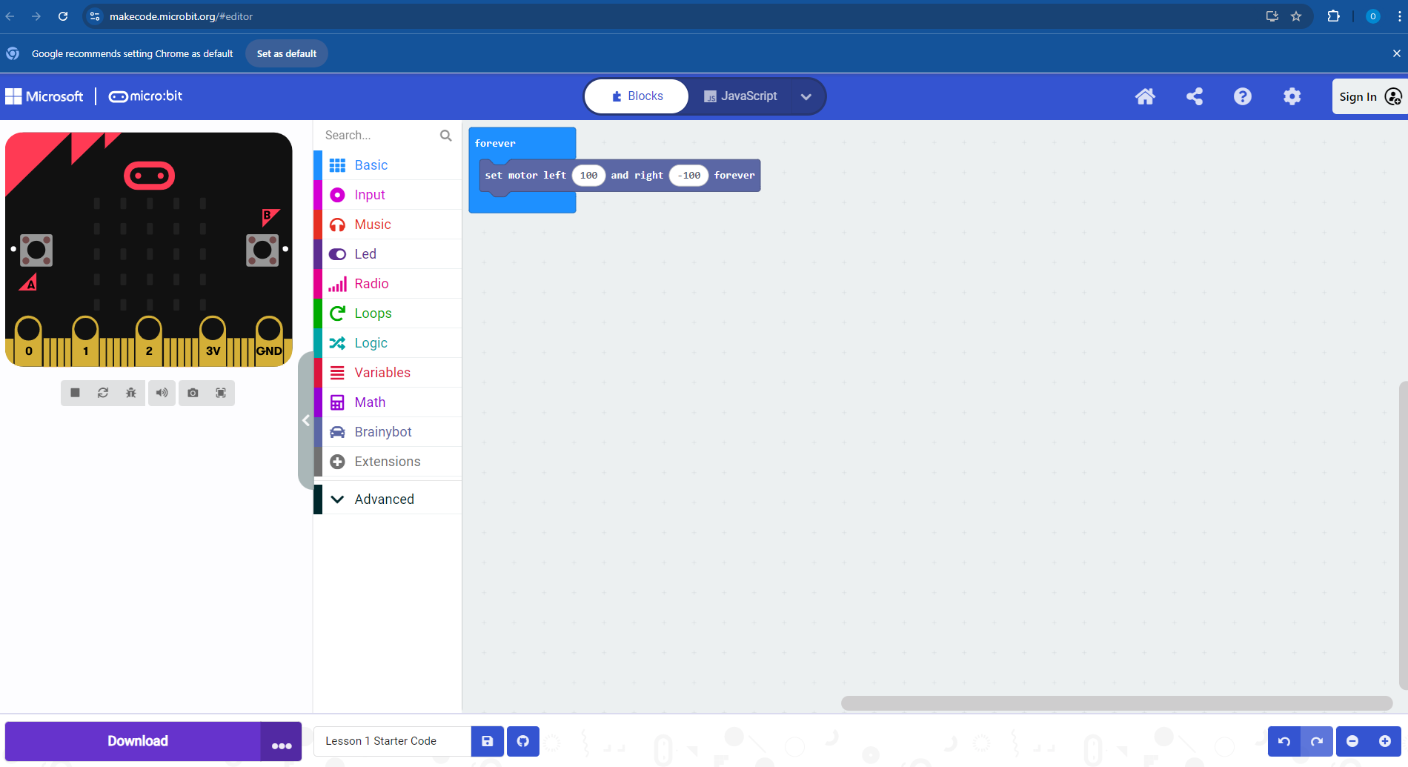
Activity Part IIa – For Students
C
D
B
PROGRAM BLOCKS
PROGRAM PAGE
TOGGLE BETWEEN BLOCKS AND JAVA FORMAT FOR PROGRAM
SHARING PROGRAMS
FOR DOWNLOADING CREATED PROGRAM
B
A
E
Notes:
The nervous system is like a circuit. We can use this to regulate or control or assist functions in the human body.

Slide 37
Activity Part IIa – For Students
Getting Started: First Program
Step 1: Go to Page 8 of the supplied booklet and practice with the DANCE LIKE A BEE!
Step 2: Page 9 gives the flowchart of what the program is meant to do. NOTE: Always draw a flowchart for your program. This is a good practice skill; it helps you troubleshoot easily.
Step 3: Download the finished code.
Step 4: Remove the cable from the micro:bit.
Step 5: Attach the ‘brainbox’ to the cutebot with the A and B buttons facing forward! (Slide 38)
Step 6: Turn on robot. Hurray, you created your first code!
Step 7: Try adding new codes using the suggestions on Page 14.
Notes:
The nervous system is like a circuit. We can use this to regulate or control or assist functions in the human body.

Slide 38
Activity Part IIa – For Students
Getting started
Step 9: Slide the micro:bit into the middle of the robot, between the head and the batteries. Make sure the strip of metal on the bottom is completely covered up, and the micro:bit’s lights are facing the front!
This is what the final setup would look like after you have put your program into the micro:bit chip, the brainbox of your robot.
Notes:
The nervous system is like a circuit. We can use this to regulate or control or assist functions in the human body.

Slide 39
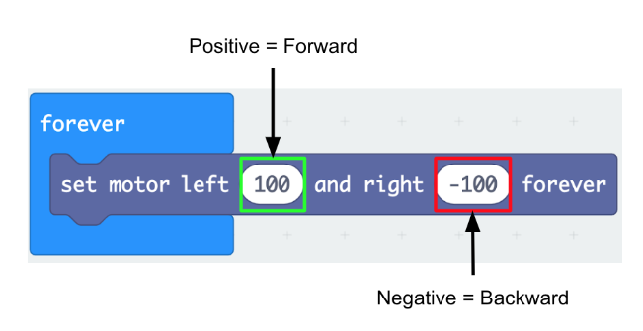
Activity Part IIa – For Students
Explaining the code
Because the numbers are equal, this would produce a circular motion.
What happens:
If both numbers are positive?
If the left number is smaller or greater than the right?
If both numbers are negative?
Notes:
The nervous system is like a circuit. We can use this to regulate or control or assist functions in the human body.

Slide 40
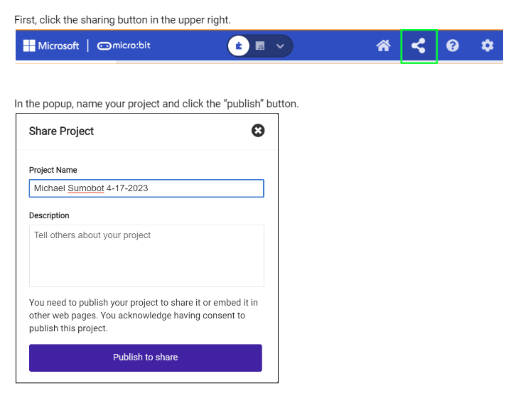
Activity Part IIb – For Students
Saving your code
Click on the share icon.
Give your project a name. (e.g., Your name and title of project/ challenge and date).
Write a short note.
Click copy link and save the link by emailing to yourself or to Google classroom.
Notes:
The nervous system is like a circuit. We can use this to regulate or control or assist functions in the human body.

Slide 41
Activity Part IIb – For Students
EXTENSION (if there is time)
Add new blocks SEE PAGE 14
Take a look at the list of blocks and see which one you want to add to the program to make the robot do something different. There’s music, lights, and even radio communication so you can talk to other robots!
Here are some things you can try:
Play the “Middle C” note.
Trace out a shape of your choice (square, triangle) and then reverse directions.
Play a melody.
Play a “mysterious” sound.
Spin in one direction for 2 seconds, then reverse spin direction.
Spin while moving only one wheel.
Light up the LEDs on the micro:bit in a pattern of your choosing.
PRACTICE WITH OTHER EXAMPLES IN LESSONS 2-4.
Notes:
The nervous system is like a circuit. We can use this to regulate or control or assist functions in the human body.

Slide 42
DAY 3

Slide 43
CHALLENGE 1:
Create a program that gets your Cutebot through the maze.

Slide 44
Activity Part III – For Teacher
Create a maze with wooden planks (or any other solid objects forming walls of the maze) – increase the size of the maze (add more turns) to increase difficulty.
Use the PowerPoint slides that follow (Slides 36-41) to review with the students how to program using the micro:bit platform.
Engineering Design Challenge - Ask students to use the micro:bit platform to create programs to get their Cutebots through the maze (or to navigate the path) provided.
Suggestion – Slides 36 through 41 can be printed and provided to the students so that they can use them to troubleshoot when they begin writing their programs or guided notes.
Notes:
The nervous system is like a circuit. We can use this to regulate or control or assist functions in the human body.

Slide 45
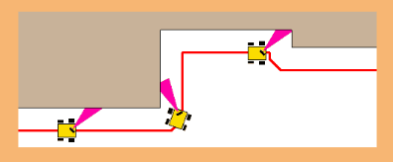
Activity Part III – For Teacher
Engineering Design Challenge - Ask students to use the micro:bit platform to create programs to get their Cutebots through the maze provided.
Suggestion – hints
Ask the following prompts
What sensors might you use? Ultrasound or linetracker?
What is the robot doing at each point? (while, if else?)
Notes:
The nervous system is like a circuit. We can use this to regulate or control or assist functions in the human body.

Slide 46
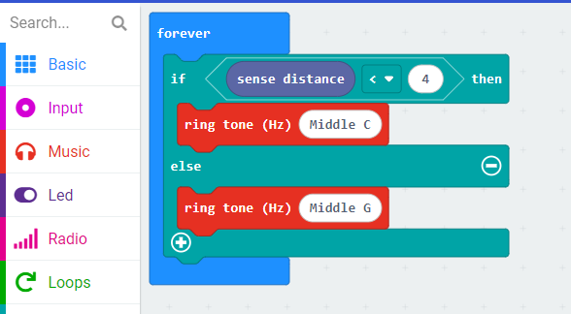
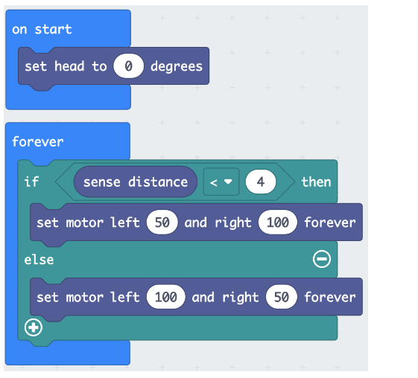
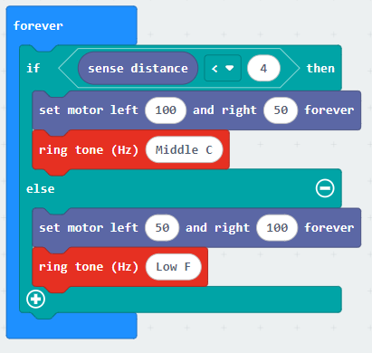
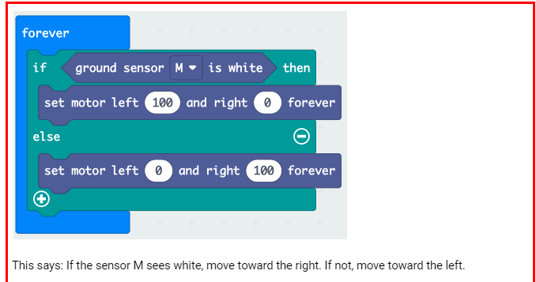
Activity Part III – For Teacher
1
2
3
4
Demo codes for follow
The wall with sensors
Same above
Same with extensions
Using line tracker
Notes:
The nervous system is like a circuit. We can use this to regulate or control or assist functions in the human body.

Slide 47
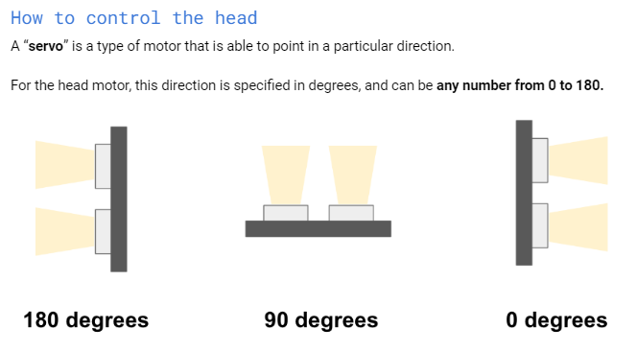
Activity Part III – For Teacher
Ask students what direction the robot will go when facing these positions.
right
left
straight
Notes:
The nervous system is like a circuit. We can use this to regulate or control or assist functions in the human body.

Slide 48
BEFORE THE CHALLENGE
You can ask students to try out some other examples from the micro:bit page to boost their confidence:
https://microbit.org/projects/make-it-code-it

Slide 49
Activity Part V – For Students
Engineering Design Challenge I - Ask students to use the micro:bit platform to create programs to get their Cutebots through the maze (or to navigate the path) provided.
EXTENSION:
Each time your robot changes direction, let it play a sound.
Use a different sound for a different direction.
Let the LED light light up as it changes direction.
Upon completion of the maze, display a victory sign, tune.
Notes:
The nervous system is like a circuit. We can use this to regulate or control or assist functions in the human body.

Slide 50
Activity Part VI – For Students
Engineering Design Challenge II
EXTENSION - Ask students to use the micro:bit platform to create programs to get their Mini Cutebots to communicate to another bot their directions for navigating the maze.
Notes:
The nervous system is like a circuit. We can use this to regulate or control or assist functions in the human body.

Slide 51
Post assessment Sheet: What is a Robot?
Describe in one sentence below what you understand by the term robot.
What are the main parts of a robot? Describe its similarities and differences to a human brain.
What do you need to do to make a robot move?
Notes:
The nervous system is like a circuit. We can use this to regulate or control or assist functions in the human body.

Slide 52
Post assessment Sheet: What is a Robot Key
Describe in one sentence below what you understand by the term robot.
A robot is a machine that gathers information about its environment (senses) and uses that information (thinks) to follow instructions to do work (acts).
What are the main parts of a robot?
Computer (to make decisions), input ports (connected to sensors), and outputs (connected to motors, for example).
What do you need to do to make a robot move?
They program it using software telling it precisely what to do, step by step.
Notes:
The nervous system is like a circuit. We can use this to regulate or control or assist functions in the human body.

Slide 53
Vocabulary
Computer: A human-created electronic device that processes data, performs mathematical and logical calculations, displays graphics, and helps you connect to the internet.
Robot: A mechanical device that sometimes resembles a human and is capable of performing a variety of often complex human tasks on command or by being programmed in advance.
Sensor: A device that converts one type of signal to another. For instance, a tachometer displays the speed that your car is traveling.
Actuator: A device that causes a machine or other device to operate.
Notes:
The nervous system is like a circuit. We can use this to regulate or control or assist functions in the human body.

Slide 54
Image Sources
Image 1: X-ray like image showing shoulders, spinal cord, and brain in a head; filename: MP900438746-225x300.jpg; source: AZ Dept. of Health Services Director's Blog http://directorsblog.health.azdhs.gov/wp-content/uploads/2013/02/MP900438746.jpg
Image 2: Components of mini cutebot; filename: N/A; source: Amazon.com
https://a.co/d/bub7QxI
Image 3: Nervous system; filename: TE-Nervous_system_diagram.svg.png; source: Wikimedia Commons http://commons.wikimedia.org/wiki/File:TE-Nervous_system_diagram.svg
Image 4: Picture of the brain; filename: CCN.png; source: http://commons.wikimedia.org/wiki/File:CCN.png
Image 5: Human brain showing left and right hemispheres; filename: Płaty mózgu.png; source: Wikimedia Commons http://commons.wikimedia.org/wiki/File:P%C5%82aty_m%C3%B3zgu.png
Image 6: Four lobes of the brain; filename: Gehirn, lateral - Lobi eng.svg; source: 2007, NEUROtiker, Wikimedia Commons http://commons.wikimedia.org/wiki/File:Gehirn,_lateral_-_Lobi_eng.svg
Image 7: Makecode platform; source: 2024, https://makecode.microbit.org/#editor
Notes:
The nervous system is like a circuit. We can use this to regulate or control or assist functions in the human body.

Slide 55
Solutions
Maze navigation
https://makecode.microbit.org/_HUeeWxEF4Csu
Maze Navigation-Radio to another bot
https://makecode.microbit.org/_X0hey7AYzazF
Notes:
The nervous system is like a circuit. We can use this to regulate or control or assist functions in the human body.

Slide 56
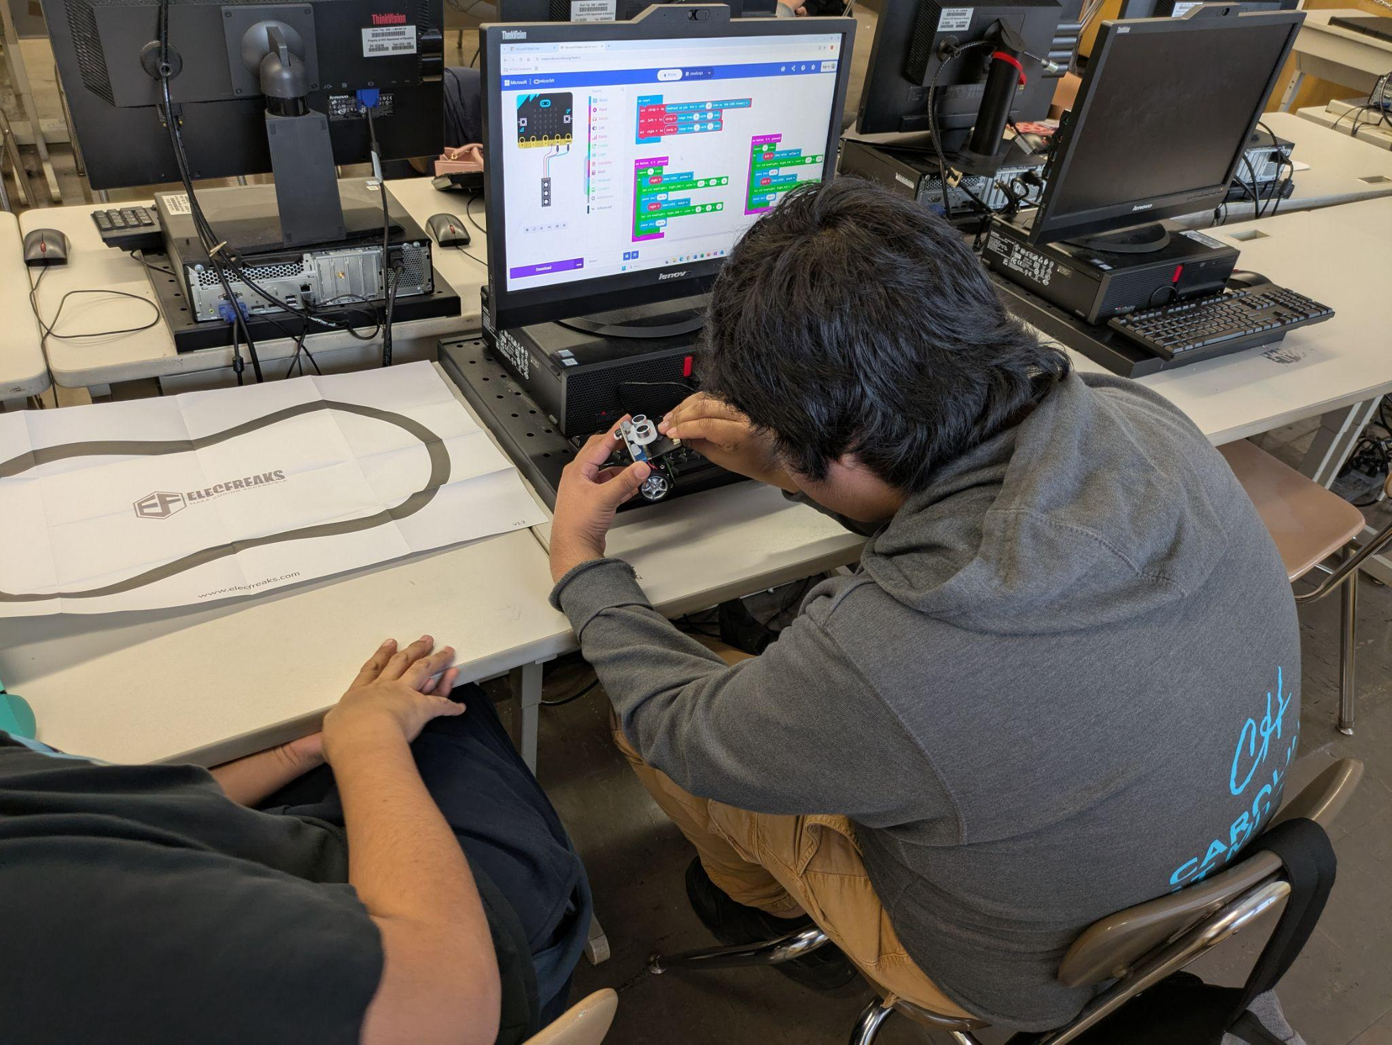
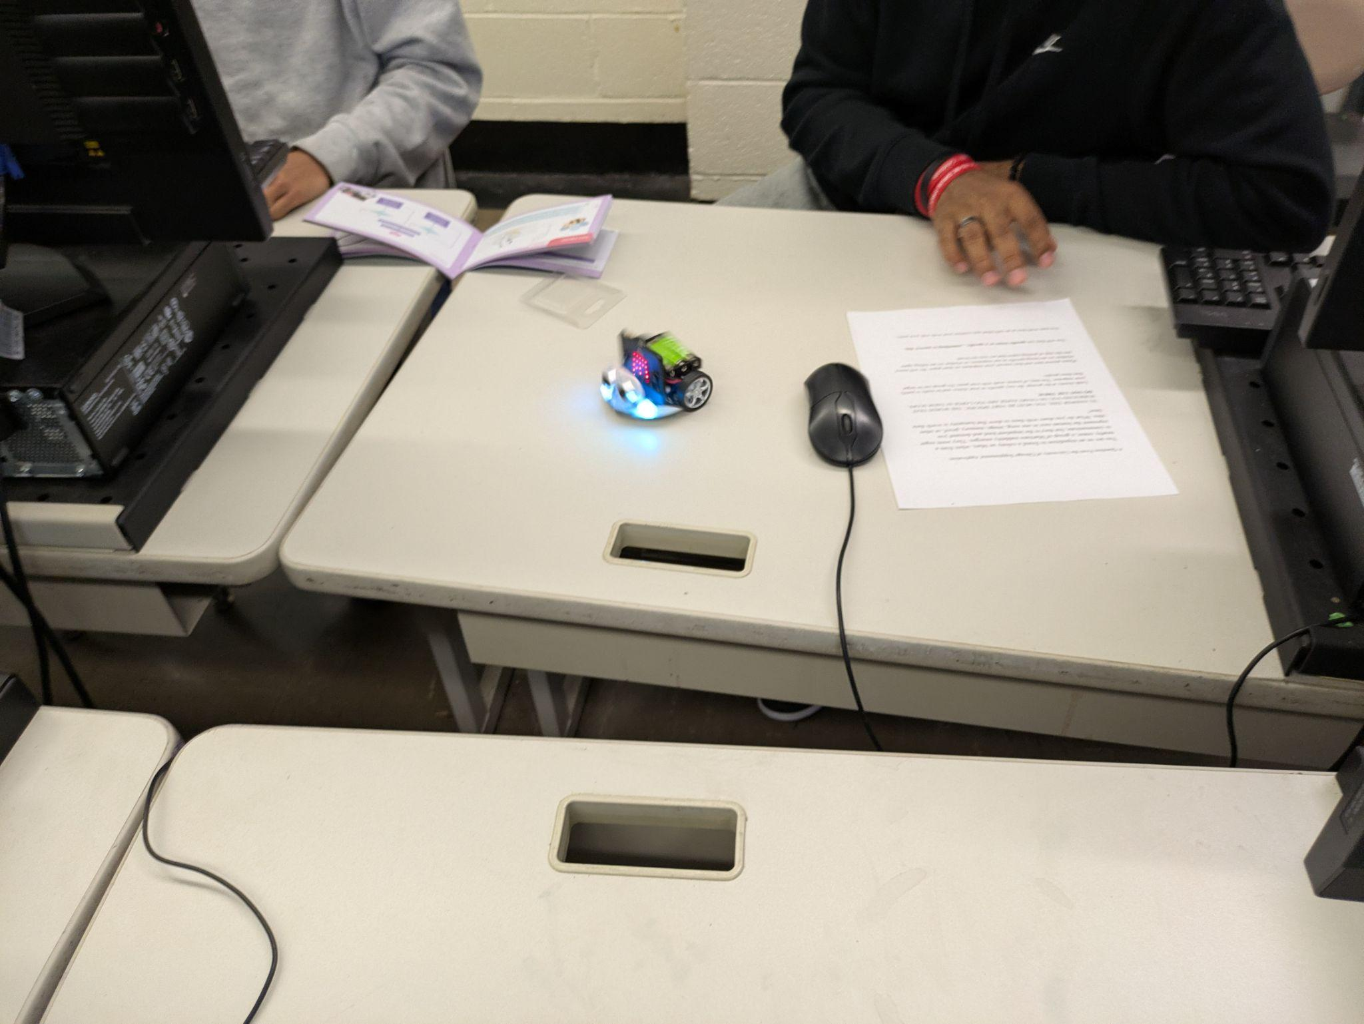
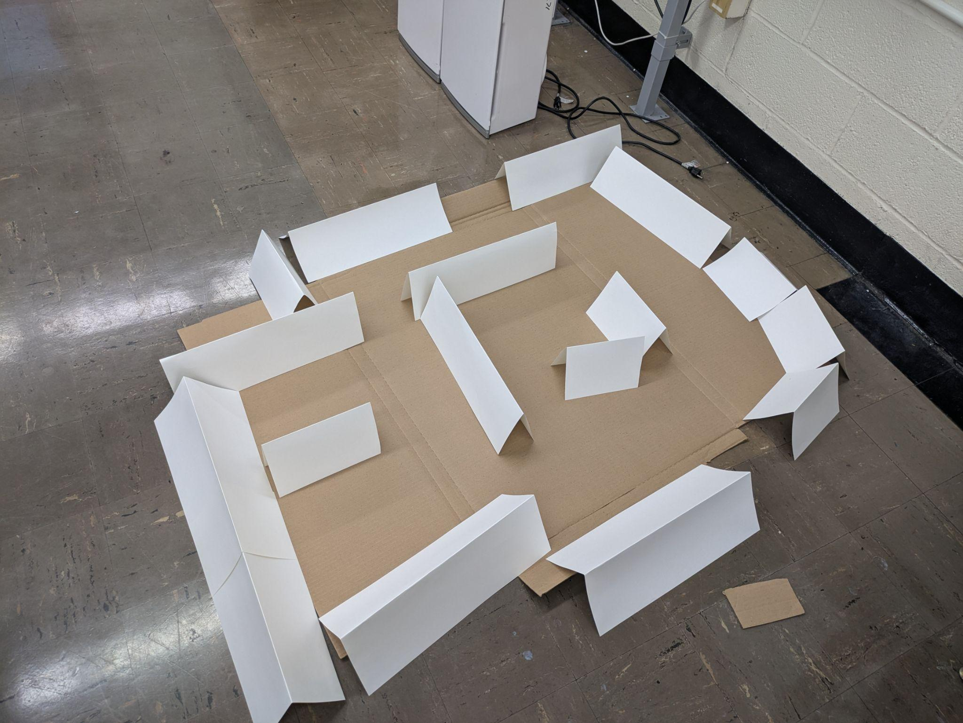
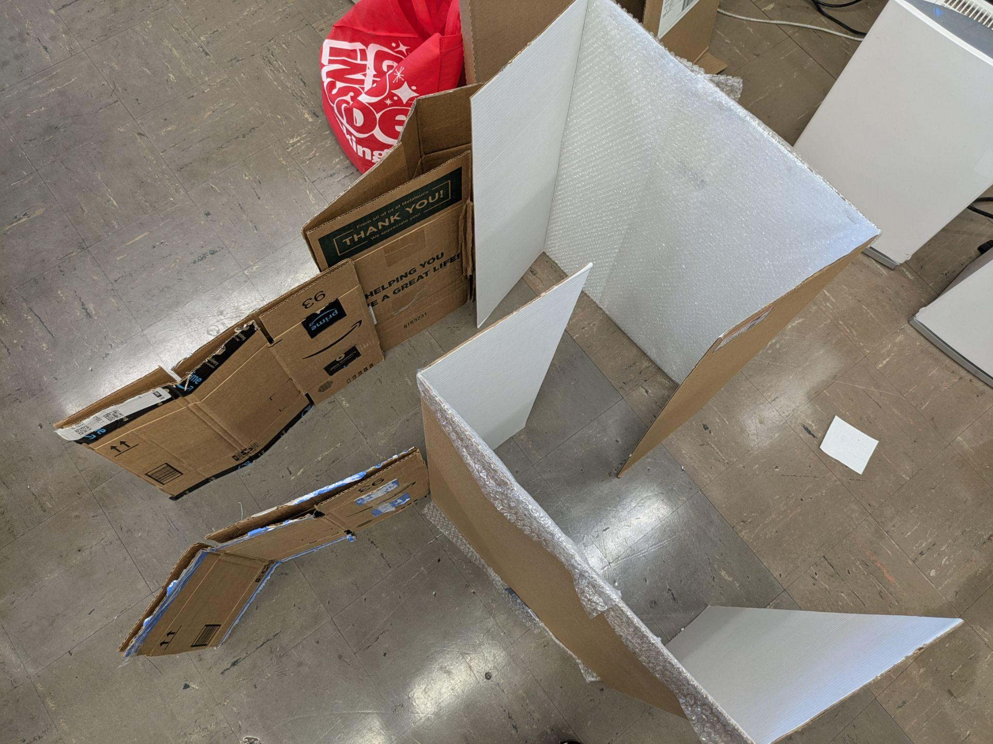
VIDEOS and IMAGES-

