Slide 1


Line Follower Challenge

Slide 2
Pre-Activity Quiz
How does a color sensor work? Does the color sensor detect white or black as a higher amount of light reflectivity? What about absorbance?
Can you think of a method to have the robot follow the line using turns? Describe how it would work.

Slide 3
Pre-Activity Quiz Answers
How does a color sensor work? Does the color sensor detect white or black as a higher amount of light reflectivity? What about absorbance?
A color sensor sends out light from one side and uses a sensor next to it to detect the light that comes back after being reflected by the surface the light hits.
White objects reflect most of the light, whereas dark objects reflect very little light. Thus, a higher reading of the color sensor means that more of the light is reflected.
Looking at it another way, darker objects absorb more light, so less is available to be reflected. That is, more absorption means less reflectance.
Can you think of a method to have the robot follow the line using turns? Describe how it would work.
The two main program commands used are:
1. If the color sensor detects a whitish color, program the robot to turn in a certain direction.
2. If the color sensor detects a darkish color, program the robot to turn in the opposite direction.
With this technique, the robot can be made to follow the edge of a line.

Slide 4
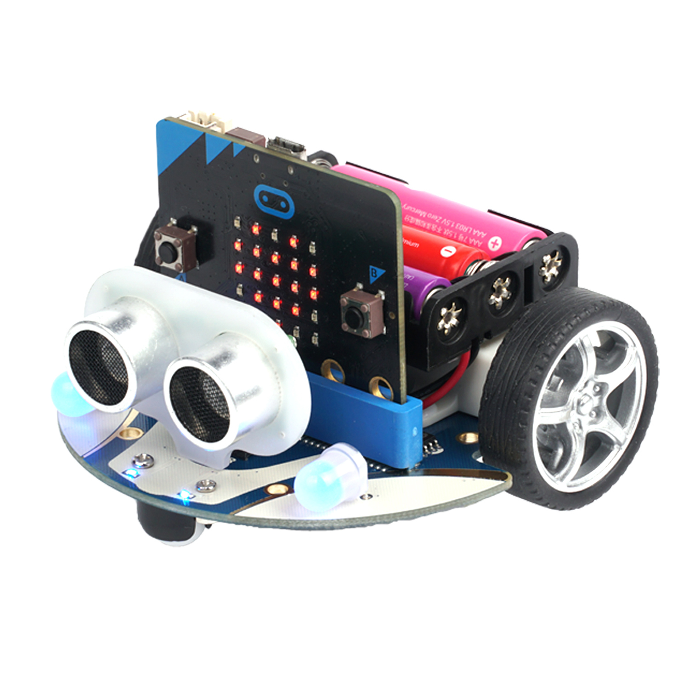
Line Follower Challenge
60 minutes
Make your robot follow a black line.
First, let’s review how
the color sensor works.
Next, find the two color sensors on your Cutebot.
Then, create a program that uses the color sensors to make it follow the black line.
Notes:
Image source: LEGO MINDSTORMS EV3 User’s Guide

Slide 5
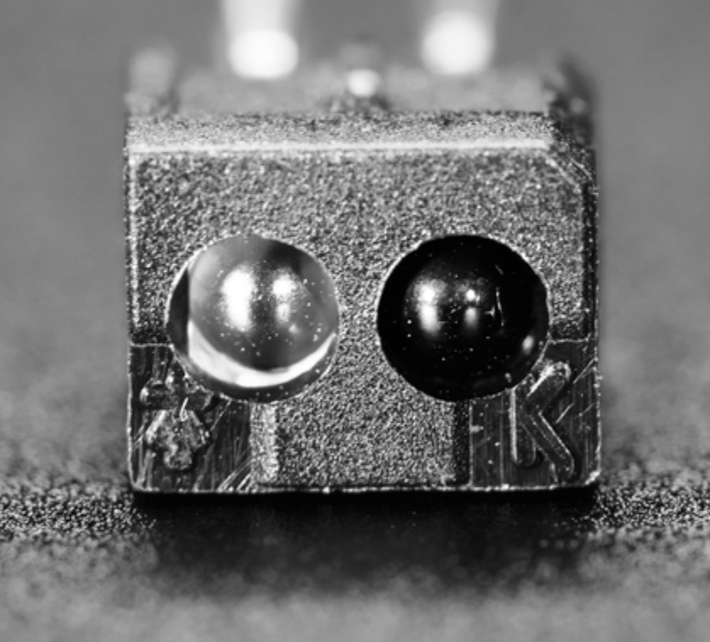
Understanding the Color Sensor
Review: How does a color sensor work?
top: lamp (sends out light)
bottom: color sensor (receives light)
Color Sensor: Adafruit
Questions:
What is the connection between color and light reflectivity?
How would you use this information to program a solution to the line follower challenge?
Notes:
The LEGO color sensor sees black and white; it cannot distinguish colors. It works in 2 different ways:
It can detect the amount of ambient light and convert it to a numerical value. This value is sent to the EV3 brick.
It can send out light and detect how much is reflected by an object. The sensor detects the brightness of an object and converts it to a numerical value and sends it to the EV3 brick. If no object is in front of the sensor, it sends a value of zero.
Images source (color sensor and brick: LEGO MINDSTORMS EV3 User’s Guide

Slide 6
Understanding the Color Sensor
Review: How does it work?
indicates a LIGHTER color
indicates a DARKER color
Notes:
Images sources: LEGO MINDSTORMS EV3 User’s Guide

Slide 7
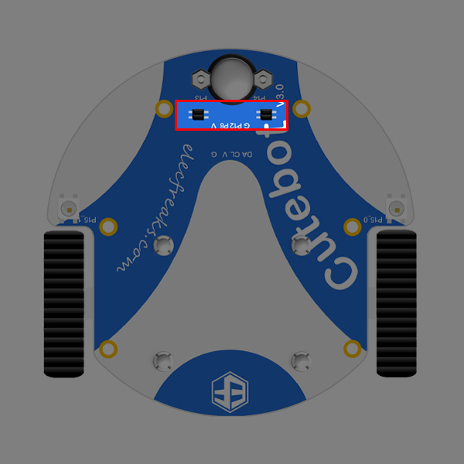
Understanding the Color Sensor
1 2
Did you find the color sensors?
They are located underneath the Cutebot.
Notes:
The LEGO color sensor sees black and white; it cannot distinguish colors. It works in 2 different ways:
It can detect the amount of ambient light and convert it to a numerical value. This value is sent to the EV3 brick.
It can send out light and detect how much is reflected by an object. The sensor detects the brightness of an object and converts it to a numerical value and sends it to the EV3 brick. If no object is in front of the sensor, it sends a value of zero.
Images source (color sensor and brick: LEGO MINDSTORMS EV3 User’s Guide

Slide 8

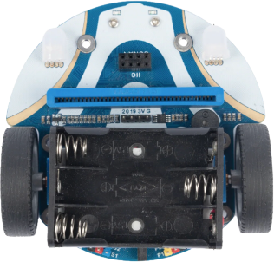
Understanding the Color Sensor
Remember, there are two color sensors on the Cutebot: a left sensor and a right sensor.
The right color sensor is reading that there is no line below.
The left color sensor is reading there is a line beneath it.
Which way would you instruct the robot to turn to stay on the line?
Notes:
Images sources: LEGO MINDSTORMS EV3 User’s Guide

Slide 9
Line Follower Activity
Clear a space on a smooth floor where the included line track can be placed.
To test a line follower program design, position the robot’s light sensors over the line and start the program.

Slide 10
Line Follower Challenge Solution
Description:
This program is for an ElecFreaks Cutebot. This activity works best in the Google Chrome Browser. The program will cause the robot to follow a black line on a white surface.
Setting up the programming environment:
Navigate to the Micro:bit MakeCode website: https://makecode.microbit.org

Slide 11

Line Follower Challenge Solution
Setting up the programming environment:
Create a New Project

Slide 12
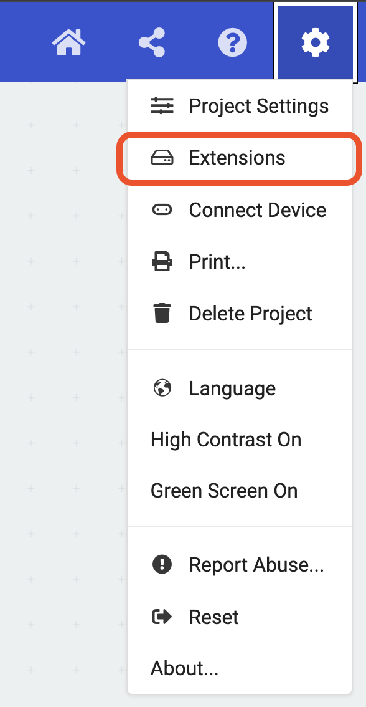
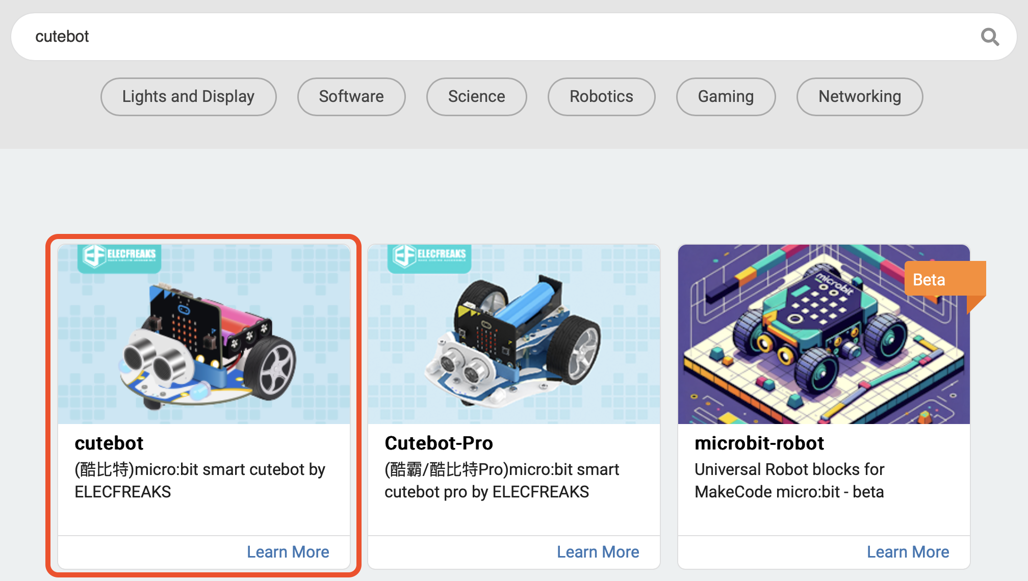
Line Follower Challenge Solution
Setting up the programming environment:
We must pair the micro:bit with Cutebot actions. Go to the Gear icon in the top right part of your screen. Click Extensions.
Search “cutebot” in the search bar and click the extension: “cutebot”.

Slide 13

Line Follower Challenge Solution
Programming:
The ”forever” code block is used to execute code over and over again.
Add your instructions to the ”forever” block.

Slide 14
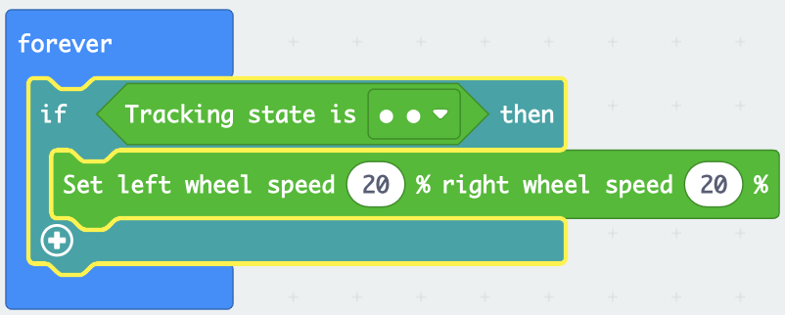
Line Follower Challenge Solution
Programming:
We need the robot to check for a few states and respond in certain ways if those states are true.
If both sensors read “dark” (on top of the black line), then we want the robot to go straight.

Slide 15
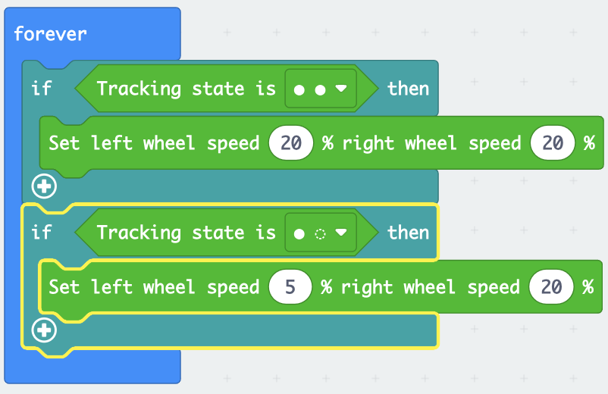
Line Follower Challenge Solution
Programming:
Let’s continue adding commands to the robot.
If the left sensor reads “dark” and the right sensor reads “bright”,
then turn the robot left.

Slide 16
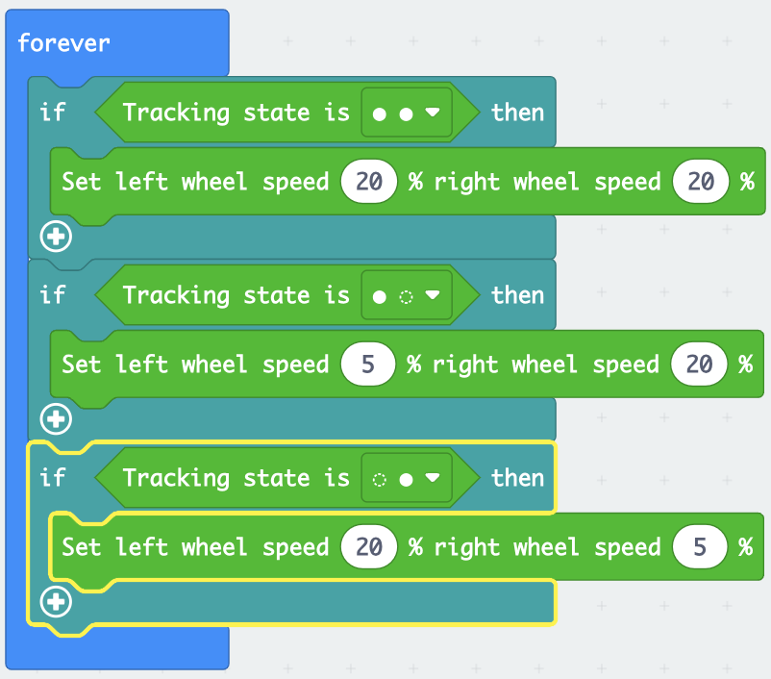
Line Follower Challenge Solution
Programming:
Let’s continue adding commands to the robot.
If the left sensor reads “bright” and the right sensor reads “dark”,
then turn the robot right.

Slide 17
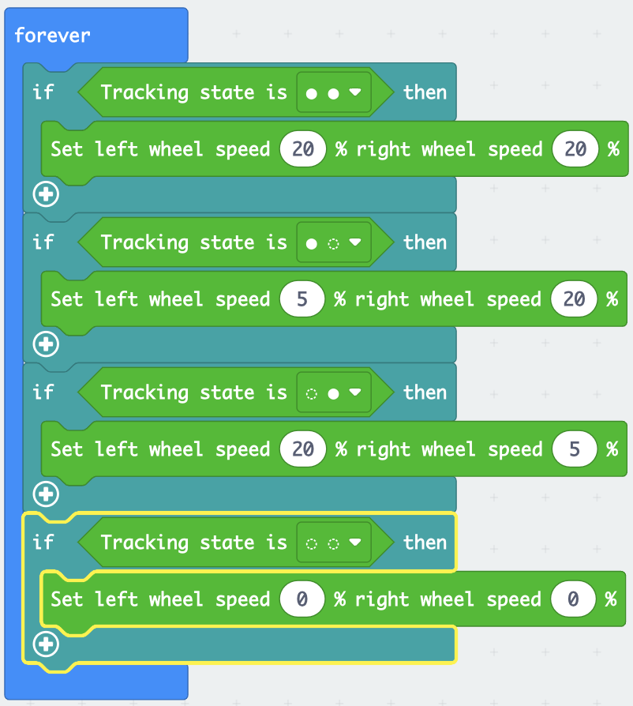
Line Follower Challenge Solution
If both sensors read “bright” (off the track),
then stop the robot.
Programming:
Let’s continue adding commands to the robot.
That’s it! Test your robot to see if it works.

Slide 18
Troubleshooting Tips
If the robot does not follow a black line, check for these common problems:
Decrease the speed of the robot motors to give it more time to sense where it is and turn properly.
Change the difference between the left and right wheel speed to change how sharply it turns.
Read back through the instructions and make sure all the properties for the commands are set correctly.

Slide 19
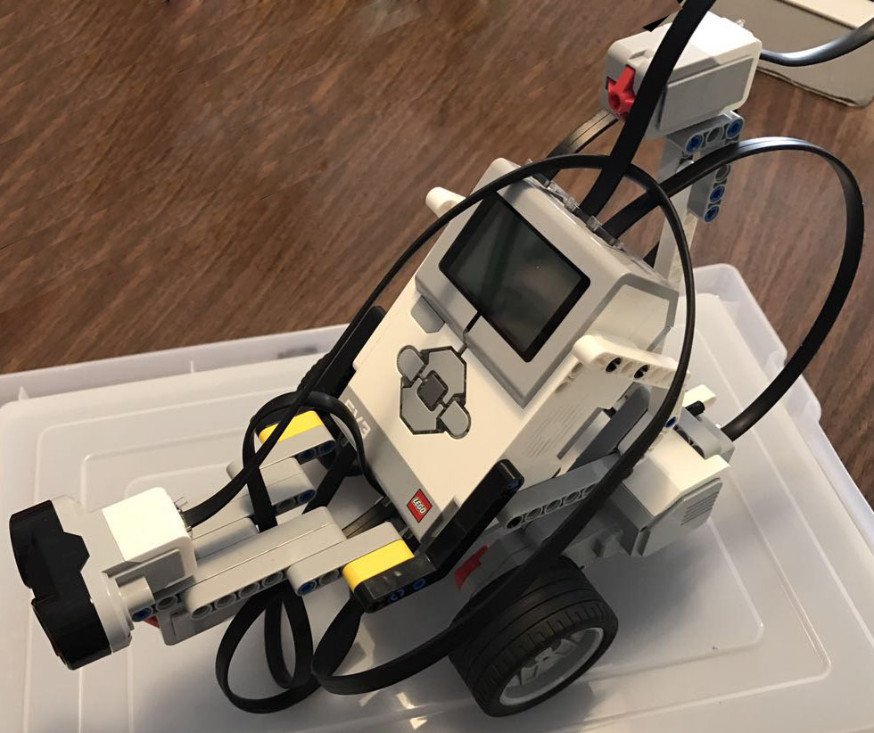
Post-Activity Quiz
Explain the logic you used in your line follower program.
Where might “follow the line” logic be used in the real world?
Notes:
Image source: 2011 chauromano, Wikimedia Commons http://commons.wikimedia.org/wiki/File:40365_Line_Follower_Robot.jpg

Slide 20
Post-Activity Quiz Answers
Explain the logic you used in your line follower program.
With the color sensors set to detect light reflectivity, it follows the line, directing the robot to turn one way when it detects the line edge with more light reflectivity (bright color) in one sensor and less light reflectivity (dark color) in the other sensor. By continuously doing this, sensor input and the programming come together to direct the robot to follow the line.
Where might “follow the line” logic be used in the real world?
This idea can be turned into technology that is suitable for running buses and other mass transit systems and may end up as part of autonomous cars navigating freeways. Engineers are designing future highways where cars will travel in lanes without drivers; a Google car has been tested to do this. Smarter versions of line follower robots are used to deliver mail in office buildings, move items through factory assembly lines, find and collect products in a warehouse, and deliver medications in hospitals.

Slide 21
Vocabulary
design: Loosely stated, the art of creating something that does not exist.
engineering: The use of science and mathematics to solve problems to improve the world around us.

