Slide 1
Navigating a Maze

Slide 2
Navigating a Maze Pre-Quiz
What is the difference between a program and an algorithm?
About how many inches does an EV3 move in one motor rotation?
How many rotations do you need for a 90º turn?

Slide 3
Navigating a Maze Pre-Quiz Answers
What is the difference between a program and an algorithm?
A program is a sequence of instructions written to direct a computer to perform a task. It is specific to the computer. On the other hand, an algorithm is a clear and specific procedure for solving a problem in a finite number of steps, and it is general to any task. For example, the “addition algorithm” is a procedure for how to add together any two numbers.
About how many inches does an EV3 move in one motor rotation? An EV3 taskbot moves about 7 inches in one rotation.
How many rotations do you need for a 90º turn?
A 90o turn is about 0.5 rotations with the steering pointer pulled all the way in one direction.

Slide 4
Activity: Navigating a Maze
Do This:
Program the robot to complete the maze (on the right using only the rotation sensor.
3 ft
end
45º
2 ft
➔)
45º
1.5 ft
3 ft
start

Slide 5
How Do You Develop a Computer Program?
(As we saw in the previous lesson) a program is a sequence of logical instructions written to direct a computer to perform a task.
Developing such instructions involves careful thinking!
So, we are creating something that does not exist. In engineering, such a process is called “design.” In this case, we are “designing” a program to do a particular task.
The engineering design process involves certain well-defined steps. What do you think is the first step?
The first step is to come up with what you want the computer program to do! Define the problem. Understand the need.
Once you know what you want the program to do, we need a method to do it. Let’s look more closely at the engineering design cycle, which tells us how.

Slide 6
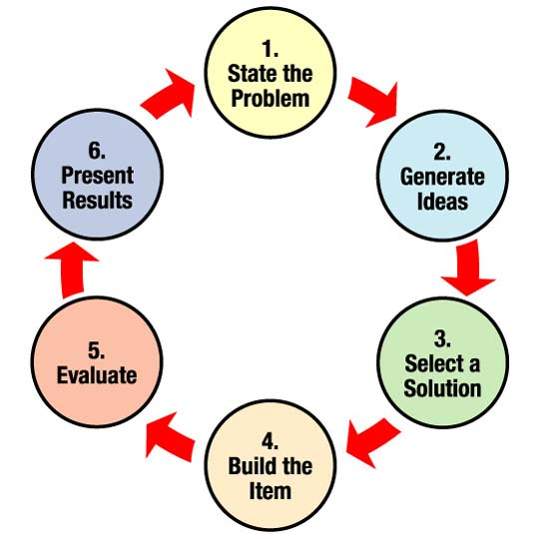
Engineering Design Cycle: How Engineers Design
For engineers, the design process is a series of steps that helps teams frame and solve complex problems. Anyone can do it!
To figure out how to build something, engineering teams gather information and conduct research to understand the needs and challenges to be addressed.
⬅So, in a design cycle, the steps are done in this sequence but often repeated because it may not work, or you want to improve the design!
More details on the next slide. ➔

Slide 7
Engineering Design Cycle: How Engineers Design
Notes:
An alternate but equivalent way to look at the engineering design process.
Usually, engineers must go through many iterations before a successful solution is achieved.

Slide 8
Activity: Navigating a Maze
3 ft
Your Design Challenge:
Program the robot to complete the maze on the right ➔ using only the rotation sensor.
Things to keep in mind:
If 1 rotation ≈ 7 inches, how many rotations are needed to make the robot go 3 ft? 1.5 ft? 2 ft?
If 0.5 rotations is the duration for a 90º turn, what duration is needed for a 135º turn?
end
45º
2 ft
45º
1.5 ft
3 ft
start

Slide 9
Programming Activity Answer
Note: Keep in mind that the values for durations shown in the solution are approximate and may need to be adjusted for each robot.

Slide 10
Navigating a Maze Post-Quiz
What is the difference between a program and an algorithm?
About how many inches does an EV3 move in one motor rotation?
How many rotations do you need for a 90º turn?

Slide 11
Navigating a Maze Post-Quiz Answers
What is the difference between a program and an algorithm?
A program is a sequence of instructions written to direct a computer to perform a task. It is specific to the computer. On the other hand, an algorithm is a clear and specific procedure for solving a problem in a finite number of steps, and it is general to any task. For example, the “addition algorithm” is a procedure for how to add together any two numbers.
About how many inches does an EV3 move in one motor rotation? An EV3 taskbot moves about 7 inches in one rotation.
How many rotations do you need for a 90º turn?
A 90o turn is about 0.5 rotations with the steering pointer pulled all the way in one direction.

Slide 12
Vocabulary
algorithm: A clear and specific procedure for solving a problem in a finite number of steps.
brainstorming: Thinking of ideas as a group.
engineering: Creating new solutions and new things.
engineering design process: A series of steps used by engineering teams to guide them as they develop new solutions and new things.
iteration: Doing something again, especially with the intent to make improvements.
program: A sequence of instructions written to direct a computer to perform a task.

Slide 13
Images Sources
Slide 1: Maze lost sign; source: Lake County, FL: http://www.lakecountyfl.gov/hometown_highlights/cornfield_maze.aspx
Slide 4: standing on maze graphic; source: Maine State Library: http://www.maine.gov/msl/libs/ce/mentor/
Slide 6: engineering design process 6 steps diagram and text; source: eGFI: http://teachers.egfi-k12.org/design-process/ and NASA http://www.nasa.gov/audience/foreducators/plantgrowth/reference/Eng_Design_5-12.html
Slide 7: improve/iterate EDP steps detail; source: Museum of Science, Boston: http://www.mos.org/doc/1559
Diagrams and screen captures by author

