Slide 1
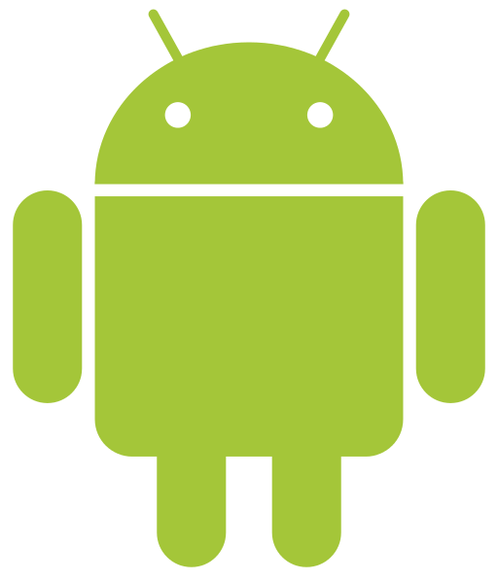
Remote Control Using Bluetooth
Notes:
Remote Control Using Bluetooth Activity > TeachEngineering.org

Slide 2
Remote Control Using Bluetooth Pre-Quiz
Give two examples of electrical connections.
What is the difference between wired and wireless connections?
What is an advantage of using wireless connections?
What is the name of the wireless electrical connection that the NXT can make?

Slide 3
Remote Control Using Bluetooth Pre-Quiz
Answers
Give two examples of electrical connections.
The connection between a garage door opener and a garage.
The connection between an iPod and a computer.
What is the difference between wired and wireless connections?
In a wired connection, electrical signals are sent through a physical wire, while in wireless connections electrical signals are sent as waves through the air.
What is an advantage of using wireless connections?
No need for wires or cables makes messaging over long distances and rough terrain no problem. No wires to break or get disconnected. Can send/receive data and control other devices from remote locations. Can send/receive messages almost instantly.
What is the name of the wireless electrical connection that the NXT can make?
Bluetooth

Slide 4
Activity Challenge
Use a Bluetooth connection to remotely control a LEGO NXT robot through a maze using an Android phone
Do This:
Divide the class into groups of two students each.
Each group needs: android phone, LEGO robot
Sit at computers with LEGO software installed.ccc
Notes:
Android is a Linux-based operating system designed primarily for touchscreen mobile devices such as smartphones and tablet computers. Initially developed by Android, Inc.

Slide 5
Instructions: Remote Control Using Bluetooth
(continued)
Turn on the NXT brick and use the USB cord to plug it into the computer.
Launch “LEGO MINDSTORMS NXT” on the computer.
Open a new or existing program.
TIP: In a class with multiple NXT bricks trying to use Bluetooth, it is very helpful to change the NXTs’ names to unique names so that they are easily distinguishable from the other NXT devices. (instructions for how to do this are on the next slide➔)

Slide 6
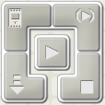
Instructions: Remote Control Using Bluetooth
(continued)
Look for a gray panel of buttons in the bottom right corner of the screen.
Click on the button with a picture of the NXT brick on it.
Click “Scan.”
Select the NXT device and press connect.
The name of the NXT (default is “NXT”) is provided in a dialogue box.
Click inside the dialogue box and change the name to something unique (such as “NXT 1”).
Close the dialogue box.

Slide 7
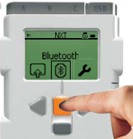
Instructions: Remote Control Using Bluetooth
(continued)
Next, to turn on Bluetooth on the NXT brick:
Scroll to Bluetooth on the NXT brick and press the orange button.
Select the “On/Off” option on screen.
Make sure to select “On” to turn Bluetooth ON.

Slide 8
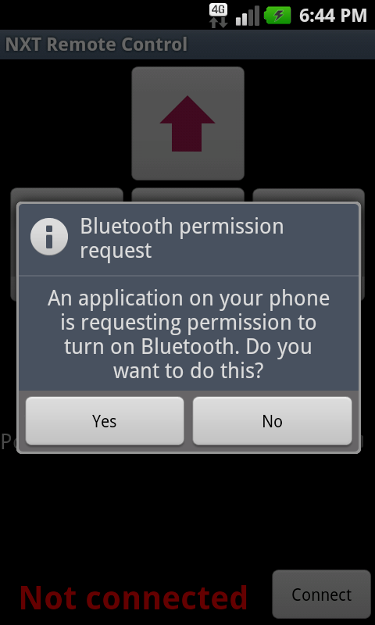
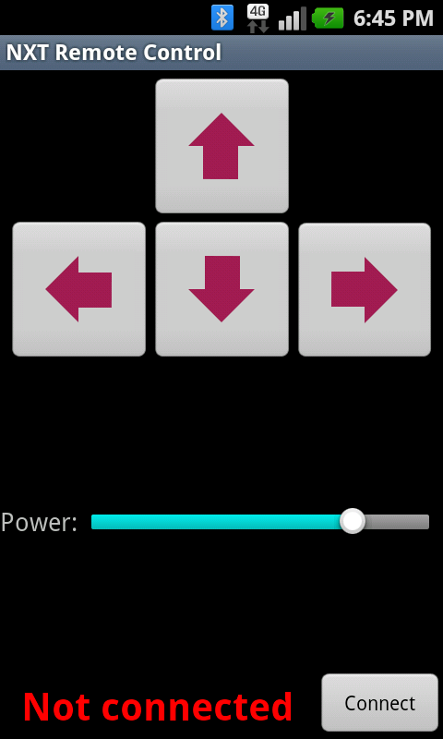
Instructions: Remote Control Using Bluetooth
(continued)
At the Google Play store, download the “NXT Remote Control” app at https://play.google.com/store/apps/details?id=org.jfedor.nxtremotecontrol
Open the downloaded app on your phone.
Click “Yes” if it asks whether it is okay to turn Bluetooth on.
Then push Connect at the bottom of the screen.

Slide 9
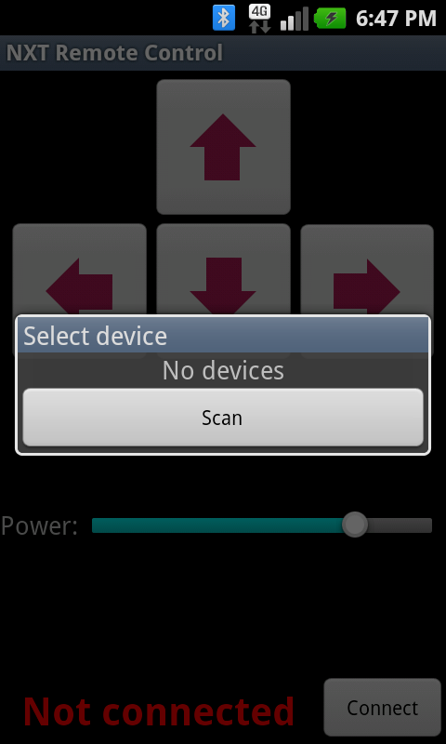
Instructions: Remote Control Using Bluetooth
(continued)
When prompted, hit Scan.
After a few seconds, the name you just gave your NXT should appear. Click this name.
After a few more seconds, the phone should be connected to the NXT.
Use the arrow keys on the phone to remotely control the NXT robot!

Slide 10
Activity: Use a Bluetooth Connection to Guide the NXT Robot through the Maze with Remote Control
7 ft
Challenge Maze➔
4 ft
Have student pairs use remote control to navigate through the maze using Bluetooth.
1 ft
1.5 ft
end
1 ft
start

Slide 11
Remote Control Using Bluetooth Post-Quiz
What is the name of the wireless electrical connection that the NXT can make?
In this activity, which two devices share an electrical connection?
Which device is sending messages? Which device is receiving messages?

Slide 12
Remote Control Using Bluetooth Post-Quiz
Answers
What is the name of the wireless electrical connection that the NXT can make?
Bluetooth
In this activity, which two devices share an electrical connection?
NXT brick and Android phone.
Which device is sending messages? Which device is receiving messages?
The Android phone sends messages that are received by the NXT brick.

Slide 13
Vocabulary
Android: A type of operating system designed for smartphones and tablet computers.
Bluetooth: A type of wireless electrical connection used for communication between two devices.
electrical connection: The link or bond that passes electricity between two or more things.

Slide 14
Images Sources
Slide 1: girl pointing remote control device; source: Microsoft® clipart: http://office.microsoft.com/en-us/images/results.aspx?qu=remote+control&ex=1#ai:MP900430788|
Slide 1: Bluetooth logo; source: 2011 Jnmasek, Wikimedia Commons: http://commons.wikimedia.org/wiki/File:Bluetooth.svg
Slide 1: Android robot logo; source: 2009, Google via Wikimedia Commons http://commons.wikimedia.org/wiki/File:Android_robot.svg
Screen captures and diagrams by author
Device and programming images from LEGO MINDSTORM NXT User’s Guide http://goo.gl/wuhSUA

