Slide 1
What Is a Program?
Notes:
What Is a Program? lesson > TeachEngineering.org

Slide 2
What Is a Program? Pre-Quiz
What is a program?
What is an algorithm? Give an example.

Slide 3
What Is a Program? Pre-Quiz Answers
What is a program?
A program is a sequence of instructions written to direct a computer to perform a task.
What is an algorithm? Give an example.
An algorithm is a clear and specific procedure for solving a problem in a finite number of steps. Example: The “addition algorithm” is a procedure for how to add any two numbers.

Slide 4
What is a program?
In today’s world, computers are everywhere!
They are capable of running all sorts of programs to perform a huge variety of tasks. Just think about all the applications (apps) that are available for smart phones and tablets. They can do everything from playing chess to setting alarms to enhancing pictures.
Each app is a program designed to perform a specific task. As computers become even more widespread, the ability for people—like you—to be able to program becomes more and more important. Programming is how you tell a computer how to perform a task that you want it to do.
Objective
In today’s lesson, we:
Investigate programs and algorithms — What are they?
Become familiar with simple commands that are used in programs
Learn how to use LEGO MINDSTORMS NXT software to write programs that the LEGO robot can execute
Notes:
50 minutes

Slide 5
What is a program?
A program is a sequence of instructions written to direct a computer to perform a task.
All computers can run programs.
Example: A calculator is a computer that is programmed to perform arithmetic operations.
Similarly, the LEGO MINDSTORMS NXT intelligent brick is a computer that we can program to perform different tasks, such as moving through a maze.

Slide 6
What is an algorithm?
An algorithm is a clear and specific procedure for solving a problem in a finite number of steps.
Example:
Addition algorithm: A systematic process that always produces the correct answer when numbers are to be added.
₁ ₁
1 2 3
+ 7 8 9
9 1 2

Slide 7
What is Programming?
Programming is designing an algorithm to solve a problem.
You need to have commands that are clear and precise… the robot will follow them exactly, so each step is important.

Slide 8
Mini-Activity: Programming as an Algorithm
(10 minutes)
Using a roll of tape, make a short maze on the floor in the corner of the room resembling this diagram 
wall
Blindfold a volunteer “robot” and have him/her stand at the start of the maze, hands at his/her sides.
Have another student—the “programmer”—give a series of commands (such as, go forward 2 steps, turn right, etc.) to instruct the volunteer to complete the maze.
3 ft
wall
6 ft
6 ft
end
start
Notes:
10 minutes

Slide 9
Mini-Activity: Programming as an Algorithm
(continued)
Observations and Questions:
Did the “programmer” get the blindfolded “robot” through the maze?
Did the “commander” always tell the “robot” to go the correct number of steps?
Often, it is easier for the “programmer” to give instructions if s/he can tell the “robot” to go forward until s/he senses something. Why?
This way, the “programmer” does not have to worry about telling the “robot” exactly how many steps to move forward.

Slide 10
Mini-Activity: Programming as an Algorithm
(continued)
Choose a new volunteer to be blindfolded.
This time, permit the volunteer “robot” to stretch out his hands in front of his body to sense when he is approaching a wall.
wall
3 ft
wall
6 ft
6 ft
Have another student give commands to instruct the volunteer to get through the maze.
end
start
Now, commands such as “go forward until you hit a wall” are permitted.

Slide 11
Mini-Activity: Programming as an Algorithm
(continued)
Was it easier to give instructions the first time or second time?
It is generally easier to tell a robot to go forward until it senses something (such as a wall) than to tell it exactly how far it should go before it turns.

Slide 12
Mini-Activity: Programming as an Algorithm
(continued)
Note that the volunteer had to be told everything, that is, which direction s/he should move in, how long to move in that direction, how much to turn, etc.
The LEGO NXT robot needs to be given exactly the same information. It knows nothing and is “blind” and will do exactly what you tell it to do. If you make an error in programming, the NXT won’t do what you want.

Slide 13
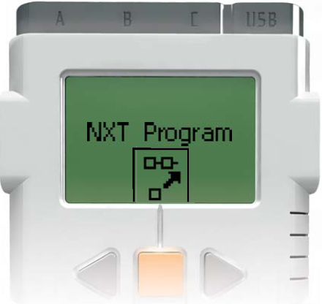
Quick Programming Using the NXT Brick
We can program a robot to do some simple tasks just by using the LEGO NXT brick because the brick is a small computer.
To turn on the brick, press the orange button
Then use the arrows to scroll to the “NXT Program” screen and press the orange button twice more

Slide 14
Quick Programming Using the NXT Brick (continued)
Do This: Let’s program the robot to move forward for 5 seconds, then wait 2 seconds, turn right for 2 seconds, wait for 5 seconds, and then stop.
Select the “Forward 5” block.
Then use the gray buttons to scroll to the “Wait 2” block and select it with the orange button.
Now scroll over to the “Right 2” block and select it.
Scroll over to the “Wait 5” block and select it.
Scroll over to the “Stop” block and select it.
Press the orange button to run the program.

Slide 15
Quick Programming Using the NXT Brick (continued)
Do This:
Press the gray button until you have cleared the 5 slots of the NXT Program.
Select different blocks and make your own quick programs on the NXT brick.
Notes:
Give students a bit of time to experiment and make their own quick programs using the brick.

Slide 16
Quick Programming Using the NXT
Drawbacks
Programming directly on the NXT brick is a convenient way to make simple programs and it is helpful to know the different features of the NXT brick.
However, this method of programming is not very efficient and won’t work for everything we want to do, for the following the reasons:
The NXT brick only provides a small set of commands and durations (timing choices) for programming.
The NXT brick can only make programs that are a maximum of 5 blocks long.

Slide 17
Quick Programming Using the NXT
Drawbacks (continued)
It is not even possible to complete the maze you worked through in the activity by programming on the NXT brick.
So, from this point forward, we will use LEGO MINSTORMS NXT software.
This software enables us to:
make longer programs
use more sophisticated commands
have control over the fine details of the program

Slide 18
DAY 2

Slide 19
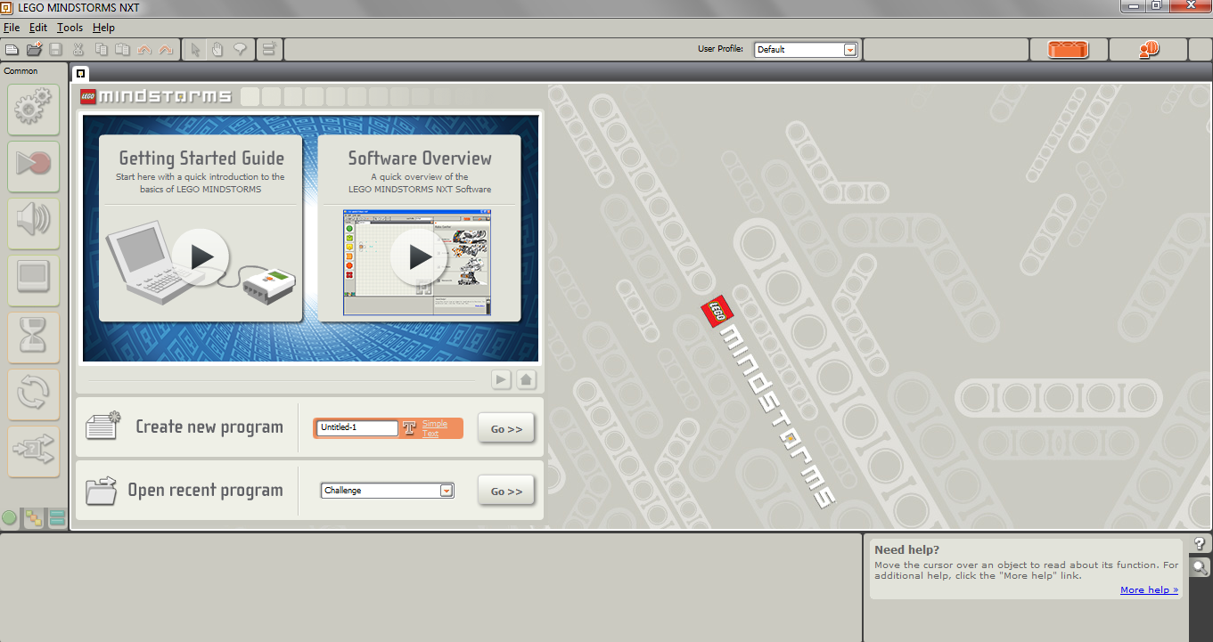
Getting Started with MINDSTORMS
Open the MINDSTORMS software by clicking on the start menu and selecting the “LEGO MINDSTORMS NXT” icon.
A window should open, looking like the one below. ⬇

Slide 20
Getting Started with MINDSTORMS (continued)
Move the cursor inside the dialogue box next to “Create new program” and type in a name for your program.
Then click “Go >>”

Slide 21
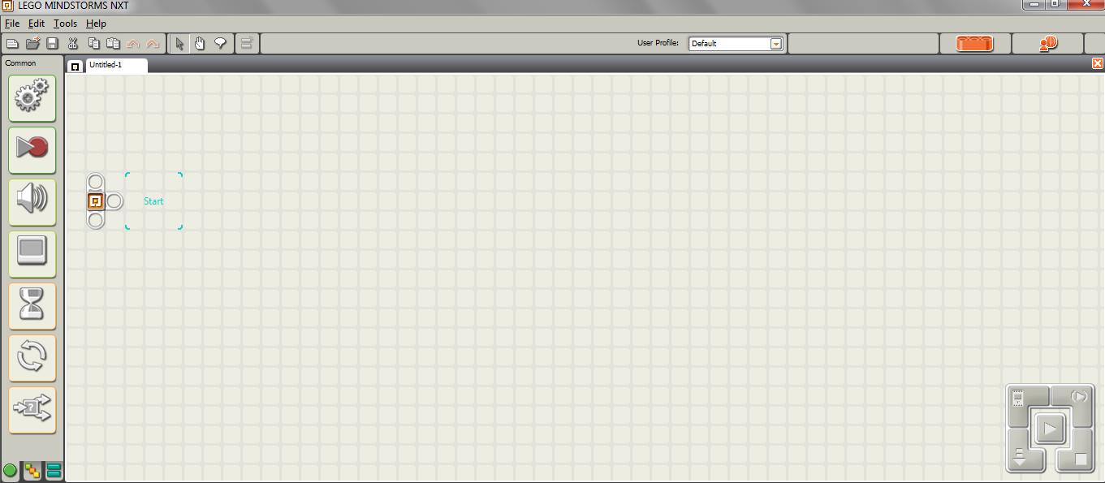
Getting Started with MINDSTORMS (continued)
Your screen should now resemble the image below. ⬇ This is the workspace you will use to create your programs.

Slide 22
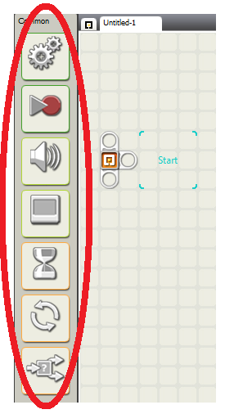
Getting Started with MINDSTORMS (continued)
The square icons on the left side of the screen represent different blocks that can be used for programming.
In this lesson, we will be using only the move block, which looks like this:

Slide 23
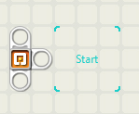
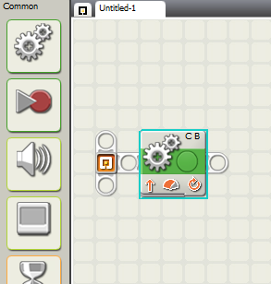
The Move Block
Move your cursor over the move block icon.
Click and drag the move block into the blue “start square”
When you are done, the top left quarter of your screen should resemble the image shown to the right ➔

Slide 24
The Move Block (continued)
The move block in your program should be highlighted in a thin light blue outline. If it is not, highlight the block by clicking on it.
Whenever you highlight a block, the bottom of the screen gives you details about that block.
The bottom of your screen should resemble the image below. ⬇

Slide 25
The Move Block: Port
A move block is used to control one or more motors.
Next to “Port:” notice the checkmarks next to “B” and “C.” This means that this block is set to control the motors attached to ports B and C of the NXT.
This is good for us, because the motors of the taskbot we built should already be connected to ports B and C.
You will rarely need to change the “Port” settings.

Slide 26
The Move Block: Direction
“Direction” controls which way the motors are set to rotate.
The upward arrow (currently selected) means forwards, but we also have the options of selecting backwards (the down arrow) or stop (the stop sign).

Slide 27
The Move Block: Steering
Steering allows us to easily make the robot turn.
Dragging the pointer to the left makes the robot turn left
Dragging it to the right makes the robot turn right
The farther to one side the pointer is dragged, the sharper the turn will be
If the pointer is dragged all the way to one side, the robot should turn in place

Slide 28
The Move Block: Power
The Power setting controls how fast the motors turn.
Increasing or decreasing the power too much tends to decrease the consistency of the motor movement, so it is recommended that “75” is used, unless there is a good reason to change it.

Slide 29
The Move Block: Duration
Duration controls how long the motors rotate.
Clicking the dropdown arrow, reveals several options. ⬇
We will talk about when/how
to use “Unlimited” in the next
lesson; it will NOT make the robot go forever if
used on its own.
“Degrees” allows you to control precisely how many degrees the motor spins, where 360° is one rotation of the motor.
“Rotations” allows you to control how many times the motor spins. (1 rotation = 1 full spin)

Slide 30
The Move Block: Duration (continued)
“Seconds” allows you to control the length of time the motors turn for.
Rotations is generally preferred over Degrees/Seconds because:
We generally need to make the robot move a few rotations in a direction and 3 rotations is much less tedious to type than 3*360 degrees = 1080 degrees.
Depending on factors such as the power setting and the amount of battery charge, the motors can spin different amounts of time in a second. But a motor spinning 1 rotation should always spin exactly the same amount.

Slide 31
The Move Block: Next Action
You will almost never need to use the Next Action option
It simply controls whether the motors are locked after performing a command or not
This option matters if the robot is on a steep incline.
“Brake” prevents the robot from rolling back down after it executes a command
“Coast” allows the motors to be turned by gravity

Slide 32
Move Block: Helpful Hints
The robots are not perfectly consistent or alike but generally:
For every 1 rotation forward, the robot moves about 7 inches.
Pulling the steering pointer all the way in one direction and setting duration to “.5 rotations” produces a turn that is close to 90°

Slide 33
Example Program
Program the robot to follow the track shown below. ⬇
Start by breaking this track down into steps:
Move forward for 2 feet
Turn left
Move forward for 1 foot
1 ft
end
2 ft
start

Slide 34
Part 1: Move forward for 2 feet
First, we drag a move block into the program.
Now we know we are moving straight forward. So this means, that we want to keep the upwards arrow selected.
Next, we have to decide what to do about the steering. Since the robot is moving straight forward, we do not want the robot to turn at all, so we do not need to change the steering.
Finally, we need to determine the duration:
In Helpful Hints, we learned that 1 rotation is about 7 inches
1 ft = 12 inches, so 2 ft = 24 inches
24 inches divided by 7 inches ≈ 3.5
So to go 2 ft, we need to go about 3.5 rotations

Slide 35
Part 1: Move Forward for 2 feet (continued)
So far, the program should look like this: ⬇

Slide 36
Part 2: Turn Left
1 ft
end
2 ft
We want the robot to turn left next, so drag another move block down and set it next to the first one.
start
Since the turn forms a rectangular corner, it is a 90° turn.
Recall from “helpful hints” that we said moving the steering pointer all the way to one direction for a duration of .5 rotations gets us close to a 90° turn.
So keeping the direction forward (the robot is moving forward as it turns), pull the steering pointer all the way to the left, and set duration to 0.5 rotations.

Slide 37
Part 2: Turn Left (continued)
So far, the program should look like this. The second move block is highlighted, and the details are shown below. ⬇

Slide 38
Part 3: Move Forward for 1 Foot
Just as in Part 1, the robot is moving straight forward, so we do not need to change direction or steering.
We do need to figure out the duration again.
This time, the robot should move 1 foot, or 12 inches forward.
Remember 1 rotation is about 7 inches.
So 12 inches divided by 7 inches ≈ 1.75
So let’s set the duration to 1.75 rotations

Slide 39
Part 3: Move Forward for 1 Foot (continued)
The complete program should look like this, with the details of the highlighted third block shown below. ⬇

Slide 40
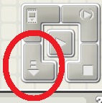
Downloading the Program onto the NXT
Now it’s time to download the program onto your NXT:
Do This:
Plug one end of the USB connecting cable into the computer, the other into the NXT
Make sure both ends are fully inserted
Turn on the NXT by pressing the orange button
Look for this set of buttons in the bottom right corner of your computer screen ➔
To download the program, click on the down arrow
Then press the orange button until the program starts running

Slide 41
What Is a Program? Post-Quiz
What is a program?
What is an algorithm? Give an example.

Slide 42
What Is a Program? Post-Quiz Answers
What is a program?
A program is a sequence of instructions written to direct a computer to perform a task.
What is an algorithm? Give an example.
An algorithm is a clear and specific procedure for solving a problem in a finite number of steps. Example: The “addition algorithm” is a procedure for how to add any two numbers.

Slide 43
Vocabulary
program: A sequence of instructions written to direct a computer to perform a task.
algorithm: A clear and specific procedure for solving a problem in a finite number of steps.

Slide 44
Images Sources
Slide 1: Girl looking at laptop monitor; source: Microsoft® clipart: http://office.microsoft.com/en-us/images/results.aspx?qu=computer&ex=1#ai:MP900430487|
Slide 8: Girl blindfolded in trust game; source: 2005 Tracee L. Jackson, U.S. Marine Corps via Wikimedia Commons: http://commons.wikimedia.org/wiki/File:Blindfoldlowres.gif
Slides 10, 11: Blindfolded kids in trees; source: North Carolina State Parks: http://www.ncparks.gov/Visit/parks/hari/pics/harp_maze.jpg
Slide 9: Maze line drawing; source: 2005 ZeroOne, Wikimedia Commons: http://commons.wikimedia.org/wiki/File:Maze01-01.png
Slide 15, 39: Girl on floor with laptop and hands raised; http://office.microsoft.com/en-us/images/results.aspx?qu=computer&ex=1#ai:MP900448599|
Slide 18: men’s feet stepping: source: Microsoft® clipart: http://office.microsoft.com/en-us/images/results.aspx?qu=feet&ex=1#ai:MP900425511|
Device and programming images from LEGO MINDSTORM NXT User’s Guide http://goo.gl/wuhSUA
Screen captures and diagrams by author

