Slide 1
Dyeing to Design

Slide 2
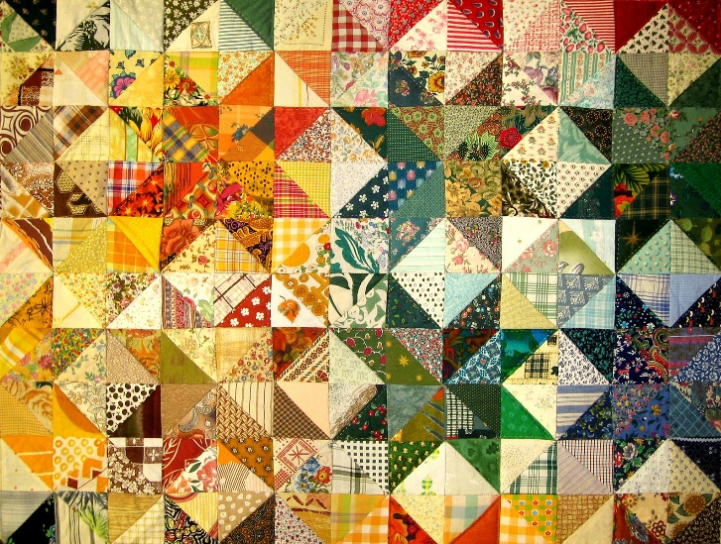
Vibrant, Colorful, Sustainable
A team of chemical engineers at a startup clothing company is taking advantage of this demand for sustainable clothing made with non-toxic materials and dyes. However, they need your help!
They have chosen several sustainable fabrics they would like to use in this new product line, but they need assistance from you in order to find dyes that are safe, but also display vibrant colors.
To help with reproduction of colors on a larger scale for the room, they are requesting to have the colorant (solute), solvent, concentration and absorbance levels, and other physical and chemical properties of the dyes used.
Notes:
https://www.freeimages.com/photo/fabric-2-1174252

Slide 3
Group Roles
Role | Description
Chemical Engineer | This person is responsible for obtaining the chemicals used during the dye creation while in the classroom. They organize the creation of the different concentrations of the dye.
Analytical Chemist | This person is responsible for checking all calculations included in the group design pitch. They are to motivate and encourage the group as they complete the data collection and analysis of the dyes.
Technical Writer | This person is responsible for checking the written portion of the groups design pitch. They are to motivate and encourage the group as they complete the written portions of the dye technical data sheets.
Designer | This person is responsible for organizing the completion of the design pitch board. This person is responsible for maintaining the group materials.

Slide 4
Engineering Design Process
Notes:
Give an example of something that was designed; a great one is the smartphone. What is the difference between an iPhone VI and an iPhone VIII? How did the people at Apple know what to change and what to keep?

Slide 5
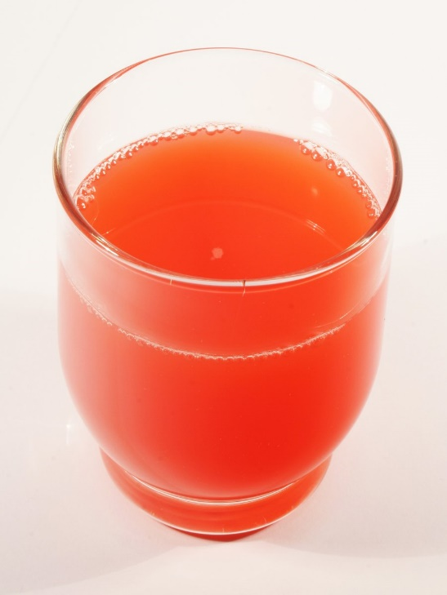
Solutions, Solvents, and Solutes
Solution – Any dissolved substance in a liquid
Solute – Any substance being dissolved
Solvent – Substance doing the dissolving
Example: The Solution of Cool-Aid
Solute – powder of flavor and sugar
Solvent - water
Notes:
https://www.freeimages.com/photo/juice-1328852

