Slide 1
Raise the Roof! Engineering a Leakproof Roof

Slide 2
Question: Why do you think pollution is a big problem in countries with fewer resources and less money?

Slide 3
How do we combat and reduce waste and pollution?

Slide 4
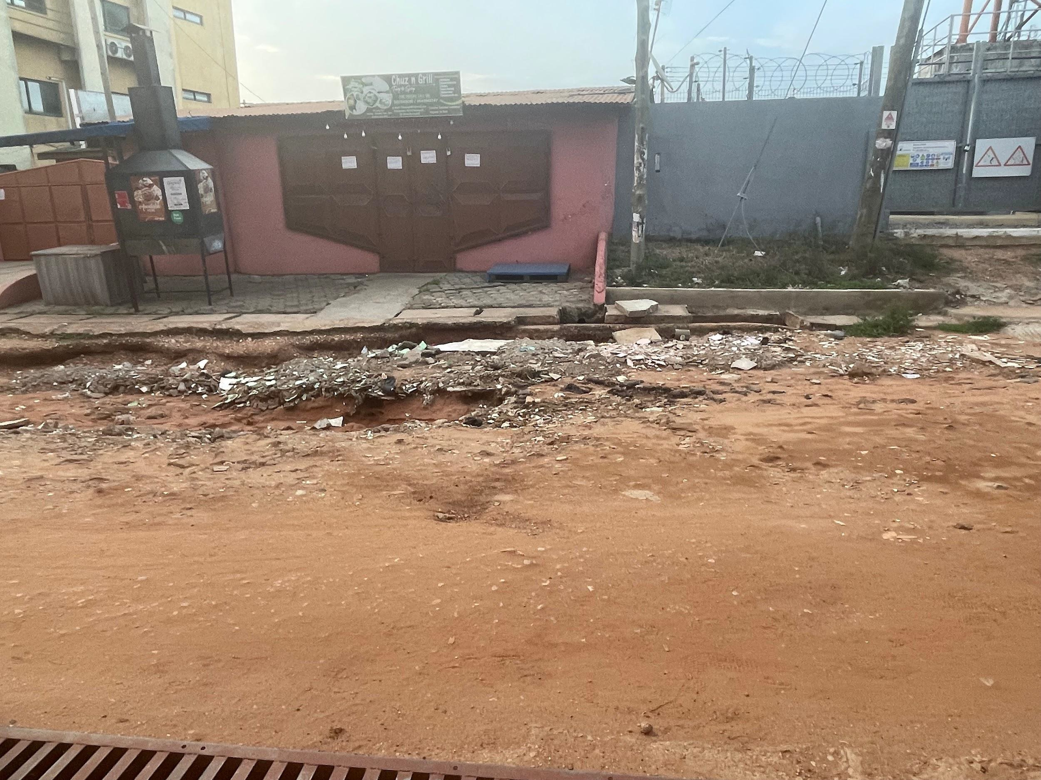
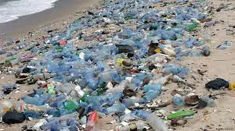
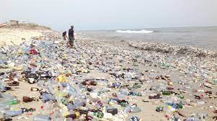
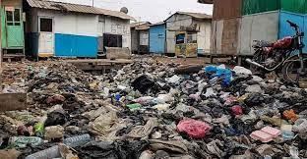
Think About It
Look at the following photos of pollution in Ghana…
What do you notice? What do you wonder?

Slide 5
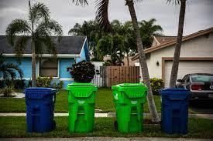
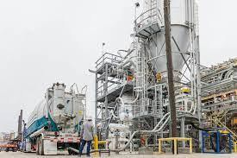
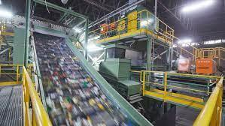
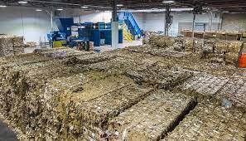
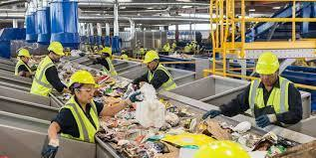
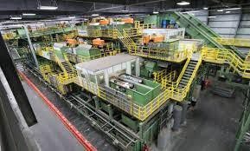
Think About It
Why do you think Ghanaians cannot just build recycling centers like wealthier countries in the world do?

Slide 6
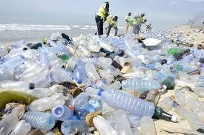
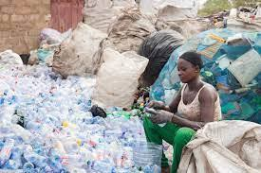
Think
Are there ways to repurpose recyclable materials without having a factory?

Slide 7
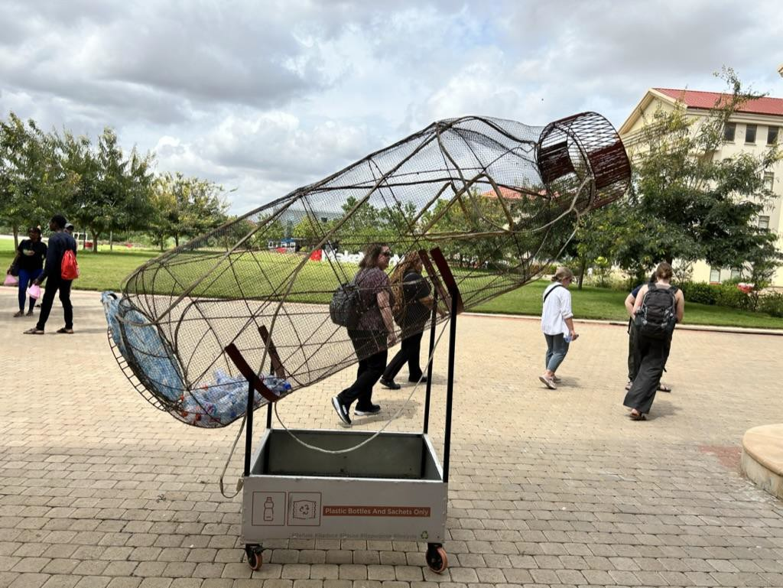
Collection

Slide 8
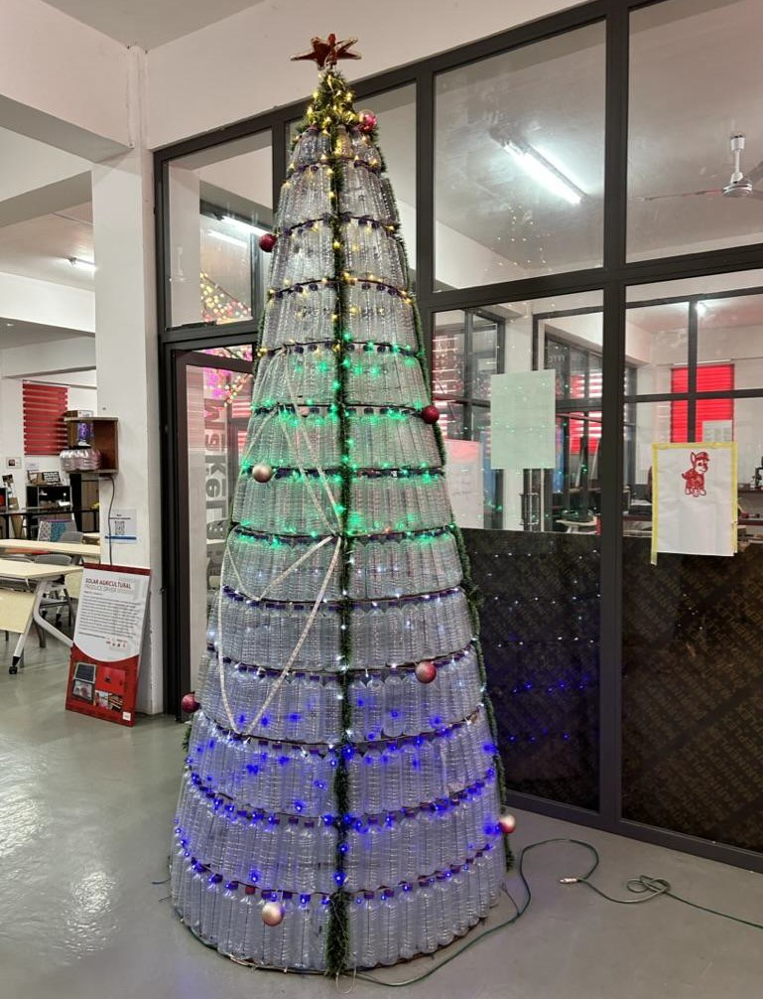
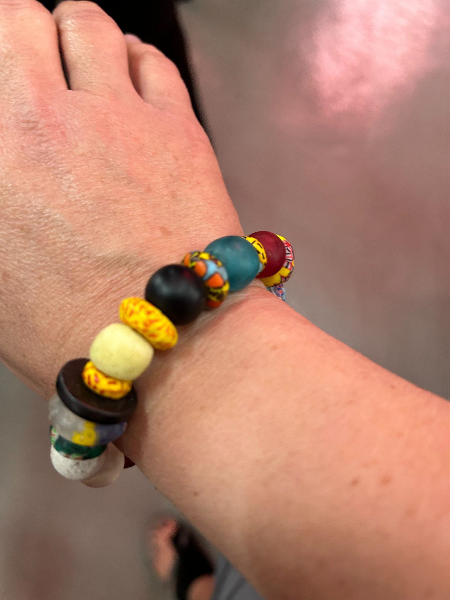
Repurposing

Slide 9
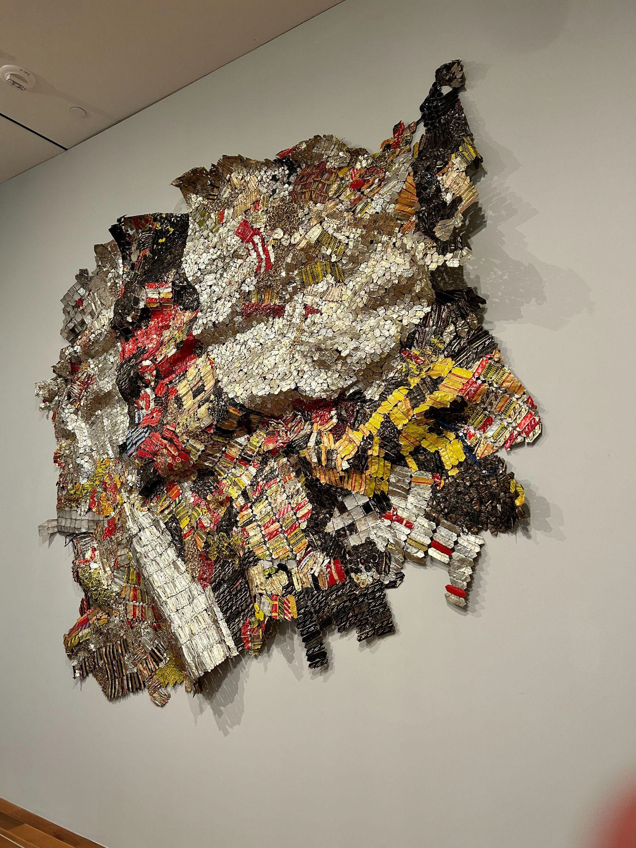
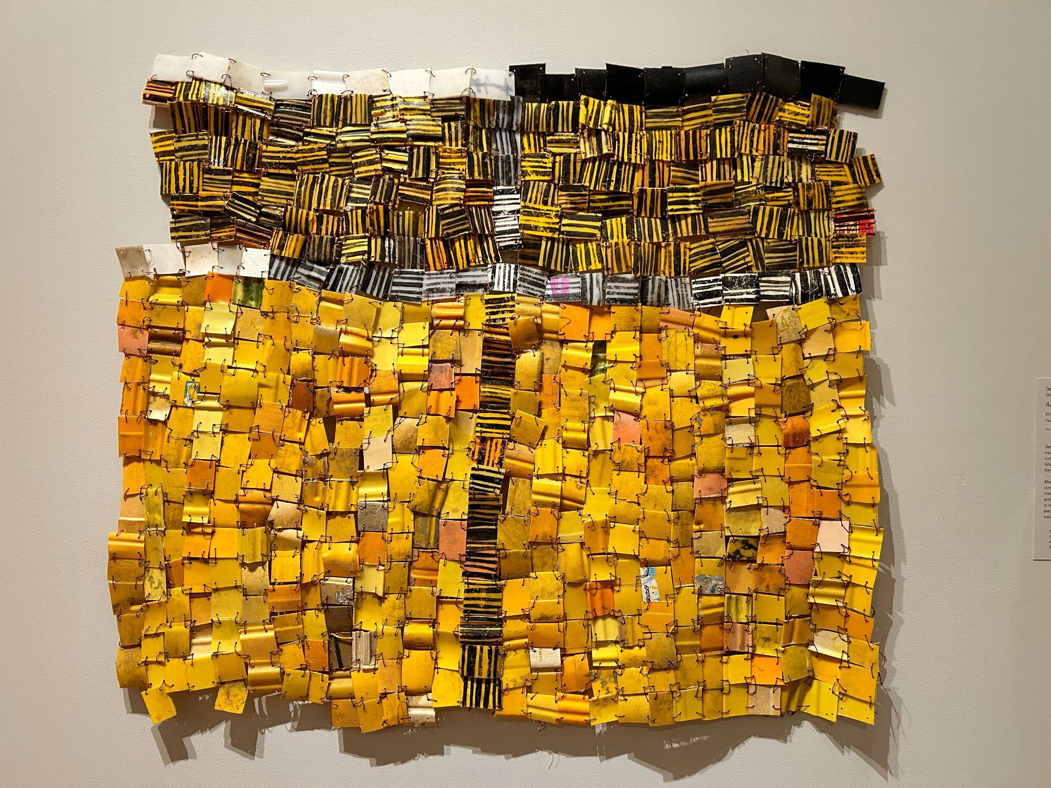
Artwork

Slide 10
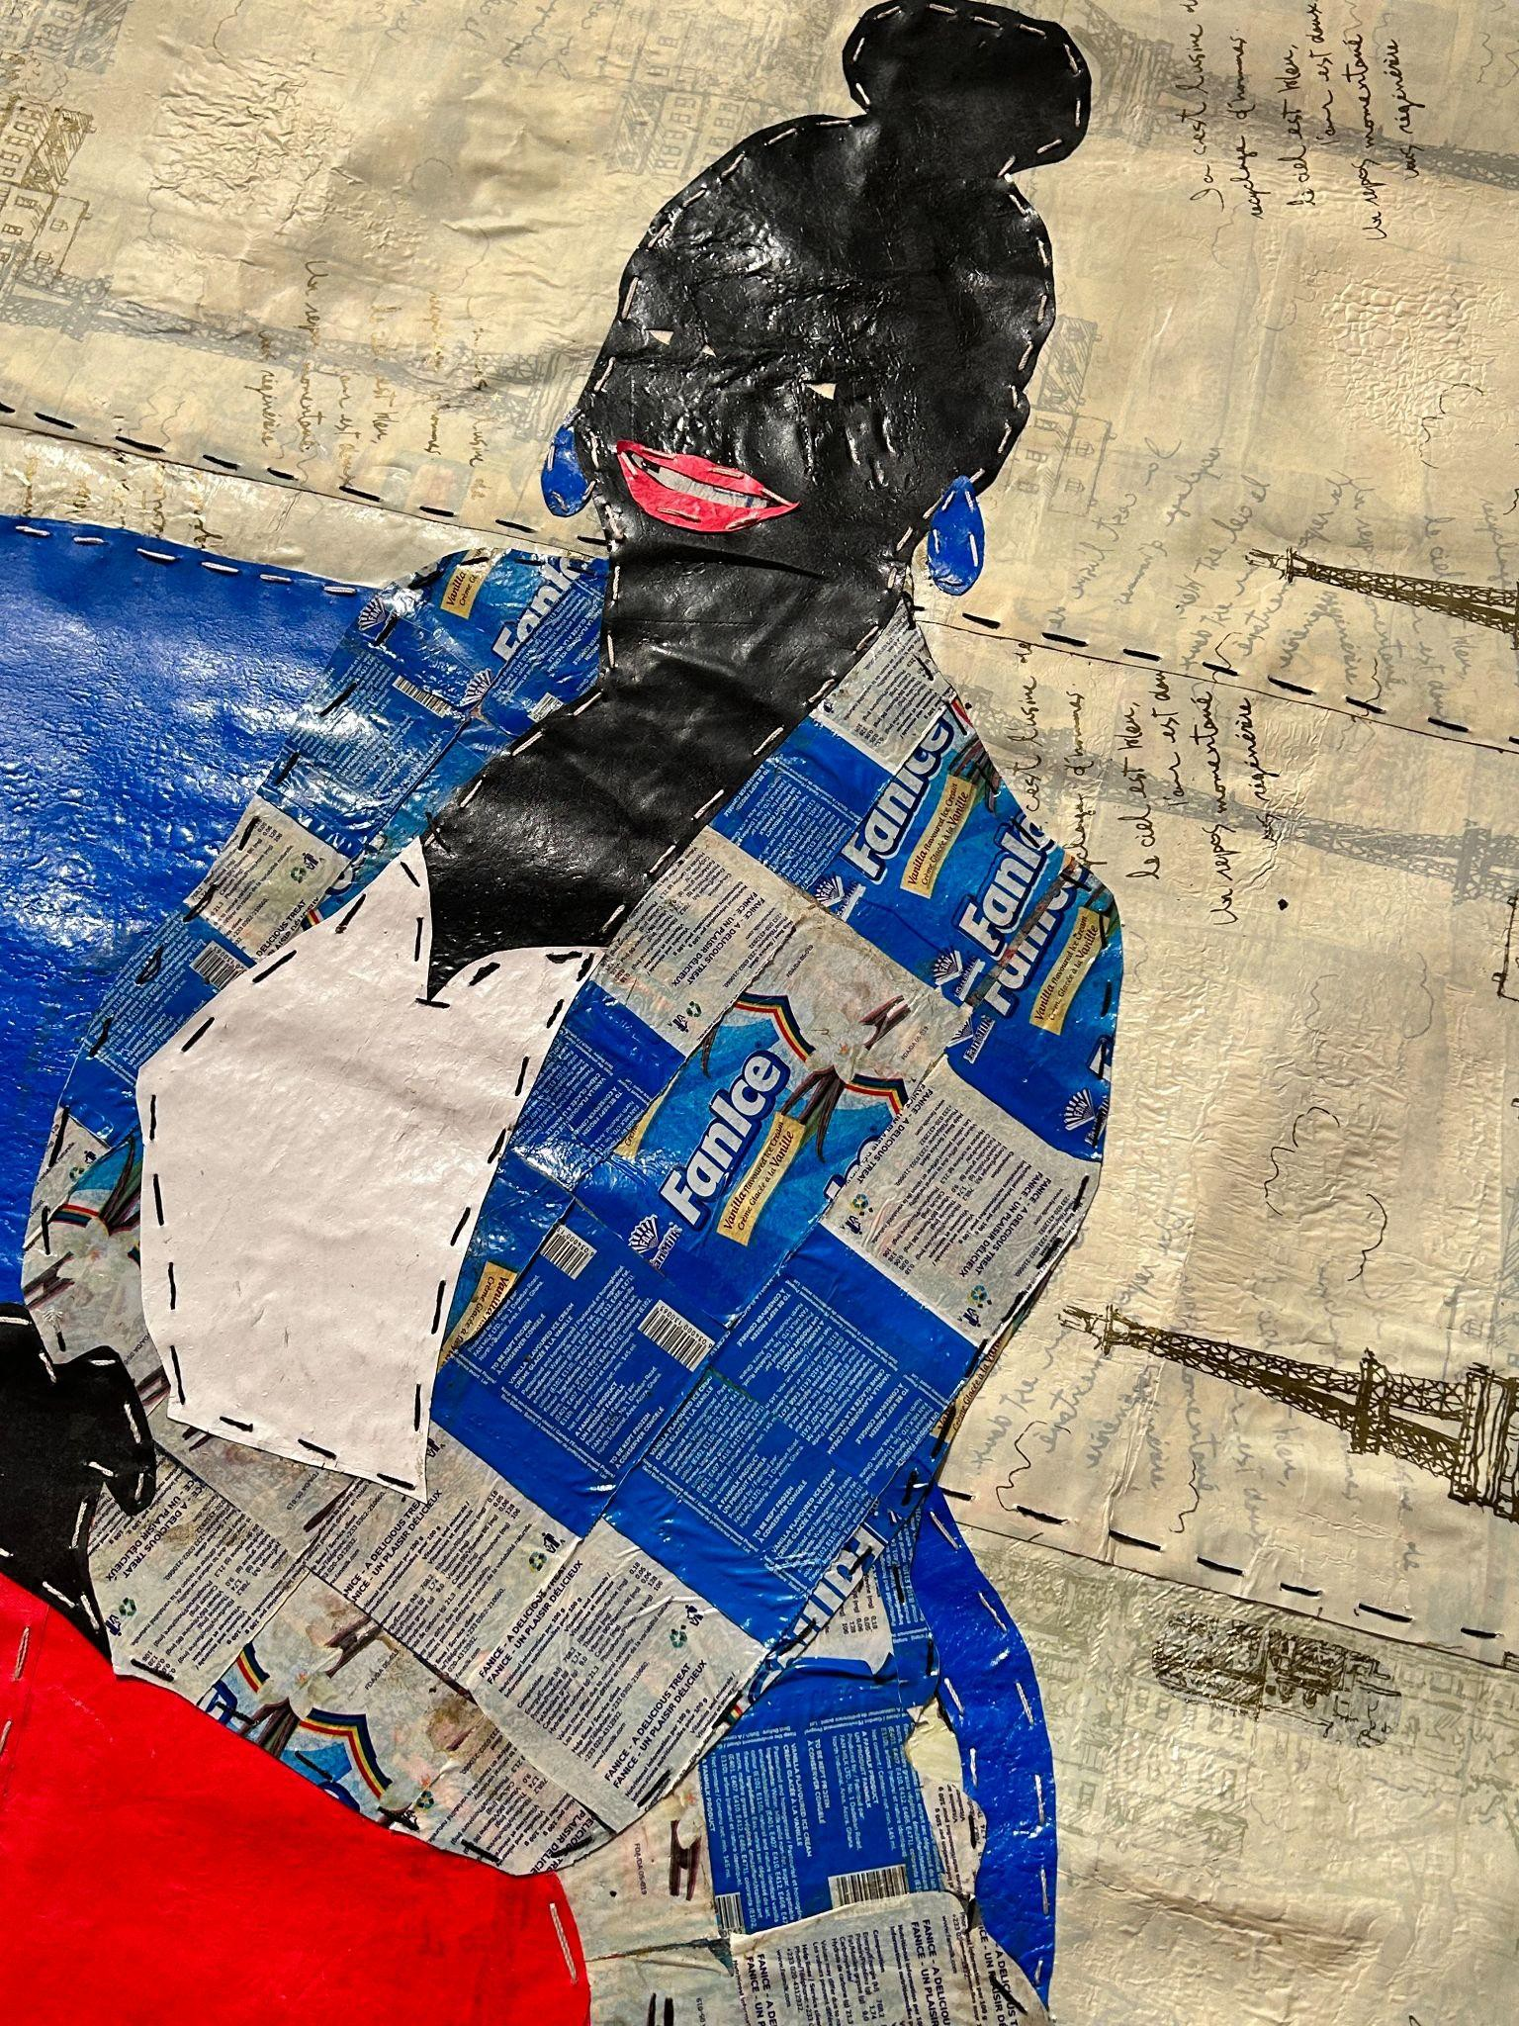
Artwork

Slide 11
Artwork

Slide 12
Can we solve the problem of excess recyclable waste while also solving another problem?

Slide 13
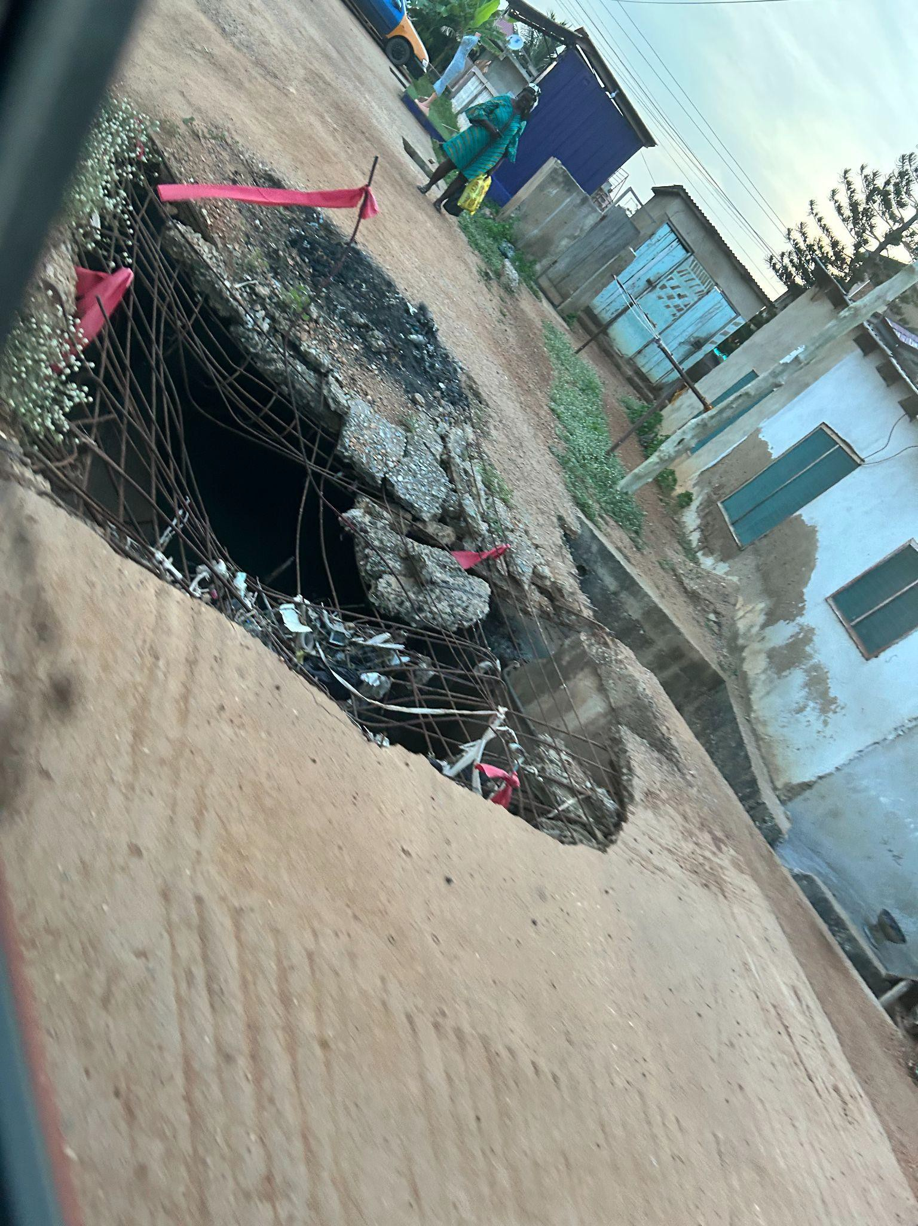
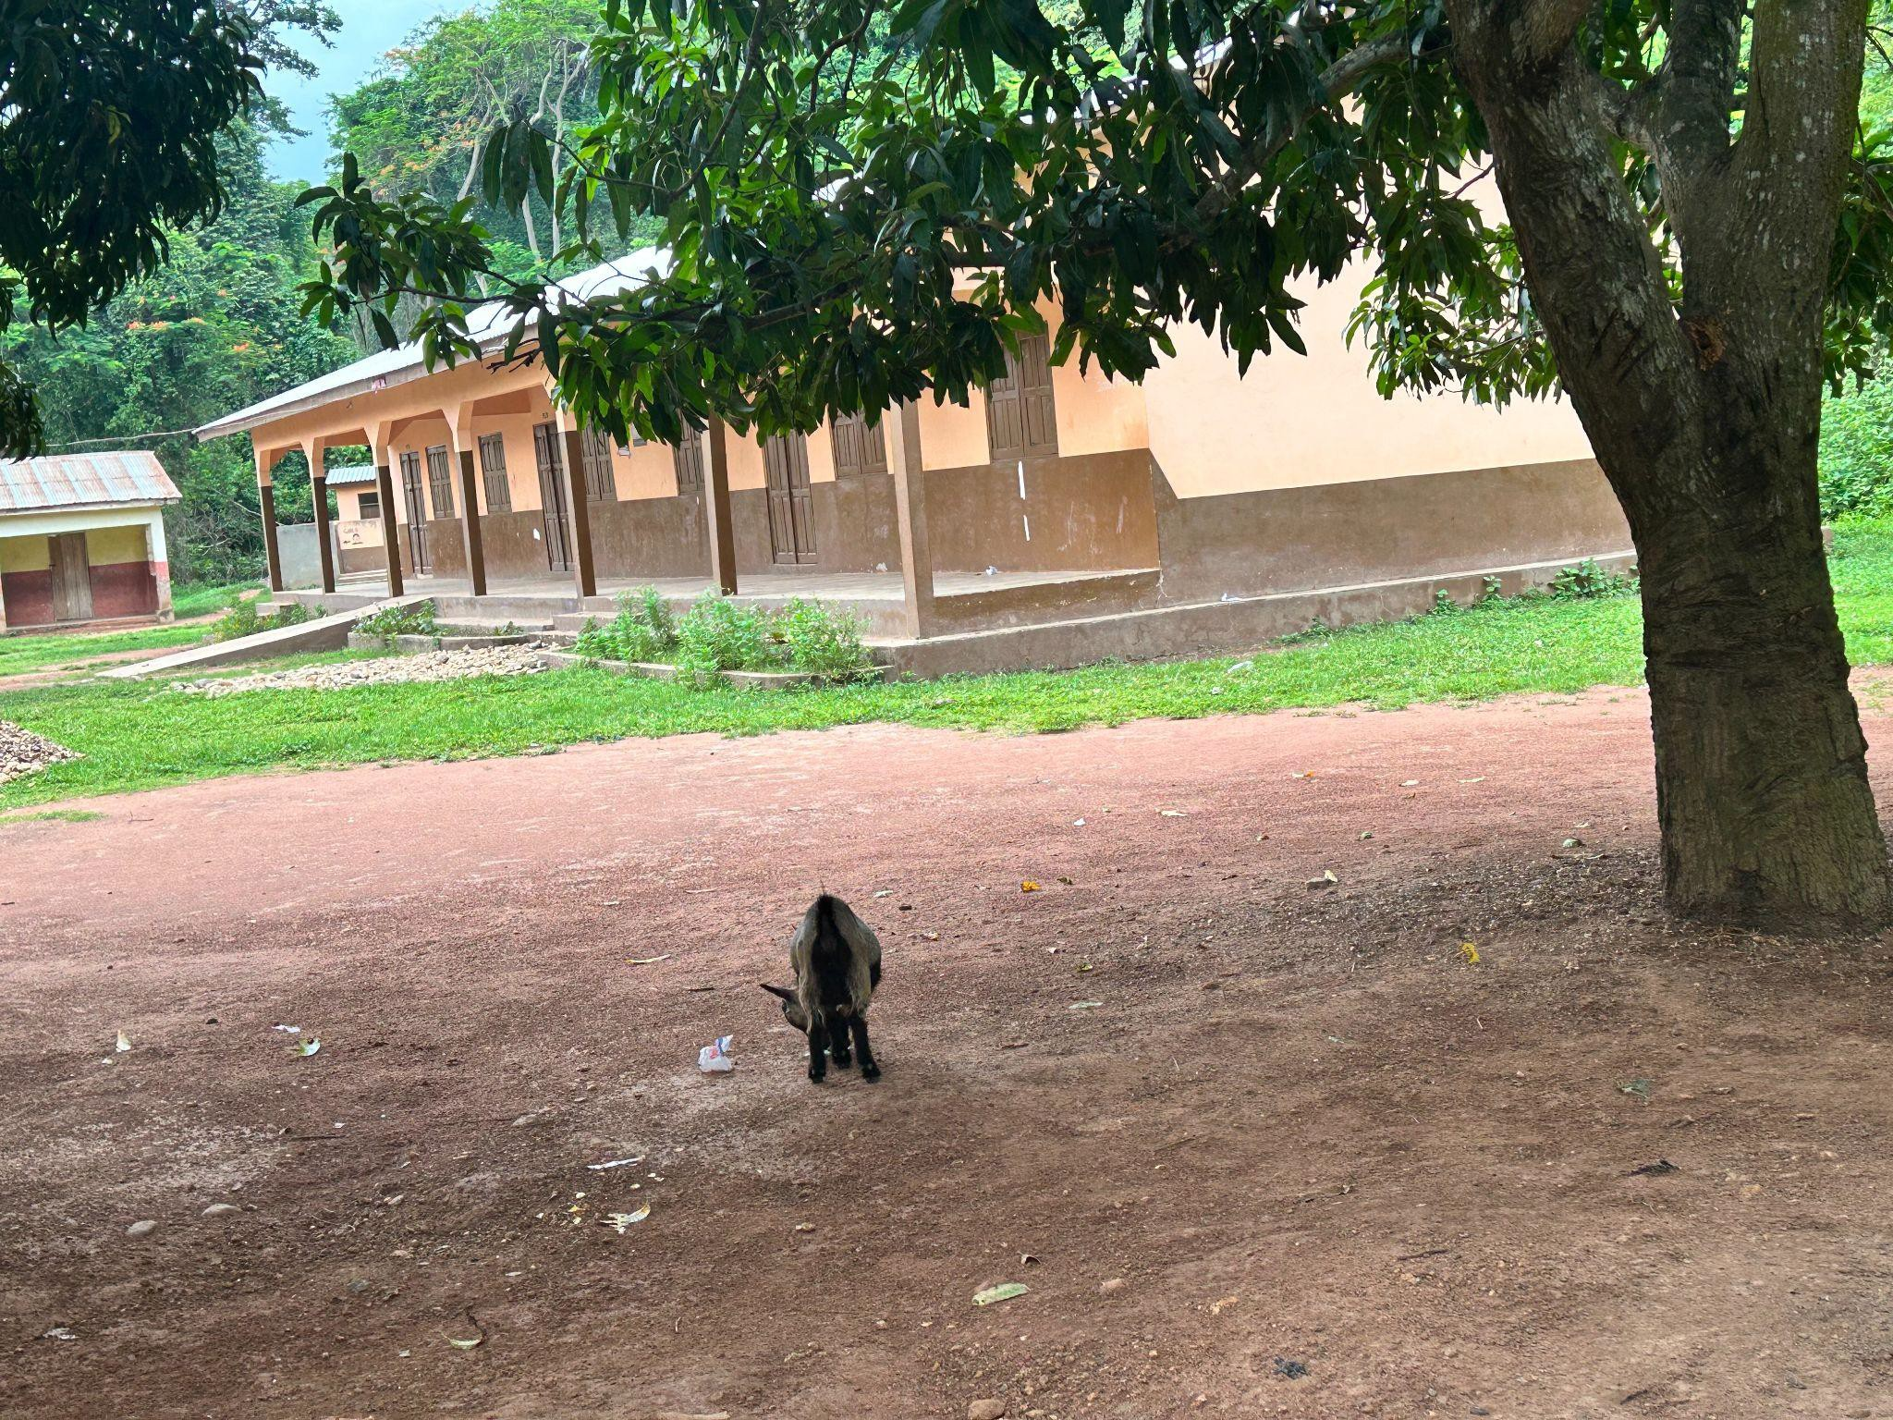
Here is the second problem: dry homes/shelters

Slide 14
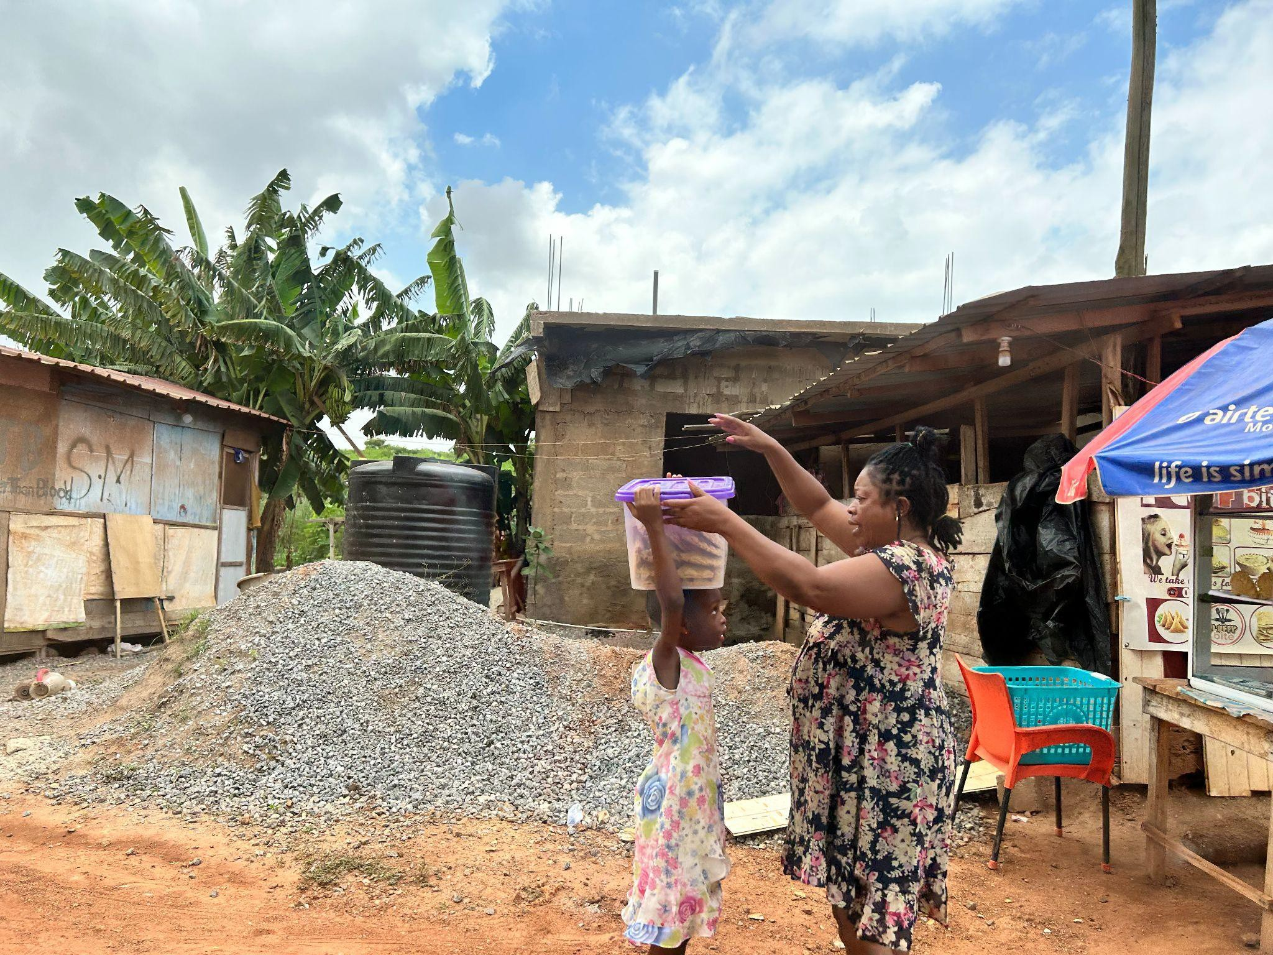
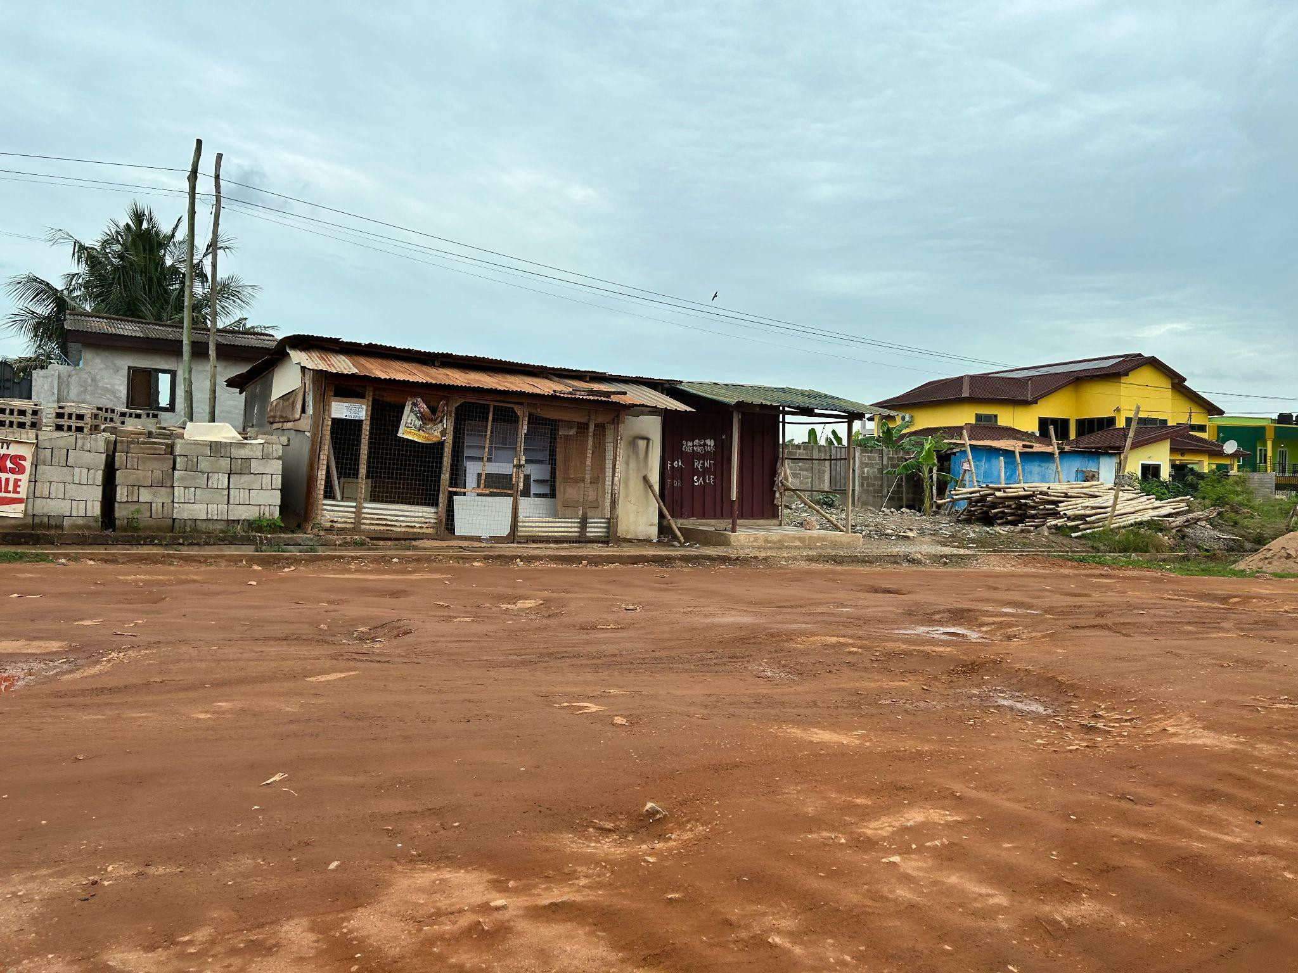
Problem 2: Dry Homes/Shelters

Slide 15
Challenge: Raise the Roof
In an eﬀort to help solve the country of Ghana’s recycling challenge and help residents to have dry roofs, you are going to create a simulation of a roof for a basic housing structure in order to design and build a more sustainable and leakproof roof.
Once the roofs are built, water will be poured on them and left for ﬁve minutes.

Slide 16
Criteria:
The housing structure must be a ﬂat, lean-to, or gable provided by your teacher.
The roof:
Must cover the entire housing structure.
Must be made of resources available to the country of Ghana and recycled materials.
The shape of the roof will determine the housing structure shape.
The more recycled materials added, the better the score.

Slide 17
Constraints:
The roof:
Must not hold water.
Must not have any leaks.
Must be made with only the materials provided.

Slide 18
Points | 1 pt | 2 pts | 3 pts | 4 pts
How well does the water run off the roof? | Water pours through the roof into the structure below. | Water pools on top of the roof. | Some water runs off the roof and some water pools on roof. | All water runs off the roof.
How much of the roof utilized the resources (glue and tape)? | Used only non-recycled resources. | Used a significant amount of glue or tape. | Only used a small amount of glue and tape to construct roof. | Used minimal glue or tape.
How much of the roof is made of recycled materials? | 25% or less. | More than 25%, less than 50%. | More than 50%, less than 75%. | More than 75%.
How well does the roof hold its shape after 5 minutes? | Roof entirely collapses. | Roof partially collapses. | Roof stays intact but bows. | Roof stays intact, remains unchanged.

