Slide 1
Around the World and Back

Slide 2
WHAT IS AN SDG?
What is a sustainable development goal (SDG)?
¿Qué es un objetivo de desarrollo sostenible (ODS)?
A universal call to action to end poverty, protect the planet, and ensure that by 2030 all people enjoy peace and prosperity.
Un llamado universal a la acción para poner fin a la pobreza, proteger el planeta y garantizar que para 2030 todas las personas disfruten de paz y prosperidad.
UN SDG | Explanation
SDG Target 10.2 | By 2030, empower and promote the social, economic, and political inclusion of all, irrespective of age, sex, disability, race, ethnicity, origin, religion or economic or other status.
SDG Target 10.3 | Ensure equal opportunity and reduce inequalities of outcome, including by eliminating discriminatory laws, policies, and practices and promoting appropriate legislation, policies, and action in this regard.

Slide 3
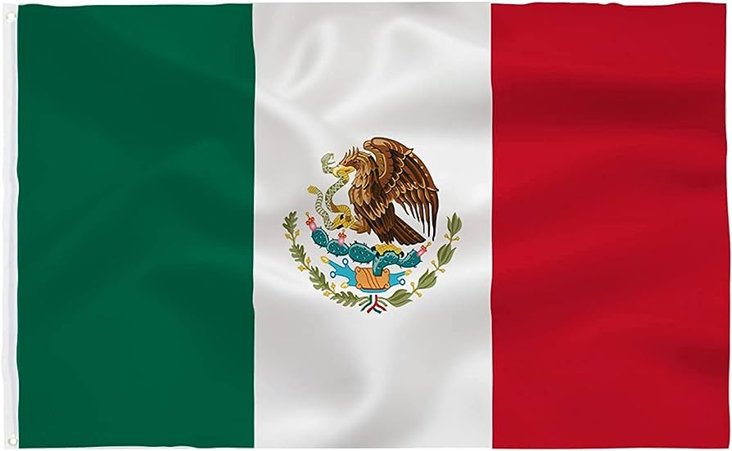
INTERNATIONAL MARKETS
What international markets are in Huber Heights, Ohio?
¿Qué mercados internacionales hay en Huber Heights, Ohio?
1) Buja International Food and Fashion
2) AHISKA MARKET, Turkish
3) Huber Mart, Turkish
4) La Michoacana Market, Mexican

Slide 4
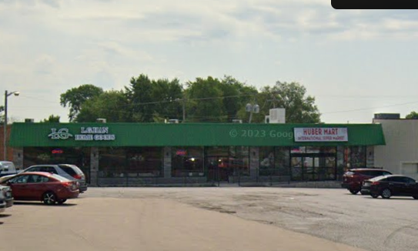
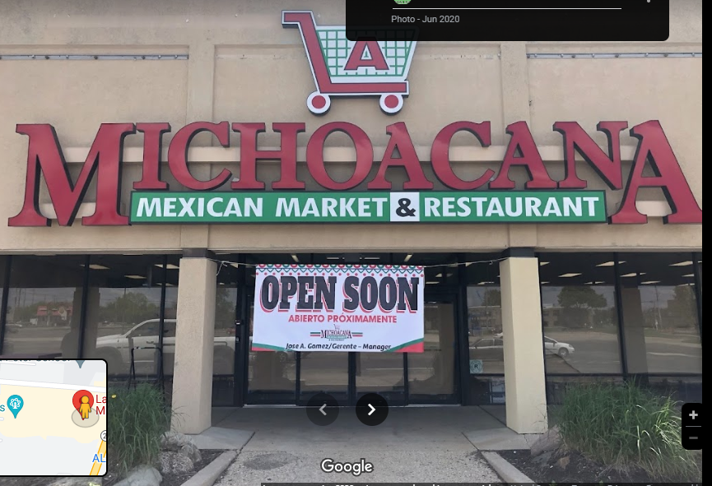
FIELD TRIP STOPS
What international markets will we visit?
¿Qué mercados internacionales visitaremos?

Slide 5
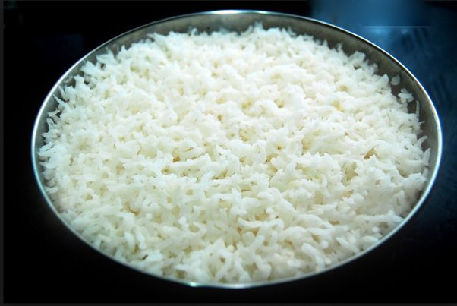
FOOD STAPLES
What is a food staple?
A staple food, food staple, or simply a staple, is a food that is eaten often and in such quantities that it constitutes a dominant portion of a standard diet for an individual or a population group, supplying a large fraction of energy needs and generally forming a significant proportion of the intake of other nutrients as well.
What food staples do you expect to find in international markets?
Asian -- ??
Mexican -- ??
Turkish -- ??
Where do you think they might be located?
Corn, beans, rice, avocado, limes, and chiles
Rice, wheat, vegetables, Dolma , rice- and meat-stuffed vegetables.

Slide 6
Protecting people with disabilities
What is the American Disabilities Act (ADA)?
The Americans with Disabilities Act (ADA) prohibits discrimination against people with disabilities in several areas, including employment, transportation, public accommodations, communications, and access to state and local government programs and services.
Why is ADA accessible design important?
The ADA and government administrative regulations provide guidance about what is required for a building or facility to be physically accessible to people with disabilities.

Slide 7
Ada accessible design
List and explain components of ADA accessible design.
Priority I – Accessible approach and entrance
Priority II – Access to goods and services
Priority III – Access to public toilet rooms
Priority IV – Access to other items such as water fountains

Slide 8
Engineering design process
What is the engineering design process (EDP)?
A series of steps that guides engineering teams as they solve problems. The design process is iterative, meaning that engineers repeat the steps as many times as needed, making improvements along the way as they learn from failure and uncover new design possibilities to arrive at great solutions.

Slide 9
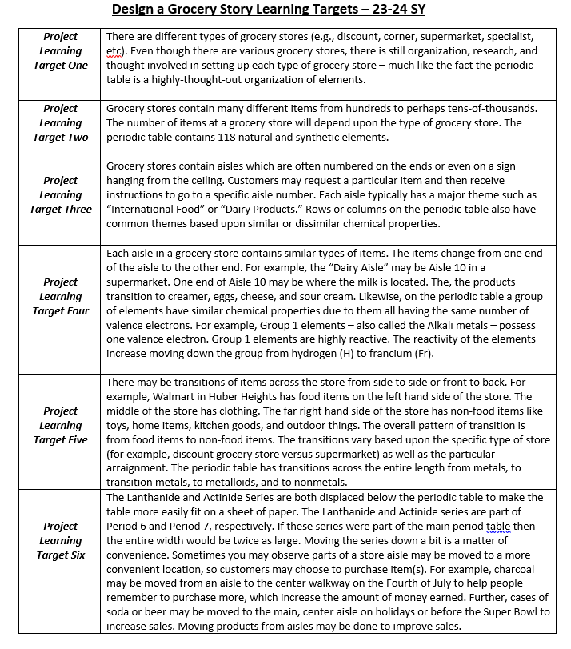
The periodic table
How is the grocery store like the periodic table? Explain!

