Slide 1


Rush Hour Mayhem:
Engineering Efficient Routes With Logic Gates

Slide 2
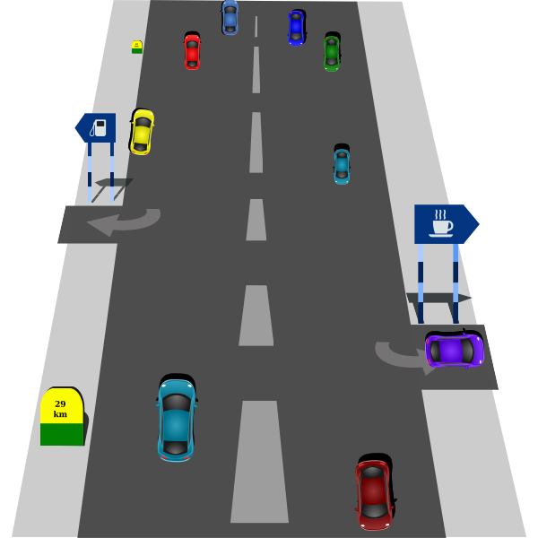
Rush Hour Mayhem
The mayor has hired you as city planners to help reduce traffic in the downtown area.
However, it is essential that all of the businesses downtown still receive the correct shipments of goods.
Make sure that the red and green delivery trucks that are coming into the city get to the right places!
Free SVG (2014)

Slide 3

Rules
Strategically use a series of gates to help send the right trucks to the right places.
Gate Types:
  Buffer
  NOT
Each gate works differently.
  OR
  AND
Vector Portal (2022)

Slide 4

Single Gates
One truck comes in, one truck goes out.
  BUFFER Gate
  NOT Gate
Dual Gates
Two trucks come in, one truck comes out.
  AND Gate
  OR Gate
Wikimedia Commons (2016)
Wikimedia Commons (2016)

Slide 5

Gate Handout #1
The truth tables show how each type of gate works.
They will show what trucks will come out of the gates (the output) based on what went in (the input(s)).
Study the truth tables and decide which type of gate applies to each example.
Free SVG (2014)
Notes:
TEACHER NOTES: Stop presentation here and have class work on Gate Handout #1. Do the first example together. Direct students to think from the perspective of the green trucks. (The green trucks represent a 1 (a switch in the on position) in a typical truth table and the red trucks represent a 0 (a switch in the off position) of a typical truth table. You could use the following dialogue: ‘Truth Table #1 represents the ‘Buffer Gate.’ A buffer keeps things the same, even as changes may be introduced. A buffer resists change. An example of a buffer solution is our blood. Throughout our lives of eating, growing, getting sick, healing, growing, feeling hot or cold, etc., our blood keeps its pH the same. Look at the first input in Truth Table #1. In the first row, is a green truck coming in? (Answer: Yes) Is a green truck coming out? (Answer: Yes.). In the second row, is a green truck coming in? (Answer: No.) Is a green truck coming out? (Answer: No.) So, when trucks that are green come in, trucks that are green come out. When trucks that aren’t green come in, trucks that aren’t green come out. The output is the same as the input. This is a BUFFER Truth Table because it shows that things are kept the same. Go over the answers. Then move on in the slide deck.

Slide 6
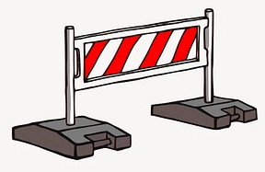
Review: Single Gates
One truck comes in, one truck goes out.
BUFFER Gate
  Allows the truck to go through unchanged.
  Green → Buffer Gate → Green
  Sometimes called a “repeater.”
NOT Gate
  Changes the type of truck.
  Green → NOT Gate → Red
  Sometimes called an “inverter.”
Raw Pixel (2025)

Slide 7

Review: Dual Gates
Two trucks come in, one truck comes out.
AND Gate
  Are both trucks green?
  Yes = Green truck comes out.
  No = Red truck comes out.
OR Gate
  Is either of the trucks green?
  Yes = Green truck comes out.
  No = Red truck comes out.
Public Domain Vectors (2020)

Slide 8
Extra Check!
Check your understanding of how these four gates work:
Red Truck → Buffer Gate → _______________
Red Truck → NOT Gate → _______________
Red + Green Truck → AND Gate → _______________
Red + Green Truck → OR Gate → _______________
Red Truck
Green Truck
Red Truck
Green Truck

Slide 9

City Map #1 - Version A
Now that you know how the gates work, it’s up to you help sort out the mess of trucks downtown.
The previous city planner set up a series of gates. Determine which trucks should end up at the drop-off points.
Wannapik (2015)

Slide 10

City Map #1 - Version B
Uh oh! There’s a new set of trucks heading into town!
Change the gates to make sure that the correct trucks end up at the drop-off points!
Wannapik (2015)
Notes:
For 7/24/25 CSU Presentation Purposes - Marj - Slides 10-14

Slide 11

Congratulations!
Great job, City Planners!
  You’ve successfully gotten the correct trucks to the drop-off points.
The mayor has decided to promote you to an even more difficult section of the city!
  We’ll have to learn about some new gates in order to fix this mess.
Wikimedia Commons (2021)

Slide 12
Logic Gate Handout #2
On your handout, you are given truth tables that show how three new gates work.
  NAND, NOR, & XOR
This time you will have to use the names and your knowledge of other gates to determine their outputs.
Free SVG (2014)
Notes:
TEACHER: Stop presentation here and have class work on Logic Gates Handout #2. Do the first example (XOR) together. Again, direct students to think from the perspective of the green trucks. (Again, the green trucks represent a 1 (switch in the on position) in a typical truth table and the red trucks represent a 0 (switch in the off position) of a typical truth table.) Perhaps tell them that the XOR gate essentially means EXCLUSIVELY (OR ONLY) OR (but NOT BOTH). Thus, the output is green ONLY when ONE truck is green but not both.
If a student struggle with the NAND and NOR gates, you can tell them that a NAND gate is a combination gate and ask them which two gates they think make up the NAND gate. The answer is that is it a combination of the NOT gate and the AND gate. If needed, you could say something like, ‘So, if this gate is an inversion of and AND gate, what would the output of the Truth Table be?’ The answer, as shown on the answer key, is that the outputs are the opposite of the outputs of the AND Gate Truth Table. NOR is also a combination gate.

Slide 13

Review: Other Dual Gates
NAND & NOR Gates
  Essentially the inverse of AND and OR
  NAND = NOT + AND
  NOR = NOT + OR
XOR Gate
  Exclusively OR
  Only returns a green output if the two inputs don’t match
Wannapik (2015)

Slide 14
Extra Check!
Check your understanding of how these four gates work:
Red + Green Truck → NAND Gate → _______________
Red + Red Truck → NOR Gate → _______________
Green + Green Truck → XOR Gate → _______________
Red + Red Truck → NAND Gate → _______________
Green Truck
Green Truck
Red Truck
Green Truck

Slide 15

City Map #2
Equipped with these new gates, let's tackle our toughest problem yet!
The previous city planner set up a series of gates. Determine which trucks should end up at the drop-off points.
Free SVG (2019)

Slide 16
Engineering Design Challenge - Part 1
This time you will create your own map!
  The inputs & the final outputs have been selected for you.
Design Constraints:
  Use the NOT, Buffer, OR, & AND gates at least once.
  Use the NOR, NAND, and XOR gates at least twice.
  5 cars must go through at least 2 gates.
  1 car must go through at least 3 gates.
  All input trucks must be used.

Slide 17

Why Did We Do This?
Throughout these activities, I’m sure you’ve wondered:
“Why am I doing this?”
“What am I supposed to learn from this?”
Believe it or not, you’ve been learning about something called logic gates!
Free SVG (2020)

Slide 18

What Are Logic Gates?
Fundamental building blocks of electrical and digital circuits.
The foundation of advanced electronics and coding (programming).
Examples:
  Computers, phones, tablets, smart-watches, etc.
  Traffic lights
  Software
Wikimedia Commons (2011)

Slide 19

How Do They Work?
Electronics only understand “on” or “off.”
  Is it receiving a “signal” or not.
We often represent this as:
  0 = No signal
  1 = Signal
What were our 0s and 1s in our city planning?
Public Domain Vectors (2016)
Notes:
ANSWER: The green trucks are the 1s and the red trucks are the 0s.

Slide 20
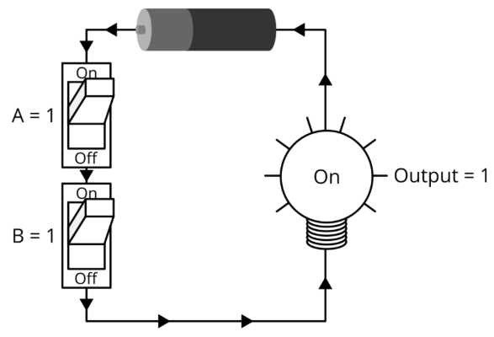
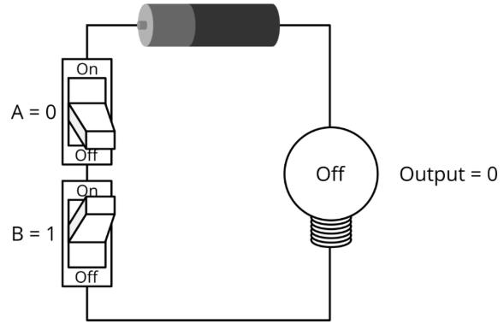
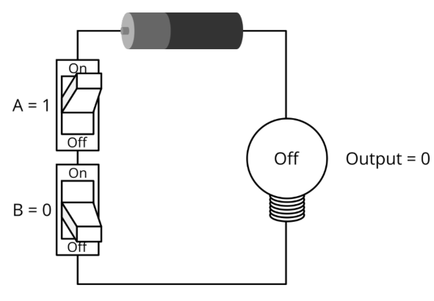
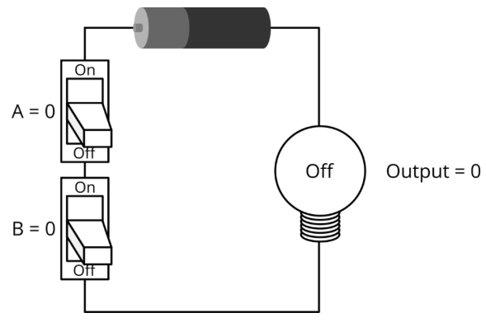
Visualizing Logic Gates
Truth Table
Input A | Input B | Output
1 | 1
1 | 0
0 | 1
0 | 0
Gate = ________
1
0
0
0
AND
Wong (2022)
Wong (2022)
Notes:
Each picture represents the same logic gate. As a class, complete the truth table based on the images and determine which is the correct gate! (Answer = AND)

Slide 21
Engineering Design Challenge - Part 2
Efficiency is important, especially in electronics.
  Leads to lower cost and energy usage.
Find a way to remove at least 3 gates from your map.
Design Constraints:
  You may NOT change any inputs or final outputs.
  You may change/remove other gates if necessary.
  There are no longer any constraints regarding the types of gates you use.
  You CANNOT change your paths/layout.
**DON’T START DESIGNING YET**

Slide 22
Brainstorm and Peer Share!
Discuss ideas with your partners…
  DO NOT MAKE THE CHANGES YET!
When instructed, you will swap your map with another team.
  Do not talk to them about your map or ideas.
  In 5 minutes, come up with 2-3 suggestions for how the other group could change their gates.
  Write these ideas on a separate sheet of paper and return it with the map. Plan to turn in this paper with your final product.
Notes:
TEACHER NOTES: You do not have to assign grades to the peer share and paper unless you want to. You could make it a participation grade in order to make it easier on yourself.

Slide 23
Presentation Requirement
Document the changes you make as you go.
You will need to create a slide deck explaining the changes you made.
Each group member must describe at least one gate change and create those related slides.
  Each member is to explain how you managed to keep the same inputs and the same FINAL outputs while changing/reducing the gates.
Notes:
TEACHER NOTES: To minimize issues, you are encouraged to grade each presentation as it occurs using the provided grade sheet and to record and hand it back to the students at the end of the class that day.

Slide 24
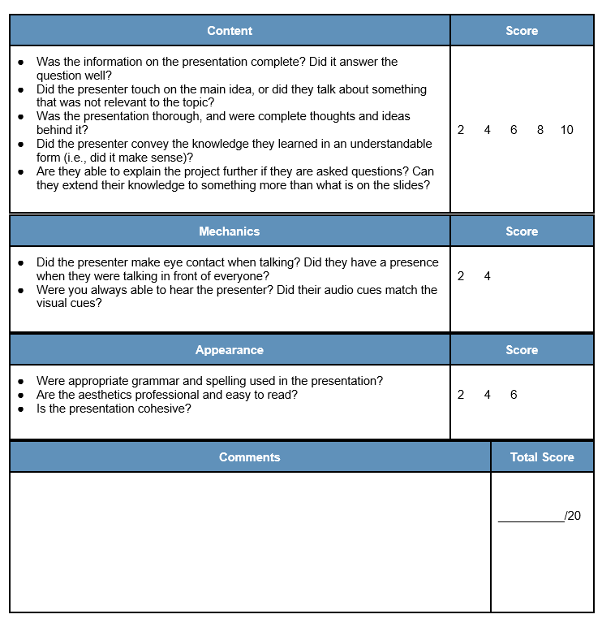
REMEMBER:
Each group member must describe at least one gate change and create those related slides.

Slide 25
Engineering Design Challenge - Part 2
You can now start!
Remember:
  Find a way to remove at least 3 gates from your map.
  Design Constraints:
    You may NOT change any inputs or final outputs.
    You may change/remove other gates if necessary.
    There are no longer any constraints regarding the types of gates you use.
    You CANNOT change your paths/layout.
Notes:
Teacher Notes: Leave this slide up on your projector as they are completing the challenge so that they can see the design constraints as they work.

Slide 26
Work Cited
Free SVG. (2014/2019/2020) https://freesvg.org
Public Domain Vectors. (2016/2020). https://publicdomainvectors.org
Raw Pixel. (2025). https://www.rawpixel.com
Vector Portal. (2022). https://vectorportal.com
Wannapik. (2015) https://www.wannapik.com/
Wikimedia Commons. (2011/2016/2021) https://commons.wikimedia.org
Wong, T. G. (2022). Introduction to classical and quantum computing. Rooted Grove.

