Slide 1


Beyond Binary:
Building Blocks of Digital Decisions

Slide 2
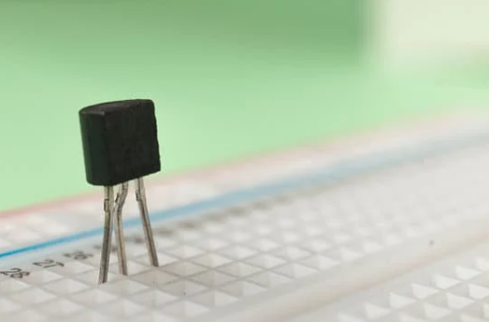
What is it?
Rules of the game:
You can only ask yes-or-no questions.
Each team gets one question per round.
If you think you know what it is,
don’t give it away. Instead, ask leading
(or misleading) questions.
At the end of the rounds, each team
discusses their final guess about what
it is and writes their guess on a
whiteboard.
Photos should preferably be a square - although horizontal or vertical are accepted
Captions should be shown like this...

Slide 3

Transistors
Body copy goes here….
Use only Open Sans for the typeface.
Use only these colors: Black, White and...
Photos should preferably be a square - although horizontal or vertical are accepted
#6091ba
#9fcc3b
#8d64aa
#f8a81b
Captions should be shown like this...

Slide 4
Key Concepts
Transistors act as switches.
They are controlled by electrical inputs instead of a human operator.
They are integral to modern computers and smart devices.
Transistors can be made much smaller than traditional switches.
They are the devices that allow for the binary on and off or 1 and 0 states used in computer logic, decision making, and programming.

Slide 5
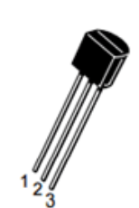
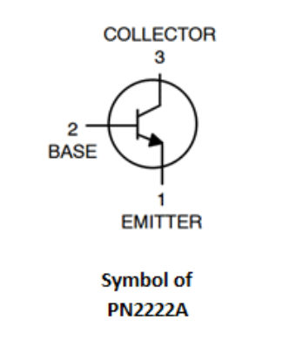
Key Points
Notice the transistor has a flat side and a round side.
Use this to help you figure out which wires connect to which pins.
The Collector and Base pins each connect to the + supply voltage.
The Emitter connects to the negative (ground).
Images from Circuit Digest

Slide 6
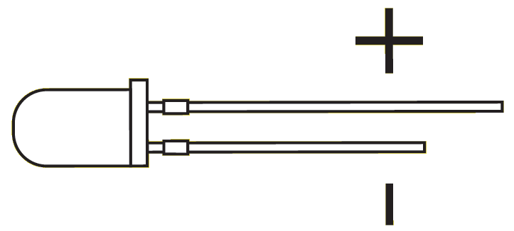
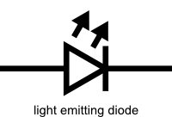
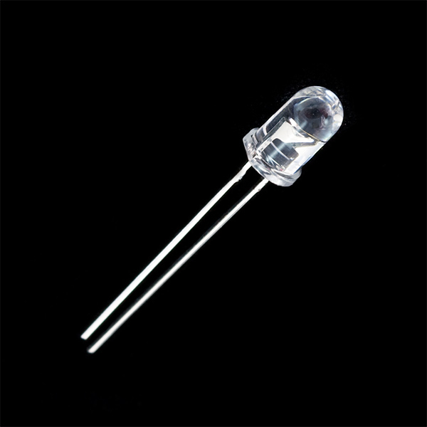
Key Points
LEDs have polarity, which means each leg functions differently. They must be placed in a circuit correctly to light up.
Pay close attention when you are putting them into a circuit.
Images from Spark Fun

Slide 7
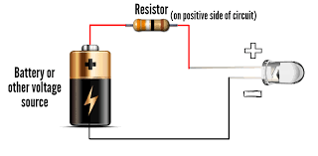
Key Points
The positive side of an LED is the anode; it is the longer lead.
The negative side of the LED is the cathode; it is the shorter lead, with the flat side of the lens.
Images from LED supply
Use this to help you figure out which wires connect to which pins/leads.

Slide 8

How do transistors relate to decision making?
Body copy goes here….
Use only Open Sans for the typeface.
Use only these colors: Black, White and...
Photos should preferably be a square - although horizontal or vertical are accepted
#6091ba
#9fcc3b
#8d64aa
#f8a81b

Slide 9
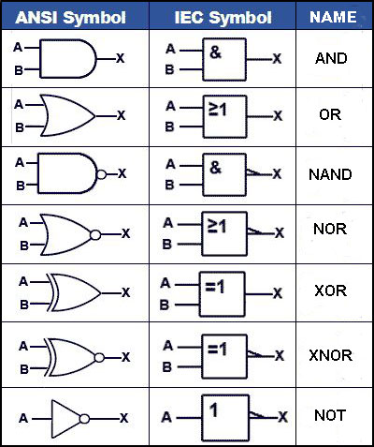
Types of Logic Gates and Their Schematic Symbols
The three logic gates we will be focusing on for this lesson are the AND, OR, and NOT gates.
When you read the symbols to the left, A and B stand for electrical inputs and X stands for electrical output.
When creating your own schematics, other letters may be used.

Slide 10
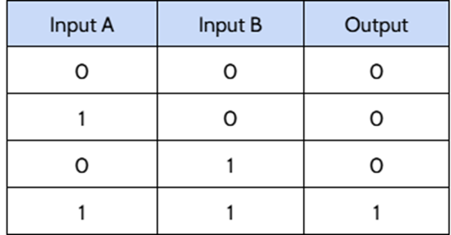

AND Gates
Body copy goes here….
Use only Open Sans for the typeface.
Use only these colors: Black, White and...
AND gates only give a high (voltage) output when both inputs are high.
Photos should preferably be a square - although horizontal or vertical are accepted
#6091ba
Captions should be shown like this...

Slide 11
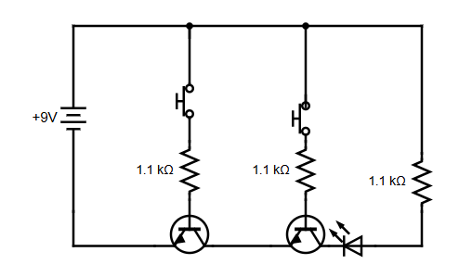
AND Gate Schematic
Body copy goes here….
Use only Open Sans for the typeface.
Use only these colors: Black, White and...
Photos should preferably be a square - although horizontal or vertical are accepted
#6091ba
#9fcc3b
Schematic made using Circuit Diagram Web Editor

Slide 12
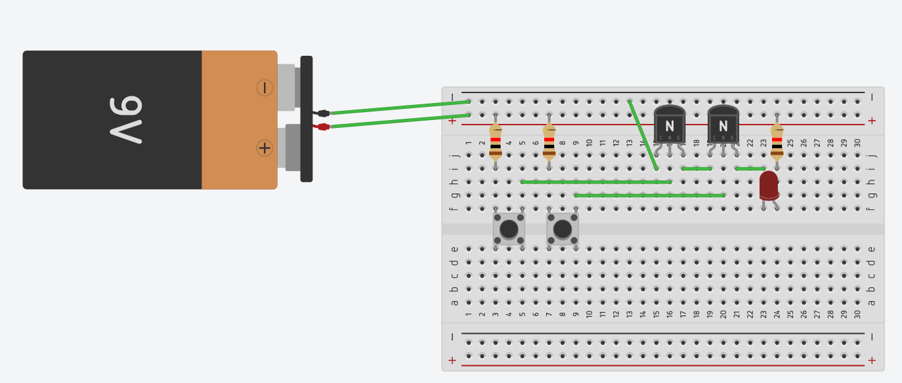
AND Gate Breadboard Example
Body copy goes here….
Use only Open Sans for the typeface.
Use only these colors: Black, White and...
Photos should preferably be a square - although horizontal or vertical are accepted
#6091ba
#9fcc3b
Image made with Tinkercad

Slide 13
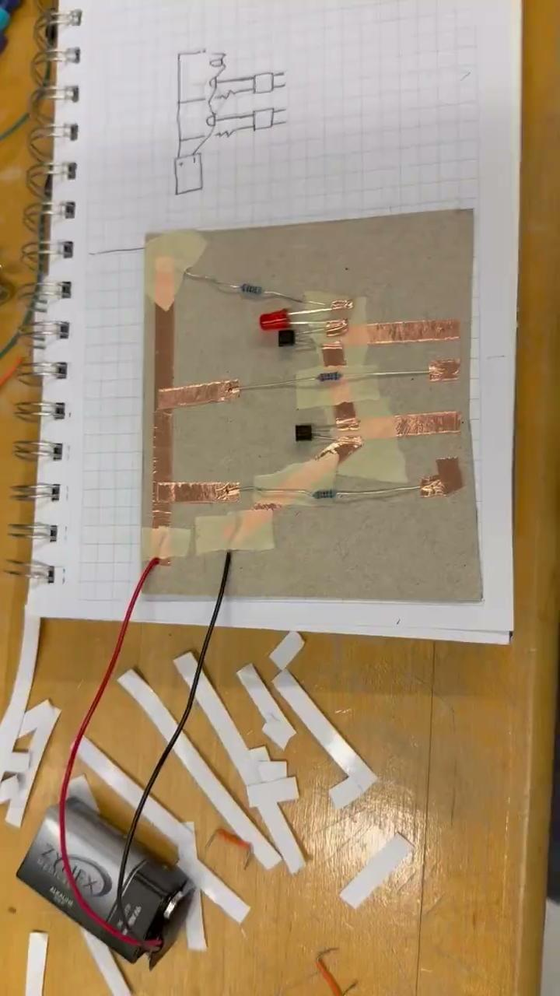
AND Gate Example: Student Built
Body copy goes here….
Use only Open Sans for the typeface.
Use only these colors: Black, White and...
Photos should preferably be a square - although horizontal or vertical are accepted
#6091ba
#9fcc3b

Slide 14

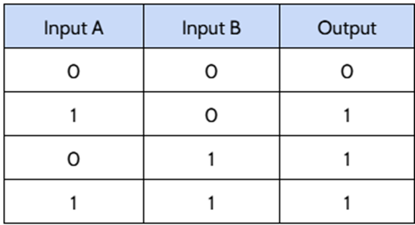
OR Gate
OR gates give a high output if either the A or B input is high.

Slide 15
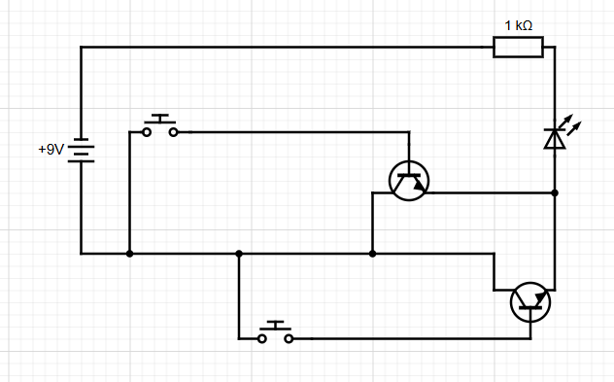
OR Gate Schematic

Slide 16
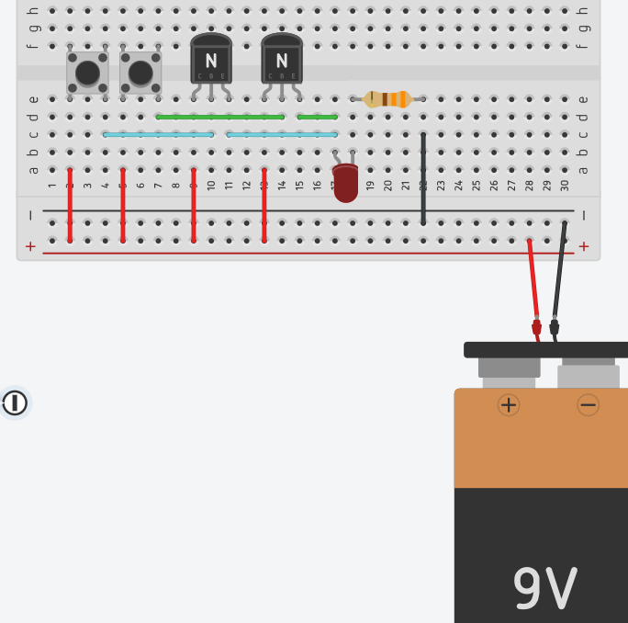
OR Gate Breadboard Example

Slide 17
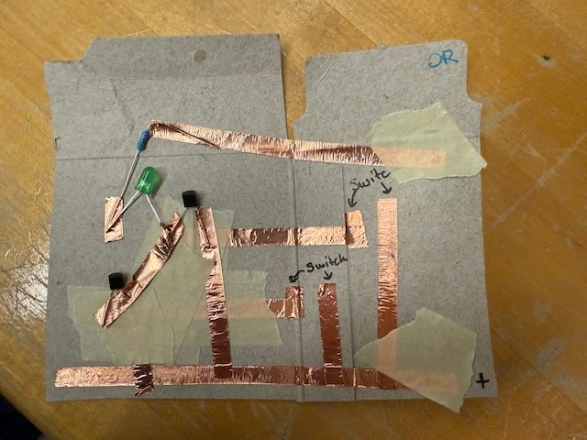
OR Gate Example: Student Built

Slide 18


NOT Gate
Also known as inverters.
If the input is high, then the output is low.
If the input is low, then the output is high.
Diagram made using Circuit Diagram Web Editor

Slide 19
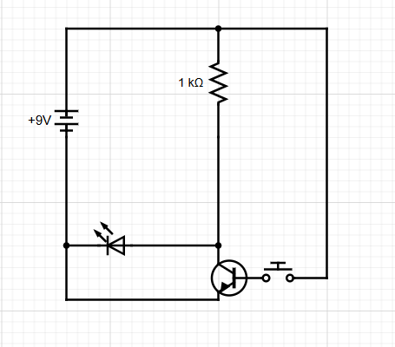
NOT Gate Schematic
Diagram made using Circuit Diagram Web Editor

Slide 20
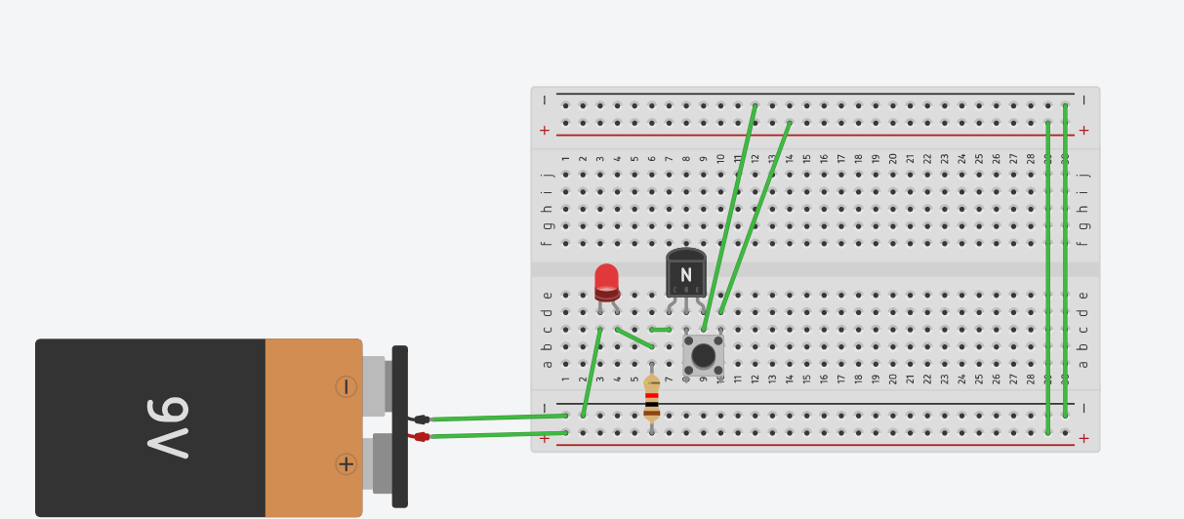
NOT Gate Breadboard Example
Image made with Tinkercad

Slide 21
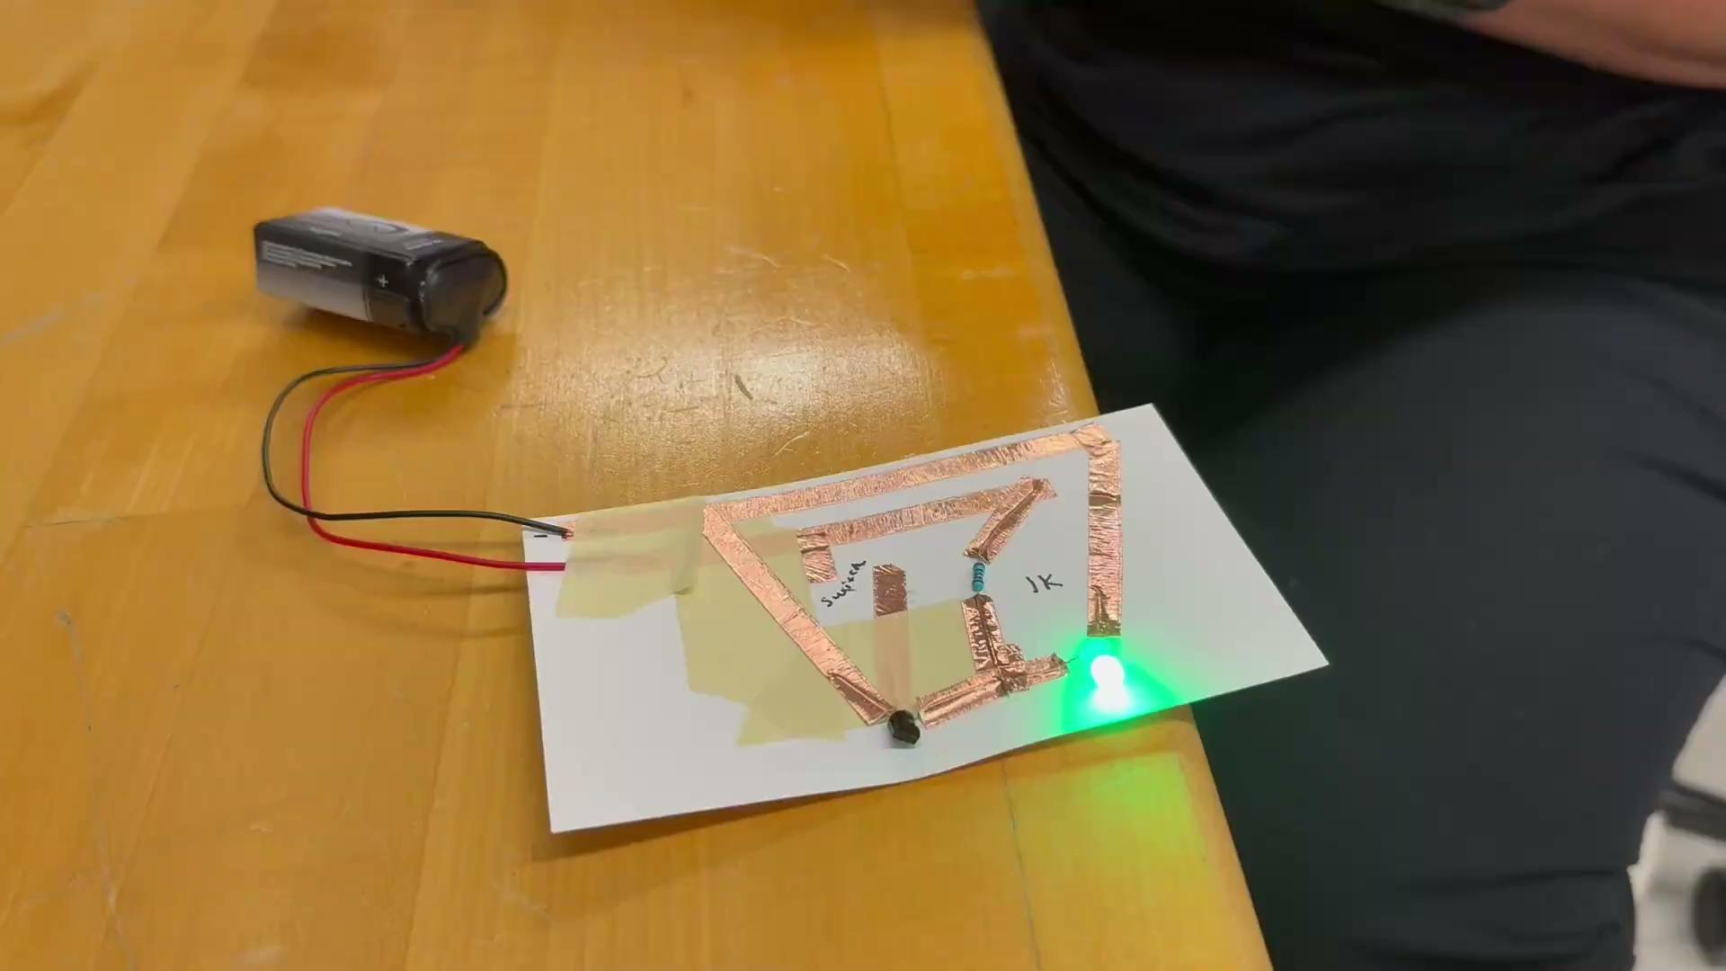
NOT Gate Example: Student Built
Image made with Tinkercad

Slide 22
Engineering Design Challenge
Body copy goes here….
Use only Open Sans for the typeface.
Use only these colors: Black, White and...
Your engineering team will be working on one of the following jobs: (Click the link to read the job description)
Smart Pet Door Design (4)
Automatic Headlight Control System (4)
Small Business Security System Project (4)
Injury Prevention System for a Mechanical Press (4)
Chemical Production Plant Safety Device (3)
Smart Greenhouse Ventilation System (3)
The numbers by each project are how many roles/engineers are needed. If you have a 3-engineer team and take on a 4-role project, you will need to determine how you will share the work of the extra role.
Photos should preferably be a square - although horizontal or vertical are accepted
#6091ba
Captions should be shown like this...

Slide 23
For this challenge each team member will…
Body copy goes here….
Use only Open Sans for the typeface.
Use only these colors: Black, White and...
Take on a specific team role.
Determine which logic gate type is required to complete the task assigned to them.
Build an AND, OR, or NOT gate using materials provided.
Test the gate using a truth table.
Troubleshoot and iterate as needed to create a working gate.
Share information and strategies with team members to help them.
Photos should preferably be a square - although horizontal or vertical are accepted
#6091ba
Captions should be shown like this...

Slide 24
Engineering Design Challenge Parameters
Body copy goes here….
Use only Open Sans for the typeface.
Use only these colors: Black, White and...
Your design must fit on a notecard.
Your goal is to create a gate that is both small and functional.
Your circuit will be tested against a truth table.
You will need to be careful not to create short circuits.
Instead of using switches, as shown in the diagrams, you will create gaps in your circuit that can be closed using fingers or jumper wires.
Photos should preferably be a square - although horizontal or vertical are accepted
#6091ba
Captions should be shown like this...

Slide 25
Engineering Challenges: Smaller Electronics
Body copy goes here….
Use only Open Sans for the typeface.
Use only these colors: Black, White and...
Microchip fabricators keep creating ways to fit more and more components into chips that take up smaller and smaller footprints.
Transistors used in current microchips are in the range of 5-10 nanometers in size.
For scale, a sheet of paper is about 100,000 nanometers thick.
In order to fit more than a billion of these tiny transistors and other components into a chip the size of your thumbnail, the engineers use some special techniques that you can borrow for this activity.
Photos should preferably be a square - although horizontal or vertical are accepted
#6091ba
Captions should be shown like this...

Slide 26
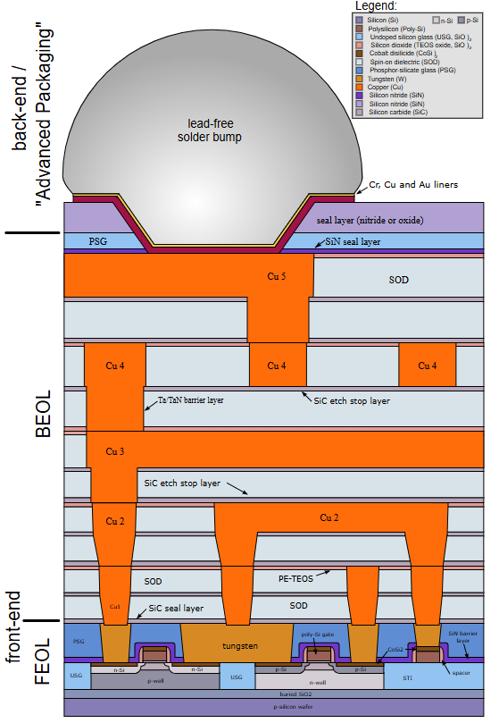
Engineering Solutions: Vertical Layering
Body copy goes here….
Use only Open Sans for the typeface.
Use only these colors: Black, White and...
Microchip fabricators use vertical layering build chips up like a cake or skyscraper.
Multiple layers are separated by insulating materials to prevent shorts but connected between layers where needed.
What material from your supply list could you use as an insulator to place between layers of your circuit to prevent shorts?
What material will act as your conductor, connecting critical circuit components both within and between layers as required by your design?
Photos should preferably be a square - although horizontal or vertical are accepted
#6091ba
Captions should be shown like this...
By Cepheiden - self made (from university scripts and scientific papers), CC BY 2.5, https://commons.wikimedia.org/w/index.php?curid=1445444

Slide 27

Engineering Solutions: Vias
Body copy goes here….
Use only Open Sans for the typeface.
Use only these colors: Black, White and...
Another technology used to fit complex circuitry into small spaces is printed circuit board (PCB) design.
PCB designers create conductive pathways that connect electronic devices directly on a thin surface.
A big challenge for PCB designers is making sure these conductive pathways don’t cross and create short circuits.
One solution is creating vias. These are holes that pass through the board, acting similar to an over or underpass on a highway.
These allow for conductive paths on both sides of the board and increase the number of available paths and connections.
Photos should preferably be a square - although horizontal or vertical are accepted
#6091ba
Captions should be shown like this...

Slide 28
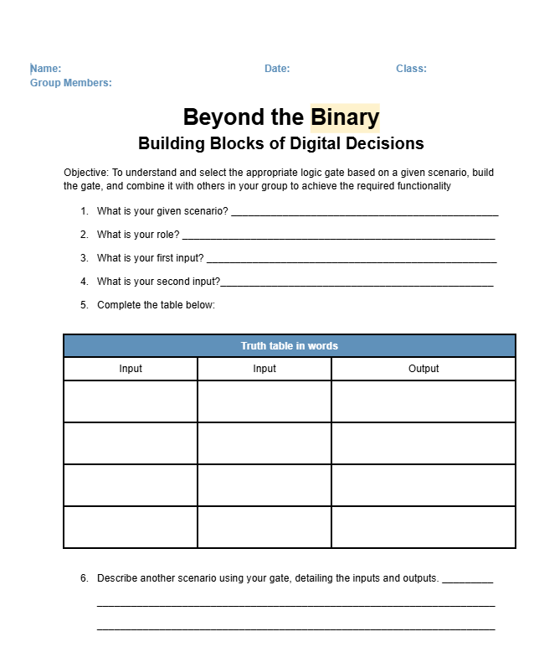
Project Planning Meeting
Body copy goes here….
Use only Open Sans for the typeface.
Use only these colors: Black, White and...
Click the link provided by your instructor to access your project’s Google Form.
Click your role and follow the description on the form to figure out what kind of gate you need to build.
Fill in the worksheet as you go.
Once you have decided what kind of gate to build, lay out your components and plan how you will connect them before beginning. You may prototype by building a working gate on a breadboard or using Tinkercad if you want. However, your final gate must be on a notecard.
Use a pencil to sketch your design for conductive pathways (copper tape) on your notecard first. Then lay down tape once you are satisfied with your design.
Will you use vertical layering or vias? How will these be integrated into your design?
Photos should preferably be a square - although horizontal or vertical are accepted
#6091ba
Captions should be shown like this...
Be sure to discuss your parameters and design with your team. They may have knowledge that you need!

Slide 29
Materials List
Body copy goes here….
Use only Open Sans for the typeface.
Use only these colors: Black, White and...
copper tape
masking tape
notecard
LEDs
9V battery and connector
resistors
2N2222 transistors
Photos should preferably be a square - although horizontal or vertical are accepted
#6091ba
Captions should be shown like this...

Slide 30
After each team member has built their gate
Body copy goes here….
Use only Open Sans for the typeface.
Use only these colors: Black, White and...
Discuss how to integrate the individual gates into a larger design that will meet the needs of the project.
Work together to sketch the integrated circuit using the symbols for each logic gate.
Work together to create a flow diagram or tables that explain how the gates work together to create the desired outcome.
Combine the gates as described in the design and test against the flow diagram/truth tables.
Troubleshoot and iterate as needed to create a working gate.
Share information and strategies with other teams.
Photos should preferably be a square - although horizontal or vertical are accepted
#6091ba
Captions should be shown like this...

Slide 31
Post-Project Debrief
Use only Open Sans for the typeface.
Use only these colors: Black, White and...
Discuss these questions with your team. Be ready to share out!
What was the most challenging part of this project?
What solutions did your team come up with to address this challenge?
What was the most interesting or rewarding part of this challenge?
What is something you learned from this challenge?
What is a question you have about microchip or PCB design after completing this challenge?
Photos should preferably be a square - although horizontal or vertical are accepted
#6091ba
Captions should be shown like this...

Slide 32
Resources
Body copy goes here….
Use only Open Sans for the typeface.
Use only these colors: Black, White and...
https://circuitdigest.com/article/npn-transistors
https://www.tinkercad.com/dashboard
https://www.circuit-diagram.org
https://news.mit.edu/2024/mit-engineers-grow-high-rise-3d-chips-1218
https://www.nano.gov/nanotech-101/what/nano-size#:~:text=A%20sheet%20of%20paper%20is,fingernail%20grows%20in%20one%20second
https://www.asml.com/en/technology/all-about-microchips/microchip-basics
By Cepheiden - self made (from university scripts and scientific papers), CC BY 2.5, https://commons.wikimedia.org/w/index.php?curid=1445444
https://learn.sparkfun.com/tutorials/pcb-basics/all
https://learn.sparkfun.com/tutorials/light-emitting-diodes-leds
https://www.ledsupply.com/blog/how-does-a-5mm-led-work/?srsltid=AfmBOopgzRk10e2-PgzxEQhwMixh_aekDvhvoG-ZXRoksJ4k1KKRqgD8
Photos should preferably be a square - although horizontal or vertical are accepted
#6091ba
Captions should be shown like this...

