Slide 1
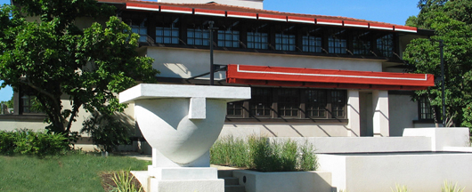
Examples of Student Work
The Westcott House is a Frank Lloyd Wright-designed home in Springfield, OH. Restored in 1998 as a house museum, its only furnishings were a dining table and chairs recreated from the architect’s original plans. The rest of the house was without any furniture, which presented a great opportunity for students to design furnishings specifically for the museum. Students were given free admission to tour the house. Curator and Director Marta Wojcik collaborated with the school to challenge students to work in teams to design and build cardboard furnishings inspired by the Prairie style architecture of Frank Lloyd Wright. Students were given one full day to complete the challenge. Final pieces were displayed in a special exhibition at held at the house. The following slides show the student’s final work made using cardboard.
Visit the Westcott House website
Notes:
Wescott House: Examples of Student Work, Out-of-the-Box: A Furniture Design + Engineering Challenge maker challenge, TeachEngineering.org
A photograph shows the front façade of the two-story Westcott House designed by Frank Lloyd Wright, showing a wide low roof and rows of windows with square panes across the front of each level.
Source/rights: 2016 The Westcott House Foundation. Used with permission.

Slide 2
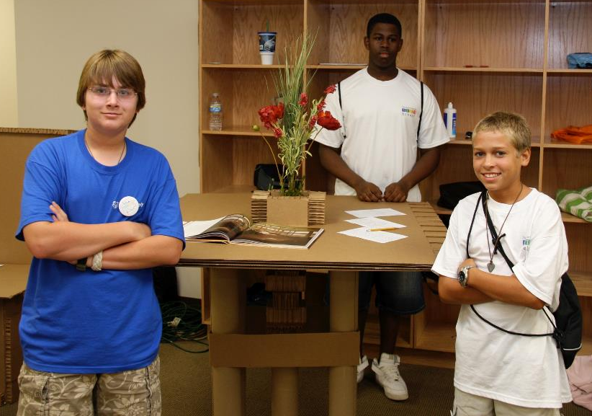
A table in the Prairie style
Notes:
Three students stand near a waist-high table made of corrugated and smooth cardboard designed in the Prairie style with simple, geometric details.
Source/rights: 2016 The Westcott House Foundation. Used with permission.

Slide 3
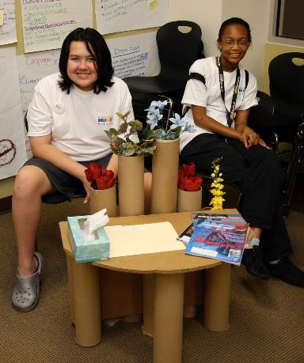
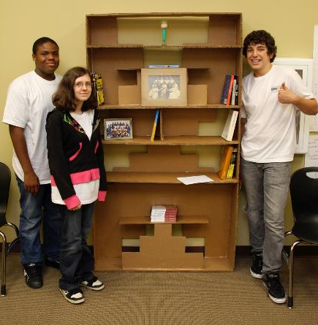
A bookshelf
A low table
Notes:
Two students sit in chairs below a low, half-round living room end table with cylindrical cardboard tube legs and cylindrical cardboard vases arranged behind the table.
Three teens stand near the tall, five-shelf bookshelf they made of cardboard with stair-step design cutouts at three levels.
Source/rights: 2016 The Westcott House Foundation. Used with permission.

Slide 4
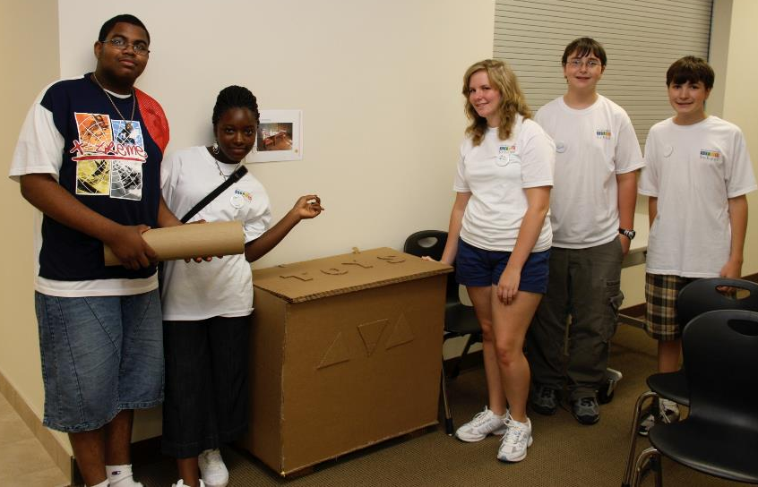
A toy box
Notes:
Five students stand to either side of a high-high cardboard toy box with a lid. Applied to the top lid are cut-outs of the letters T O Y S, and the front vertical panel of the box has three applied triangle shapes.
Source/rights: 2016 The Westcott House Foundation. Used with permission.

Slide 5
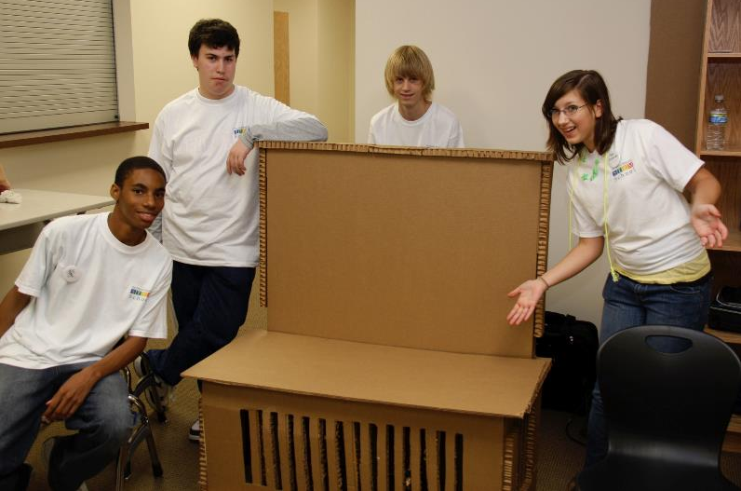
A bench in the Prairie style
Notes:
Four students gather around a card board bench.
Source/rights: 2016 The Westcott House Foundation. Used with permission.

