Slide 1
Coastal Erosion – How can we fix it?

Slide 2
Erosion- Questions to ask ourselves
Photos should be a
square like this.
#1
#2
What do we know about erosion?
How does it affect us where we live?
#3
Where can we see the effects of erosion?

Slide 3
What it looks like…
Photos should be a
square like this.

Slide 4
More Questions!
#1
#2
Photos should be a
square like this.
#5
What was the cause of the erosion in this video?
How long did it take for the beach to erode?
What solutions do we have to stop something like this from happening?
#3
#4
What problems could you see the erosion causing?
How much did they say it would cost to rebuild the coast?

Slide 5
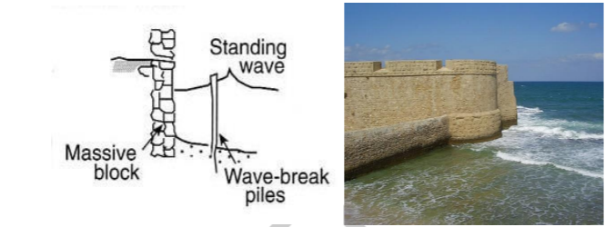
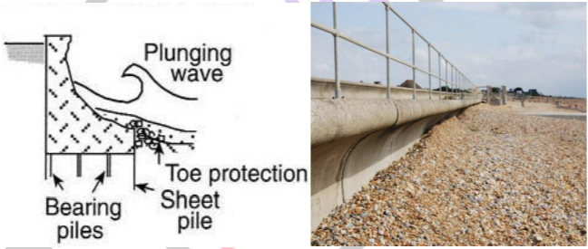
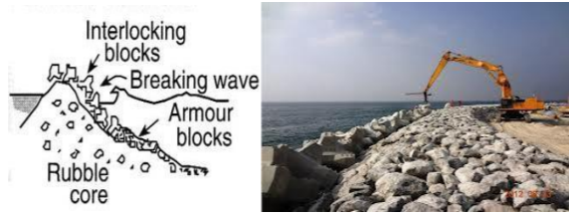
Types of Seawalls
Photos should be a
square like this.
Vertical
Curved
Mound
Helps dissipate waves as opposed to deflecting them.
Curved shape helps waves to not go over wall
Uses porous rock or concrete armor.
The gradual slope and loose material help deflect and absorb energy.
Lower cost option
Easiest type to build
Deflects the wave energy away from the coast
Contains rubble that absorbs some of the energy

Slide 6
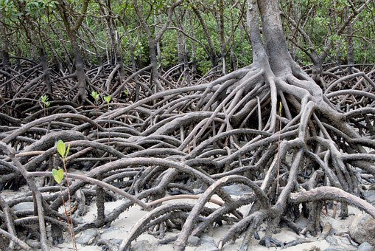
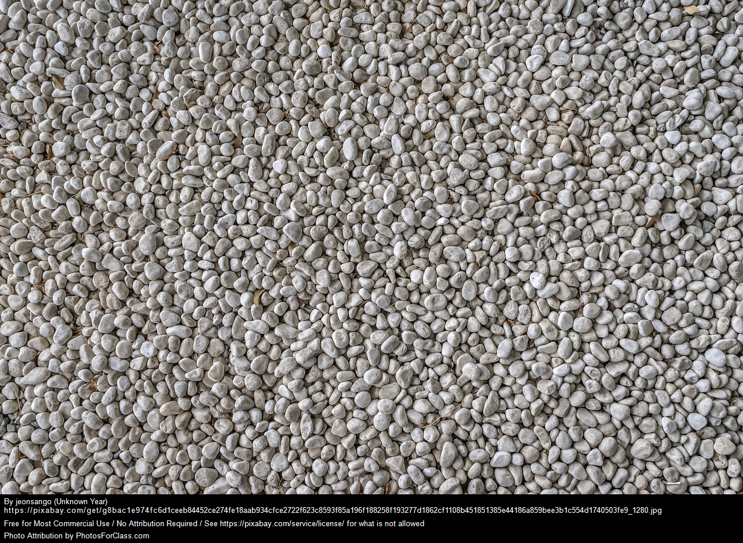
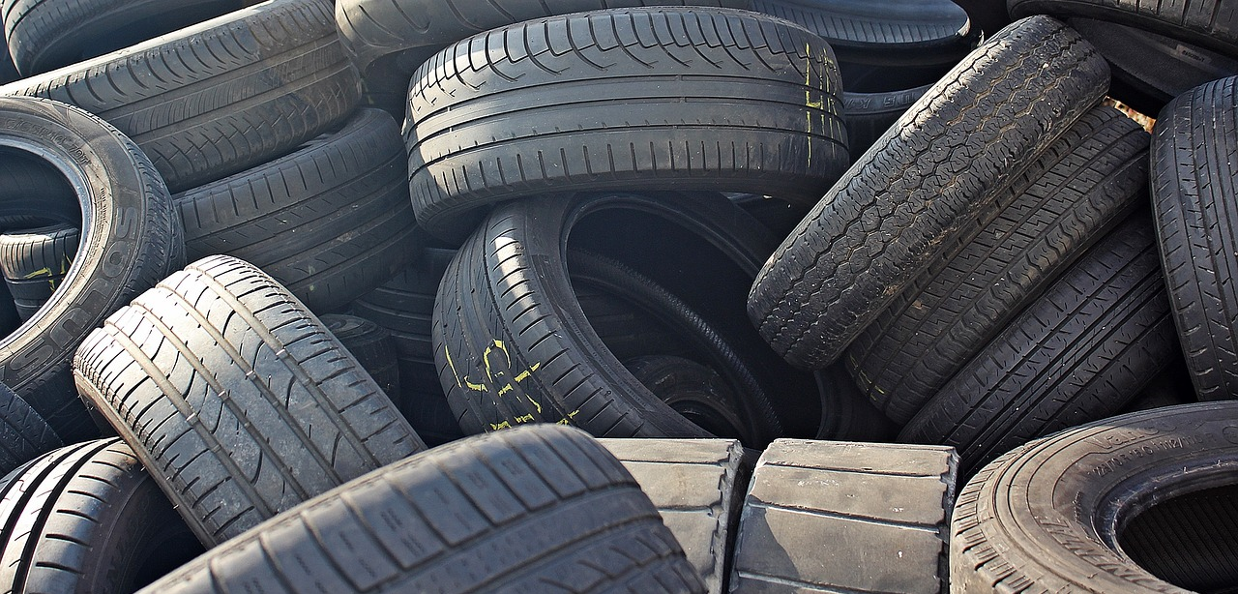
Materials to use
Photos should be a
square like this.
Mangroves (popsicle sticks)
Recycled Concrete
Recycled Rubber

Slide 7
Budget Sheet
Note: For each ½ inch of sand eroded you lose $5
 | Amount | Cost | Environmental Points
Rocks | 50 grams | $15 | -$7
Rubber | 50 grams | $10 | -$5
Mangroves | 10 popsicle sticks | $5 | +$5
Concrete | 1 cup | $3 | 0
Photos should be a
square like this.

Slide 8
Instructions- Day 1
Discuss with your group which material you think you want to use.
Take measurements of your container and estimate how much material you will need to purchase. You must also think of what type of seawall you’re creating: mound, vertical or curved. Record choices on design sheet.
Before purchasing fill out cost benefit analysis. Determine the total cost of your first seawall iteration and the environmental impact.
Once you have filled out you paper you can bring it to the store to purchase materials.
It’s time to build! Work as a team and use your materials wisely! If you need more materials add them to your ledger and then go to the store.
When you’re finished, put your wall on table to dry and fill out your predictions sheet.
Photos should be a
square like this.

Slide 9
Instructions - Day 2
Fill your container with the correct amount of sand on one side of the wall and correct amount of water on the other side.
Trace the slope of the sand in your container on the side of the container in permanent marker. Raise your hand and wait for the teacher to come over to test.
After the test, record your change in slope on the side by tracing it with a different colored marker. Measure the change in the slope at the greatest point of difference in centimeters. Record it on your sheet.
Reset your container and repeat this two more times.
Record your findings and brainstorm improvements to your wall with your team.
Once you have a new design planned you can get it approved by the teacher and then repeat all the steps from today and yesterday.
Photos should be a
square like this.

Slide 10
Final Discussion Questions
Photos should be a
square like this.
#1
#2
Did your second design work better than your first?
What changes did you make the second time to be more succesful?
#3
If you had a third try, what would you change?

Slide 11
Final Discussion Questions
#1
#2
#3
Did your second design work better than your first?
What changes did you make the second time to be more succesful?
If you had a third try, what would you change?

