Slide 1
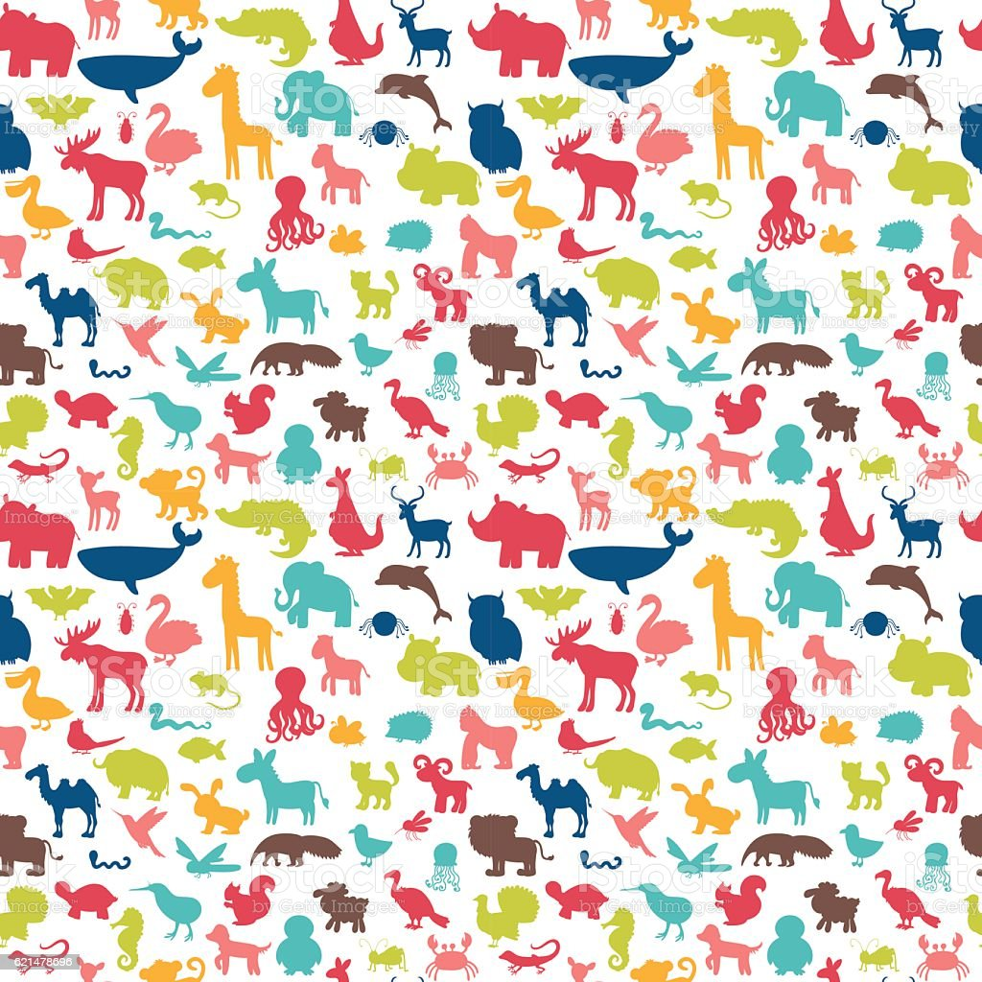
Fashion Show Groups
Outstanding Ocean
Reader-
Recorder-
Model/Materials-
Dangerous Desert
Reader-
Recorder-
Model/Materials-
Magical Mountains
Reader-
Recorder-
Model/Materials-
Jinxed Jungle
Reader-
Recorder-
Model/Materials-
Abandoned Arctic
Reader-
Recorder-
Model/Materials-
The Shady Savannah
Reader-
Recorder-
Model/Materials-

