Slide 1
Oil Spill Clean-Up Phenomenon Images

Slide 2
Image 1
What do you notice? What do you wonder?
#6091ba
#9fcc3b
#8d64aa
#f8a81b

Slide 3
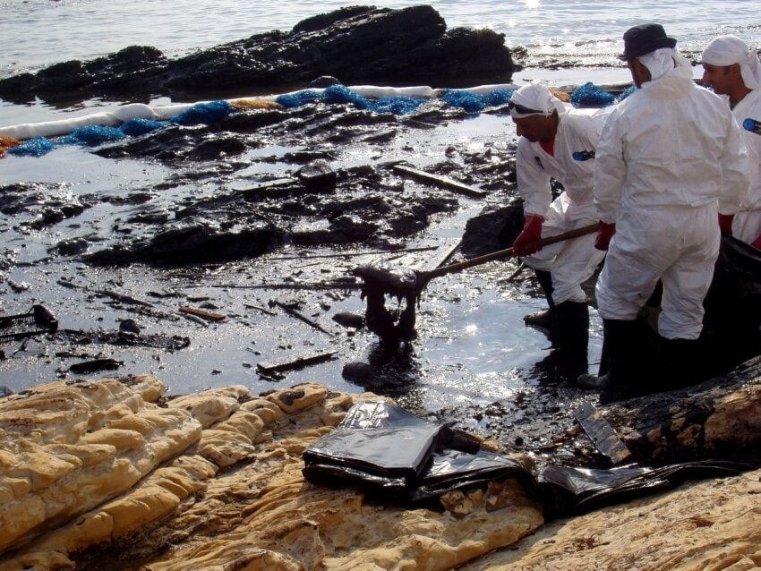
Image 2
What do you notice? What do you wonder?
#6091ba
#9fcc3b
#8d64aa
#f8a81b

Slide 4
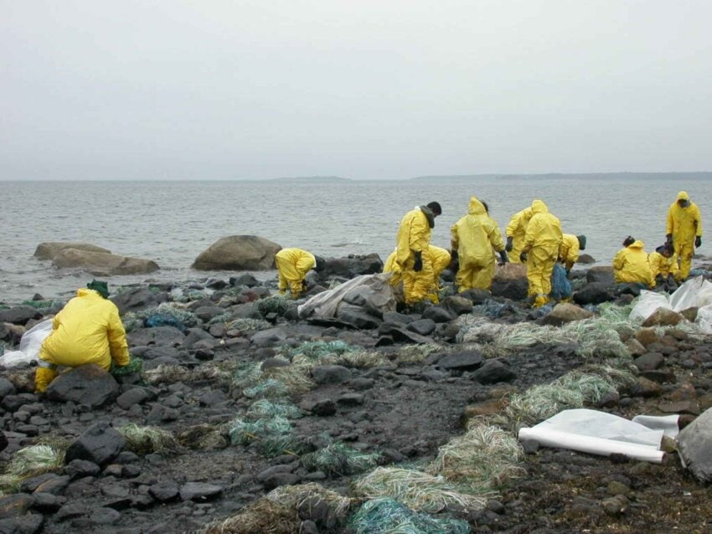
Image 3
What do you notice? What do you wonder?
#6091ba
#9fcc3b
#8d64aa
#f8a81b

Slide 5
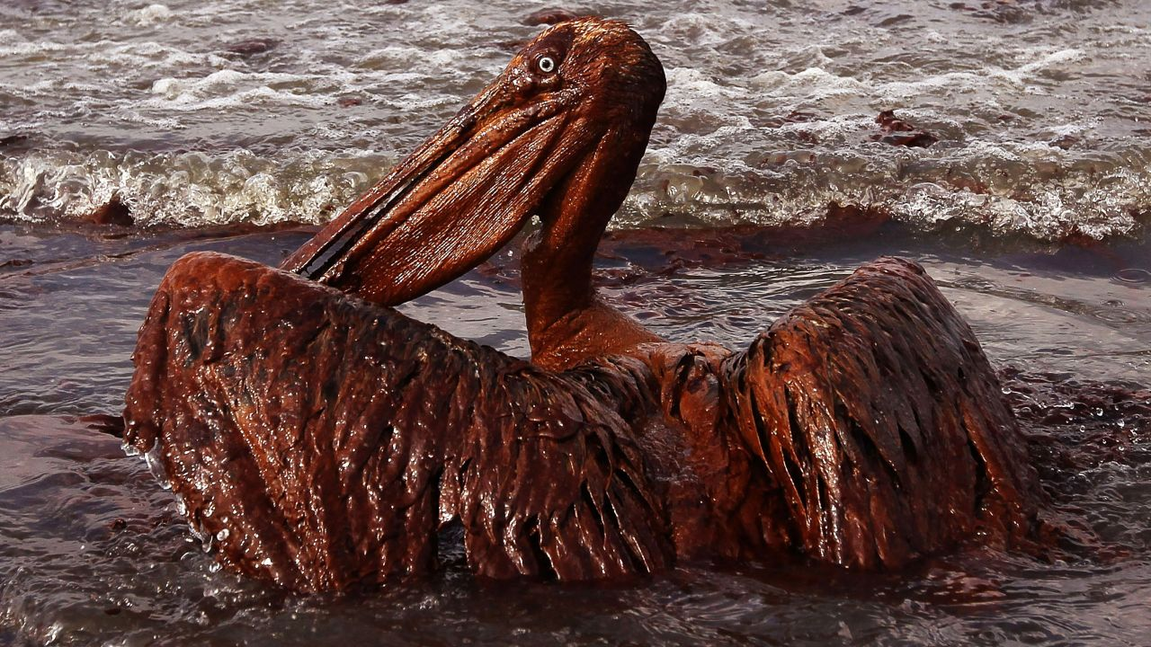
Image 4
What do you notice? What do you wonder?
#6091ba
#9fcc3b
#8d64aa
#f8a81b

Slide 6
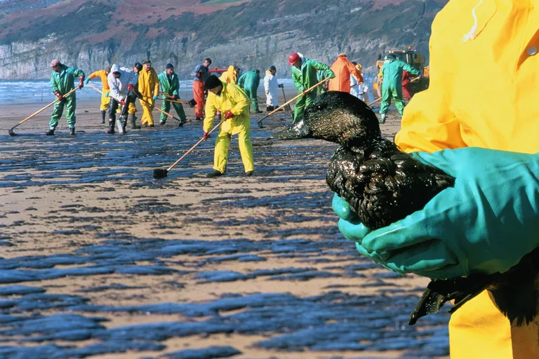
Image 5
What do you notice? What do you wonder?
#6091ba
#9fcc3b
#8d64aa
#f8a81b

