Slide 1
The Power in Prosthetics Activity

Slide 2
Learning Objectives: After this activity, you will be able to: 1. Explain and demonstrate the engineering design process. 2. Use the engineering design process to solve real-world problems. 3. Calculate and demonstrate sizes of measurements using a ruler (optional).
Photos should be a
square like this.

Slide 3
What is the Engineering Design Process?

Slide 4
Vocabulary: Words in today’s activity
“Kiss your brain” when you hear these words during our activity
Prototype | Original type, form, or instance of some thing
biomedical engineer | An engineer that designs biomedical equipment and devices, such as replacements for body parts
engineering design process | Steps that engineers follow to come up with a solution to a problem
amputation | An operation where a doctor has to cut off a body part because of a severe injury or infection
functional | Capable of serving the purpose for which it was designed
engineer | A person who designs, builds, or maintains engines, machines, or public works
quality of life | The standard of health, comfort, and happiness experienced by a person
prosthetic | An artificial body part
constraint | A limitation or a restriction
#fcc3b
#8d64aa
#f8a81b

Slide 5
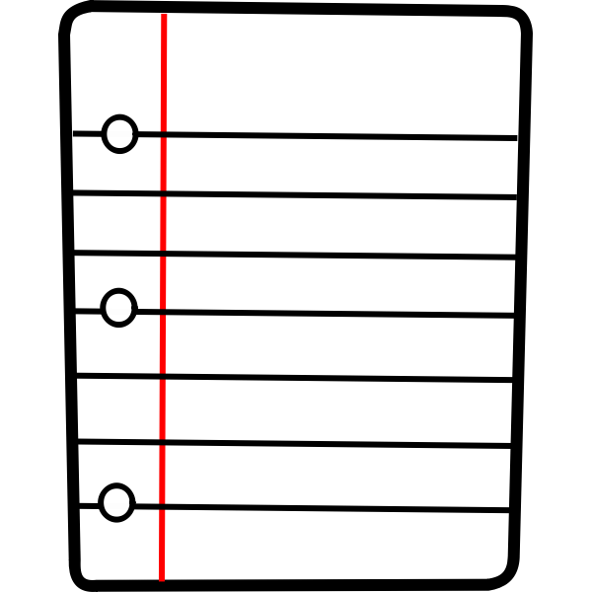
Science or Engineering Notebooks Example:
Date
Header (“The Power in Prosthetics”)
Title: My Observations
You can bullet or number your entries

Slide 6
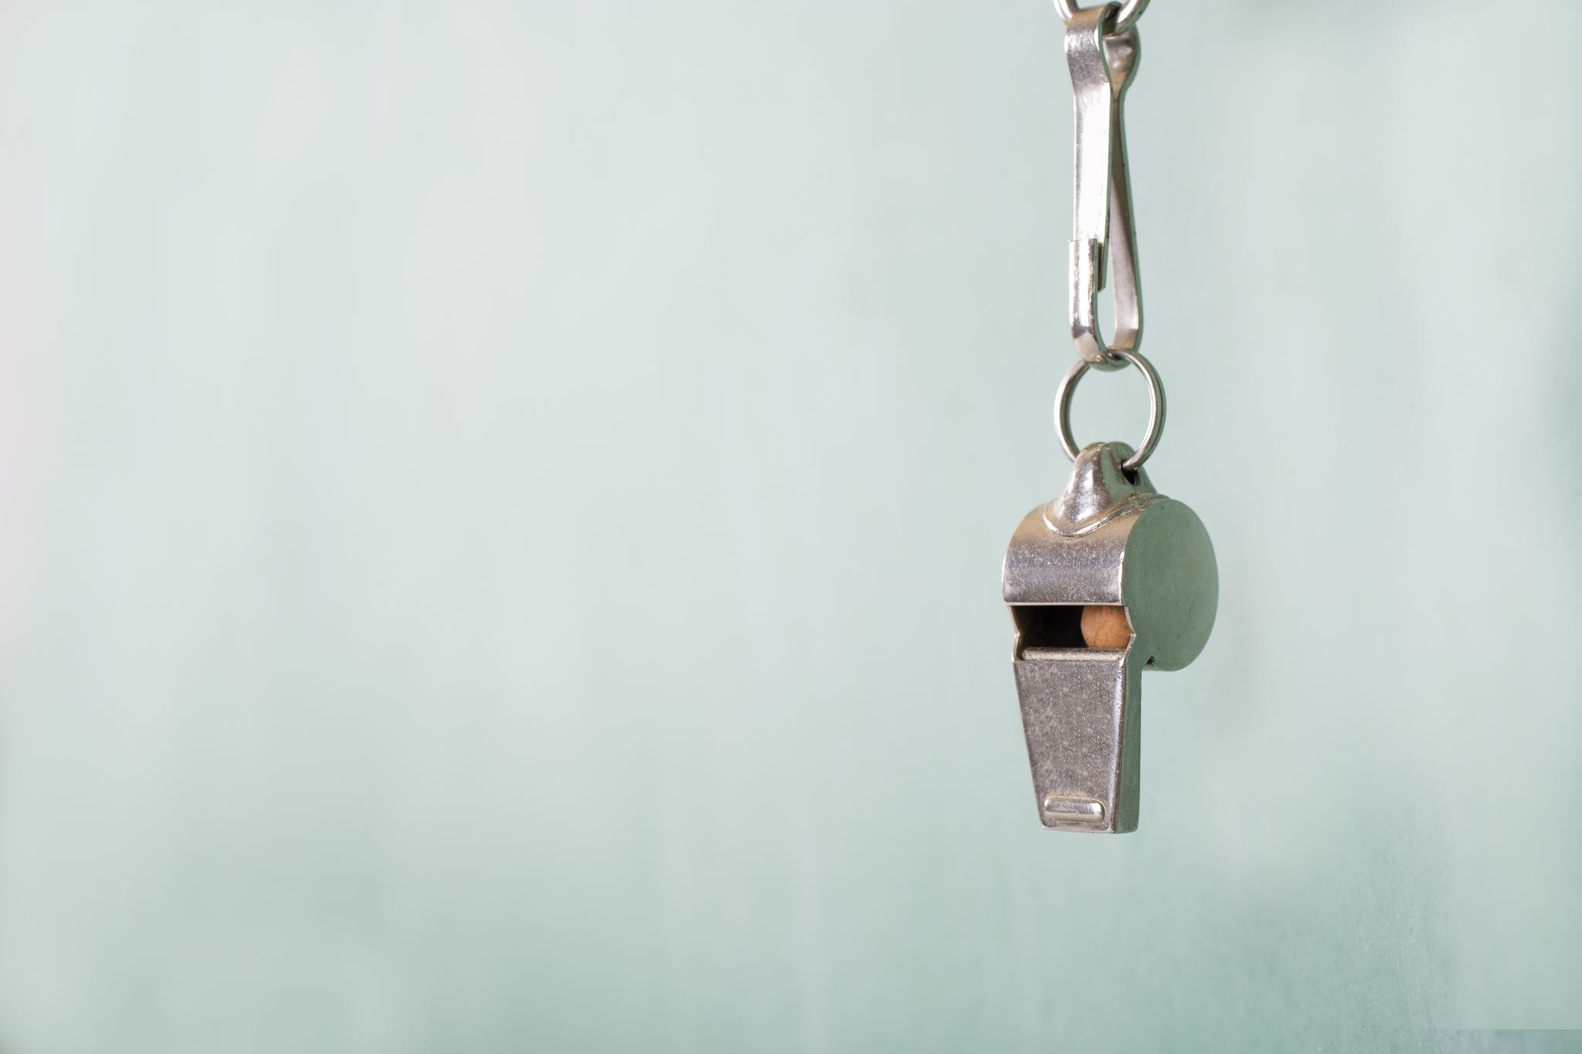
Let’s Watch… Today, we will begin our lesson by watching a quick video clip. As you are watching this video, I want you to think of at least one wondering question you have. We will share some of our wondering questions after the video. *a “womdering question” is a question that you may have after watching the video* The Rayna Dubose Story
I will give you a few moments to write your “wondering” question in your notebooks. We will share our questions out loud when you are done. I will write our questions down on the whiteboard.
Photos should be a
square like this.

Slide 7
Phenomenon Rayna Dubose was a freshman at Virginia Tech where she had just finished her first season on the women’s basketball team. Just one month after the season, Rayna fell into a coma due to bacteria meningitis and blood infection sepsis. Because of her illness, her organs began to shut down. Gangrene, death of the body’s tissues, affected her hands and feet. Doctors prescribed her medicine to save her life, but it could not save her arms and legs. Doctors would need to amputate both of her arms and legs. A group of engineers were able to design prosthetics for Rayna’s legs. Rayna still needs prosthetics for her arms to maintain her quality of life. Rayna’s doctors have come to you for your help! You are given the task of creating a functional prosthetic hand. The hand must have moveable parts to pick up a small empty Styrofoam cup, a large foam die, and a whiteboard eraser.

Slide 8
Research: -I have some “grabber reacher” toys that I would like for you to look at. -I want you press the handles on the toys and observe how the toy is moving -What do you notice when you press the handle? What is causing the toy to move? **Write at least one observation of the toy in your notebooks. You will use your observations when you begin planning your own prototypes.
Example of a grabber toy

Slide 9
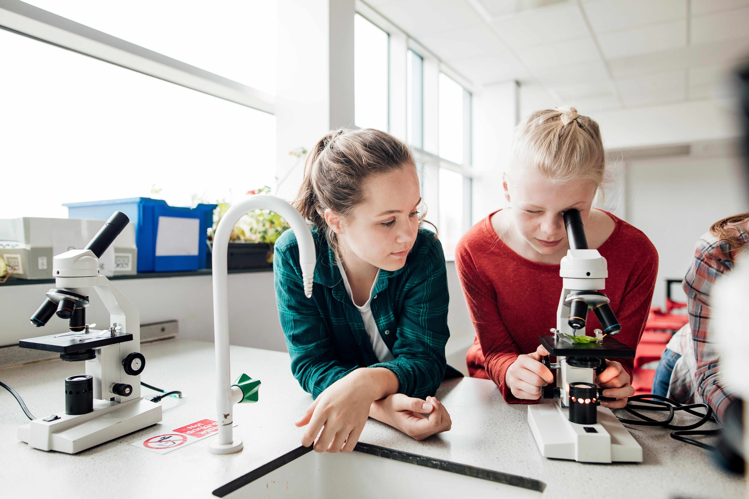
Our Activity: Today, you and a partner will work together to build your very own prototype for a prosthetic hand for Rayna. After I place you into pairs, we will review the constraints for the activity and the materials that will be available to you to use to build your prototype. You will discuss with your partner the materials that your group will use for this activity. I will also provide each group with with a materials and planning worksheet. You will use this worksheet to draw and label your prototype. You will also have the materials listed on the worksheet. As your group collects the materials that you will use, mark or check them off on your worksheet.
Photos should be a
square like this.

Slide 10
Let’s review the materials: (remember to check off materials as you grab them)
Pre-cut hand tracings (choose cardstock, construction paper, OR cardboard) | 4 pieces of masking tape
scissors | whiteboard eraser
ruler (optional) | glue
thread | 5 small colored drinking straws
large straw | small Styrofoam cup
large foam die | science notebook
pencils (2) | 5 pieces of twine string
Latex gloves (1 per group)
Remember to grab ONLY what you will need—you don’t have to choose everything that’s available!

Slide 11
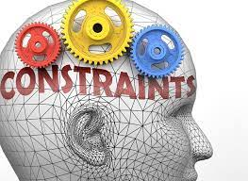
Constraints: 1. You MUST plan for your prototype (worksheet) and show to me BEFORE collecting materials. 2. You MUST keep track of your used materials by checking them off on the planning worksheet OR recording them in your science notebook. 3. For your prototype, you may choose cardboard, cardstock, OR construction paper (cannot choose more than one). 4. You may only use the selected amount of materials listed (for example, you CANNOT use more than 4 pieces of masking tape). 5. Materials that are listed as “optional” will be used as needed (you cannot use an extreme amount). 6. You MUST record your observations in your notebooks.

Slide 12
Let’s Begin… 1. You will be paired into groups of two. If there is an odd number, one group may have three members. 2. Begin planning your prototype on your planning sheet. Remember to label your drawings and record all observations in your notebooks. 3. While planning, discuss within your groups what materials you will need. 4. When your plan is complete, raise your hands so that I can review your plan BEFORE you grab your materials. Remember to keep track of the materials that you use.
Remember! If there is a change in your plans and/or materials, you MUST share them with me and record those changes in your notebooks!

Slide 13
Testing: 1. After building your prototype, you will test it to see if it is functional. 2. You will test your prototype by using it to pick up a small, empty Styrofoam cup, a foam die, and a whiteboard eraser. 3. After testing, remember to record your observations in your notebooks. 4. If your prototype fails testing (if it cannot pick up most or all items), discuss with your partner improvements that should be made to your prototype to make it functional. 5. If your protoype passes testing, discuss within in your groups what made your prototype successful, then record your successes in your notebooks.
Remember to discuss improvements with me before making them. Improvements should also be noted in your science notebooks!

Slide 14
Reflections: -You will complete a reflections activity after testing/making improvements to your prototype (to be completed by each student). -Remember to discuss each question with your partner before recording your answers. -Reflections will be turned in when complete.

Slide 15
Sharing: -Each group will present their prototype to the class (this includes sharing observations that were recorded in your science notebooks) -Groups will also share any improvements that were made to their prototype -Students will use a rubric to evaluate their peers
A rubric is a guideline used to evaluate an activity

Slide 16
Any Questions: READY, SET, BUILD ENGINEERS!!

Slide 17
Protocol: (a system of rules that explain the correct conduct and procedures to be followed for an activity) 1. Paired into groups 2. Review materials your group will use (record reasonings in your notebooks) 3. Begin planning for your prototype (record any observations in your notebooks)—SHOW TO THE TEACHER WHEN COMPLETE!! 4. Grab your materials (remember to keep track of materials used) 5. Begin building your prototype from your plan (record observations!) 6. Test your prototype (record observations)—SHARE YOR RESULTS WITH THE TEACHER 7. Make improvements if needed (record improvements in your notebooks!) 8. Complete the reflection activity 9. Share your prototype and observations with the class 10. Complete exit ticket

Slide 18
Let’s Discuss… During today’s activity, how did you…
Ask to identify the need?
Research the problem?
Imagine possible solutions?
Plan by selecting a solution?
Improve and Redesign?
Create a prototype?
Test the prototype?
Questions?

Slide 19
Exit Ticket: Use the descriptions in the box to complete each statement by writing them on the blank lines. Turn in your exit tickets when complete.

