Slide 1
Reading Hands-Free is The Way for Me!

Slide 2
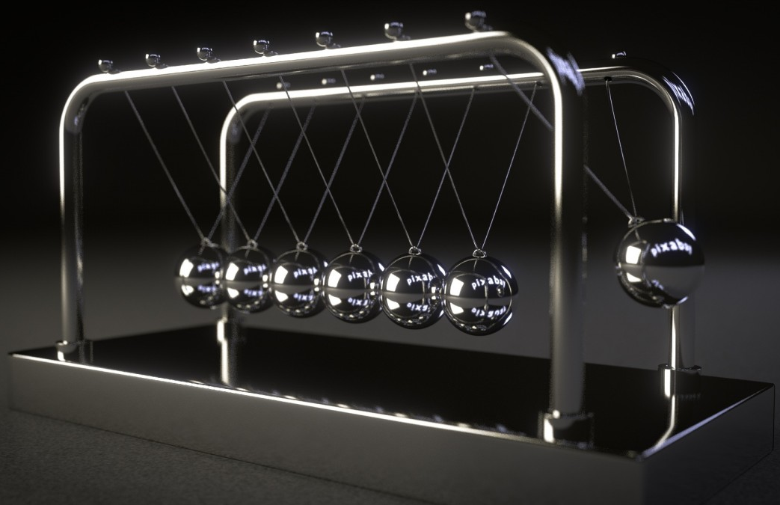
Essential Questions What are force and motion? How does an opposing force effect gravity?
#9fcc3b
#8d64aa
#f8a81b
Captions should be shown like this...

Slide 3
Objectives: By the end of this activity, I will be able to… 1. Define force and motion. 2. Explain how the amount of force effects an object. 3. Work collaboratively to complete an engineering activity related to force and motion.
#9fcc3b
#8d64aa
#f8a81b

Slide 4
Review: What is gravity? 1. Turn to your shoulder partner and, in your own words, describe gravity. 2. What are some examples of gravity? 3. Share.
#9fcc3b
#8d64aa
#f8a81b

Slide 5
Force and Motion What is force? What is motion? In your journal, write what you think force and motion are. (4 minutes)
#8d64aa
#f8a81b

Slide 6
Discuss Motion is the movement of an object from one place to another. Force is a push or pull that changes the motion of an object. How do different amounts of force affect an object’s motion?

Slide 7
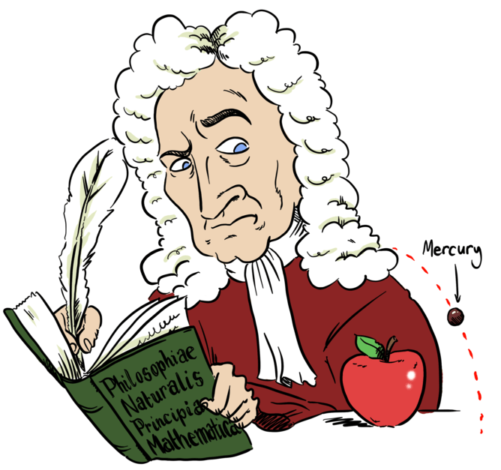
Discuss How do forces oppose, or work against, gravity?
#f8a81b

Slide 8
Engineering Design Challenge Your goal: brainstorm, plan, design and build a structure that holds a book for hands-free reading! You can create any kind of holder you want (stationary, hanging, etc.) and it must hold a book on its own.

Slide 9
Materials 8 pipe cleaners 8 large wooden popsicle sticks 4 wire hangers 4 newspaper pages 2 paper towel rolls (or 4 toilet paper rolls) 2 feet yarn 8 x 11 inches discarded cardboard 1 roll duct tape 1 pair scissors 1/2 standard size pool noodle

Slide 10
Time Constraints 20 minutes total. At least 5 minutes is strictly planning. At least 1 team member needs to sketch and record notes in a journal.

Slide 11
Brainstorm, Plan and Draw Take 5 minutes to brainstorm your prototype. At least 1 team member needs to sketch and record notes in journal.

Slide 12
Build
Have 1 team member collect your team materials.
All team members should help build!
Test
Test your prototype with lightest book first. Can your prototype hold the lightest book? If so, have it hold the next heaviest book, and so on, until your prototype fails.
Write down or draw what didn’t work in your lab notebook.
Remember that we expect our first prototype to not work and/or have issues. It’s okay to not work the first time!
Improve
Now make improvements to your prototype.
How can you make it sturdier? How can you make it hold more weight/books?

Slide 13
Reflect What worked well? What would you do differently? How could you make your design more stable? Hold more weight? How could something like this be useful in school? At home?

