Slide 1
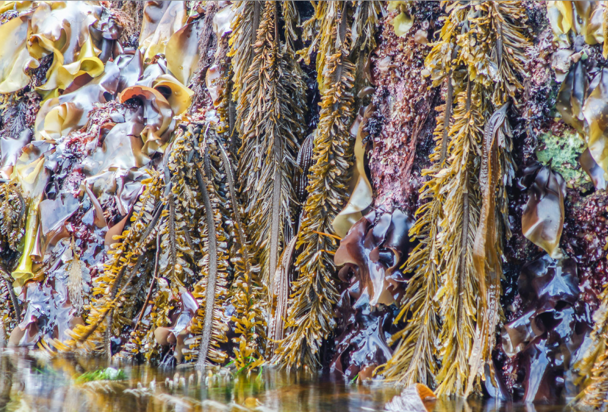
Got Algae?
activity
Notes:
Teaching suggestions:
– Can project this slide to start class or can have video of kelp forest (or algae video of choice) projected as students enter class. Example videos linked in manuscript. If two projectors are available, it is helpful to show the outline for class as students enter (see S3_LessonOutline).
– Let students know they’ll see a lot of terms and scientific names they are not familiar with. Be clear which, if any, they are required to know for any assessments.
Photo: B. Clarkston (author). Low intertidal seashore from Vancouver Island, British Columbia, showing lots of different types of algae (all seaweeds, brown and red seaweeds visible here. Most prominent are the kelps Egregia and Costaria, and the red seaweed Mazzaella).

Slide 2
Notes:
Definition: “the study of algae; it is equivalent to and has replaced the older term, algology (based upon the Greek, phykos (seaweed) & logos (discourse) or phyc (algae) & -ology (study of)).” From https://www.algaebase.org/search/glossary, search for the word “phycology.”
Photo: B. Clarkston (author). Low intertidal seashore from Vancouver Island, British Columbia, showing kelp Laminaria. Also lots of Phyllospadix (surf grass) in background. Lives side by side with seaweeds/algae but is a flowering land plant.

Slide 3
In your groups, define the word “algae.”
Try to include several characteristics of algae, and some examples of algae (if you can think of any).
Please DO NOT use any outside resources (i.e., no textbook, internet, etc.)
Notes:
Prompt to show during Worksheet Prompt #1: Prior knowledge of algae.

Slide 4
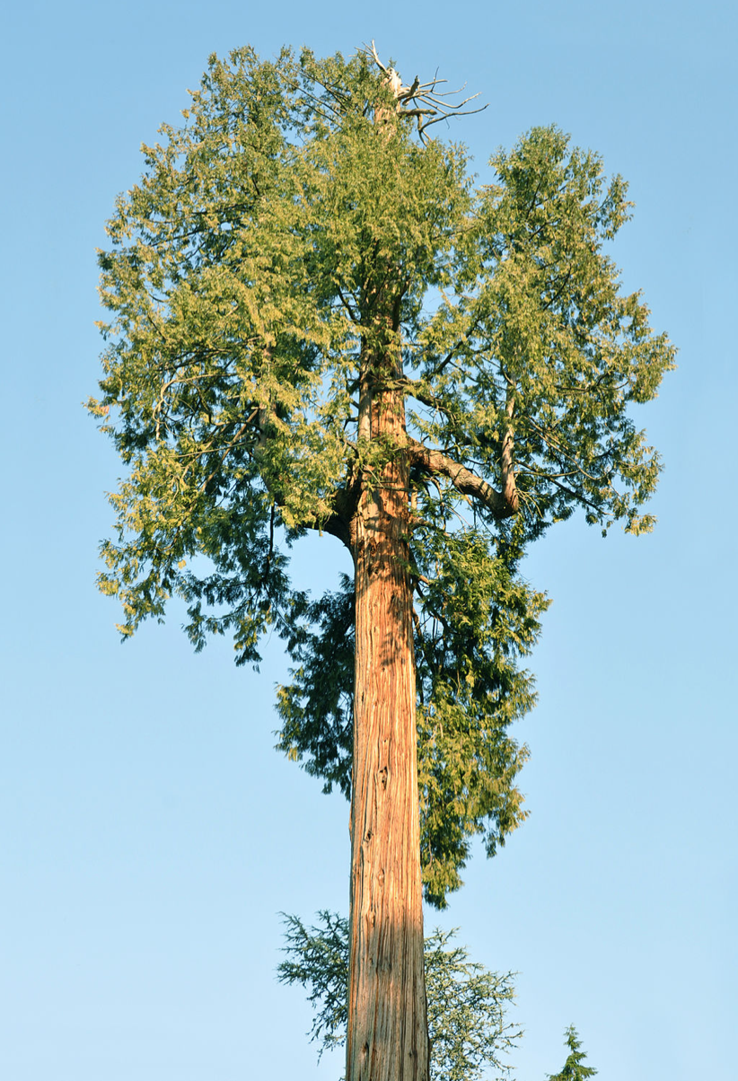
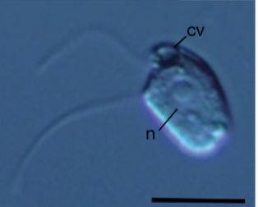
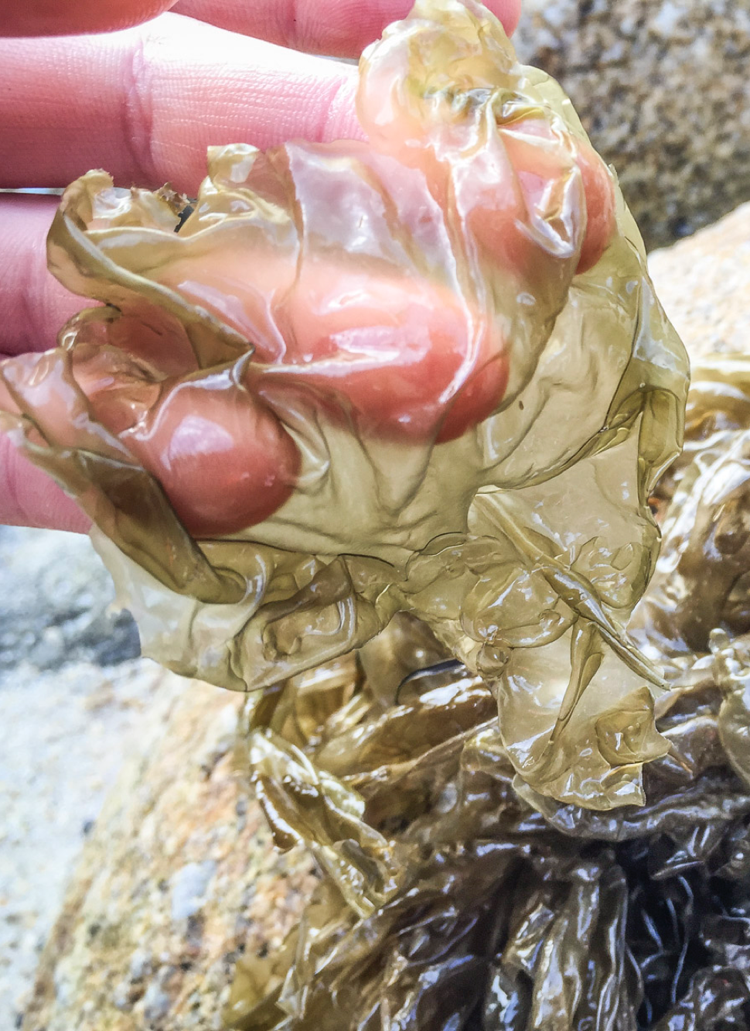
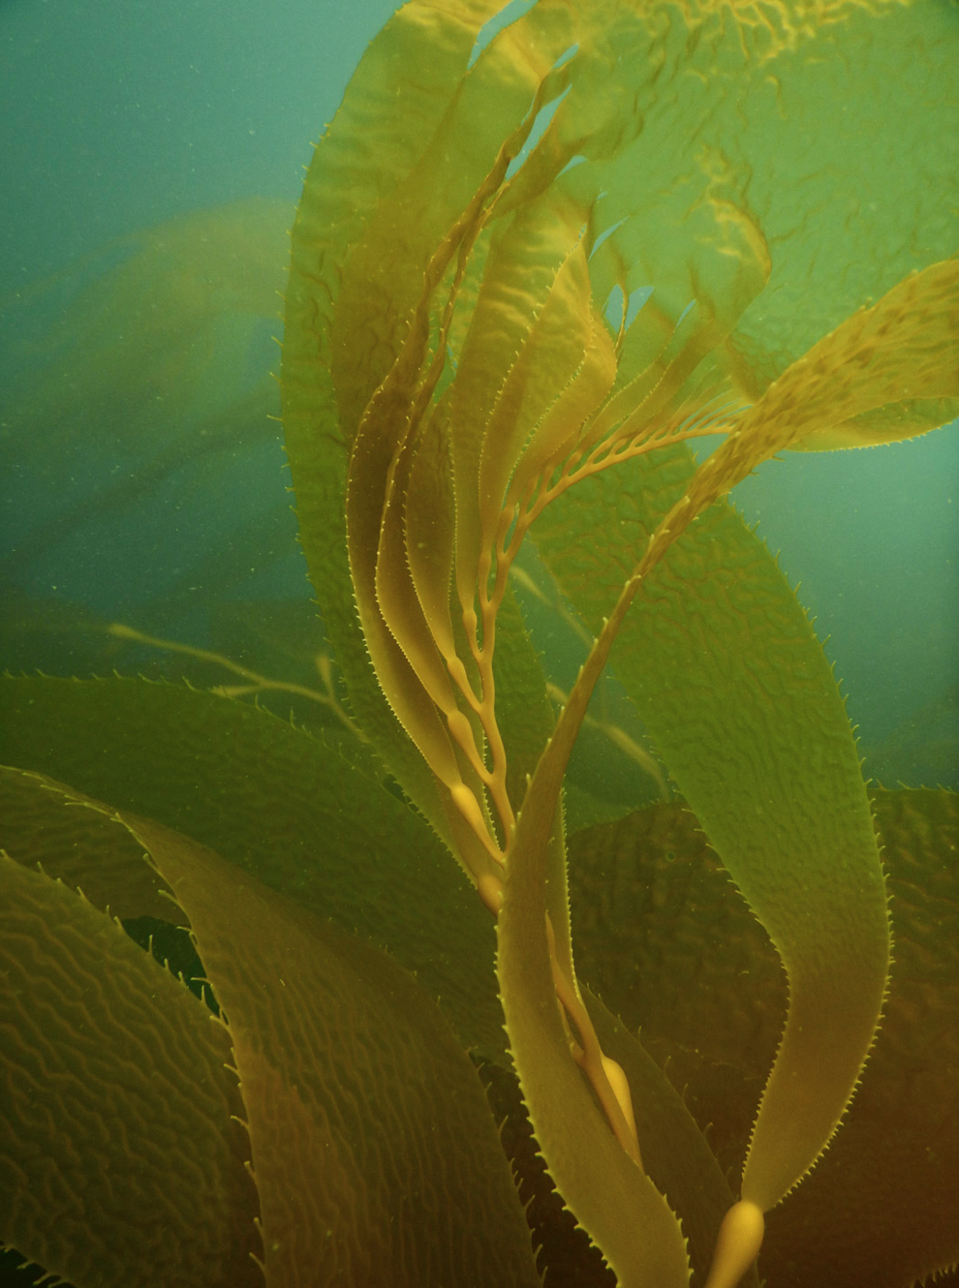
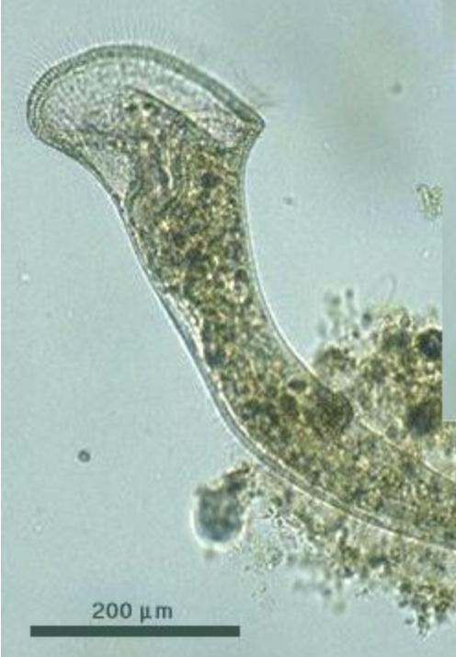
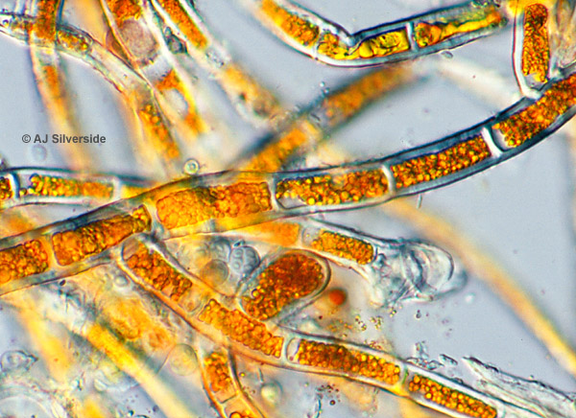
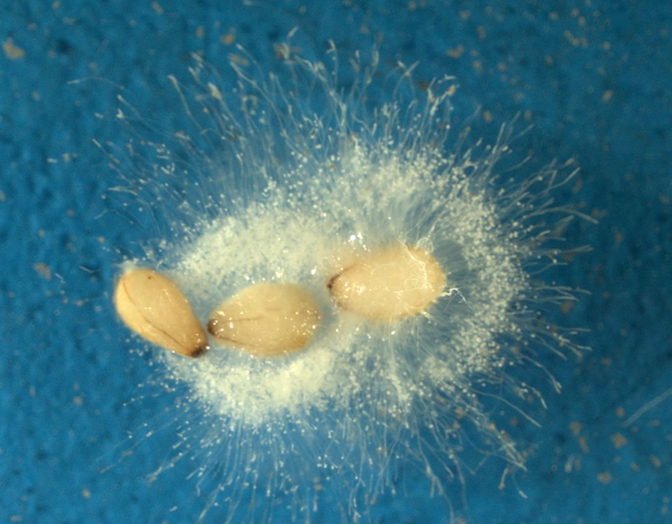
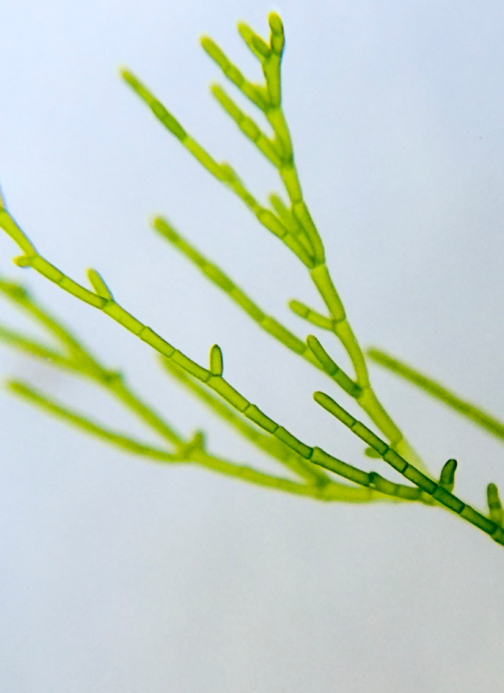
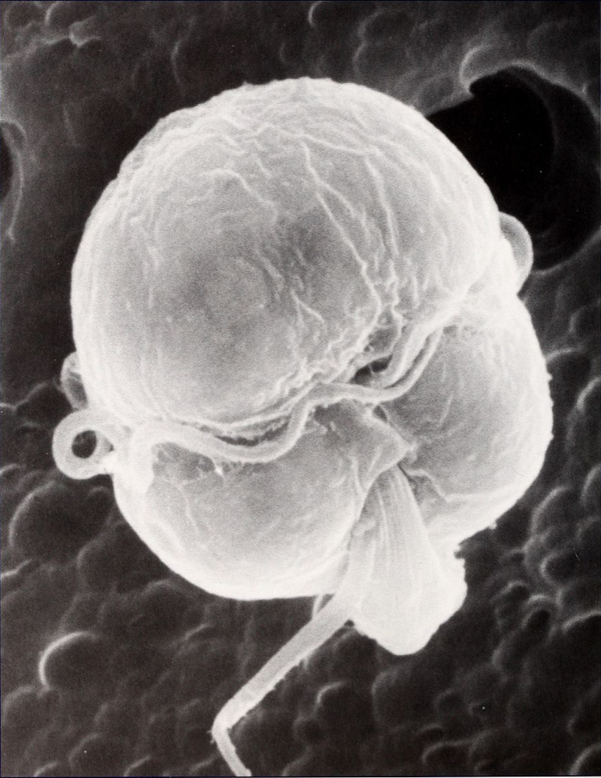
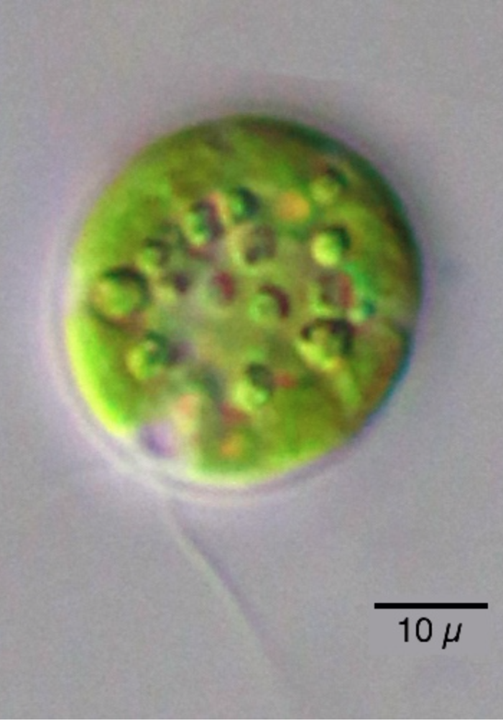
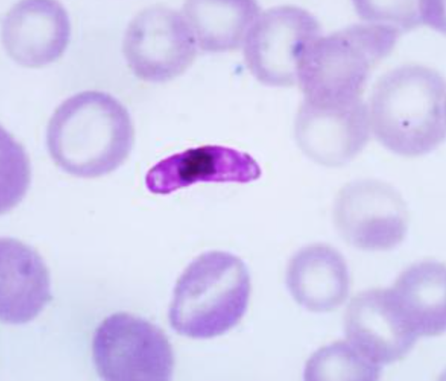
Using your set of cards, decide whether each organism is “algae” or “not algae.”
Notes:
Prompt to show during Worksheet Prompt #2: Got Algae? activity. USE THIS VERSION IF RHODELPHIS IS INCLUDED.
Photo attributions and permissions listed in S1_Algae Cards file.

Slide 5
Algae | Not Algae
Notes:
Blank table to show during Worksheet Prompt #3: Algae consensus.

Slide 6
Algae | Not Algae
Notes:
Mostly completed table (minus Plasmodium) to show after asking the class if they want to see how an expert phycologist would sort the organisms.
Photo attributions and permissions listed in S1_Algae Cards file.

Slide 7
Algae | Not Algae
Clicker Question:
Where do Plasmodium and Rhodelphis belong?
Both are algae.
Neither are algae.
Only Plasmodium is an alga.
Only Rhodelphis is an alga.
I’m not sure.
?
?
Notes:
USE THIS SLIDE IF YOU ARE INCLUDING RHODELPHIS IN YOUR ORGANISM CARD SET (THE 13 CARDS TOTAL VERSION)
Completed table with Plasmodium and Rhodelphis to show after asking the class if they think these two organisms are algae.
Photo attributions and permissions listed in S1_Algae Cards file.

Slide 8
Algae | Not Algae
Notes:
USE THIS SLIDE IF YOU ARE INCLUDING RHODELPHIS IN YOUR ORGANISM CARD SET (THE 13 CARDS TOTAL VERSION)
Completed table with all organisms sorted as most expert phycologists would. Plasmodium and Rhodelphis are generally considered to not be algae, but they each have a remnant plastid and their common ancestor with dinoflagellates (for Plasmodium) and red algae (for Rhodelphis) were likely algae.
Photo attributions and permissions listed in S1_Algae Cards file.

Slide 9
General Characteristics of Algae
Algae are:
Photosynthetic (usually) / from a photosynthetic ancestor.
Aquatic (usually), whether marine, freshwater, or brackish.
Unicellular or multicellular.
Polyphyletic, meaning some lineages are more closely related to non-algal lineages than other algae.
Lacking “complex” body structures (no roots, stems, leaves, xylem, or phloem) found in most land plants.
Lacking “complex” reproductive structures (no seeds or flowers) found in most land plants.
Notes:
Summary list of algae characteristics. Can be shown after students finish Worksheet Prompt #3: Algae consensus. However, if time is short, you can provide this summary as part of class notes.
NOTE: This lesson only covers characteristics 1–4, so students would not be expected to suggest 5 and 6. These characteristics can be added by the teacher during this class or added at the start of the next class.

Slide 10
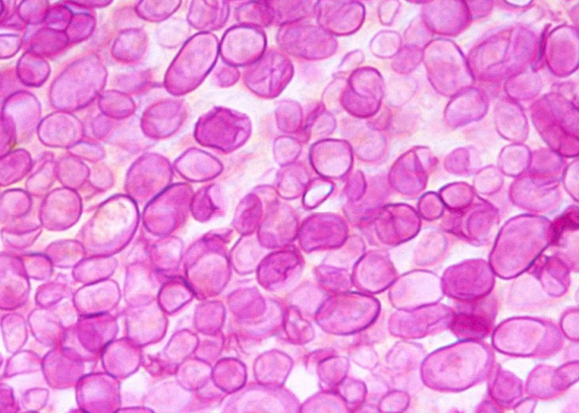
Many algal clades contain some species that lack typical “algae” characteristics.
Example: non-photosynthetic algae
Dinoflagellates are considered algae, yet almost ½ of ~2,000 species of dinoflagellates consume other cells.
Some completely heterotrophic (no photosynthesis at all)
Some ‘mixotrophic’ – can switch
Some green algae not only don’t photosynthesize, but they also cause diseases!
Prototheca causes disease Protothecosis in cattle, dogs, and humans
Helicosporidium is an insect gut parasite.
Stained cells showing Protothecosis in a dog
Notes:
Optional slide if there’s time to elaborate on some exceptions to the general characteristics of algae. This slide gives examples of algae that are not photosynthetic (another cool example is parasitic red algae). Often not shown in class and provided only with class notes because of lack of time in class.
Image: Protothecosis. Public Domain. Accessed from Wikimedia Commons: https://commons.wikimedia.org/wiki/File:Prototheca_zopfii.jpg#/media/File:Prototheca_zopfii.jpg

Slide 11
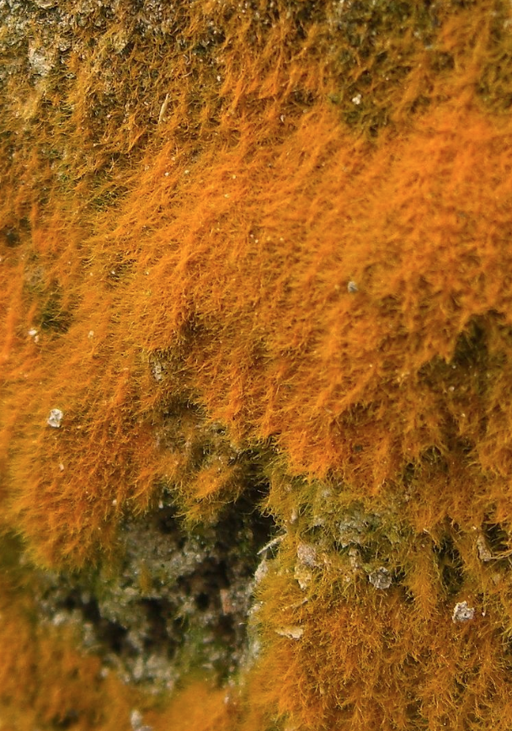
Example: Terrestrial algae (e.g., Trentepohlia)
A green alga, grows on rock faces, on plant surfaces, or within leaves.
Color is due to special pigments that help it survive the harsh UV light from living on land (as opposed to in water).
Notes:
Optional slide if there’s time to elaborate on some exceptions to the general characteristics of algae. This slide gives examples of algae that are not aquatic. Often not shown in class and provided only with class notes because of lack of time in class.
Image: Trentepohlia, by Jason Hollinger. Copyright CC BY 2.0; Accessed from Wikimedia Commons:
https://commons.wikimedia.org/wiki/File:Trentepohlia_sp._-_Flickr_-_pellaea_(1).jpg#/media/File:Trentepohlia_sp._-_Flickr_-_pellaea_(1).jpg

Slide 12
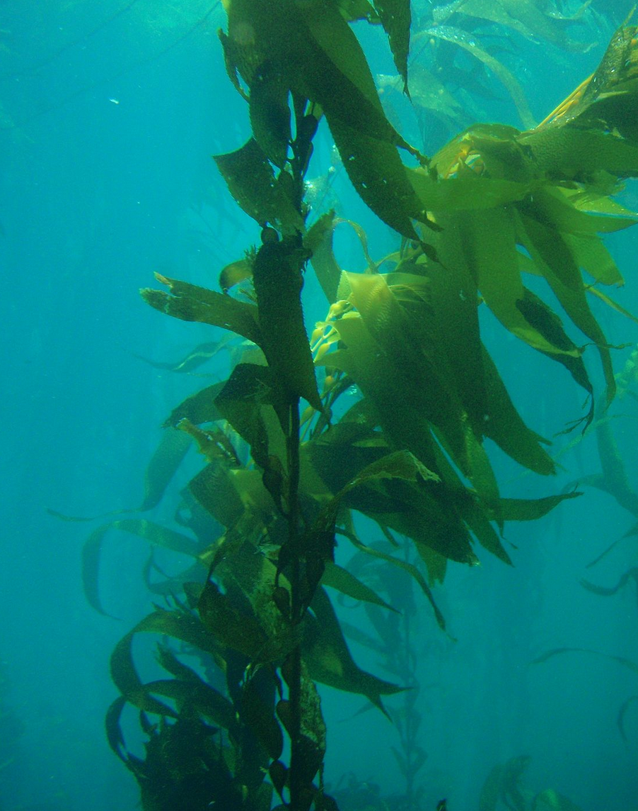
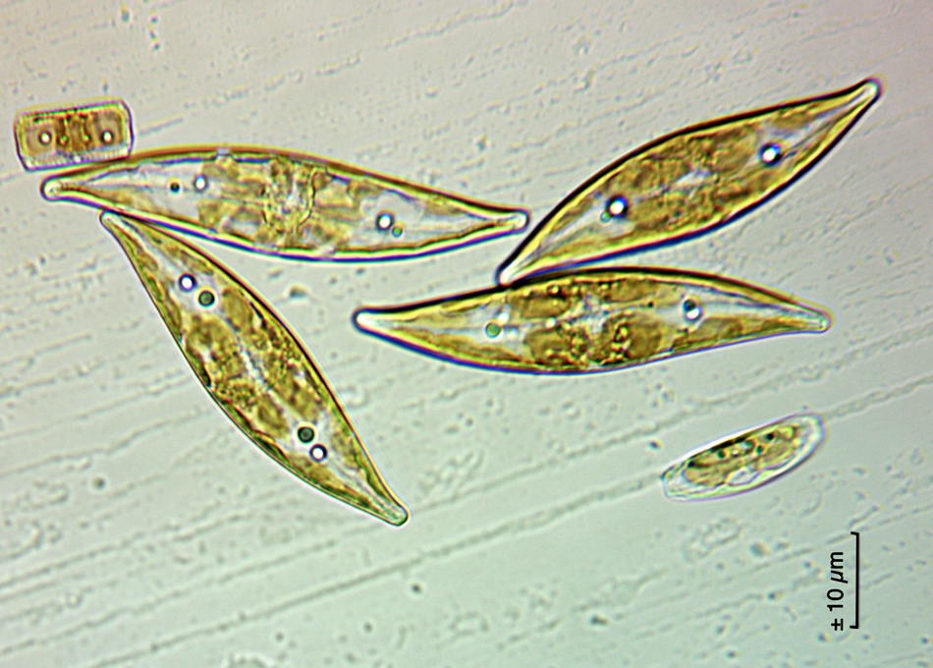
Diversity of body types...
Microalgae can’t be seen with the unaided eye; macroalgae can.
…but not all unicellular algae are microscopic, and vise versa!
Unicellular
Multicellular
Notes:
Optional slide if there’s time to elaborate on some exceptions to the general characteristics of algae. This slide gives examples of algae of diverse body types in algae. Often not shown in class and provided only with class notes because of lack of time in class.
Benthic pennate diatom photo: Dick, CC BY-NA-SA 2.0 Accessed from: https://www.flickr.com/photos/76798465@N00/28613526665
Giant kelp (Macrocystis pyrifera) photo: Claire Fackler, Wikimedia Commons. Public Domain. Accessed from: https://commons.wikimedia.org/wiki/File:Sanc0063_-_Flickr_-_NOAA_Photo_Library.jpg#/media/File:Sanc0063_-_Flickr_-_NOAA_Photo_Library.jpg

Slide 13
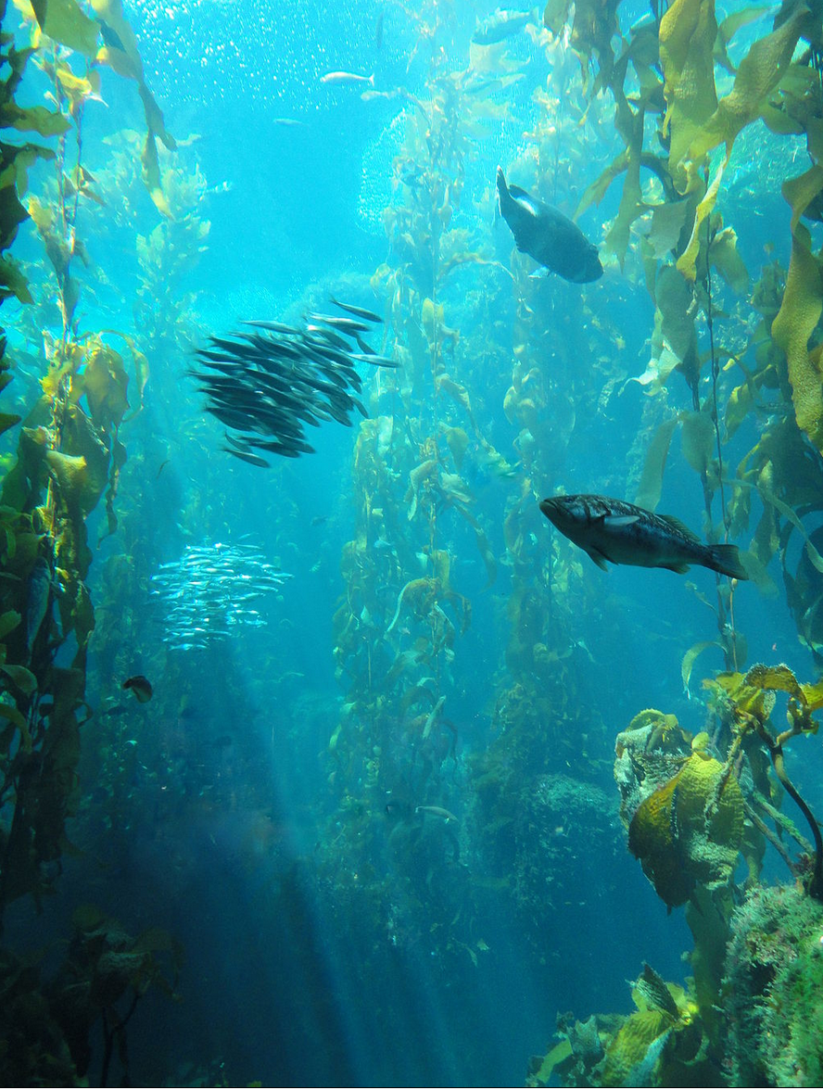
If algae are so diverse, why even group them together?
Because algae usually perform similar roles in their environment, as primary producers who form the base of food webs as well as create habitats such as:
marine forests
Notes:
To show during final class debriefing, if there’s time, or can be provided with class slides.
Kelp forest photo: Daderot, accessed from Wikimedia Commons, copyright CC0 1.0 Public Domain
Link: https://commons.wikimedia.org/wiki/File:Kelp_Forest_-_MBA_-_DSC06954.JPG#/media/File:Kelp_Forest_-_MBA_-_DSC06954.JPG

Slide 14
If algae are so diverse, why even group them together?
Because algae usually perform similar roles in their environment, as primary producers who form the base of food webs as well as create habitats such as:
intertidal
Notes:
To show during final class debriefing, if there’s time, or can be provided with class slides.
Photo: B.Clarkston (author). Low intertidal seashore from Vancouver Island, British Columbia, showing lots of different types of algae (all seaweeds, brown and red seaweeds visible here. Most prominent are the kelps Egregia and Costaria, and the red seaweed Mazzaella).

Slide 15
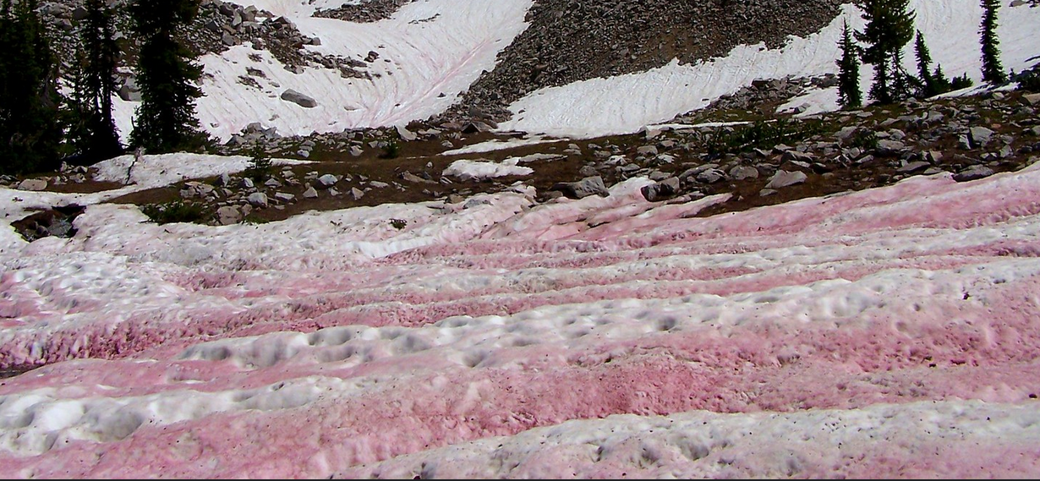
If algae are so diverse, why even group them together?
Algae are everywhere — even the snow!
“Watermelon snow” is actually populations of Chlamydomonas nivalis (a unicellular green alga!)
Notes:
To show during final class debriefing, if there’s time, or can be provided with class slides.
The pink streaks in the snow are populations of the single-celled algae Chlamydomonas nivalis. Commonly known as Watermelon Snow.
Photo: Bryant Olsen; license CC BY-NC 2.0
Link: https://www.flickr.com/photos/bryanto/3709360794

Slide 16
Goal for the next month: Learn more about algae!
Notes:
Photo: B. Clarkston (author). Low intertidal seashore from Vancouver Island, British Columbia, showing lots of different types of algae (all seaweeds, brown and red seaweeds visible here. Most prominent are the kelps Egregia and Costaria, and the red seaweed Mazzaella).

