Slide 1
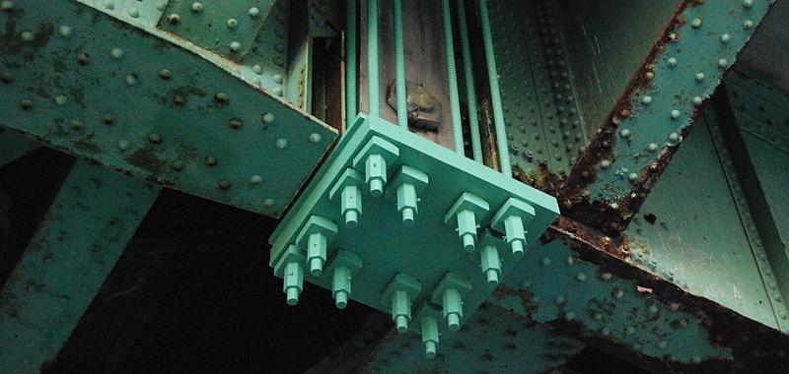
Activity
Statistical Analysis of Methods to Repair Steel
Notes:
Activity Intro Presentation, Statistical Analysis of Methods to Repair Cracked Steel activity, TeachEngineering.org
Photo: Detail of temporary repairs on steel structure of the Pawtucket River Bridge (1958); the bridge has since been replaced.
Image source: 2010 Marcbela (Marc N. Belanger), Wikimedia Commons https://commons.wikimedia.org/wiki/File:Pawtucket_bridge_detail-1.JPG

Slide 2
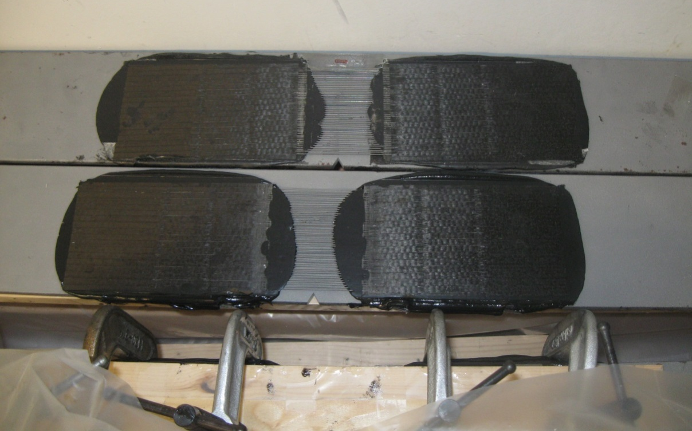
Civil Engineering Challenge
Perform a statistical analysis of the effectiveness of the different configurations of CFRP patching to rehabilitate steel structures, comparing the mean fatigue life of slightly cracked steel beams and mean fatigue life of slightly cracked steel beam reinforced with CFRP patches.
Notes:
Photo: Patches made of a composite of carbon-fiber-reinforced polymers and epoxy adhesive to repair cracked steel structures.
Image source: 2015 Environmental and Civil Engineering Department, Cullen College of Engineering, University of Houston

Slide 3
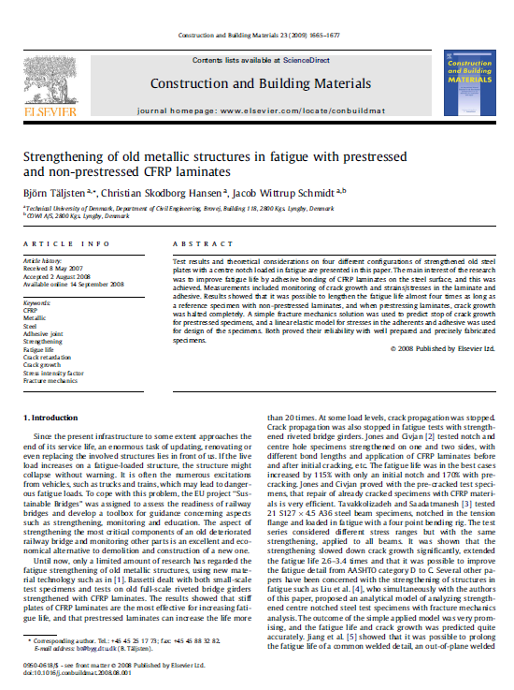
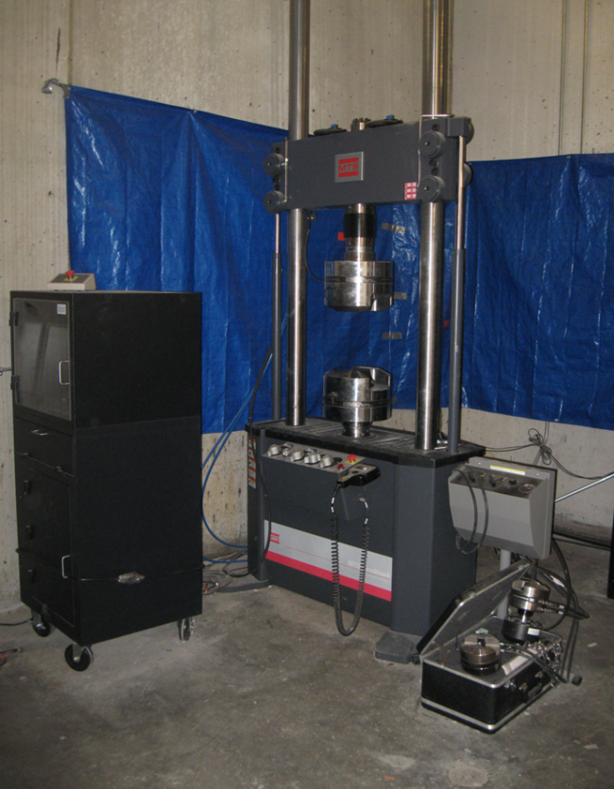
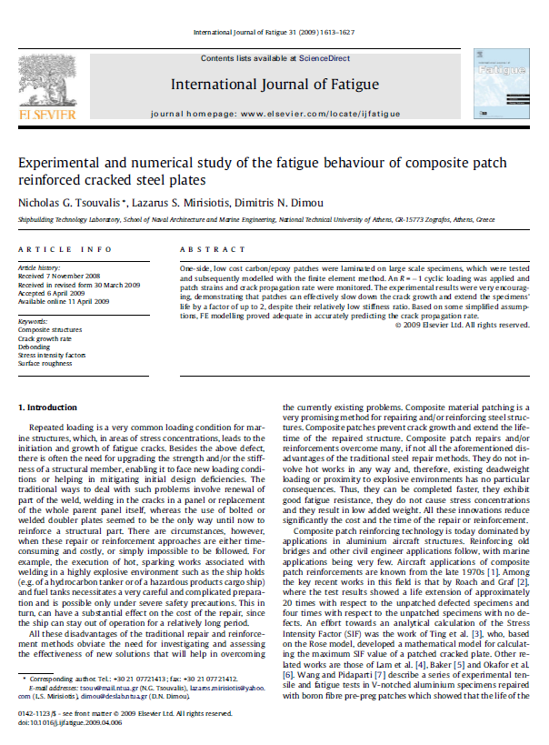
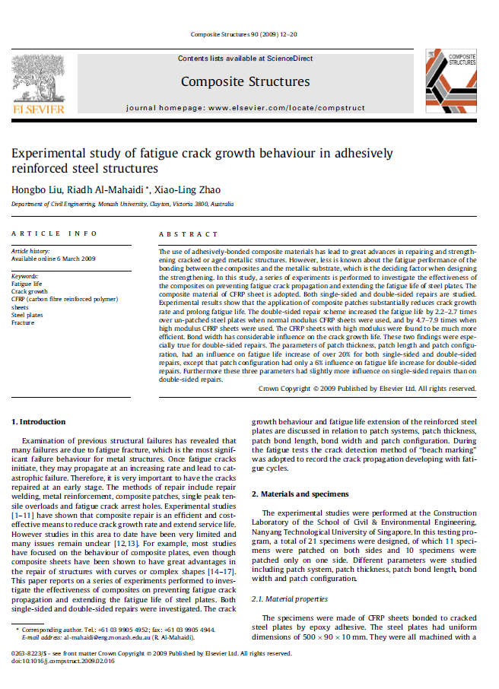
Data Analysis
CFRP Experimental Results
NiTiNb –CFRP Experimental Results
Notes:
Image source:
Structural Research Laboratory, 2015 Civil and Environmental Engineering Department, South Annex, University of Houston

Slide 4
Data Analysis
Five-Number Summary
minimum
Q1
median (Q2)
Q3
maximum
Central Tendency
sample mean
sample standard deviation

Slide 5
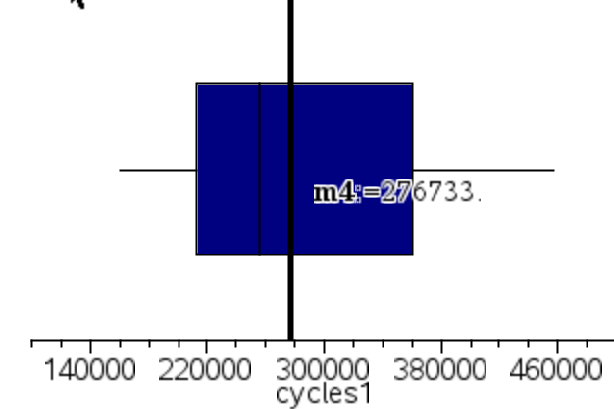
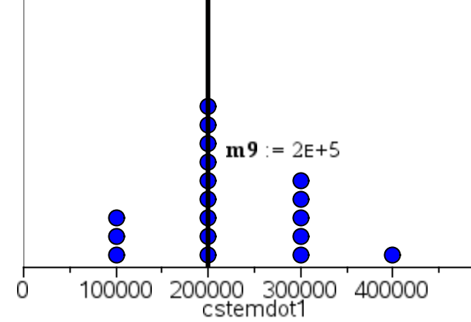
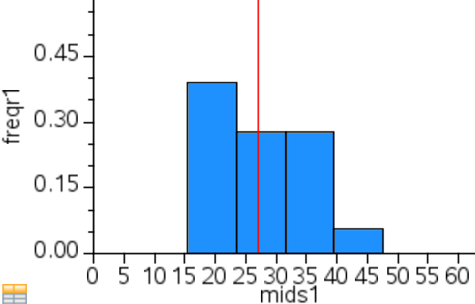
Data Analysis: Graphs
Notes:
Image source: 2015 Civil and Environmental Engineering Department. University of Houston

Slide 6
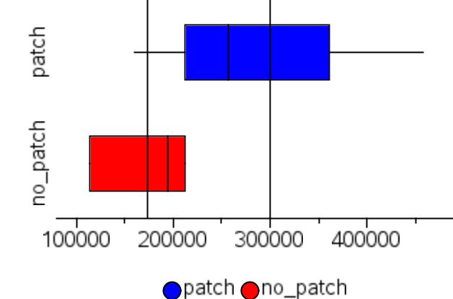
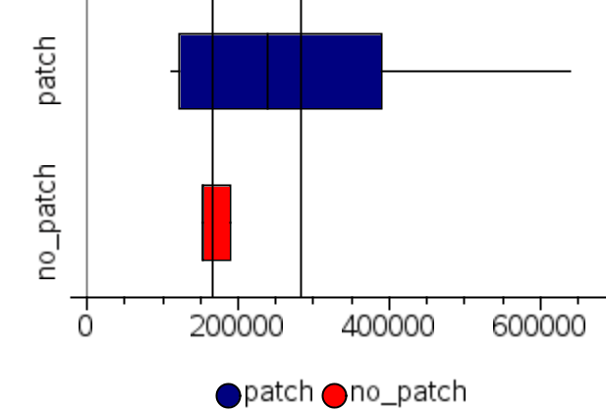
Data Analysis: Graphs
Patched vs. Unpatched Fatigue Life Comparison
Interpretation of the graphs
Notes:
Image source: 2015 Civil and Environmental Engineering Department. University of Houston

Slide 7
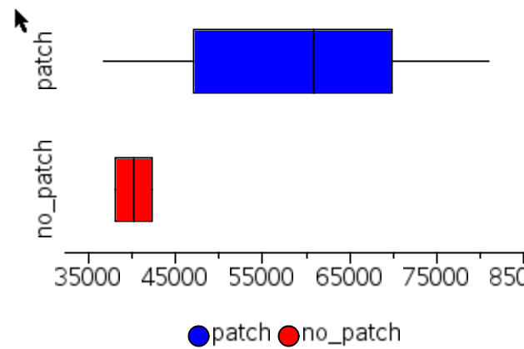
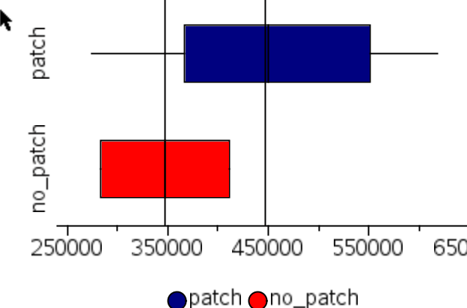
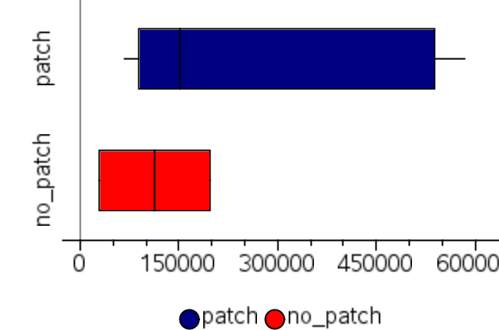
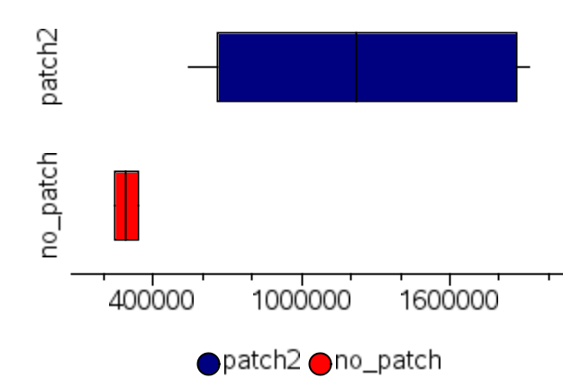
Data Analysis: Graphs
How to compare all the available data when coming from different experimental setups?
Notes:
Image source: 2015 Civil and Environmental Engineering Department. University of Houston

Slide 8
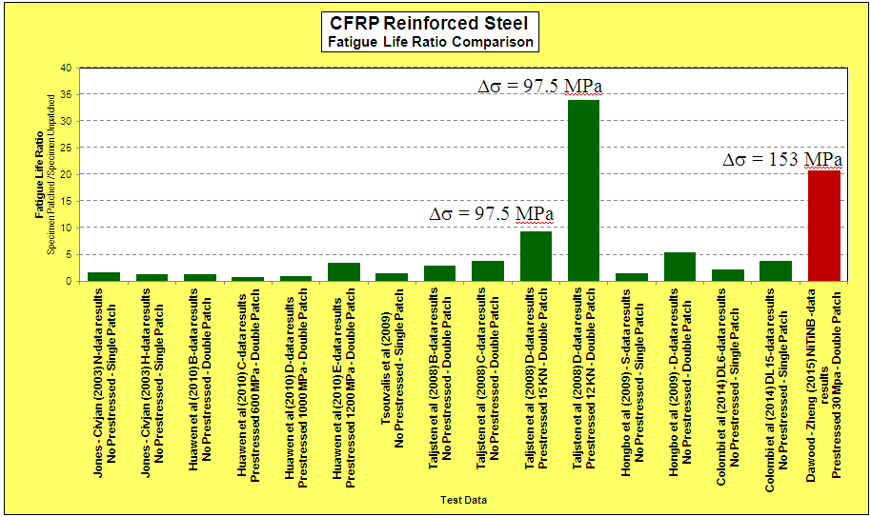
Data Analysis: Graphs
patched specimen mean fatigue life
Using the fatigue life ratio:
unpatched specimen mean fatigue life
Notes:
Image source: 2015 Civil and Environmental Engineering Department. University of Houston

Slide 9
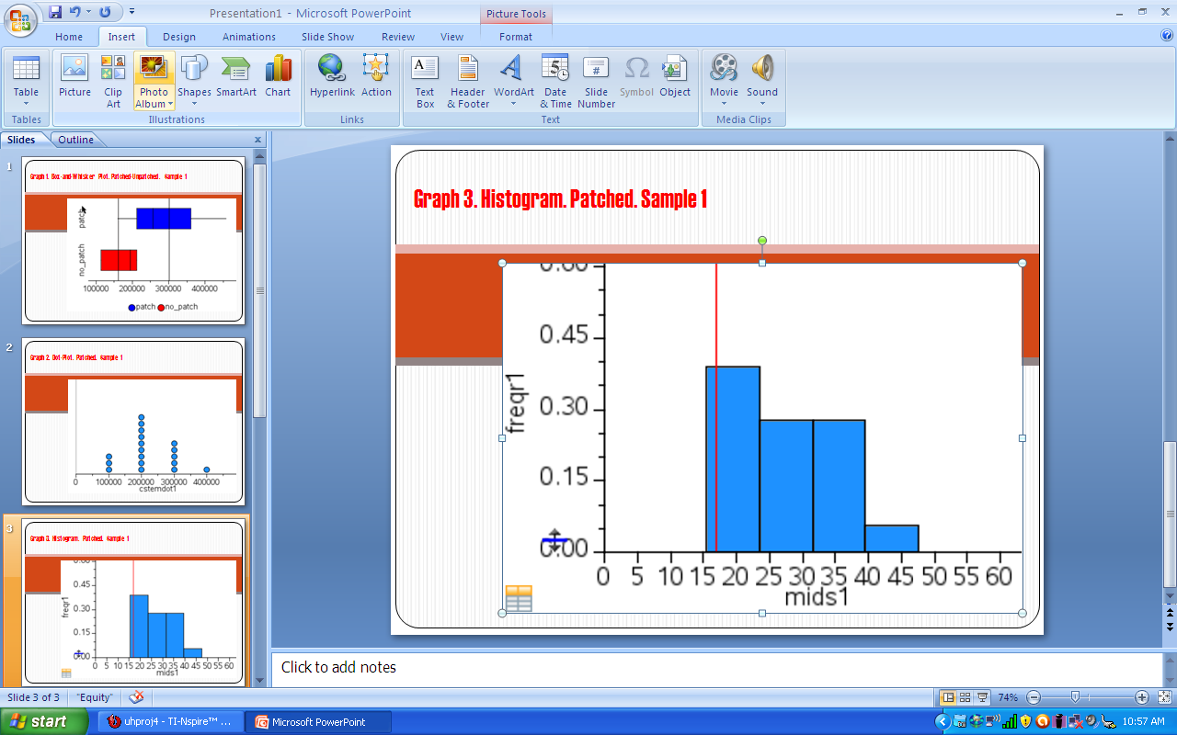
Student Results Presentations
PowerPoint + in-class presentation—or video (wmv, mp4)
Background
Procedure
Data
Graphs
Stat analysis
Conclusions
Notes:
Image source: 2015 Civil and Environmental Engineering Department. University of Houston
Refer students to the project rubric for details of what to include in the final report and presentation

