Slide 1
Ellipses

Slide 2
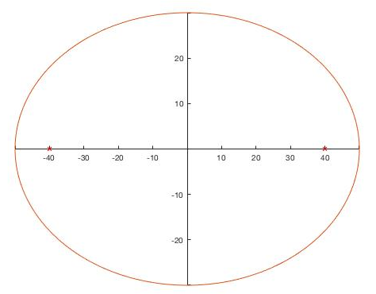
What makes an ellipse?
b
F1
F2
a
F1 and F2 = foci
a = major axis
b = minor axis

Slide 3
What makes an ellipse?
Definition
A curve in a plane surrounding 2 focal points
The sum of the distances from each focal point to the curve is constant for every point of the curve
Major axis is the longer axis
Foci always located along the major axis
A circle is one type of ellipse

Slide 4
Special property of an elipse
The sum of the distances from each focal point to the curve is constant for every point of the curve
d1
d2
d4
d3
a
d1+d2=2a
d3+d4=2a

Slide 5
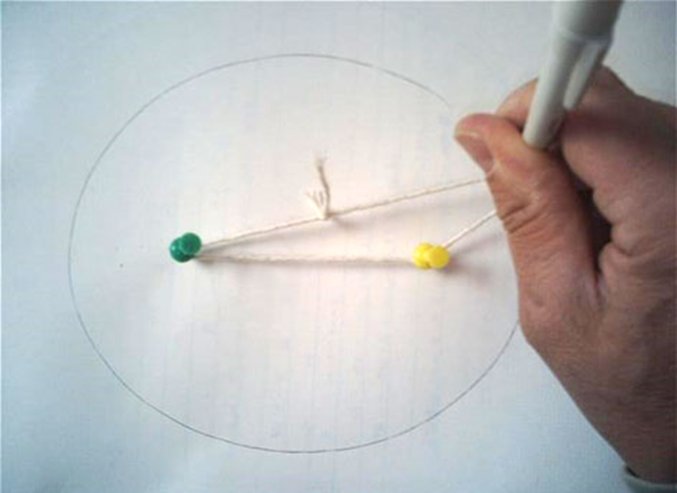
Test this property yourself!
Use graph paper to draw an ellipse:
Find the foci
Cut a length of string that is equal to 2a
Pin down each end of the string to the foci
Trace the string around the edge of the ellipse

Slide 6
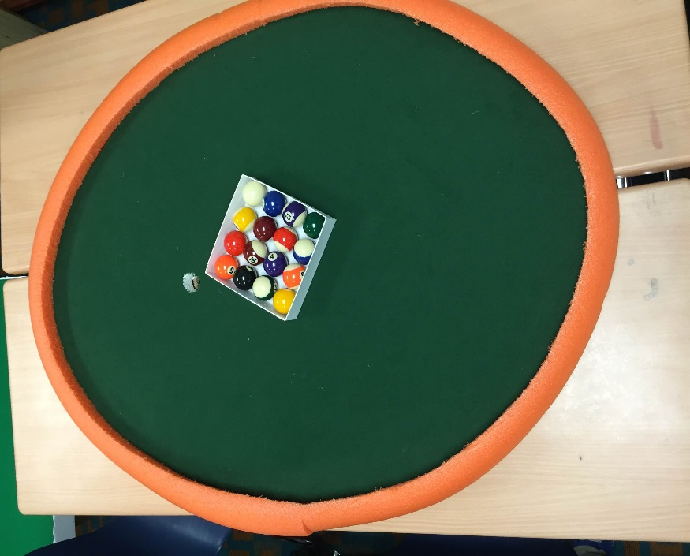
Your Engineering Design Challenge
Today’s task is to demonstrate your knowledge of ellipses by creating an elliptical pool table

Slide 7
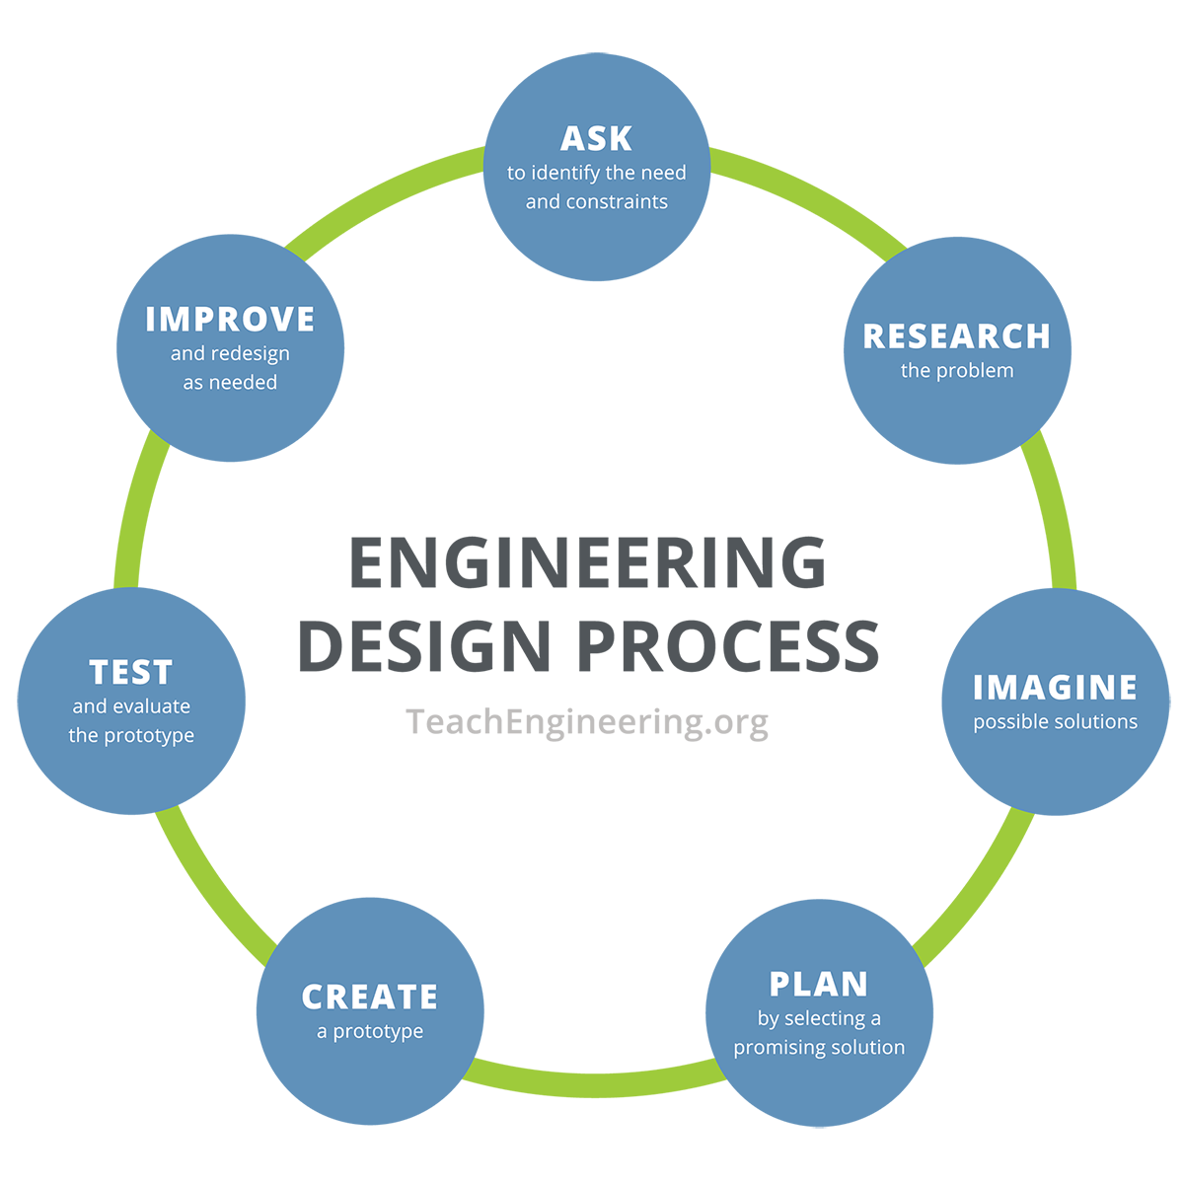
Your Engineering Design Challenge
Follow the steps of the engineering design process to create your table
Note the imagine, plan, and improve steps!

Slide 8
Design Constraints
Elliptical-shaped pool table
One focal point is the pocket
The other focal point is the break spot
Group budget = $10
Maximum table size = 2 feet x 2 feet
For engineers, design constraints are the requirements and limitations that final design solutions must meet.

Slide 9
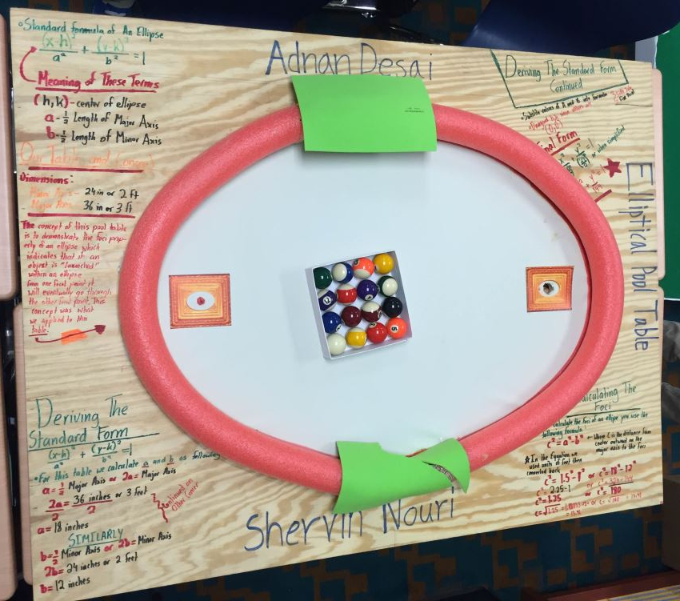
Past Student Examples (for the teacher)

Slide 10
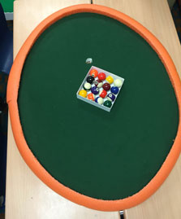
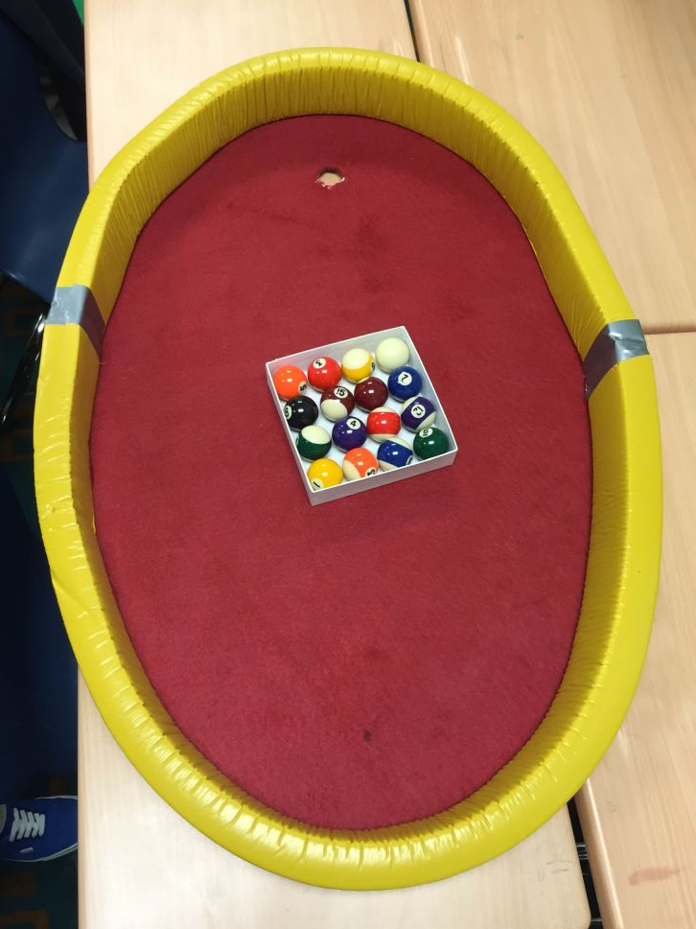
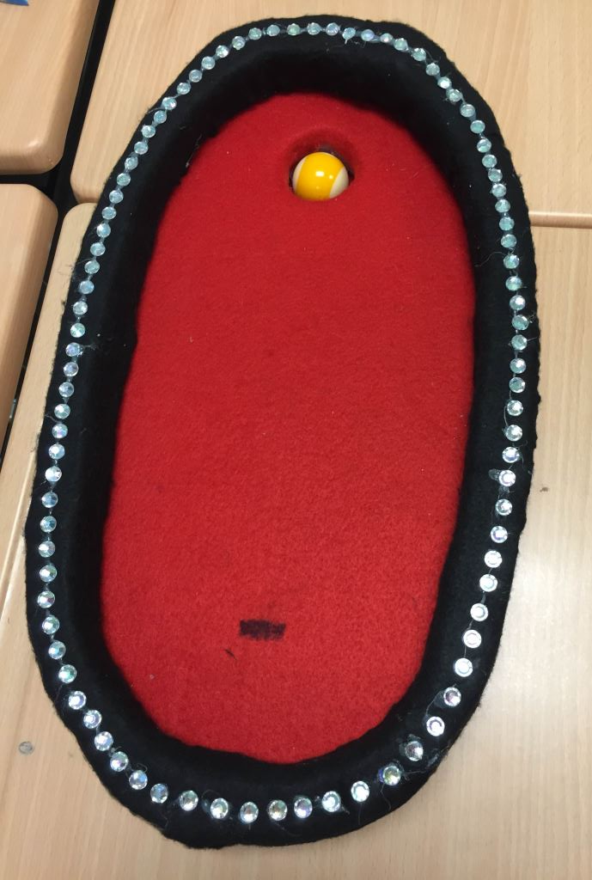
Past Student Examples (for the teacher)

Slide 11
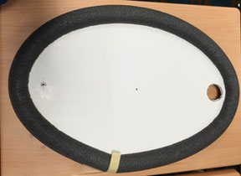
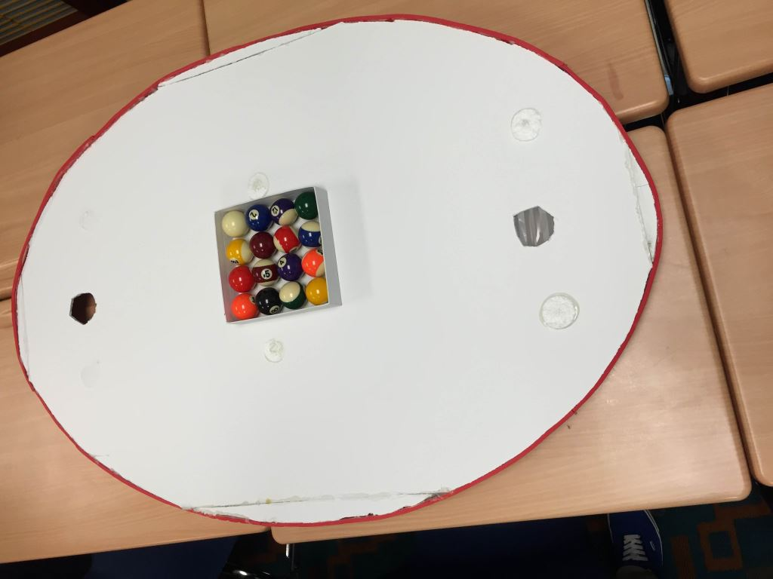
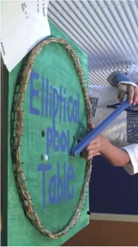
Past Student Examples (for the teacher)

