Slide 1
Above-ground storage tank Conclusions

Slide 2
Group Presentations!
Notes:
Have students present their designs for improved above-ground storage tanks here.
Animated gif of team thinking of ideas from Microsoft clipart http://office.microsoft.com/en-us/images/results.aspx?qu=idea&ex=1#ai:MM910001094|

Slide 3
Combating Storm Surge Video SSPEED Center, Rice University
Protecting the Houston region from the next hurricane
(2:44 minutes)
http://news.rice.edu/2013/09/13/hurricane-ike-5-years-later/
Notes:
Boyd, Jade. Hurricane Ike: 5 years later. September 13, 2013.
Copyright Rice University News & Media. http://news.rice.edu/2013/09/13/hurricane-ike-5-years-later/

Slide 4
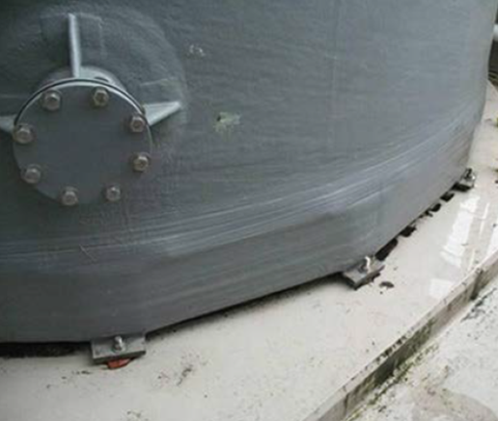
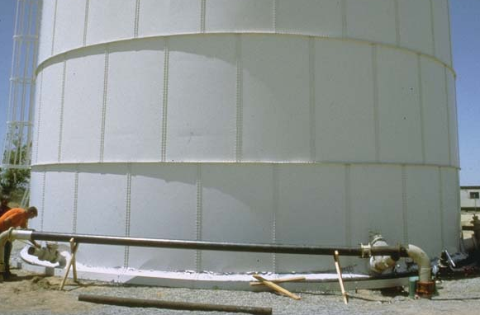
Engineering Design IDEAS for Preventing Storm Surge, Uplift and Displacement
Install flood gates
Elevate highways
Coastal recreation or revetment
Install anchors around AST bases
Install stiffening rings
Before storm, fill ASTs with water or liquid product
Image source: fema.gov
Image source: www.ngdc.noaa.gov
Notes:
Image sources:
(top) Anchors at base of fiberglass-reinforced plastic tank; image from FEMA at http://www.fema.gov/earthquake/fema-e-74-reducing-risks-nonstructural-earthquake-damage-31 (Photo courtesy of Jeffrey Soulages, Intel) (bottom) Storage tank with stiffening rings; image from NOAA at http://www.ngdc.noaa.gov/hazardimages/picture/show/344

