Slide 1
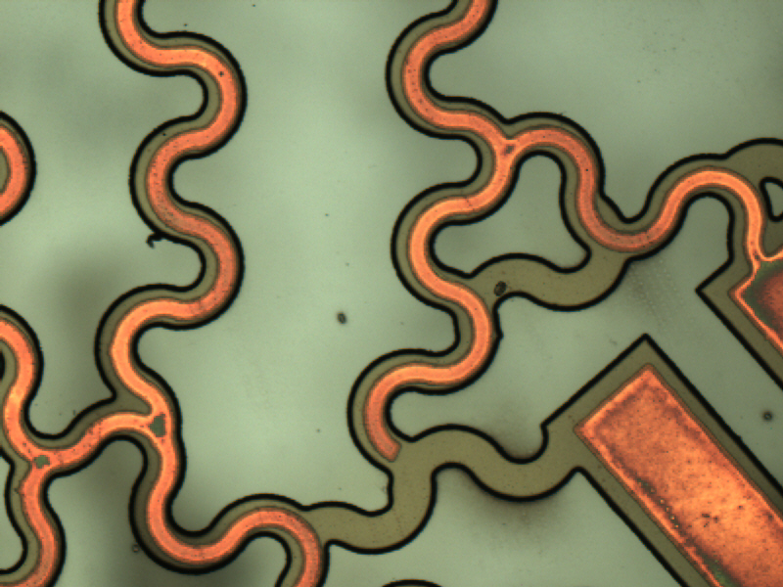
Flexible Circuits:
Project Scope Presentation
“Flexible circuits are a high-growth technology in the area of electrical interconnectivity and look set to deliver improved performance against the demands of many 21st century products… flexible printed circuits have replaced hand-built wire harnesses in many applications.”
Peter Macleod, Flexible Circuit Technology
Prime Faraday Technology Watch
Notes:
Background image source: (smart lens nano-circuit portion) Wearable Electronics Laboratory, Energy Park Unit, Mechanical Engineering Department, University of Houston

Slide 2
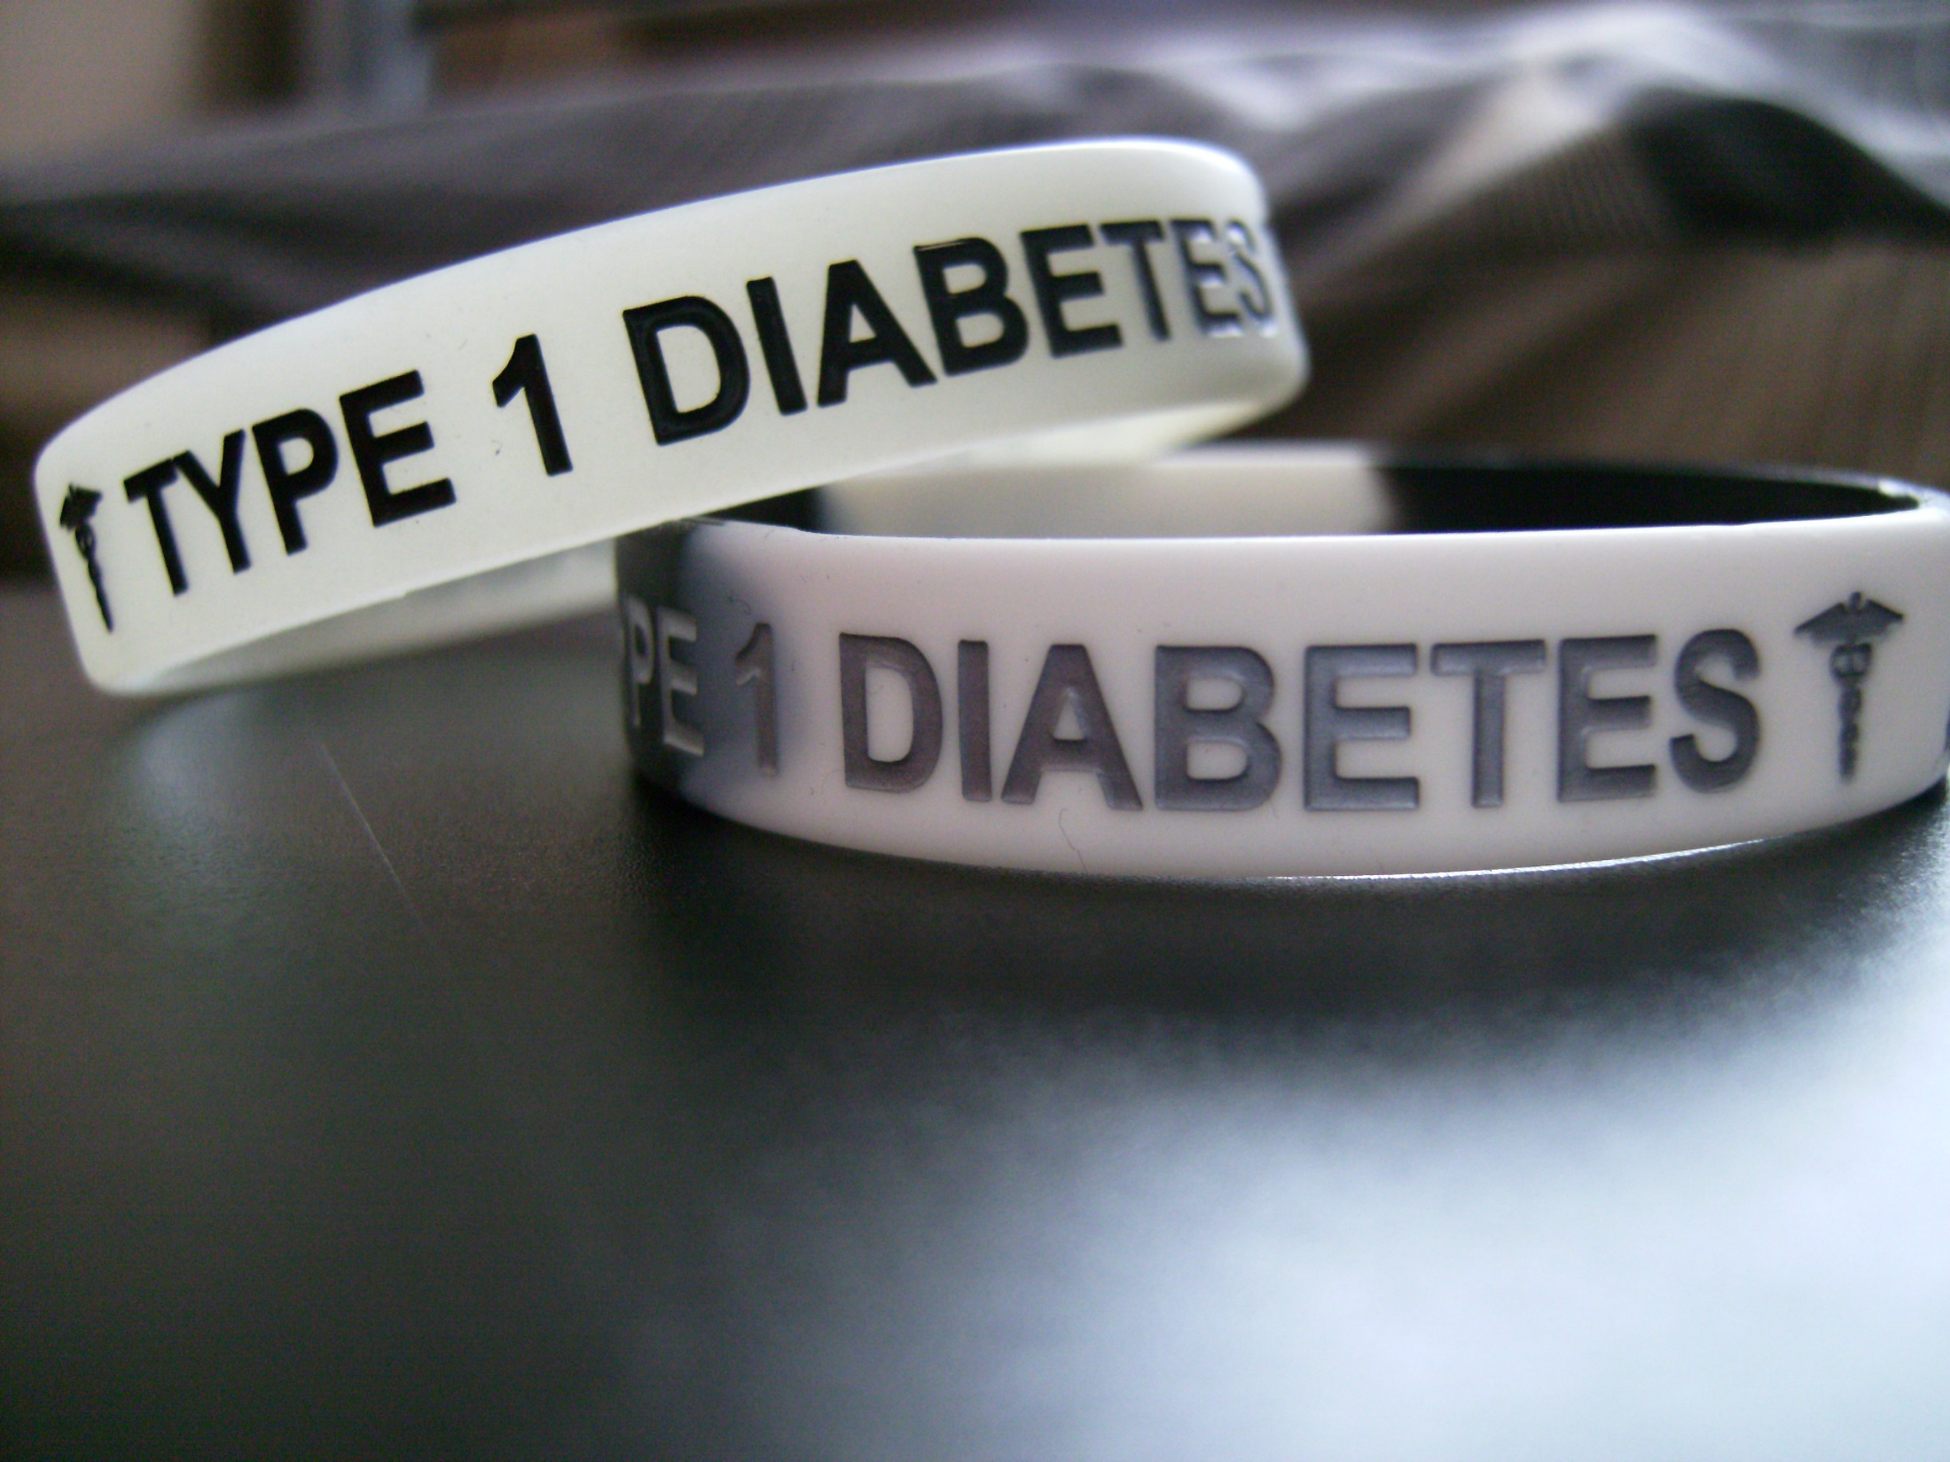
What is diabetes?
A metabolic disease in which the body’s inability to produce any or enough insulin causes elevated levels of glucose in the blood.
If not controlled, diabetes can produce complications that can affect nearly every organ in the body:
heart attack
stroke
atherosclerosis
high blood pressure
neuropathy
nephropathy
cataracts and glaucoma
foot damage and possible limb amputation
hearing impairment
skin conditions
Alzheimer's disease
Notes:
Background image source: (diabetic bracelets) 2011 Bradley Johnson, flickr https://www.flickr.com/photos/bradlightyear/5736670215 [Attribution-NonCommercial-NoDerivs 2.0 Generic (CC BY-NC-ND 2.0); https://creativecommons.org/licenses/by-nc-nd/2.0/legalcode]

Slide 3
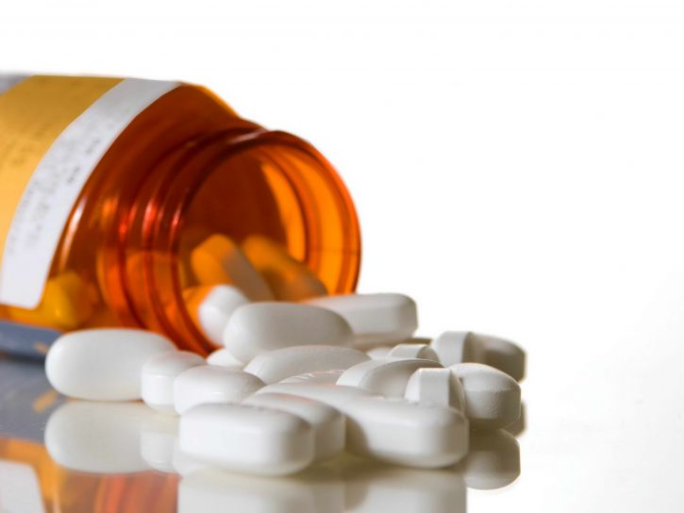
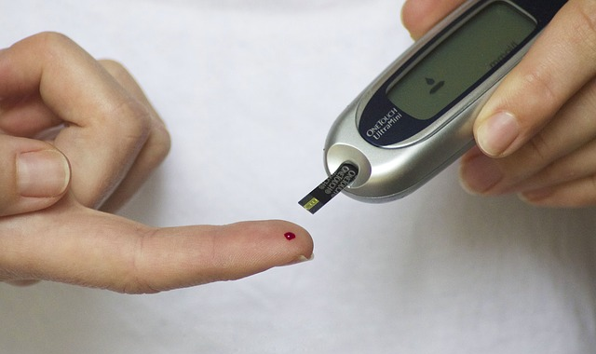
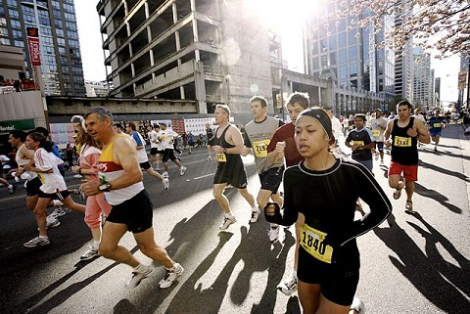
Diabetes Care
Medical Care
Medication
Diet
Glucose Monitoring
Exercise and Lifestyle
Notes:
Image sources
Background: (stop diabetes hands) 2010, Steven Depolo, Flickr [Attribution 2.0 Generic (CC BY 2.0)] https://www.flickr.com/photos/stevendepolo/4270844630
Medical care: (blood pressure measurement) 2009 www.volganet.ru, Wikimedia Commons [Creative Commons Attribution-Share Alike 3.0 ] https://commons.wikimedia.org/wiki/File:Blood_pressure_measurement_(2009).jpg
Medication: (amber bottle & tablets) 2015 Amber Mills, UCSDCP, public domain image from http://www.public-domain-image.com/free-images/science/medical-science/uncapped-amber-medication-bottle-and-tablets-725x544.jpg
Exercise and lifestyle: (runners on street) 2006 Kris Krug, Wikimedia Commons https://commons.wikimedia.org/wiki/File:Sunrun_shot_by_kk.jpg
Diet: (basket fruits vegetables) 2007 Gila Brand, Wikimedia Commons https://commons.wikimedia.org/wiki/File:BikurimS.jpg
Glucose monitoring: (pricking finger) TesaPhotography, Pixabay [CC0 Public Domain) https://pixabay.com/en/diabetes-blood-finger-glucose-777002/

Slide 4
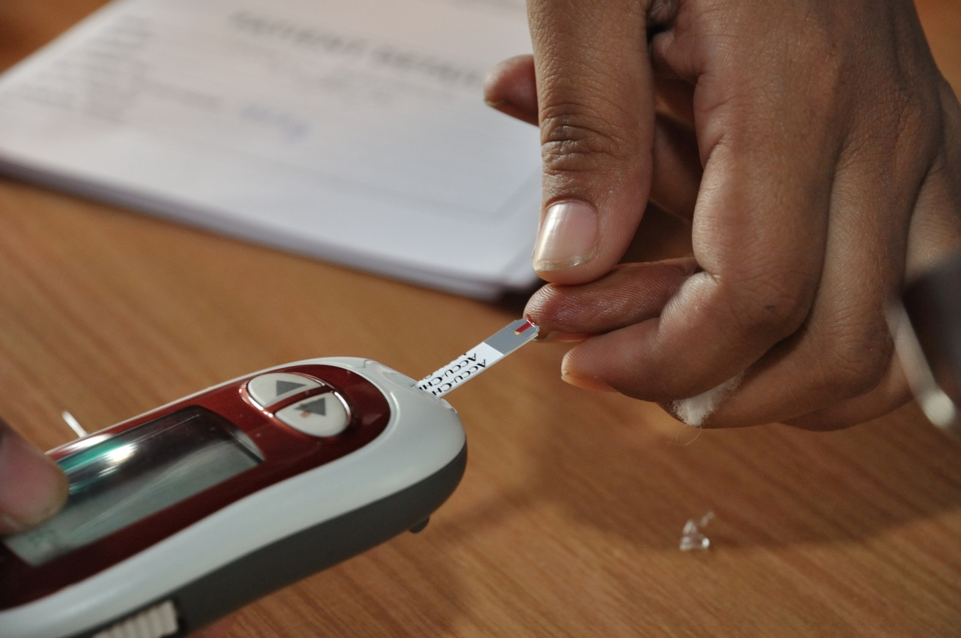
Glucose Monitoring
For some people, it is necessary to monitor their blood glucose levels daily—and sometimes more than once a day!
Fact: Glucose levels can be also measured in other corporal (human body) fluids…
Knowing this… Could an alternative to the annoying pinching procedure be developed?
Notes:
Background image source:
(testing blood glucose with a glucose testing device) 2011 Biswarup Ganguly, Wikimedia Commons https://commons.wikimedia.org/wiki/File:Blood_Glucose_Testing_-_Kolkata_2011-07-25_3982.JPG

Slide 5
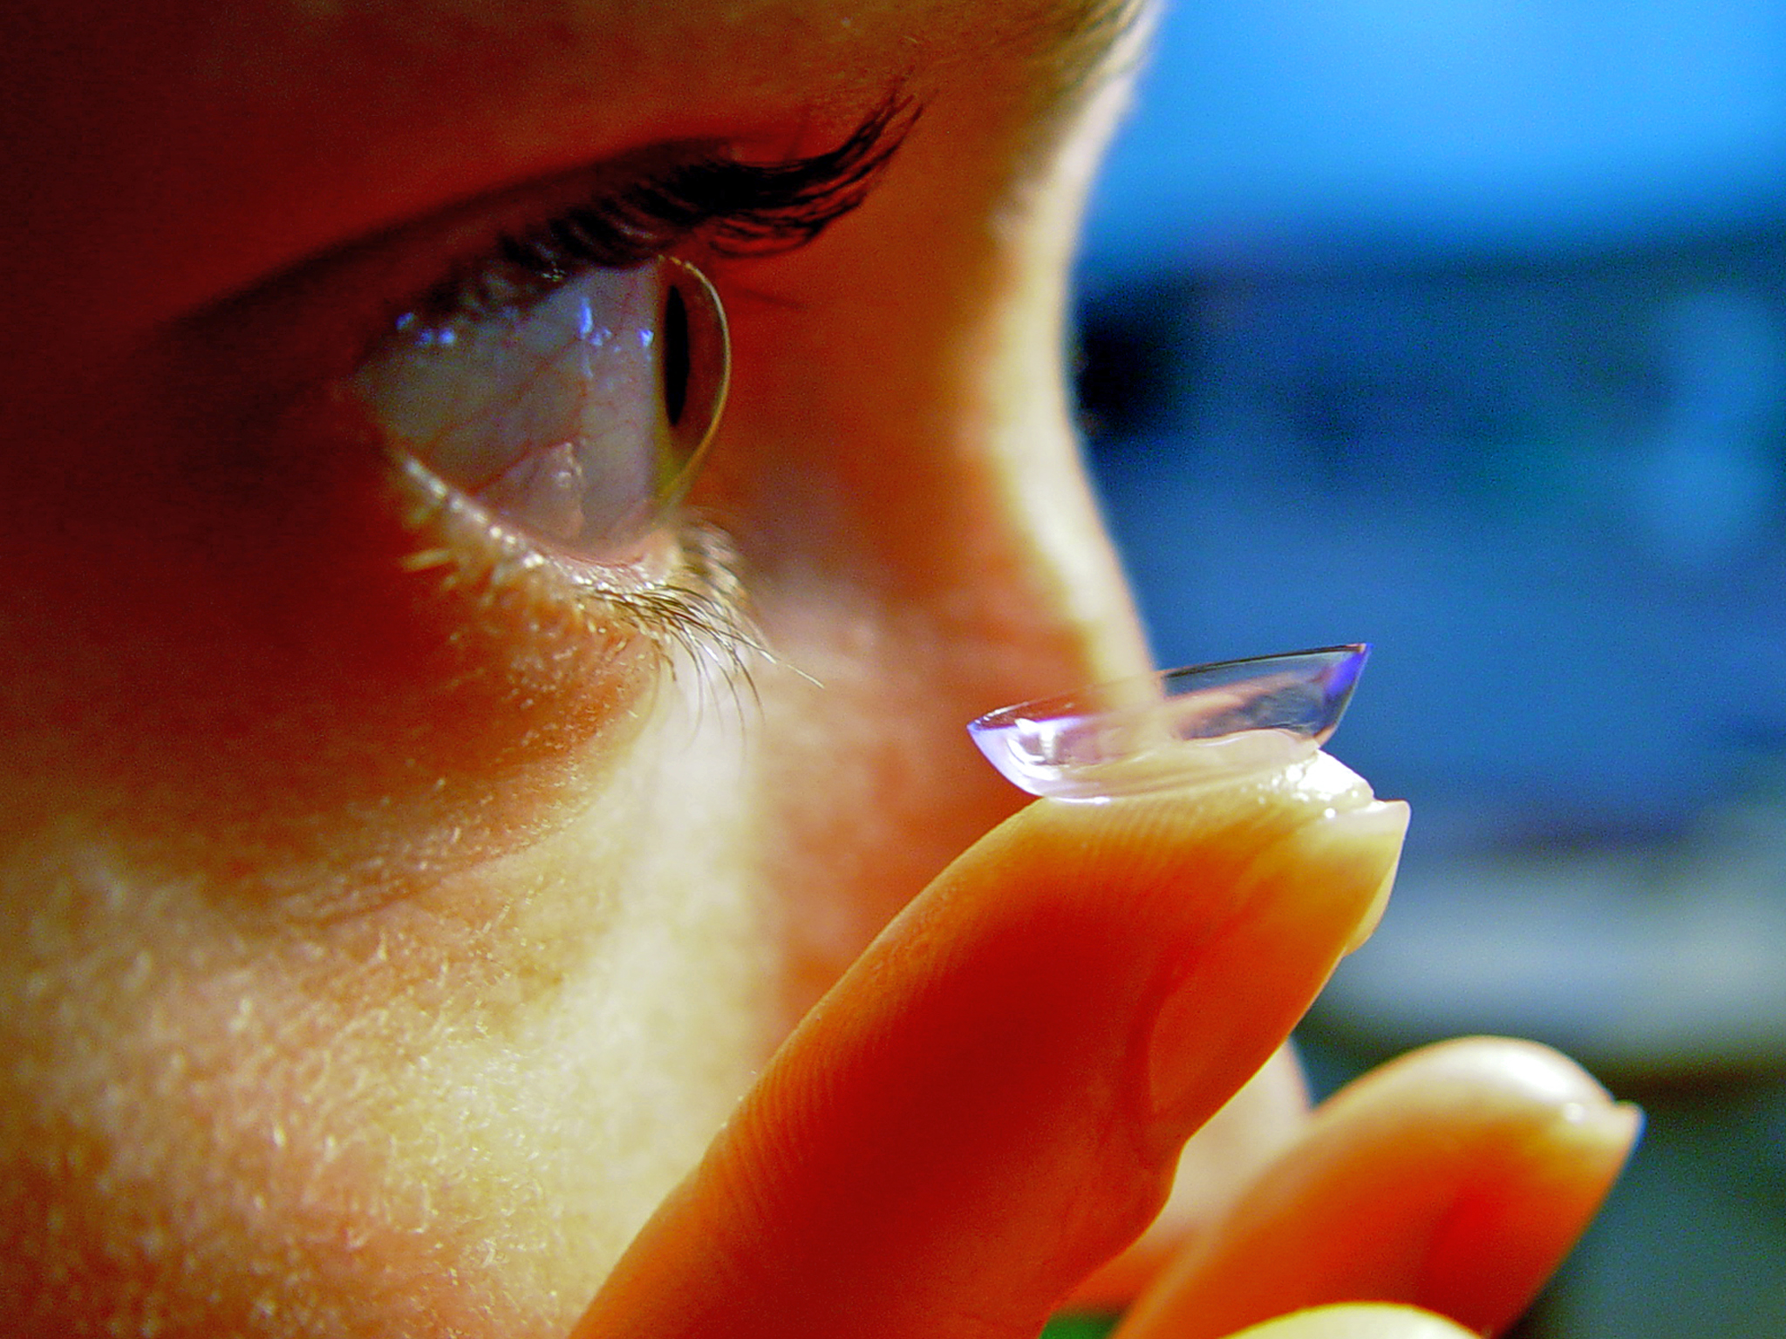
Example Idea: Smart Lens
Developed by Google Labs and Novartis
The lens can measure blood sugar levels directly from tear fluid on the eyeball surface
It contains a low-power microchip and an almost invisible, hair-thin electronic flexible circuit
The system sends data to a mobile device to keep the person informed.
Notes:
While in slide-show mode, double-click on the left blue button to link to a news article titled, “Google Smart Contact Lens Focuses on Healthcare Billions” at http://www.forbes.com/sites/leoking/2014/07/15/google-smart-contact-lens-focuses-on-healthcare-billions/
Double-click on the right blue button to link to another news article titled, “Novartis licenses Google's smart lens technology” at Hehxus.net at http://hexus.net/mobile/news/accessories/72117-novartis-licenses-googles-smart-lens-technology/
Background image source: (finger with contact lens) 2002 Etan J. Tal, Wikimedia Commons https://commons.wikimedia.org/wiki/File:Contact_Lens_Ayala.jpg

Slide 6
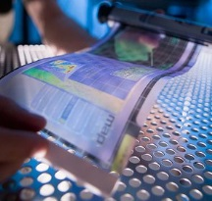
Flexible Electronics
At the core of the Google smart lens is a thin and flexible printed circuit
“A flexible printed circuit is a patterned arrangement of printed circuitry and components that uses a flexible base material with or without a flexible cover lay.”
—IPC, Association Connecting Electronics Industries
Notes:
Background image source: (flexible plastic display) 2009 RDECOM, Wikimedia Commons
https://commons.wikimedia.org/wiki/File:Flexible_display.jpg

Slide 7
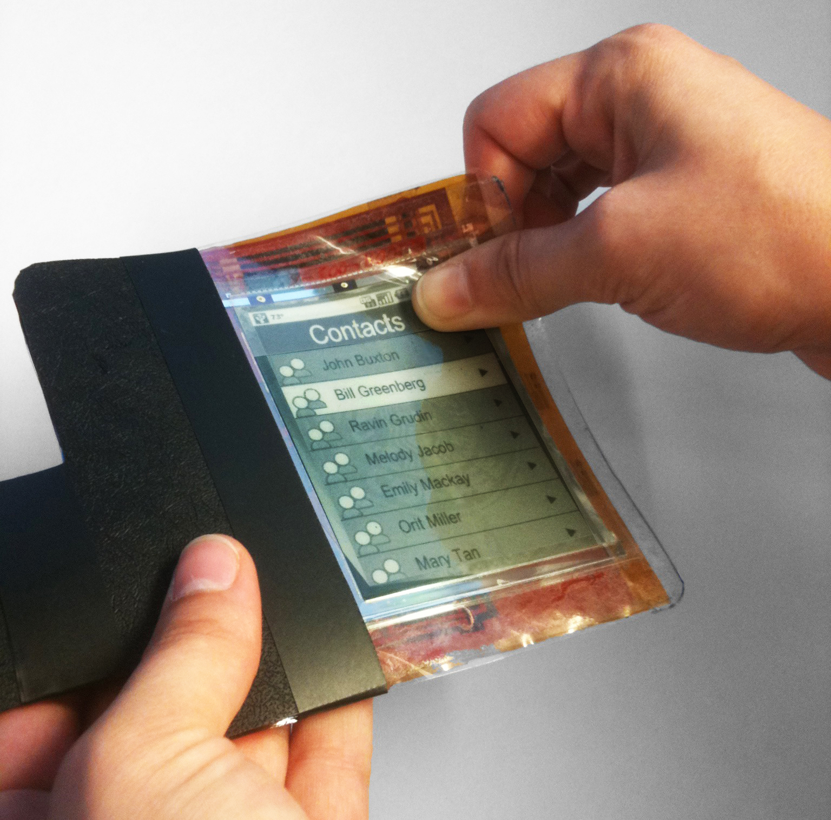
Flexible Circuit Composition
flexible circuit =
dielectric substrate film
(base material)
+
electrical conductors
(circuit traces)
+
protective finish
(cover coat)
+
adhesives
(bond materials)
Notes:
Background image source: (flexible paper phone prototype) 2011 Superdiddley, Wikimedia Commons https://commons.wikimedia.org/wiki/File:PaperPhone_Flexible_Smartphone.jpg

Slide 8
Flexible Circuit Composition
Substrate materials:
Polyesters: Low cost and highly flexible
Polymides: high-temperature characteristics (~700 ºC) and low thermal expansion
Electrical conductors:
Gold, aluminum, nickel or silver, but mainly copper
Ink loaded with carbon or silver particles
Notes:
Background image source: (flexible paper phone prototype) 2011 Superdiddley, Wikimedia Commons https://commons.wikimedia.org/wiki/File:PaperPhone_Flexible_Smartphone.jpg

Slide 9
Flexible Circuit Composition
Single-Sided Flexible Circuits
Most common type
Single conductor layer on a flexible dielectric film
Access to circuit-termination from one side only
With or without cover lays and protective coatings
Simple design; highly cost effective
Best suited to dynamic-flexing
Notes:
Background image source: (flexible paper phone prototype) 2011 Superdiddley, Wikimedia Commons https://commons.wikimedia.org/wiki/File:PaperPhone_Flexible_Smartphone.jpg

Slide 10
Flexible Circuits Composition
Single-Sided Flexible Circuits
Base Substrate
Adhesive
Conductor
Coverlay
Notes:
Background image source: (flexible paper phone prototype) 2011 Superdiddley, Wikimedia Commons https://commons.wikimedia.org/wiki/File:PaperPhone_Flexible_Smartphone.jpg

Slide 11
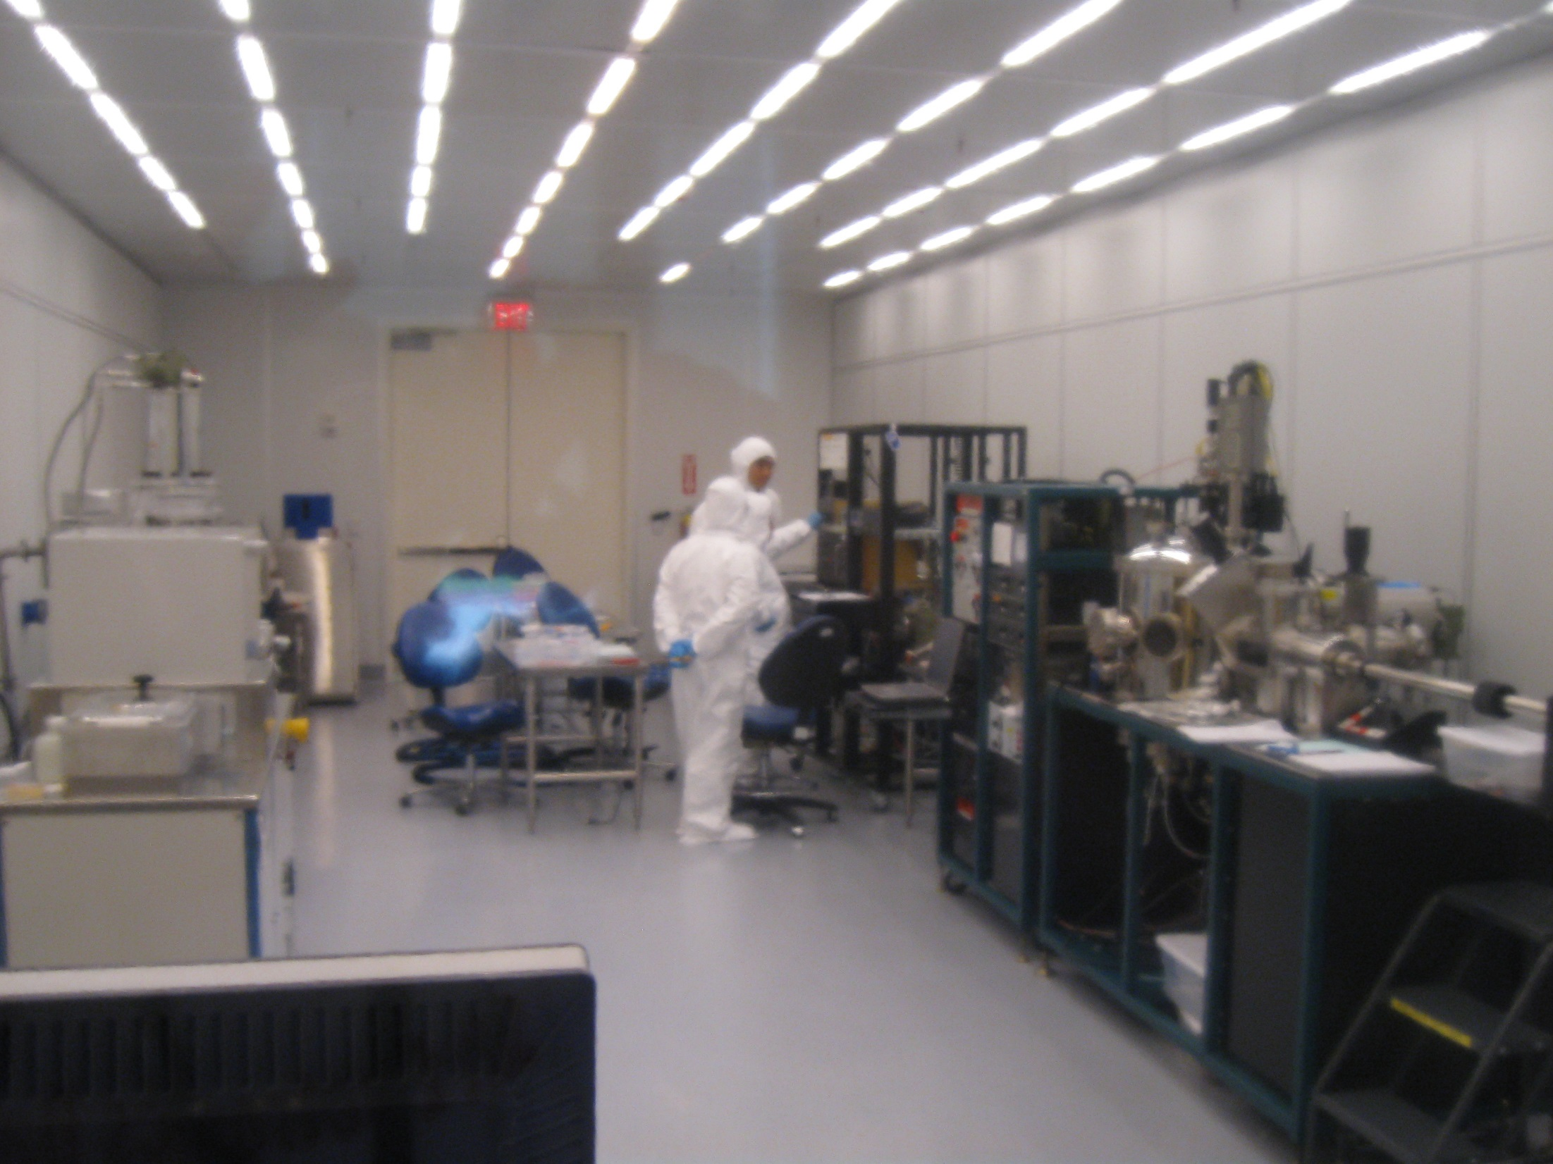
Flexible Circuit Fabrication
Cleaning Impurities
Photoresist Coating
Sputter Deposition
UV Ligth Exposure
Photolithography
Stripping
Photoresist Removal
Etching
Notes:
Special instructions: Click on arrows to see a brief explanation of each step of the process. Explanations are in Custom Shows that automatically return to this slide - Photo-litho-graphy: latin: light-stone-writing
- Photolithography is an optical means for transferring patterns onto a substrate. It is essentially the same process that is used in lithographic printing.
- Patterns are first transferred to an imagable photoresist layer.
- Photoresist is a liquid film that can be spread out onto a substrate, exposed with a desired pattern, and developed into a selectively placed layer for subsequent processing.
Photolithography is a binary pattern transfer: there is no gray-scale, color nor depth to the image.
Background image source for this slide: Nanofabrication Facility, Wearable Electronics Laboratory, Energy Park Unit, Mechanical Engineering Department, University of Houston

Slide 12
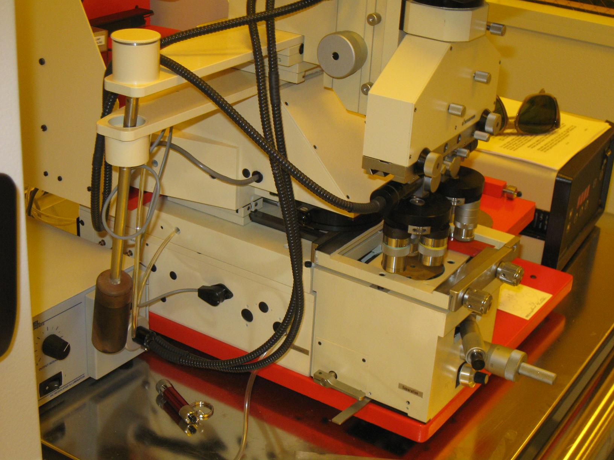
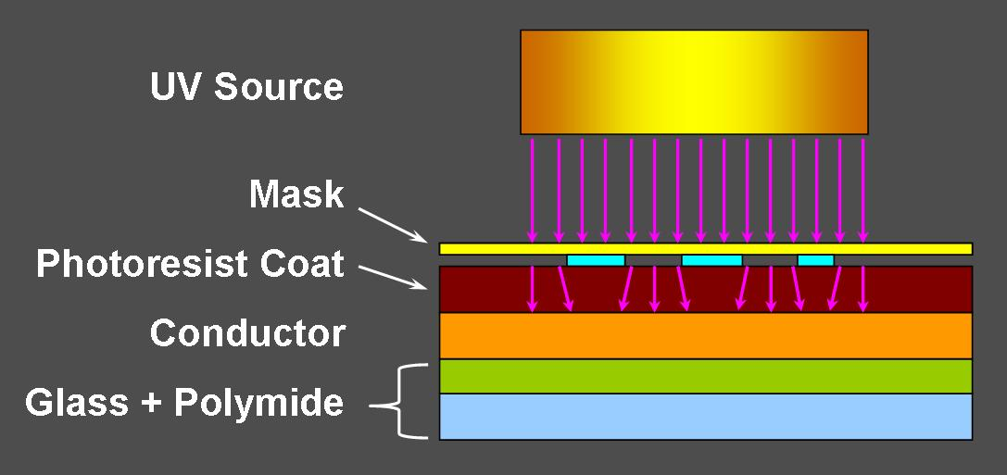
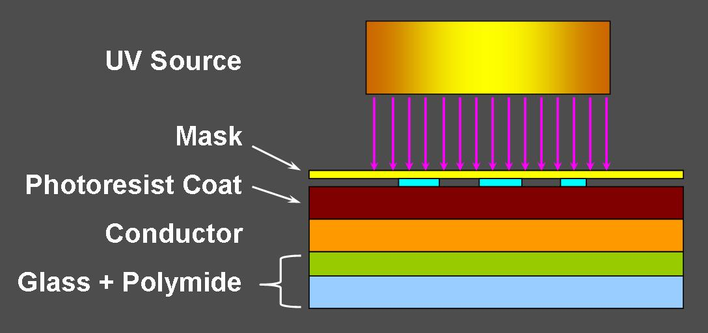
What is the research?
The UV light exposure step in the photolithography process is the core of the research performed for this lesson. Note that the circuit mask is placed over the wafer coated with the photoresist. Challenge question:
Is it expected that that the printed circuit is an exact copy of the mask, or is an alteration produced by the pass of the UV light through the photoresist coat? Or, is the diffraction of the light in this coating significant?
Notes:
At the end of this slide, show students this link: http://www.mike-willis.com/Tutorial/diffraction.htm so they see that the mathematical solution for diffraction is extremely complex!
Image sources:
Background equipment photo: Wearable Electronics Laboratory, Mechanical Engineering Department, University of Houston
Lower-right diagrams: Miguel R. Ramirez, UH-RET Program, University of Houston (author)

Slide 13
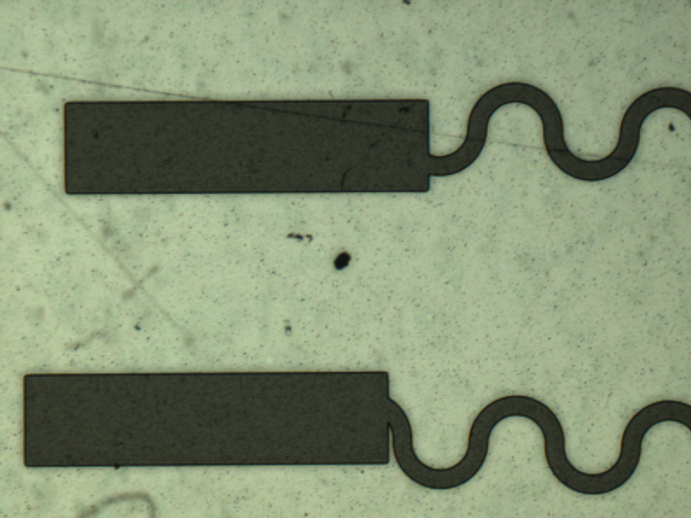
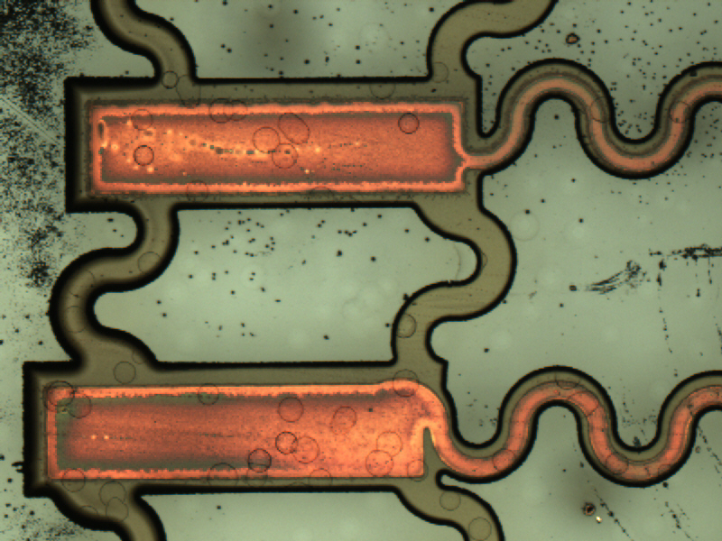
What is the research?
To answer this question, we must compare the dimensions of a circuit in the original mask, and the dimensions of the final circuit obtained through the photolithography process.
Notes:
Source of all images on this slide: Wearable Electronics Laboratory, Energy Park Unit, Mechanical Engineering Department, University of Houston

Slide 14
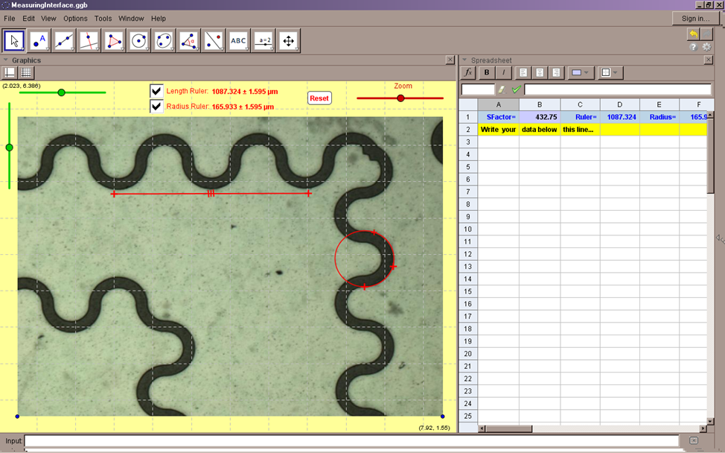
What is the research?
We will take samples of measurements from two sets of pictures: original circuits on masks and their corresponding printed circuits.
We will use a special graph interface created in GeoGebra to perform these measurements
Notes:
Source of all images on this slide: Wearable Electronics Laboratory, Energy Park Unit, Mechanical Engineering Department, University of Houston

Slide 15
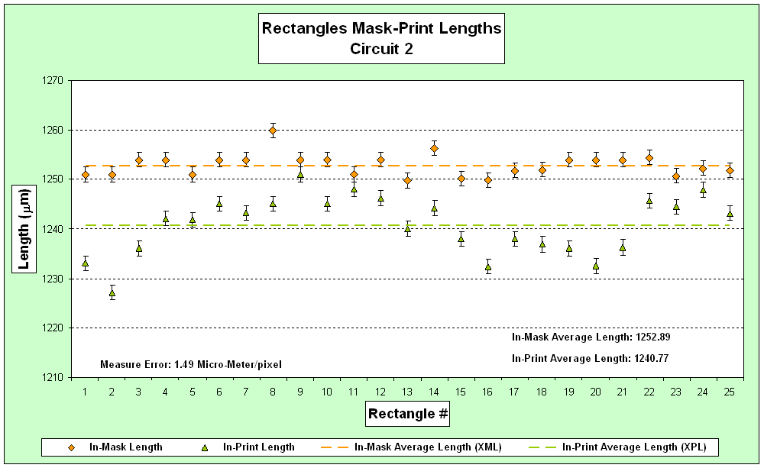
What is the research?
We will use statistical analysis, hypothesis testing for differences, to conclude if the differences in dimensions mask-printed circuits are statistically significant or not.
A T-test is the correct approach for dependent or independent samples
Dependent or Paired Data
Notes:
Source of all images on this slide: Wearable Electronics Laboratory, Energy Park Unit, Mechanical Engineering Department, University of Houston

Slide 16
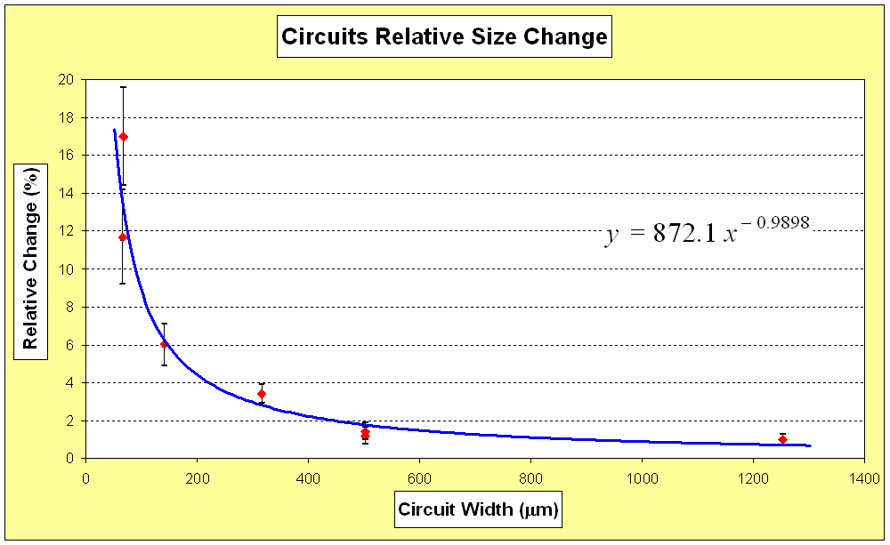
What is the research?
We’ll put the measurements from the different circuits together in a relative size change graph
We’ll use the equation:
to compute the dependent variable y of the graph
Notes:
Source of all images on this slide: Wearable Electronics Laboratory, Energy Park Unit, Mechanical Engineering Department, University of Houston

Slide 17
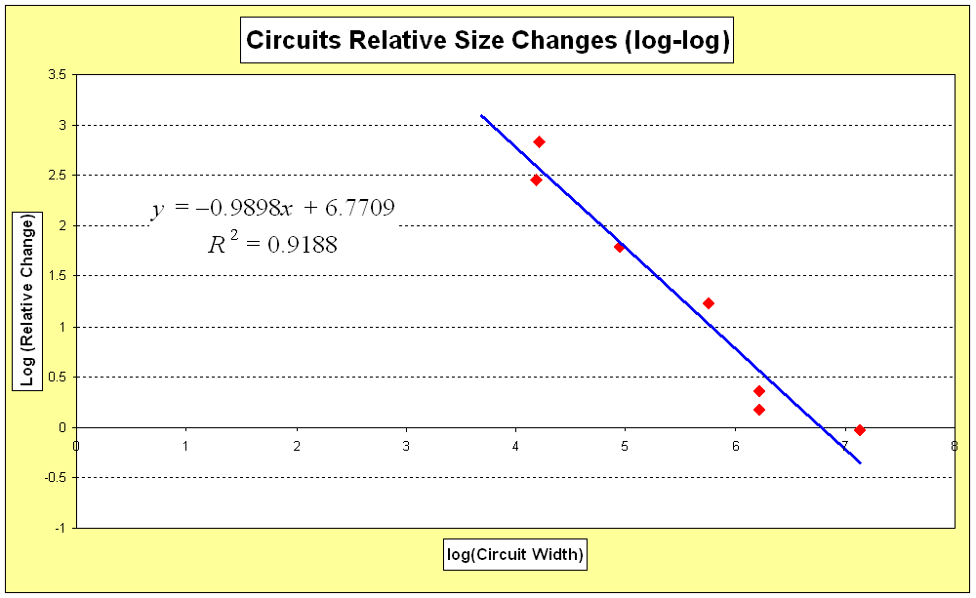
What is the research?
Taking logarithm of the y variable, a linear relationship can be found. Solving for y, an empirical relationship for the relative change can be obtained.
With this equation, it is possible to predict the change in the printed circuit as a function of the original dimensions
Notes:
Source of all images on this slide: Wearable Electronics Laboratory, Energy Park Unit, Mechanical Engineering Department, University of Houston

Slide 18
Suggested reading:
Photolithography: http://en.wikipedia.org/wiki/Photolithography
What is photolithography: http://whatis.techtarget.com/definition/photolithography
Carl Batt: Photolithography: http://www.youtube.com/watch?v=9x3Lh1ZfggM
Semiconductor Lithography. The Basic Process: http://www.lithoguru.com/scientist/lithobasics.html
What Else Could Smart Contact Lenses Do?: http://www.technologyreview.com/news/529196/what-else-could-smart-contact-lenses-do/
Google's Prototype "Smart Contact Lens": Measuring Blood Glucose Levels for People with Diabetes: http://www.visionaware.org/blog/visionaware-blog/googles-prototype-smart-contact-lens-measuring-blood-glucose-levels-for-people-with-diabetes-1418/12

Slide 19
Custom Shows
Custom Shows
Notes:
Background image source for this slide and all next slides: Nanofabrication Facility, Wearable Electronics Laboratory, Energy Park Unit, Mechanical Engineering Department, University of Houston

Slide 20
Flexible Circuit Fabrication
Sputter Deposition
Photolithography

Slide 21
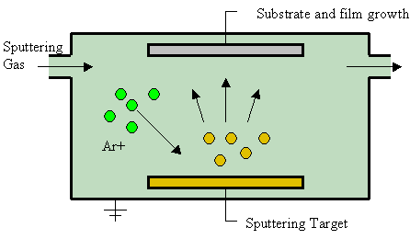
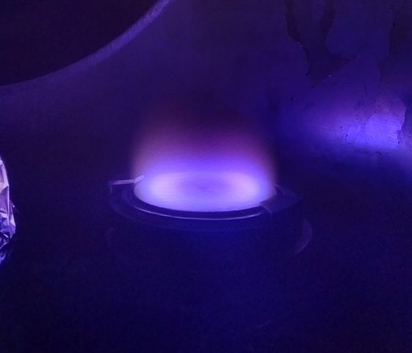
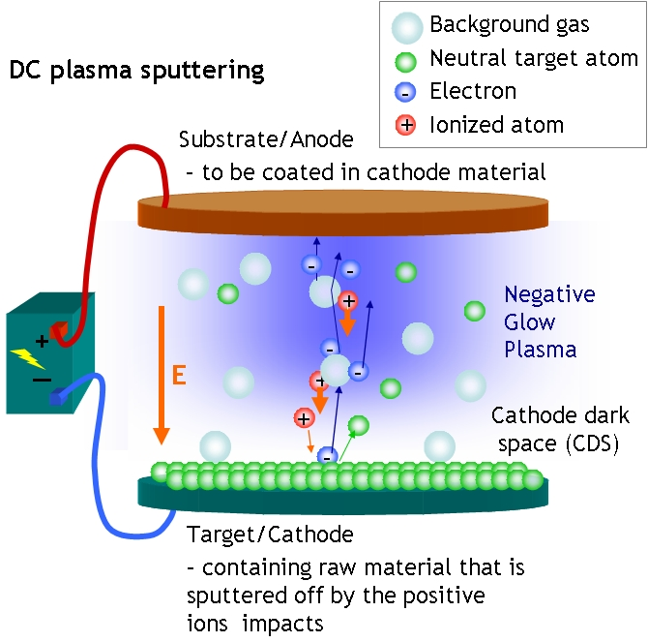
Sputter Deposition
A method of depositing thin films by way of eroding material from a “target” source onto a “substrate.”
Typically accomplished by bombarding the “target” (that is, the source of deposition material) with atoms of inert gas.
The momentum of the bombarding atoms transfers to target atoms enabling them to separate from the target flying towards the deposition surface.
Notes:
Image sources:
Top diagram: (sputtering process diagram) 2009 Jesse Viviano, Wikipedia
https://en.wikipedia.org/wiki/File:Sputtering.gif
Bottom diagram: (DC plasma sputtering) 2006 Opensource Handbook of Nanoscience and Nanotechnology via Wikimedia Commons https://commons.wikimedia.org/wiki/File:DCplasmaSputtering.jpg
Photograph: (blue magnetron sputtering system) 2013 Immodus, Wikimedia Commons https://commons.wikimedia.org/wiki/File:Magnetron_sputtering_source.jpg

Slide 22
Flexible Circuit Fabrication
Cleaning Impurities
Photolithography

Slide 23
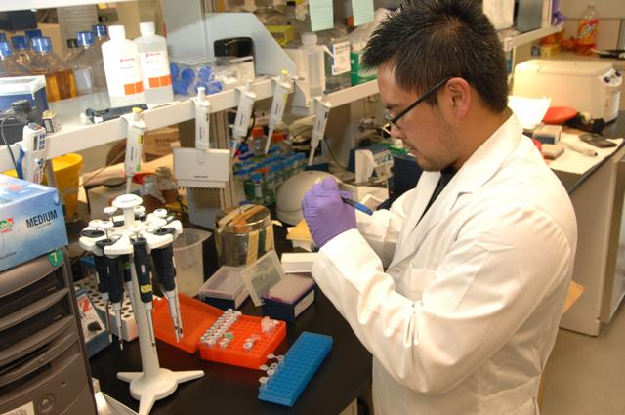
Cleaning Impurities
Organic / inorganic contaminations are usually removed by wet chemical treatment using solutions containing hydrogen peroxide.
Other solutions made with trichloro-ethylene, acetone or methanol may also be used to clean
Notes:
Image source: (medical lab scientist) 2012 National Institutes of Health via Wikimedia Commons https://commons.wikimedia.org/wiki/File:Medical_Laboratory_Scientist_US_NIH.jpg

Slide 24
Flexible Circuit Fabrication
Photoresist Coating
Photolithography

Slide 25
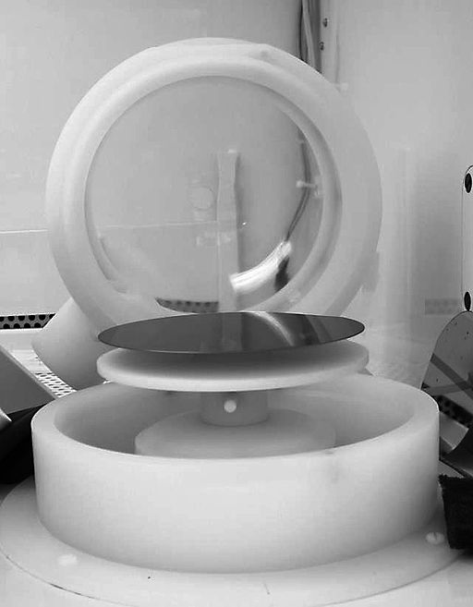
Photoresist Coating
A UV light-sensitive liquid that loses its resistance (its susceptibility to attack by an etchant or solvent) when exposed to UV light.
A wafer coated with a thin conductor, is covered with photoresist by spin coating; this viscous liquid solution is dispensed onto a rapidly spun wafer, to produce a uniformly thick layer.
Notes:
Image sources:
Left: (b/w photo of spinner) 2006 Alison Chaiken, HP Labs via Wikimedia Commons https://commons.wikimedia.org/wiki/File:Spinner.jpg
Right: (photoresist during spin coating on silicon wafer) 2014 Sei, Wikimedia Commons https://commons.wikimedia.org/wiki/File:Photoresist_spin_coating.jpg

Slide 26
Flexible Circuit Fabrication
UV Ligth Exposure
Photolithography

Slide 27
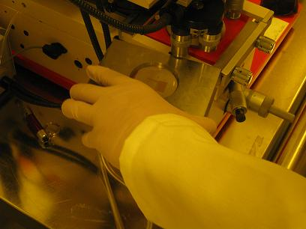
UV Light Exposure
UV light passes through a mask (a print of the circuit to be transferred to the wafer) placed on the conductor coated wafer. Light causes a chemical change on the photoresist. Positive photoresist becomes soluble in the developer when exposed; with negative photoresist, unexposed regions are soluble in the developer.
Notes:
Image sources:
Left: (diagram) Miguel R. Ramirez, UH-RET Program, University of Houston (author)
Right: (photograph hand machine) Wearable Electronics Laboratory, Energy Park Unit, Mechanical Engineering Department, University of Houston

Slide 28
Flexible Circuit Fabrication
Photolithography
Photoresist Removal

Slide 29
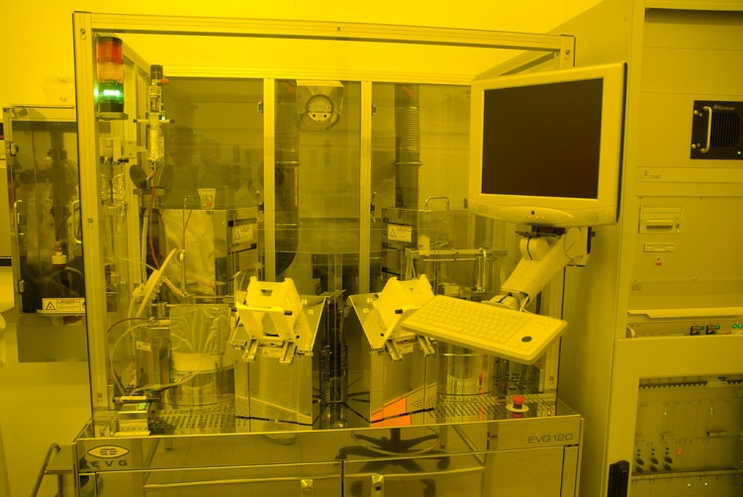
Photoresist Removal
After a photoresist is no longer needed, it must be removed from the substrate
This usually requires a liquid resist stripper or developer that chemically alters the resist so that it no longer adheres to the substrate
Photoresist Developer
Notes:
Image source: (photoresist developer machine) 2007 Guillaume Paumier, CC-BY, Wikimedia Commons https://commons.wikimedia.org/wiki/File:EVG_120_resist_coater-developer_at_LAAS_0434.jpg

Slide 30
Flexible Circuit Fabrication
Photolithography
Etching

Slide 31
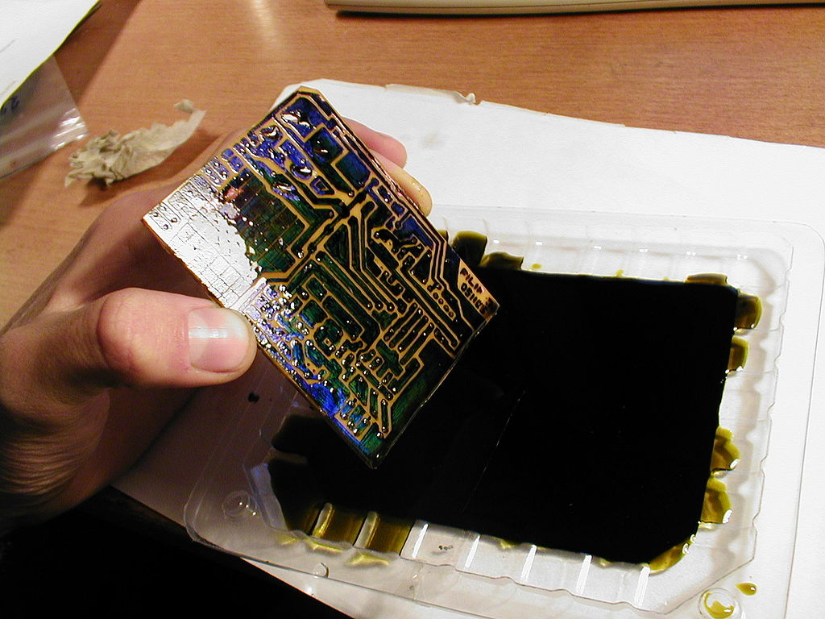
Etching
A liquid ("wet") or plasma ("dry") chemical agent is used to remove the uppermost layer of the substrate in the areas that are not protected by photoresist
Notes:
Image source: (hand holding just-etched circuit board) 2006 Filip Dominec, CC-BY-SA-3.0, Wikimedia Commons https://commons.wikimedia.org/wiki/File:Circuit_board_successfully_etched.jpg

Slide 32
Flexible Circuit Fabrication
Photolithography
Stripping

Slide 33
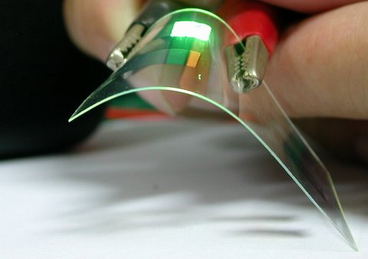
Stripping
The use of a solvent called a stripper to remove the photoresist and any of its residues
Notes:
Image source: (alligator clips hold clear bending material, a flexible OLED device) 2001 meharris, Wikimedia Commons
https://en.wikipedia.org/wiki/OLED#/media/File:OLED_EarlyProduct.JPG
OLED = organic light-emitting diode

