Slide 1
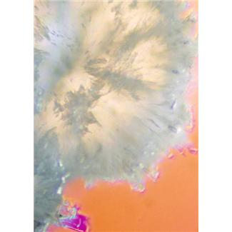
Crystallization in the Body
Notes:
In the body, crystals are made in various systems. However, do you know where they are made? How the crystals are formed? Why do our bodies perform this process?
Crystallization in the Body Presentation, Body Full of Crystals lesson > TeachEngineering.org
Image source: Microsoft clipart at http://office.microsoft.com/en-us/images/results.aspx?qu=crystal&ex=1#ai:MP900387674|mt:2|

Slide 2
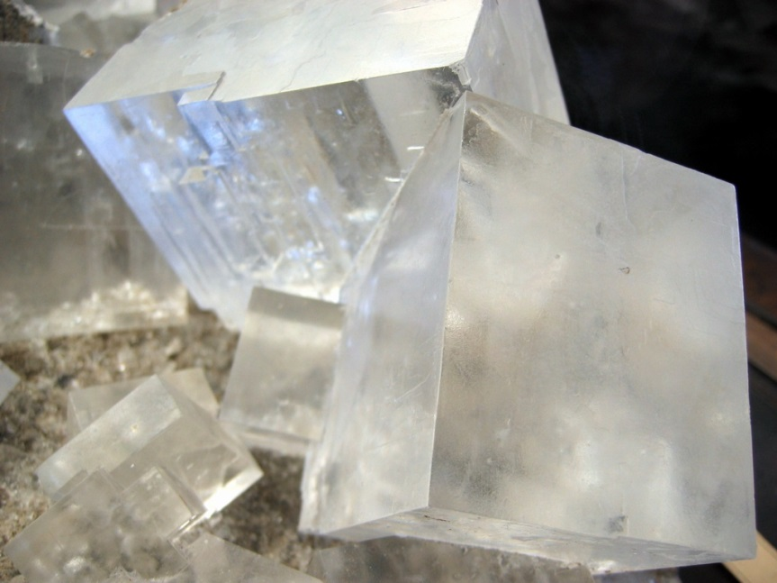
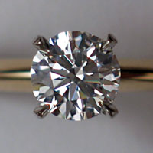
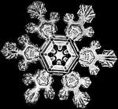
rock salt
diamond
snowflake
Notes:
Examples of crystals found in nature. Salt is a crystal, including the salt on your French fries. Most gemstones are crystals and form over long periods of time. Snowflakes are ice crystals and form unique shapes based on the conditions when they fall to the ground.
Image sources:
(rock salt) 2004 włodi, Wikimedia Commons http://commons.wikimedia.org/wiki/File:Rock_salt_crystal.jpg
(diamond ring) 2004, CrucifiedChrist, Wikimedia Commons http://commons.wikimedia.org/wiki/File:Diamond.jpg
(snowflake) 2002 NASA, Wikimedia Commons http://commons.wikimedia.org/wiki/File:Schnee2.jpg

Slide 3
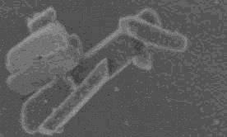
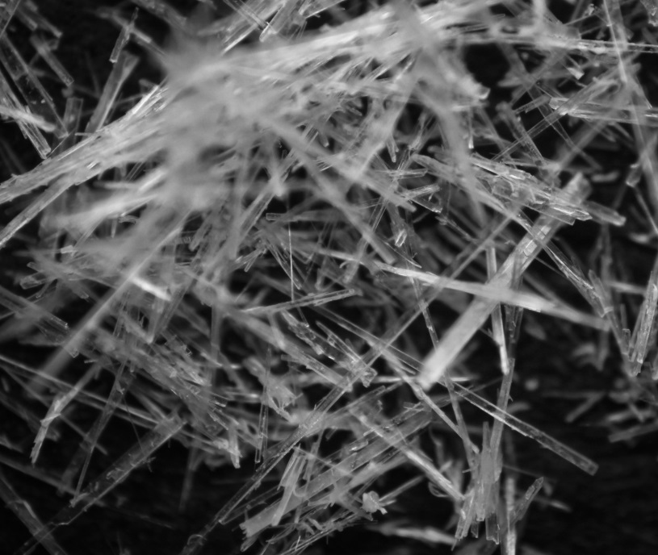
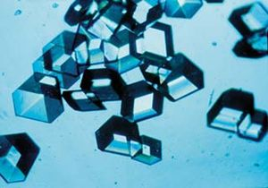
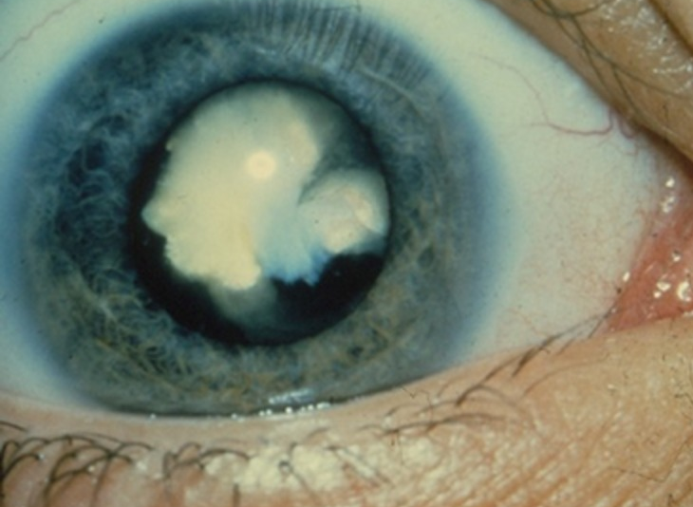
aspirin
hemozoin found in malaria
insulin
cataracts
Notes:
Aspirin is a commonly used painkiller. Most drugs are in crystalline forms.
The parasite that causes malaria eats red blood cells, which breaks down the hemoglobin into hematin, which is toxic to the parasite. The parasite saves itself by crystallizing hematin into hemozoin.
Cataracts are caused by the crystallization of eye proteins, causing the eye to become opaque. Proteins in the eye do not replenish themselves.
Image sources:
(macrophoto of aspirin, acetylsalic acid crystals) 2013 Steve Mike Neef, Wikimedia Commons http://commons.wikimedia.org/wiki/File:Aspirin.jpg
(electron micrograph of hemozoin crystals isolated from the malaria parasite; magnified 68,490 times) 2008 David Sullivan, Wikimedia Commons http://commons.wikimedia.org/wiki/File:Hemozoin_crystals.jpg
(cataract) 2012 National Eye Institute, Wikimedia Commons http://commons.wikimedia.org/wiki/File:White_congenital_cataract.tif
(insulin crystals) 2005 Marshall, NASA, Wikimedia Commons http://commons.wikimedia.org/wiki/File:Insulincrystals.jpg

Slide 4
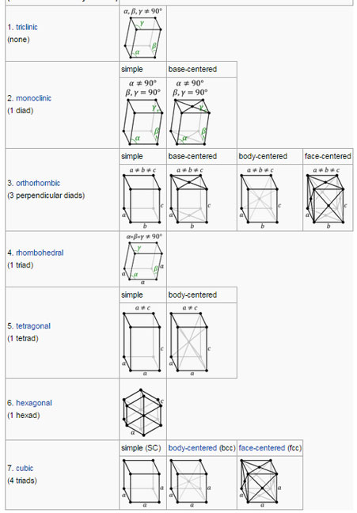
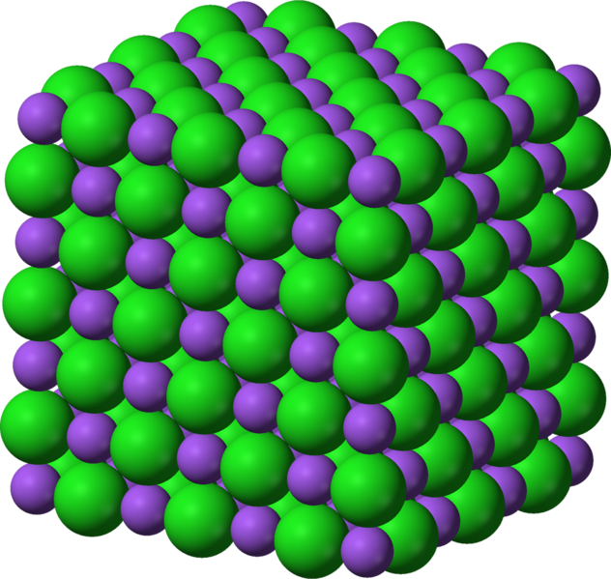
What is a crystal?
A crystal is a solid material whose atoms, molecules or ions are arranged in an ordered pattern extending in all directions
salt→
(sodium chloride)
Notes:
Crystals form a variety of shapes based on how the molecules pack together.
Image sources:
(crystal structure of sodium chloride, table salt) 2006 Benjah-bmm27 , Wikimedia Commons http://commons.wikimedia.org/wiki/File:Sulfuryl-chloride-fluoride-xtal-3D-vdW.png
(crystal structures: triclinic, momoclinic, orthorhombic, rhombohedral, tetragonal, hexagonal, cubic) 2007 DrBob, Wikimedia Commons http://commons.wikimedia.org/wiki/File:Triclinic.svg and http://en.wikipedia.org/wiki/Crystal_structure

Slide 5
Crystal Surface & Growth Process
Each side of a crystal is called a face.
During crystal growth, steps are layers or sheets of molecules stacked on top of each other.
ledge
terrace
kink
terrace vacancy
step
molecule
Crystal shapes are determined by the speed of step growth on each face of the crystal.
Notes:
This is the general setup of a crystal surface. During crystal growth, steps are basically layers or sheets of molecules stacked together. A terrace is the flat surface between steps. Of five different types of places on a crystal surface, a kink is the most likely place where a molecule will attach to the crystal surface and continue to grow. The shape of a crystal is determined by the speed of step growth on each face of the crystal.
Image source (with some modifications): Brookhaven National Laboratories http://www.bnl.gov/nsls2/sciOps/chemSci/growth.asp
Alternate image source: Dr. Ilya Reviakine, University of Montreal http://esilrch1.esi.umontreal.ca/~syguschj/cours/BCM6200/PD_2_1.html

Slide 6
Crystal Formation Process
Crystal has three growth phases:
What is the driving force?
* supersaturation *
Notes:
When a crystal forms, it goes through a number of phases. During the first phase, clustering, particles begin to agglomerate together. During the second phase, nucleation, the clusters become a stable nuclei and arrange themselves into the basic building structure of the crystal. If the clusters are not stable, they re-dissolve and the process starts from the beginning again. If nucleation occurs, then the third phase of crystal growth begins; at this point, more molecules attach to the stable nuclei so the crystal grows in size. The main driving force of this process is supersaturation. Supersaturation occurs when more solute exists than the solvent can dissolve. A crystal continues to grow until the solution is saturated. Crystal nucleation and growth can occur simultaneously, depending on the system conditions. Usually, one or the other is predominant, causing different crystal sizes and shapes. Polymorphism occurs when one compound can crystallize with different crystal structures.
Image source: editor, TeachEngineering.org

Slide 7
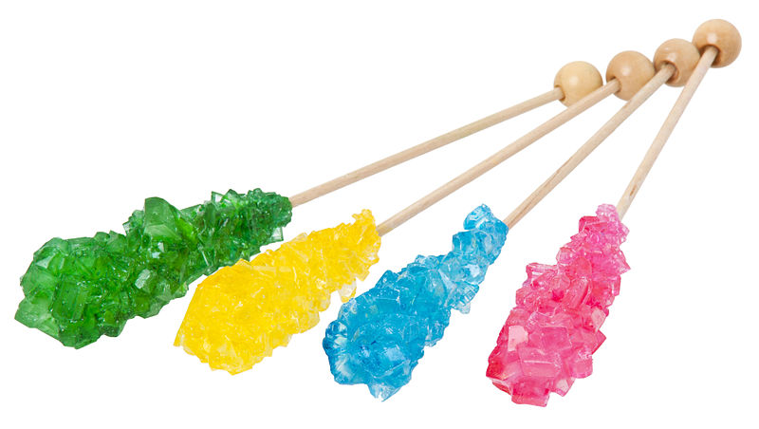
Rock Candy
Sugar dissolved in water
Higher temperatures – more sugar dissolves
Supersaturation occurs when left at room temperature, due to differences in solubility
The higher the supersaturation, the faster the growth
Seed crystals cause growth to start immediately and skip past the nucleation phase
Notes:
Image source: (rock candy sticks) 2012 Evan-Amos, Wikimedia Commons http://commons.wikimedia.org/wiki/File:Rock-Candy-Sticks.jpg

Slide 8
Inhibiting Crystallization
Impurity incorporation
solution of impurity ions or drug
kink
kink
Notes:
Researchers who want to block the crystallization process investigate to identify molecules that are able to halt further crystal growth. The most likely place for growth is at a kink, so the spot where researchers want an impurity or drug to bind is in the kink. Some impurities do not stop a crystal from growing, they just cause defects in the crystal (see the next slide), changing their shapes.
Image source: editor, TeachEngineering.org

Slide 9
Crystal Shape Changes
When inhibitors bind to specific faces, they affect the overall crystal shapes.
Notes:
When inhibitors bind to the crystal surface, they attach to specific faces. This blocks growth in one direction, but not the others, causing different shapes to result as the crystal growth continues.
This series of diagrams compares normal calcium oxalate crystals to crystals grown with different additives, showing how the crystal shapes change depending on where the inhibitor binds.
Image source: Jeffrey D. Rimer, University of Houston

Slide 10
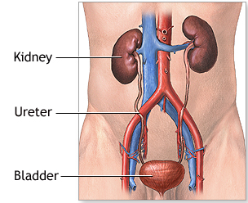
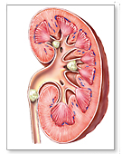
Kidney Stone Formation
Kidneys filter the blood, remove waste, maintain electrolyte levels
Waste products form crystals that are usually very small and pass through the urinary system with no effects
Crystals that grow large can block the ureter (kidney stones or renal stones)
Supersaturation caused by:
dehydration
diet
kidney stone→
ureter→
kidney
Notes:
When the body becomes dehydrated, the kidney removes less water. This increases the supersaturation of minerals and the likelihood that kidney stones form.
Image sources:
(urinary tract diagram) Medline, U.S. National Library of Medicine http://www.nlm.nih.gov/medlineplus/ency/presentations/100087_1.htm
(kidney with stones) Medline, U.S. National Library of Medicine http://www.nlm.nih.gov/medlineplus/kidneystones.html

Slide 11
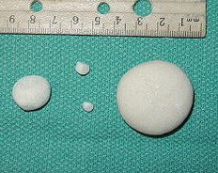
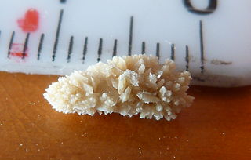
Types of Kidney Stones
Four main types:
calcium oxalate
struvite
uric acid
cystine
calcium oxalate
uric acid
struvite
Notes:
Four main types of kidney stones can occur within the kidney.
Calcium-containing stones are the most common, usually in the form of calcium oxalate. Oxalate is made by the liver and is also in many foods such as nuts, chocolate, fruits and vegetables.
Struvite stones are formed in response to an infection.
Uric acid stones occur when the body does not intake enough fluid or too much protein.
Cystine stones form in those who have certain hereditary disorders in which the kidney releases too much amino acid.
Image sources:
(calcium oxalate) 2006 Joel Mills, Wikimedia Commons http://commons.wikimedia.org/wiki/File:Calcium_oxalate_stones.JPG
(uric acid) 2006 Joel Mills, Wikimedia Commons http://commons.wikimedia.org/wiki/File:Urate_stones.JPG
(kidney stone-type unknown) 2014 Tsester, Wikimedia Commons http://commons.wikimedia.org/wiki/File:Kidney_stone_01.JPG
(struvite stones from a dog’s urinary bladder) 2006 Joel Mills, Wikimedia Commons http://commons.wikimedia.org/wiki/File:Struvite_stones.JPG

Slide 12
Drug Development Considerations
1 in 11 people have kidney stones in their lifetimes
80% of all cases are men
Kidney stones usually reoccur
Surgery and shock therapy are the usual removal methods, for which $2 billion is spent each year —for a condition that could be prevented
The body makes natural crystal inhibitors: citrate
Diuretics: reduce calcium excretion in urine
Researchers are creating new drugs to block crystallization intending to more effectively prevent kidney stones

Slide 13
Drug Design Considerations
Efficacy: Full inhibition of crystal growth
Potency: A small amount causes large amount of inhibition
Toxicity: Can this drug be put into the body without radical side effects?
Administration: How is the drug going to be delivered into the body? Oral, IV, rectally, aerosol or topical?
Cost: Is this drug feasible to produce?
Notes:
On the graph, potency can be seen by the slope of the lines. The larger the slope, the more potent a drug is. However, a potent drug can have a lower overall efficacy because the red line has a higher percent inhibition. The best drug to choose has a high potency and efficacy to limit the amount that could be toxic.
For toxicity, something may block crystallization, but cannot be put into the body. For example, mercury might be able to block crystallization but it is harmful to humans so it would not be a usable drug.
For administration, the drug must be able to be taken by the patient. Is it soluble enough to be digested? How will it get to the kidneys when ingested?
A drug could be a miracle worker, but if it is not cost effective, no company will make the product. So it is a balancing act.
Image source (graph): 2014 Megan Ketchum, University of Houston

