Slide 1
Fluids: Archimedes’ Principle, Pascal’s Law, Bernoulli’s Principle

Slide 2
Fluids and Buoyant Force
Fluids: Matter that flows (liquid and gas).
Mass Density: Mass per unit volume of a substance. It is often represented by the Greek letter ρ (rho).
ρ = $\frac{\text{m}}{\text{v}}$
Buoyant Force: The upward force on objects that are partially or completely submerged in fluids.

Slide 3
Archimedes’ Principle

Slide 4
“Any object completely or partially
submerged in a fluid experiences
an upward force equal in
magnitude to the weight of the
fluid displaced by the object.”
- Archimedes’ Principle

Slide 5
For Floating Objects
Buoyant Force:
F_{B} = F_{g (displaced)} = m_{f} g
where m_{f} = mass of fluid displaced
For Floating Objects:
F_{B} = F_{g (object)} = m_{o} g

Slide 6
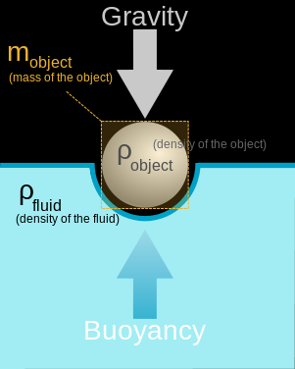
Image source: 2008 Yupi666, Wikimedia Commons http://commons.wikimedia.org/wiki/File:Buoyancy.svg

Slide 7
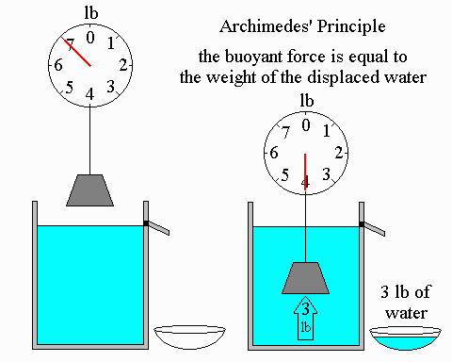
Archimedes’ Principle:
The buoyant force is equal to the weight of the displaced water.
Image source: Bradley W. Carroll. Used with permission. http://physics.weber.edu/carroll/archimedes/principle.htm

Slide 8
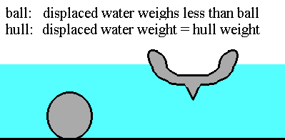
ball: displaced water weighs less than the ball
hull: displaced water weight equals hull weight
Image source: Bradley W. Carroll. Used with permission. http://physics.weber.edu/carroll/archimedes/principle.htm

Slide 9
Buoyant Force
Buoyant force is also equal to the difference between the weight of an object in air and weight of an object in fluid.
F_{B} = W_{air} - W_{fluid}
In other words, the apparent loss in weight of a body immersed in a fluid is equal to the weight of the displaced fluid.

Slide 10
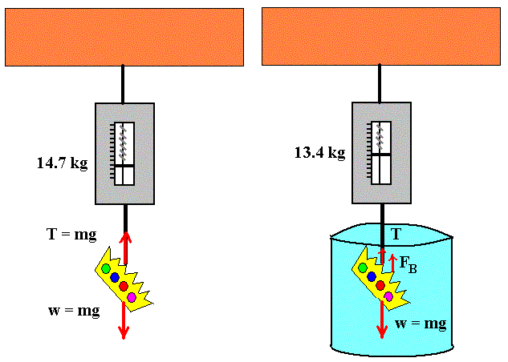
Image source: Bill Winfield. Used with permission.

Slide 11
Other Relationships
Net force (F_{net}) is the object’s apparent weight:
F_{net} = F_{B} – F_{g (object)}
F_{net} = (ρ_{f}v_{f} - ρ_{o}v_{o}) g
where: m = ρv
In solving buoyancy problems, the following derived expression is used:
$\frac{\text{F}\text{g}\text{ (}\text{object}\text{)}}{\text{F}\text{B}}$= $\frac{\text{ρ}\text{0}}{\text{ρ}\text{f}}$

Slide 12
Pascal’s Law

Slide 13
Pressure
Pressure is a measure of how much force is applied over a given area.
P = $\frac{\text{F}}{\text{A}}$
units:
1 Pa (Pascal) = 1 N/m²
1 atm = 105 Pa

Slide 14
“Pressure applied to a fluid in a closed container is
transmitted equally to every
point of the fluid and to
the walls of the container.”
- Pascal’s Law

Slide 15
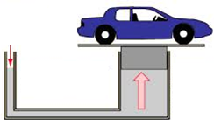
Pressure applied anywhere to a fluid causes a force to be transmitted equally in all directions.
Change in pressure disperses equally throughout the fluid.
Force acts at right angles to any surface in contact with the fluid.
A₁ = 1 m²
F₁ = 10 N
P₁ = ___?
A₂ = 10 m²
P₂ = ____?
F₂ = ____?
Image source: Bill Winfield. Used with permission.

Slide 16
Bernoulli’s Principle

Slide 17
Types of Fluid Flow
Laminar: When fluid particles move along the same smooth path. The path is called a streamline.
Source: Wikimedia Commons http://commons.wikimedia.org/wiki/File:Toky.png

Slide 18
Types of Fluid Flow
Turbulent: When fluid particles flow irregularly causing changes in velocity. They form eddy currents.
Source: Wikimedia Commons http://commons.wikimedia.org/wiki/File:Toky.png

Slide 19
“The pressure in a fluid decreases
as the fluid’s velocity increases.”
- Bernoulli’s Principle
Continuity equation:
A₁v₁ = A₂v₂
Bernoulli’s equation:
P + ½ ρv² + ρgh = constant

Slide 20
Bernoulli’s equation at different points in a horizontal pipe:
P₁ + ½ ρv₁² = P₂ + ½ ρv₂²
Point 1
Point 2
Point 3
Image source: 2013 Emily Sappington, University of Houston

Slide 21
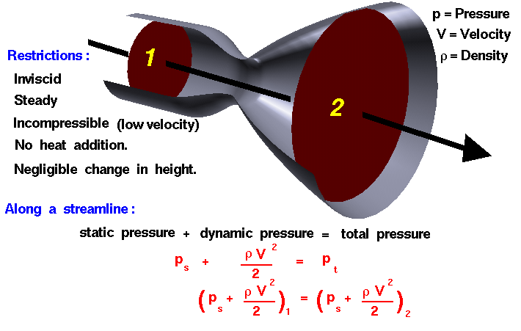
Bernoulli’s Equation
Source: NASA http://www.grc.nasa.gov/WWW/k-12/airplane/bern.html

Slide 22
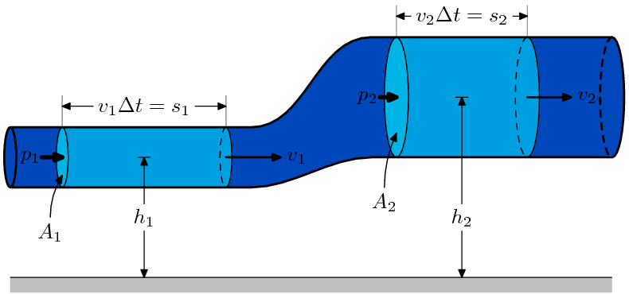
Bernoulli’s equation at two different points of varying height
P₁ + ½ ρv₁² + ρgh₁ = P₂ + ½ ρv₂² + ρgh₂
Source: http://commons.wikimedia.org/wiki/File:BernoullisLawDerivationDiagram.svg

