Slide 1
No More Peg Legs and Hooks
Better Prosthetic Design through
Engineering
Notes:
No More Peg Legs and Hooks Presentation > The Pirates of Prosthetics: Peg Legs and Hooks lesson > TeachEngineering.org
Image source: 2006 J.J., Wikimedia Commons, http://commons.wikimedia.org/wiki/File:Piratey,_vector_version.svg

Slide 2
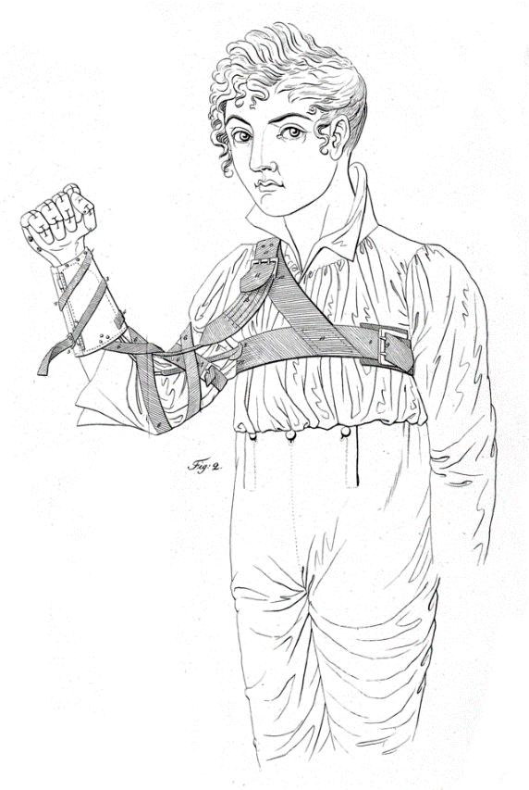
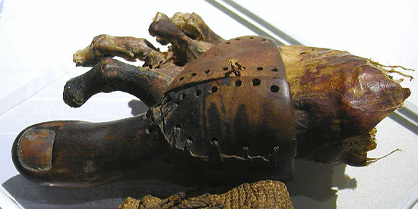
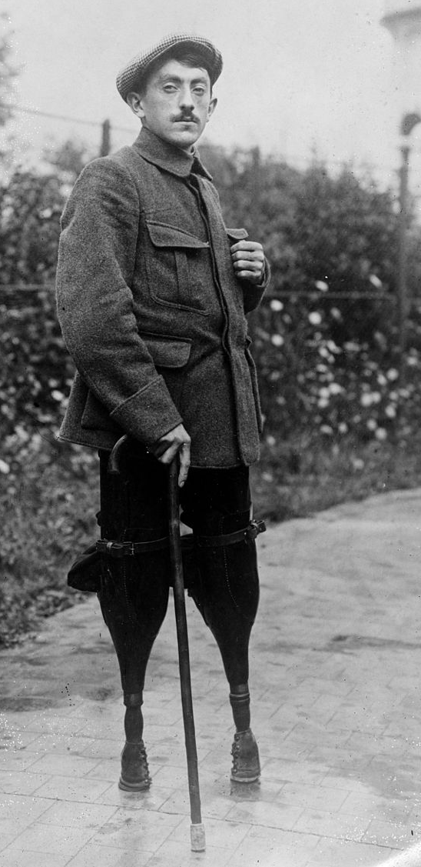
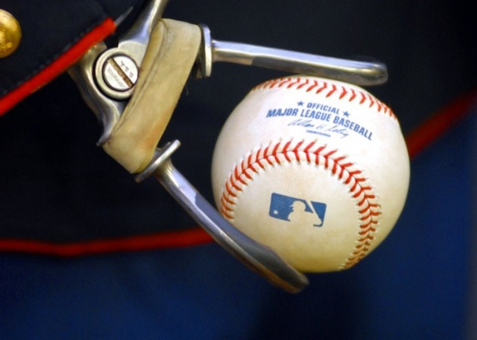
History of Prostheses
Used in Greek and Roman times
Prosthetic toe found on 3000-year-old Egyptian mummy
Before 1840s, few survived amputation and prosthetic supplies were often scavenged
Surgery advances (anesthesia in 1842) > more precise surgeries and better prosthetic fit
So many amputees from WWI and WWII increased the need for better prosthetic designs
Notes:
Image sources:
(top left; ancient Egyptian replacement plaster toe laced onto rest of foot) 2007 Jon Bodsworth, Wikimedia Commons http://commons.wikimedia.org/wiki/File:Prosthetic_toe.jpg
(top right; artificial hand and harness) 1812 Pierre Ballif, Prussia via Wikimedia Commons http://commons.wikimedia.org/wiki/Category:Hand_prostheses#mediaviewer/File:Kunsthand_Ballif_2.png
(bottom left; soldier with two prosthetic legs) 1948 U.S. Library of Congress via Wikimedia Commons
http://commons.wikimedia.org/wiki/Category:Leg_prostheses#mediaviewer/File:Louis_Blin_ggbain_26871u.jpg
(bottom right; hand prosthesis holds baseball) 2007 U.S. Navy via Wikimedia Commons http://commons.wikimedia.org/wiki/File:US_Navy_070403-N-7981E-090_Marine_Sgt._James.jpg

Slide 3
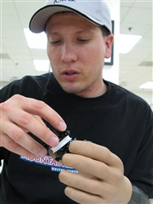
How Do Prostheses Work?
Purpose and benefits:
To restore functionality and capabilities of lost limb
Enables patients to regain mobility, conduct daily living activities, keep a job
Engineering design considerations:
Location (at a joint? cosmetic vs. functional?)
Strength vs. weight
Attachment method
Available materials
Cost
Which hand is a prosthesis? ➔
Notes:
Engineering Design Considerations
Location of amputation: Does the prosthesis need to include a movable joint, such as a knee or elbow? Is the purpose of the prosthesis to improve appearance only (an eye or ear) or to perform some of the lost functions of the original limb, or both?
Strength vs weight: The material needs to be strong enough to perform and hold body weight if necessary, but light enough to move easily. May be a trade-off to balance strength vs. weight.
Attachment: How will the prosthesis attach to the body? How do you keep it from falling off?
Available Materials and Cost: What materials are available to use? What materials make sense for the particular prosthesis? How much do they cost? Is the cost reasonable so that patients can afford the prostheses? May be a trade-off to balance available materials with cost of materials.
Image source: (A soldier practices his fine motor skills using his prosthetic hand.) 2007 Fred W. Baker III, U.S. Dept. of Defense http://www.defense.gov/news/newsarticle.aspx?id=46308

Slide 4
Parts of a Prosthesis
Interface (socket): Where the prosthetic device meets the remaining part of the limb
Usually includes a suspension system that uses an attachment method:
A suction valve forms a seal with the limb
Locking pin
Belt and harness
Components (pylon): The internal working parts of the prosthesis
Foot: Or hand, in the case of an arm prosthesis
Cover: May be covered in a material so more lifelike
Notes:
Image source: (drawing of leg prosthetic showing basic parts) Figure 4, U.S. Department of Veterans Affairs http://www.rehab.research.va.gov/jour/2013/509/page1201.html

Slide 5
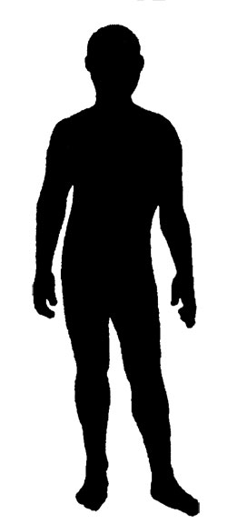
Main Types of Artificial Limbs
Transradial: Replaces an arm from below the elbow (includes the wrist, hand and fingers)
Transhumeral: Replaces an arm from above the elbow (includes the elbow, wrist, hand and fingers)
Transtibial: Replaces the leg from below the knee (includes the ankle, foot and toes)
Transfemoral: Replaces the leg from above the knee (includes the knee, ankle, foot and toes)
Notes:
The more joints that are included in a prosthesis, the more complicated the design must be to successfully emulate the complexity of natural body movements and functions.
Image source: (silhouette of body; modifications by TeachEngineering.org) Controle su diabetes (pdf), Centros para el Control y la Prevencion de Enfermedades (CDC) http://www.cdc.gov/diabetes/spanish/pdfs/controle.pdf

Slide 6
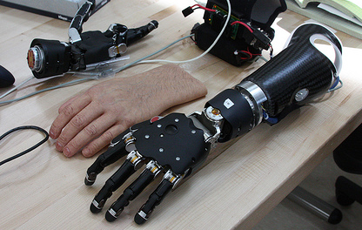
Modern Materials
Modern materials make prostheses stronger, lighter and more realistic in appearance and use:
Advanced plastics
Carbon fiber composites
Electronic components for control
A brain-controlled prosthetic limb➔
Notes:
Image description: This brain-controlled modular prosthetic limb is controlled by surface electrodes that pick up electric signals generated by the muscles underneath the skin. The electrodes then convert those patterns into a robotic function.
Image source: U.S. Navy http://blog.usa.gov/post/18017495812/image-description-this-brain-controlled-modular

Slide 7
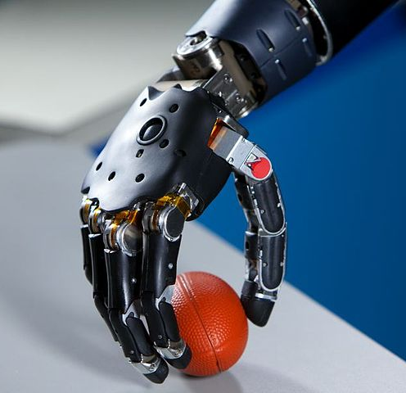
Categories of Modern Prostheses
Specialty
2. Functional
Notes:
Specialty prosthesis built for running; 2000 Sport the library via Wikimedia Commons http://commons.wikimedia.org/wiki/File:281000_-_Athletics_track_Neil_Fuller_Australian_flag_-_3b_-_2000_Sydney_race_photo.jpg
2. A brain-controlled functional arm prosthesis built to closely mimic natural hand movements; 2011 FDA/Johns Hopkins University Applied Physics Laboratory http://commons.wikimedia.org/wiki/File:Brain-Controlled_Prosthetic_Arm_2.jpg

Slide 8
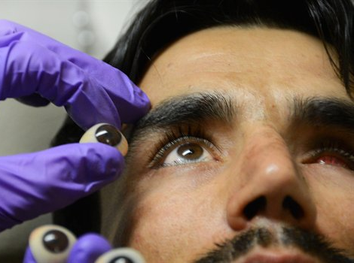
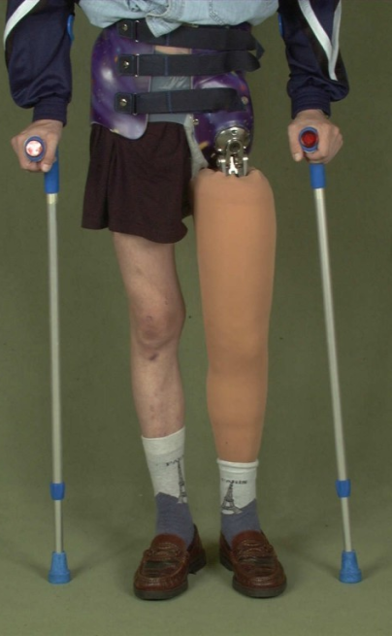
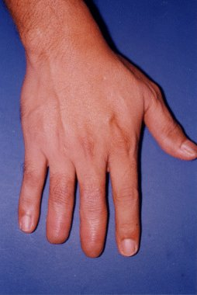
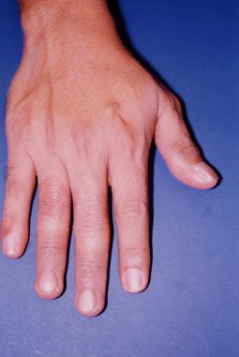
Categories of Modern Prostheses
3. Cosmetic
Eye
Fingers
Leg
Notes:
3. Cosmetic prostheses restore the appearance of lost structures (sometimes ALSO have functional abilities)
(eye; replacement eyeballs) 2014 U.S. Dept. of Defense http://www.defense.gov/photoessays/PhotoEssaySS.aspx?ID=5389
(fingers; thimble prostheses for right, middle and ring fingers; before/after) VA Research & Development http://www.rehab.research.va.gov/jour/01/38/2/leow382.htm
(thumb prosthesis) VA Research & Development http://www.rehab.research.va.gov/jour/01/38/2/images/bran-f04.gif
(leg prosthesis) National Library of Medicine/National Institutes of Health http://openi.nlm.nih.gov/detailedresult.php?img=2647924_1477-7819-7-15-10&req=4

Slide 9
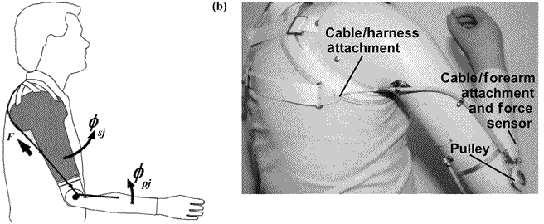
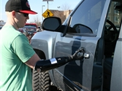
Controlling the Prosthetic
External cable/switch control systems➔
Electronic systems:
Electrodes implanted in residual limbs (forearm in this example) control muscle movements ➔
Electrodes implanted into the brain (neural implants) provide residual limb muscle control via neuron signals
Notes:
Image sources:
(Top; cable control system for a below-elbow prosthesis actuated by gross body movements) VA Research & Development http://www.rehab.research.va.gov/jour/05/42/3/Farrell.html
(Bottom; man opens door using prosthetic robotic hand actuated by electrodes implanted in his forearm) Sharon Holland, U.S. Department of Defense http://www.defense.gov/news/newsarticle.aspx?id=121685

Slide 10
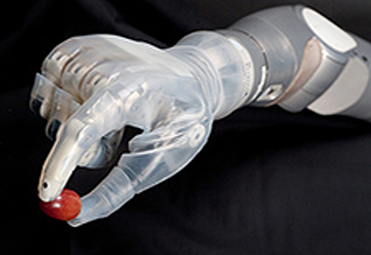
Biomedical & Mechanical Engineers
Engineers apply their expert knowledge of:
anatomy
neurology
biomechanics
sensor motor control
to design prostheses and other medical devices that improve mobility and function for people
Notes:
The DEKA arm features six preprogrammed grips so users can perform a variety of everyday tasks, from handling small, delicate objects to using tools.
More info on the prosthesis in the photo: The DEKA system is a huge leap forward in technology from existing prosthetic arms and hands. Still today, most upper-limb amputees use a hook or split-hook prosthesis that offers only limited function, or an artificial hand that looks natural on the outside but provides no finger movement or grasp. The DEKA arm offers a variety of firsts: It has multiple powered joints and degrees of freedom and can carry out several movements at the same time. It uses an array of sensors and switches and has wireless control. The wrist and fingers adjust into six different grips, enabling users to perform a range of everyday functions: picking up a grape or a glass, holding a tube of toothpaste, turning a key in a lock, using a power tool. Many features of this arm are unprecedented.
Image source: 2014 U.S. Dept. of Veterans Affairs http://www.newengland.va.gov/VISN1/features/DEKA_advanced_prosthetic_arm_gains_FDA_approval.asp

