Slide 1
Close Encounters of the Polymer Kind
A lesson on Polymers
Notes:
Today we are going to begin a polymer unit, entitled “Close Encounters of the Polymer Kind.” The title is in reference to a popular sci-fi movie about UFOs and is appropriate because—for most of you—this topic is a foreign concept.

Slide 2
Outline
Basics of polymers
What is a polymer?
What is a thermoplastic?
What is a thermoset?
Unusual Behavior of Polymers (Thermoplastics)
Weissenberg
Kaye
Barus
Anti-Gravity
Manipulating Thermosets
How to make a thermoset
What can you manipulate?
Thermoset activity
Notes:
Starting off with the basics, we will discuss what a polymer is and introduce two categories of polymers, thermoplastics and thermosets. From there, we will discuss the cool behaviors of thermoplastics and the fundamentals that go into making a good thermoset. To round out the lesson, we will perform a thermoset activity and, using our knowledge from the lesson, make our own thermosets.

Slide 3
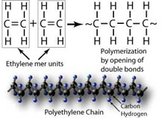
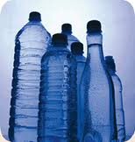
Polymers
What is a polymer?
(poly-) = many (-mer) = unit
A polymer consists of many repeating chemical units
Notes:
So what is a polymer? A polymer is a long chain of repeating chemical units. If you look to the etymology of the word we can see a similar meaning.
Using chemical reactions, you make many different type of polymers. The example here uses ethylene monomer units to make polyethylene, a common thermoplastic polymer used to make plastic bottles.

Slide 4
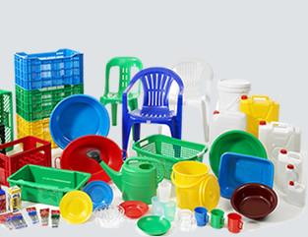
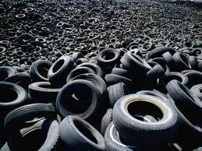
Polymers
Separated into two classes
Thermosets Thermoplastics
Notes:
If we look deeper, we see that polymers are typically separated into two types: thermosets, such as tires and car bumpers, and thermoplastics, such as water bottles, which are often made out of polyethylene, as mentioned earlier.
Can anyone tell me the difference between a thermoplastic and thermoset? (Pause to wait for both terms to be defined if possible. Emphasize the SET portion of thermoset, in that if something is SET can it be changed?) Answers are on next two slides.

Slide 5
Polymers
What is a thermoset polymer?
A polymer material that is “cured” into a final form that can not be changed.
The curing reaction creates a 3-D network of covalently bonded molecules.
Notes:
A thermoset is a polymer in which the final shape of the product is set, or cured, due to an irreversible chemical reaction.
Ask the students “what is meant by curing?” To become tougher or harden; emphasize that ‘curing’ is a term for the chemical reaction that takes place to form the final 3D network that sets the shape.
What is a covalent bond? A chemical bond that shares electrons.

Slide 6
Polymers
What is a thermoplastic polymer?
A polymer material whose final form can be changed through heating and molding.
Typically they consist of many many linear polymers that are held together by their enthalpic interactions and physical entanglements
Notes:
Thermoplastic is a linear polymer whose final shape can be changed through heating the material and melting it so that other shapes can be formed.
What are some typical thermoplastics materials you encounter? Water and soda bottles are the most common example.
We will discuss enthalpic interactions in a bit.
To understand polymers, physical entanglements are an important concept to know. Ask students to imagine of a bowl of spaghetti. Remind them that all of the noodles are entangled. This is due to their long lengths. This explains physical entanglements at the molecular level.

Slide 7
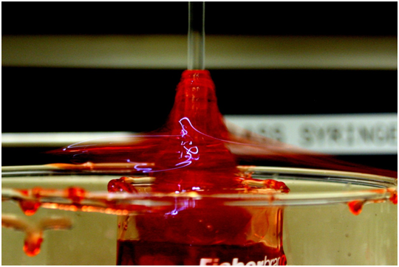
Weissenberg Effect
Take a moment to observe the Weissenberg Effect.
Why do you think the material behaved the way it did?
Notes:
Okay so now that we have introduced two categories of polymers, let’s talk about some of the cool behaviors of thermoplastics.
***Perform the Weissenburg demo***
What did you observe in the Weissenburg demo? The polymer goes toward and up the rod; the water moves away from the rod.
Lets do another demo to see if we can figure out what happens.

Slide 8
Weissenberg Effect
Now take a moment to observe the macroscopic demo of this molecular phenomenon
Why do you think the material behaved the way it did?
Notes:
Now, let’s look at a macroscopic example. In front of me are a pile of rubber bands and a pile of salt. Watch what happens when a wooden dowel is rotated in salt.
**Rotate the wooden dowel in the mound of salt; the salt should move away from the dowel.**
What happens in this demo? Salt, which represents water, moves away from the dowel.
**Rotate the wooden dowel in the mound of rubber bands; the rubber bands should wrap around the dowel.**
What happened? The rubber bands, which represent the polymer, wraps around the wooden dowel. This is an excellent example of what happens at the microscopic level. To put this in more scientific terms, we need to learn some vocabulary so we can relate this to the polymer.

Slide 9
Weissenberg Effect
Life is always a balance.
Here we have a balance between the enthalpic interactions and the entropic interactions
Enthalpic interactions - How much you like the person next to you
Entropic interactions - How close you are sitting together
Notes:
We have a balance between enthalpic interactions and entropic interactions. Enthalpic interactions are how much you like the person next to you or— in molecular terms — how much a molecule likes the molecule next to it. Entropic interactions are how close you are to the one sitting next to you. The closer you sit to each other, the less entropy (capacity for disorder) you have available and the more uncomfortable you are in terms of literally sitting on top of each other.

Slide 10
Barus Effect (Die Swell)
Take a moment to watch the Barus Effect video below.
Why do you think that happens?
Notes:
These next two effects are a bit more subtle, so we will watch a YouTube video demonstration (http://www.youtube.com/watch?v=nX6GxoiCneY). The first demo is of the Barus effect and causes what is known as ‘die swell’. What is meant by ‘die’? (Answers will vary.) When you have a thermoplastic, it can be melted and forced through a die (a mold) to give it a particular shape. For example, if I wanted to make polyethylene (PE) fibers, I could melt PE and force it through a small diameter die to get my fiber.
***Watch Video***
Why do you think the swelling occurs? (Note: if students don’t understand what is meant by swelling, rewind the video to show how the liquid stream is wider than the mouth of the bottle. This is ‘swelling’.) Allow students time to think about this viscoelastic effect; do not provide the answer.

Slide 11
Barus Effect (Die Swell)
How does the moving wall analogy relate to the Barus Effect?
As the plunger (our classroom wall) is pushed, the molecules are forced in a confined space (decreasing entropy). They exit the die and increase entropy by spreading out.
Notes:
Ask students, which has more entropy: a polymer chain that is forced to be straight or a chain that is free to move? A polymer that is forced to be straight has less entropy available to it, as it is confined. In order to increase the entropy of the system, the polymer spreads out when exiting the die.
Ask students to explain why water does not swell after exiting the die. Compare the state of entropy in the die and the one after the die. Is it different or roughly the same? It is the same since it is so small. A confined water molecule looks very similar to an unconfined molecule of water so it cannot tell the difference.

Slide 12
Kaye Effect
Watch the Kaye Effect video.
Notes:
This next effect is a much debated topic so we are just going to present one theory as to why this happens. Take a moment to watch the video of the Kaye effect. Pay attention to how the material behaves when it hits the surface.
**Watch the Kaye Effect portion of the YouTube video [you may either review the Weissenberg Effert portion or skip to the Kaye Effect, which starts at the 45 sec. mark**
What happens during the Kaye Effect? (Allow students time to discuss). The stream of poured material ‘skips’ off the surface of the mound. One of the theories as to why this happens is called shear thinning. To understand this concept, let’s consider the ‘pool of cornstarch and water’ experiment, commonly called ‘oobleck’. The experiment demonstrates shear thickening—the exact opposite of what is happening in the Kaye Effect video. In the cornstarch example, the material gets stiffer as you run across it. In fact, the faster you run, the easier it is to cross the material. With shear thinning, the material gets softer as you run across it. The faster you run, the softer the material gets. Think of the floor; although it is solid, you would fall through it if you ran across it too fast if it was shear thinning.

Slide 13
Kaye Effect
Polymers undergo a similar process if they are pushed too quickly. They go too quickly to keep their bulky original shape and are forced to stretch out.
Notes:
Now extend this to polymers. We have established that polymers like to have their own space and curl up in a relaxed configuration. But when they begin to collide with each other more quickly than they can return back to their relaxed configuration, they get stretched out.
Is it easier or harder for polymers to slide past each other when it is stretched out? (Allow students time to discuss.) It is easier, which results in shear thinning.

Slide 14
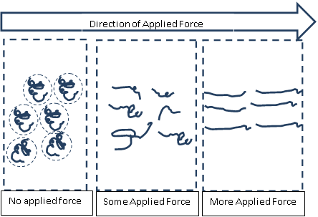
Kaye Effect
If it is easier to flow past each other, is the viscosity low or high?
Notes:
Viscosity is the resistance to flow. If it is difficult for the fluid to flow, it is said that the viscosity is high—or more viscous. A real world example of this would be paint (which is a type of thermoplastic polymer). When you paint something, you do not want the paint to be all runny and slide down the wall. However, you also do not want it to be too thick, making it difficult to apply. As you apply the brush to the wall you apply force to the paint and it shear thins, making it easy to apply. When the polymer leaves the brush (and the applied force of the brush) it returns to its original state of being somewhat “thick” so as to not run down the wall.

Slide 15
“Anti-Gravity”
What if I told you that I could defy gravity?
What happened?
Notes:
This is my last effect...what if I told you that I could defy gravity and remove material from the beaker without the syringe being in the beaker the whole time?
***Perform the demo***
What happened in the demo? Did I defy gravity? Yes; the material could be removed from the beaker without the syringe being in it.) Why was this possible? (Note: Entanglements is the answer but hold off on revealing this just yet.)

Slide 16
“Anti-Gravity”
How do the rubber bands relate to polymers?
As the syringe pulls up polymers, the polymers already in the syringe pull up other polymers due to physical entanglements.
Notes:
How does this relate? A similar event happens in the syringe. As one polymer is sucked up, it drags others with it. When the syringe is initially in the solution, it “grabs” onto a bunch of other polymers. Once removed from the solution, those chains continue to drag other chains into the syringe.

Slide 17
Thermosets and Their Uses
Thermosets are polymer systems that have gone through a curing reaction and are “set” in its final shape. A thermoset cannot be reshaped by heating.
Possible uses are?
Notes:
Thermosets are polymer systems that have gone through a curing reaction and are “set” in their final shape. A thermoset cannot be reshaped by heating. Thermosets are interesting because you can take a bunch of small reactive molecules, fill up a shape that you like, and then the molecules react, forming permanent bonds that keep the shape of the mold. Because the starting materials are small molecules, they can fill up all the little features of the mold before it reacts (something that is sometimes difficult with the larger molecule thermoplastics).
As a result of this, thermosets often find uses in polymer/fiber composites, where the small molecules fill a mold that contains long thin fibers (typically a few microns thick). The long fibers provide the majority of the strength, but the thermoset keeps the fibers in place and allow the force to be distributed amongst the fibers.

Slide 18
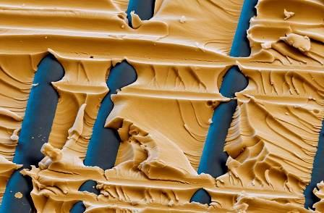
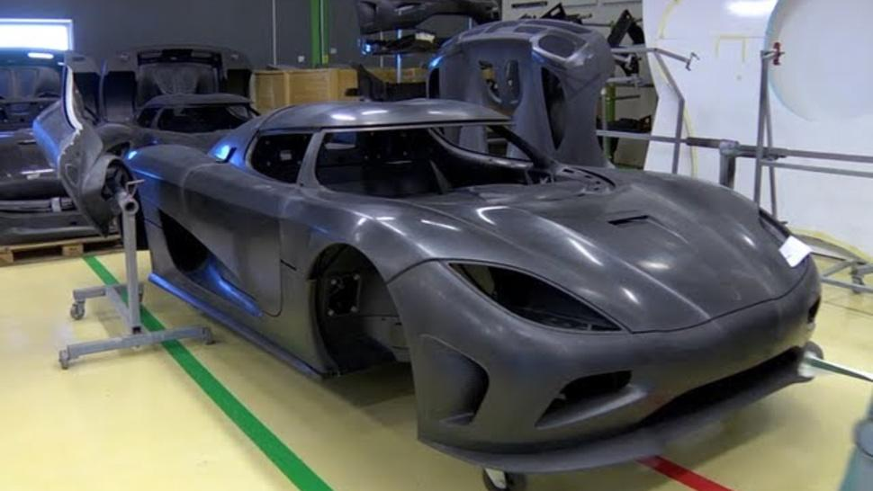
Example Usage
Close-up of an thermoset (Yellow)
Fiber (Blue) composite
Possible end use of such a composite, the Koenigsegg super car
Notes:
The top left image is a close-up image of a thermoset matrix surrounding fibers in a thermoset/fiber composite. The fibers are typically on the order of 1 micron in diameter so you can see that the thermoset precursors, the small molecules that will eventually react, are useful to fill those small spaces. The Koenigsegg super car (right image) is a really cool example of such usage, where the entire body of the car is made out of a thermoset/carbon fiber composite, due to its low weight and high strength. So how is the thermoset portion made? Can you control the properties of that portion?

Slide 19
Chemical Bridges
By varying the
ratio of
Molecules. we
can vary the
number of
Connections.
Linear Molecule
+
A
B
C
Branched Molecule
A or B
E
D
+
Notes:
The thermoset materials undergo a chemical reaction where new covalent bonds are created. Let’s take a look at some of the details. To make a linear molecule (thermoplastic), you mix molecule A (red) and molecule B (blue) together to allow them to react. One red group reacts with one blue group to make a purple group. No matter how much A and B react, they will always create a linear molecule (imagine there are many A and B molecules mixed together).
Next let us consider the foundation for a thermoset system. Here we have a small molecule A and a small molecule D. They react and form molecule E. The more they react, they form this huge branched interconnected 3-D network (unfortunately, we can only represent 2D on the slides). So how do we control the properties?

Slide 20
Classical Bridge
Example of a weak bridge
Example of a strong bridge
Notes:
Here we have two bridges. All things being equal, you could probably say that the bridge on the bottom would be more mechanically robust than the bridge on the top. The obvious difference is that the number of connections is different. We consider the bridge with more connections to be stronger.

Slide 21
Chemical Bridges
Assume: Starting point is 500 A and 500 B
Discuss the extremes.
We exchange A molecules with D molecules
1 A for 1 D - Linear with branches
10 A for 10 D - A few more connections…
500 A for 333 D - (Stoichiometry)
500 A for 10000 D - (Loose ends)
Notes:
Now let’s apply that to thermoset. We already talked about the basics of the reaction, but how can we control the strength of our bridge? Let’s assume that we have 1,000 molecules: 500 are A and 500 are B, and we make changes as shown on the next slide.

Slide 22
Chemical Bridges
We exchange 1 A molecules with 1 D molecules
Notes:
If we exchange 1 A molecule with 1 D molecule (500A + 499B + 1 D), we have a polymer that is mostly linear, but has one branch at the D molecule.
Is this a strong bridge? No

Slide 23
Chemical Bridges
We exchange 10 A molecules with 10 D molecules
Notes:
If we exchange 10 A molecules with 10 D molecules (490A + 500B + 10 D), we have a polymer that is mostly linear, but now has 10 crosslinks in it at the D molecules.
Is this a strong bridge? Not really, but it is at least getting better.

Slide 24
Chemical Bridges
We exchange 500 A (difunctional) molecules with 333 D (trifunctional) molecules
Notes:
What if we exchange the 500 A molecules with 333 D molecules? Every A functional group can react with a D functional group. You have maximized the number of connections by achieving stoichiometry—or establishing relative quantities.
Is this a strong bridge? Very strong. You have the most number of connections possible.

Slide 25
Chemical Bridges
We exchange 500 A molecules with 10000 D molecules
Notes:
What if you keep adding D molecules? Say you exchange 500 A with 10,000 D molecules.
Does that help your strength? Why/Why Not. No, it does not help the strength because you are creating loose ends that do not participate in the connections, but add length to the bridge.
How would you make a flexible chemical bridge? Bridges with fewer chemical connections will be more flexible.
How would you make a strong chemical bridge? Bridges with more chemical connections will be stronger.
Is there an optimum ratio? Yes. Typically stoichiometry leads to superior mechanical properties

Slide 26
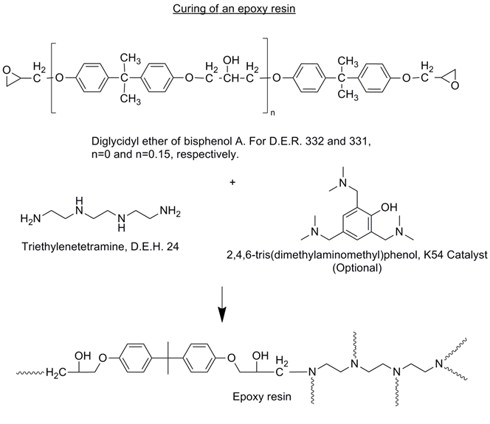
Chemical Bridges
Epoxide
Epoxy = Di-functional
Amine = Hexa-functional
We can manipulate the
thermosets properties
by varying the ratio of
epoxy to amine.
Amine
Notes:
Let’s consider a real life example: we have an epoxy-based molecule and amine-based molecule. The amine can attack the epoxy forming crosslinks. Each hydrogen on the nitrogen is referred to as an active hydrogen, meaning that it can participate in the reaction. The amine here has six active hydrogens, so it has a functionality of six, while the epoxy has two epoxide groups. Following the same ideas as before, we can vary the properties by varying the ratio of amine and epoxy, which is exactly what we are going to explore in the associated activity.

