Slide 1


Exploring Surfactants

Slide 2
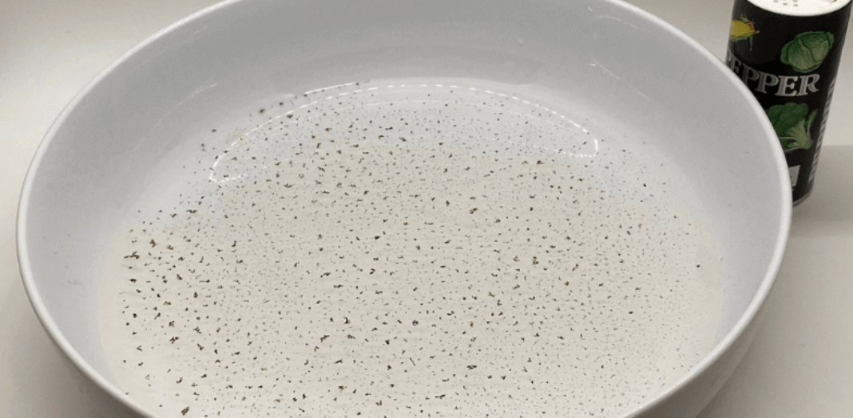
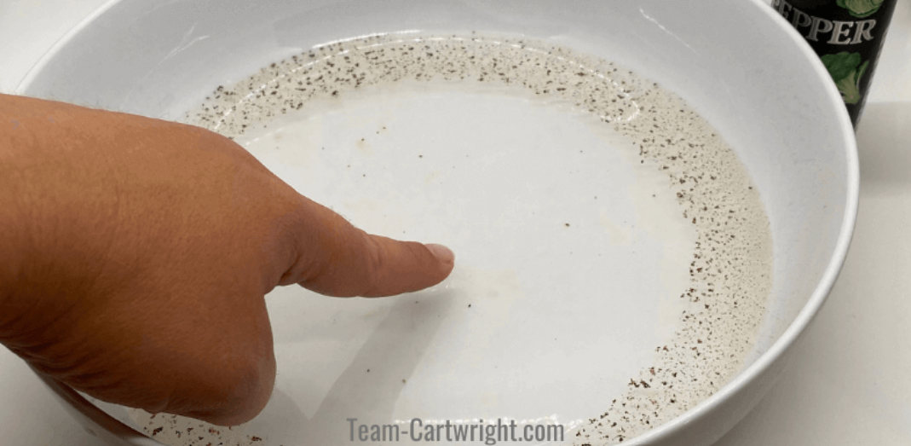
Pepper Demonstration
What do you observe about the water and the pepper?
What happened to the pepper after the soap was added? Why do you think this occurred?
Would the pepper react the same way if another substance was added to the water? What type of substance do you think would cause a similar reaction?

Slide 3
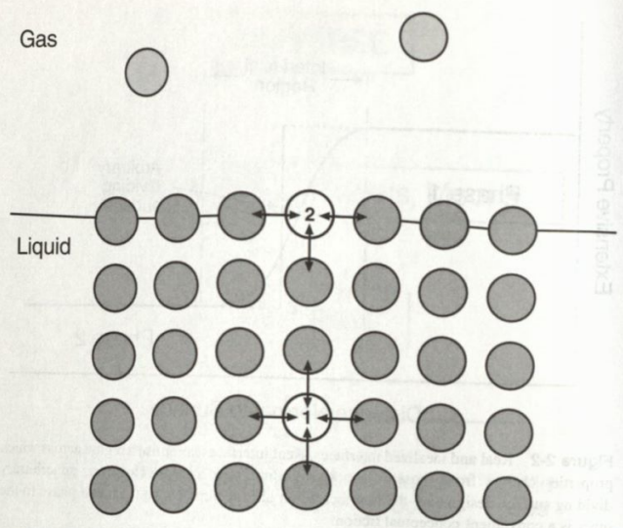
What causes surface tension?
Imagine the bowl of water without the pepper added to it. What is the water touching?
The water molecules at the surface are going to behave differently than water molecules in the bulk of the liquid.
Water molecules in the bulk of the liquid are equally attracted to each other. This means there is no net force in any direction. How do you think water molecules at the surface will behave?
Water molecules at the surface are more attracted to the other water molecules than molecules in the air. This attraction does cause a net force and creates the surface tension.
Notter, R. H. (2000). Lung Surfactants: Basic Science and Clinical Applications

Slide 4
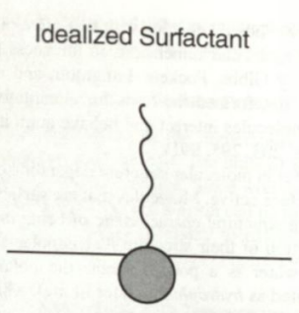
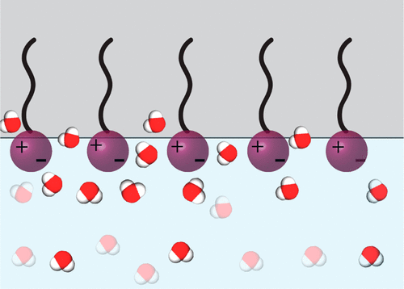
What affects surface tension?
Thinking about the pepper example, do you think the soap affected the surface tension? If so, how?
Most soaps contain "surface active agents," otherwise known as surfactants.
Surfactants are amphiphilic. This means they have a hydrophilic head and a hydrophobic tail. These characteristics mean they prefer being at that air-liquid interface.
Notter, R. H. (2000). Lung Surfactants: Basic Science and Clinical Applications
Surfactants will move to the interface and disrupt the molecular forces of the water. This lowers the surface tension.
There are many examples of surfactants in the world! While they are often associated with soaps, they are also added to medicines. We'll explore this idea more later in this lesson!
https://pubs.acs.org/doi/10.1021/acs.langmuir.6b02558

Slide 5
So what happened to the pepper?
Using the information you have learned, write a short explanation as to what happened to the pepper.
Include the terms:
Surface tension
Forces
Surfactants

Slide 6
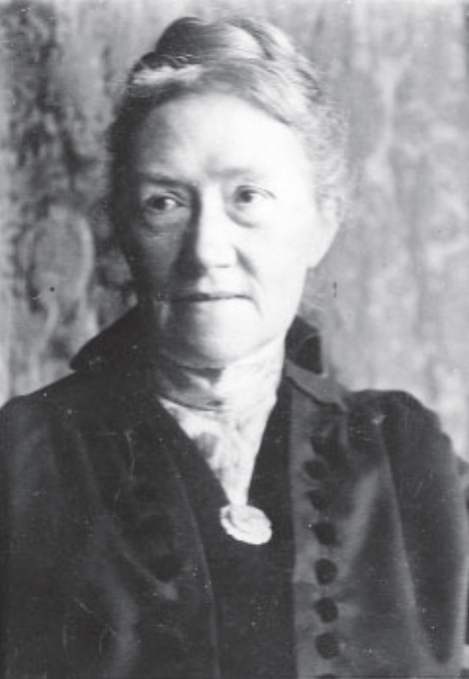
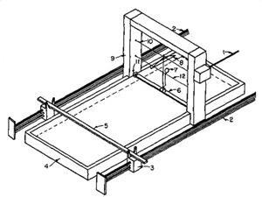
Measuring surface tension
One way surface tension can be measured is by suspending a disk on the surface of water. The disk is attached to a balance that measures the force needed to pull the disk from the surface of the water.
This method was pioneered by Agnes Pockels, a German scientist who was born in 1862. Her research focused on surface tension.
https://en.wikipedia.org/wiki/Agnes_Pockels
However, because she was a woman, she did not receive any formal training.
Despite this, she was able to conduct research in her home using dishwater. She designed her own device for measuring surface tension, known as the Pockels trough.
https://www.chemistryworld.com/opinion/pockels-trough/8574.article

Slide 7
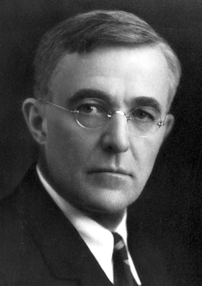
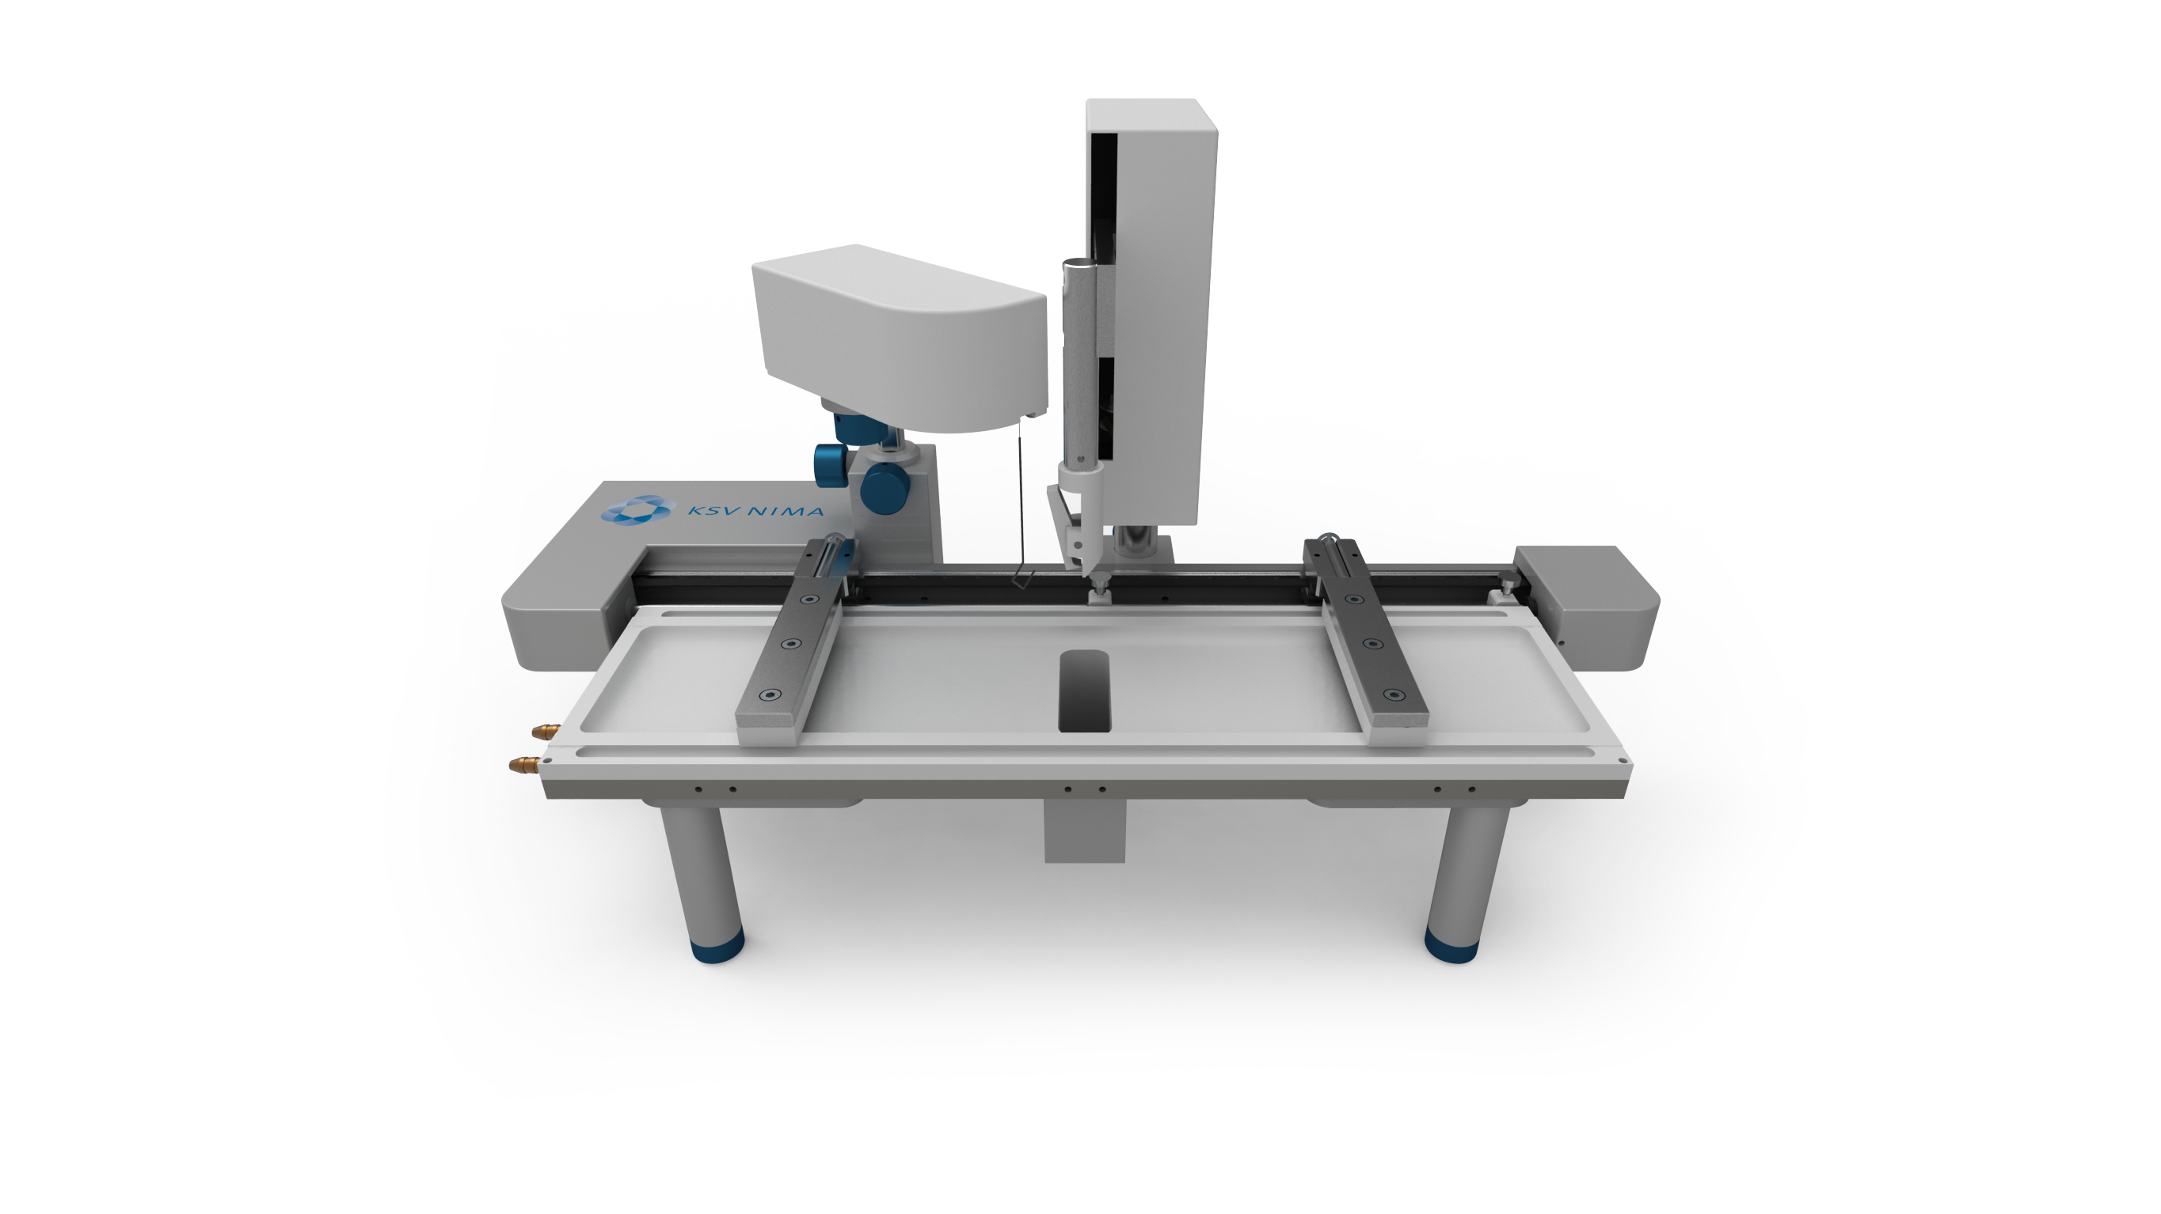
Measuring surface tension
After conducting research for 10 years, Pockels wrote up her findings and sent them to a prominent scientist at the time, Lord Rayleigh. Luckily, rather than stealing her work, as was common practice at the time, he helped get her research published in Nature magazine.
Her research was then used by Irving Langmuir, an American chemist born in 1881. He designed the Langmuir trough for measuring surface tension at an air-liquid interface.
https://en.wikipedia.org/wiki/Irving_Langmuir
The Langmuir trough is currently used today for many applications. Bioengineers use can use a Langmuir trough to conduct research on the effects of surfactants in medicines.
https://en.wikipedia.org/wiki/Langmuir%E2%80%93Blodgett_trough

Slide 8
Measuring Surface Tension Experiment
OPTION 1: We will be making our own version of the Pockels' trough to measure the surface tension of water. Please refer to your worksheets for directions.
OPTION 2: We will be using a triple beam balance to replicate Pockel's trough method and measure the surface tension of water. Please refer to your worksheet for directions.

Slide 9
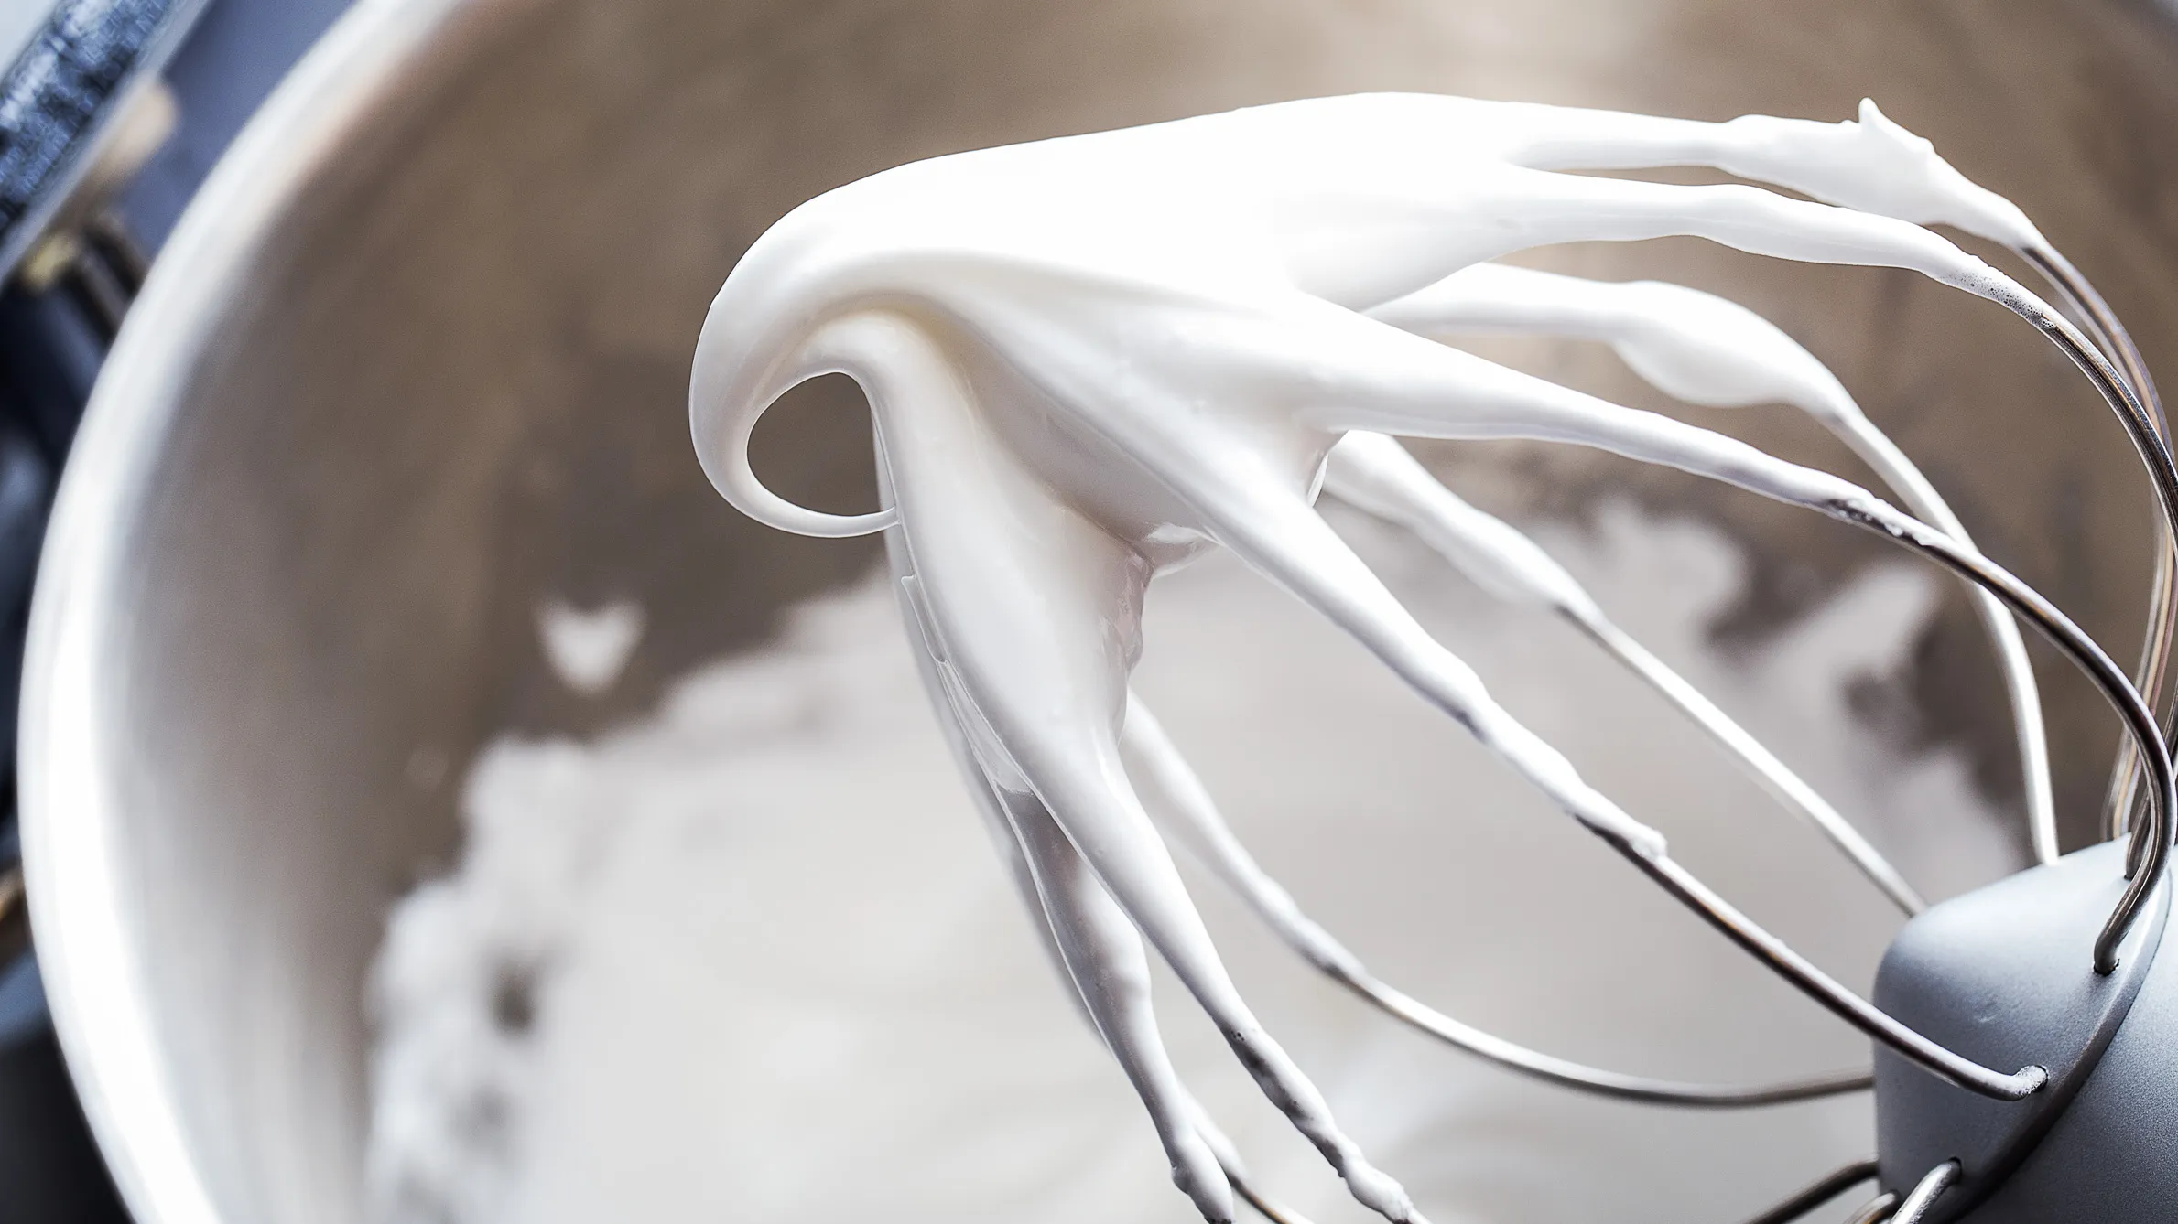
Proteins in Medication
What happens when you whisk egg whites for a long time?
Medicines often contain proteins! What are some examples of agitation that medicines might face from production to patient?
https://www.epicurious.com/expert-advice/how-to-make-meringue-for-pro-level-macarons-pavlova-and-frosting-at-home-article
Protein aggregation in medicines is a big problem and can cause the drug to be less effective.
This is a problem bioengineers want to prevent. What do you think could be done about this problem?

Slide 10
Protein Aggregation Experiment
Bioengineers are often expected to run tests on samples without being told exactly what they are!
We are going to run an experiment to see what mystery solution, when added to egg whites, could prevent protein aggregation at the interface of the protein solution.

