Slide 1


Mission Myelin:
Model, Damage, Repair

Slide 2
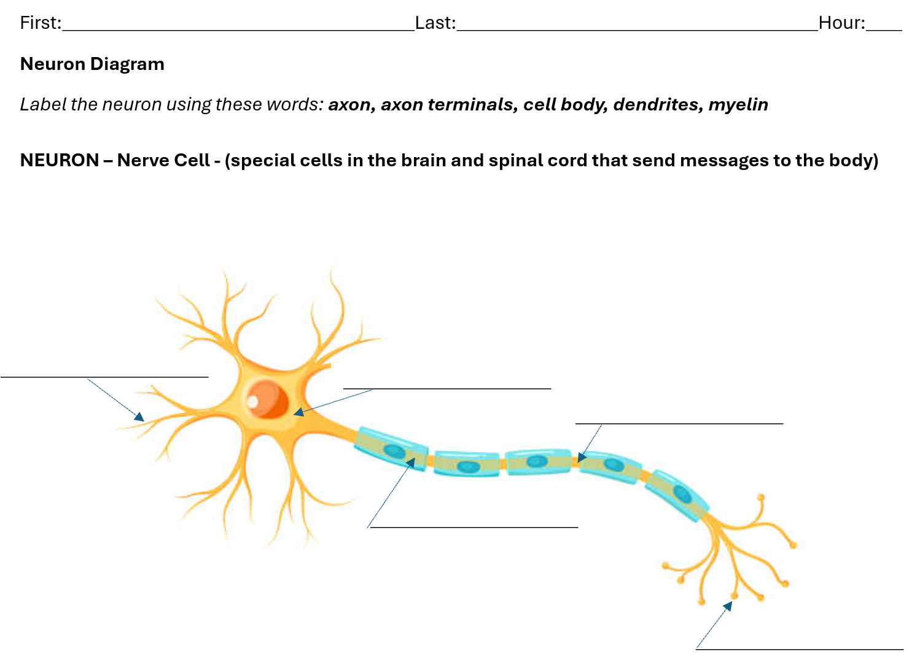

Day 1
Play “Telephone” game
Show neuron diagram
Explain and discuss the science connection to the games of Telephone
Discuss disorders and diseases that can result from demyelination
40 minutes

Slide 3
“TELEPHONE”
Stand in a line.
Whisper the message you heard to the next person.
Say it only once; no repeats.
Say only the message, no other words or explanations allowed.

Slide 4
Is the final message correct?
What was easy or difficult about this game?

Slide 5
  What would make the game
  of Telephone easier to play?
  What could be done to make sure
  the correct message gets to each person?

Slide 6
LET’S TRY AGAIN!
New message
Read the message from the paper to the next person in line. Hand them the paper.

Slide 7
Is the final message correct?
What was easy or difficult about this version of the game?

Slide 8
LET’S PLAY ONE MORE TIME!
New message
With some extra directions (follow the directions on the card you are given)

Slide 9
Is the final message correct?
What was easy or difficult about this version of the game?

Slide 10
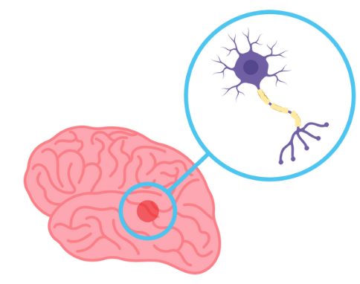
neuron
brain

Slide 11
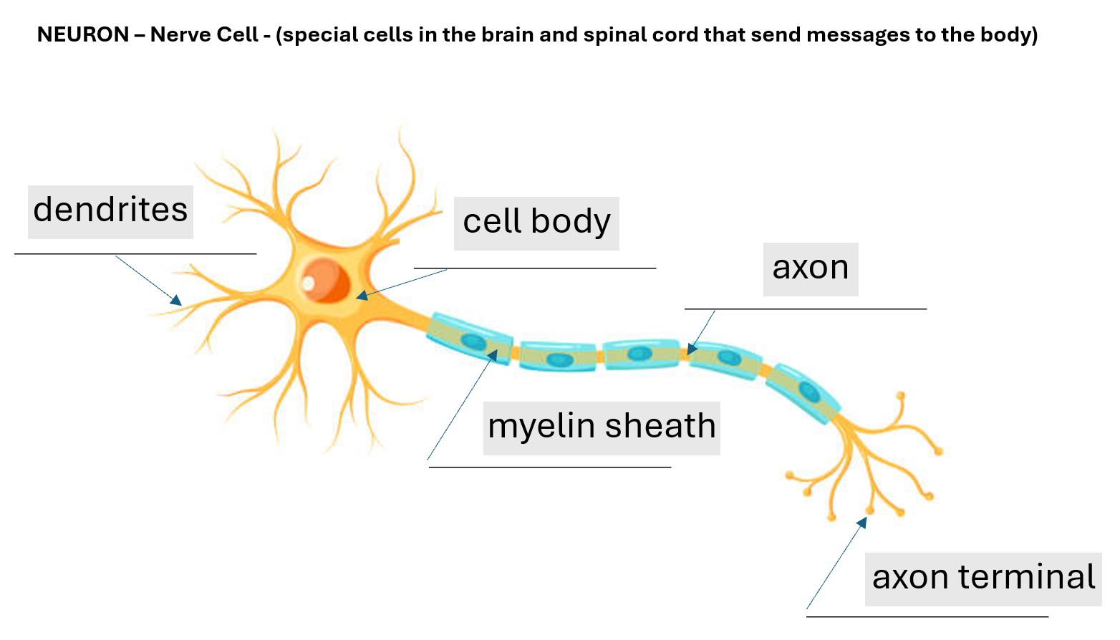

Slide 12
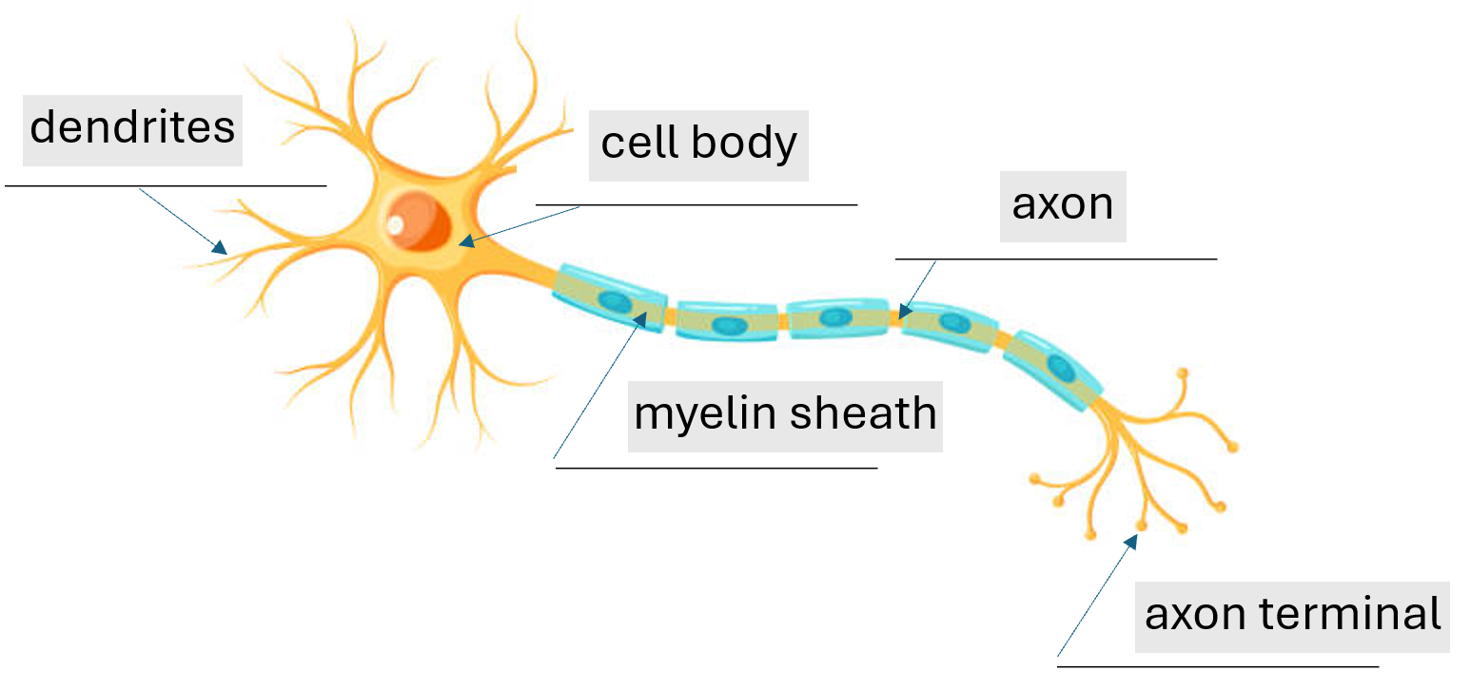

First Telephone Game
MESSAGE
MESSAGE

Slide 13



Second Telephone Game
MESSAGE
MESSAGE

Slide 14
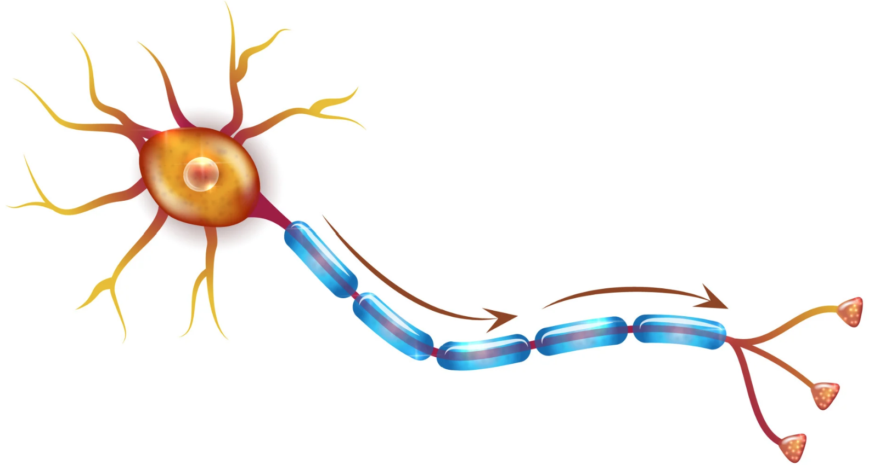
  Myelination

Slide 15




Third Telephone Game
MESSAGE
MESSAGE

Slide 16
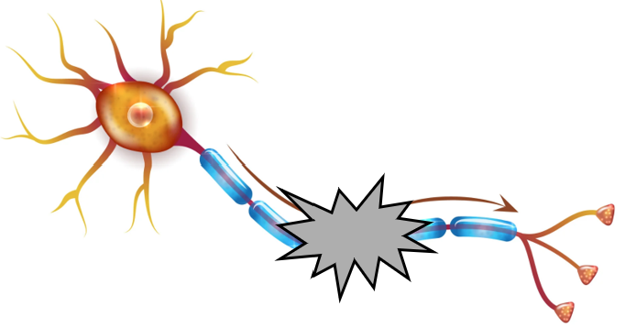
  Myelination
  Demyelination

Slide 17
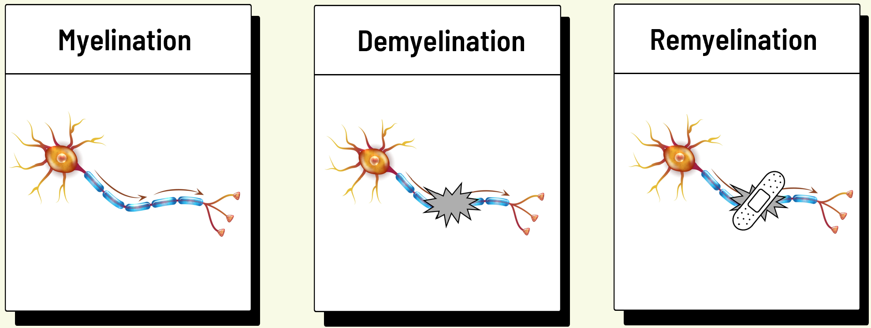
Damage to the myelin can slow down, disrupt, or block signals to/from the brain. This can cause various health issues involving vision, muscles, coordination, balance, memory, concentration, thinking, and more. A commonly known demyelination disorder/disease is multiple sclerosis (MS). There is no known cure, but scientists are working to protect myelin from damage and also learning how to repair or replace damaged or missing myelin. The Hartley lab is exploring the roles of hormones and lipids in the myelination and remyelination processes.

Slide 18

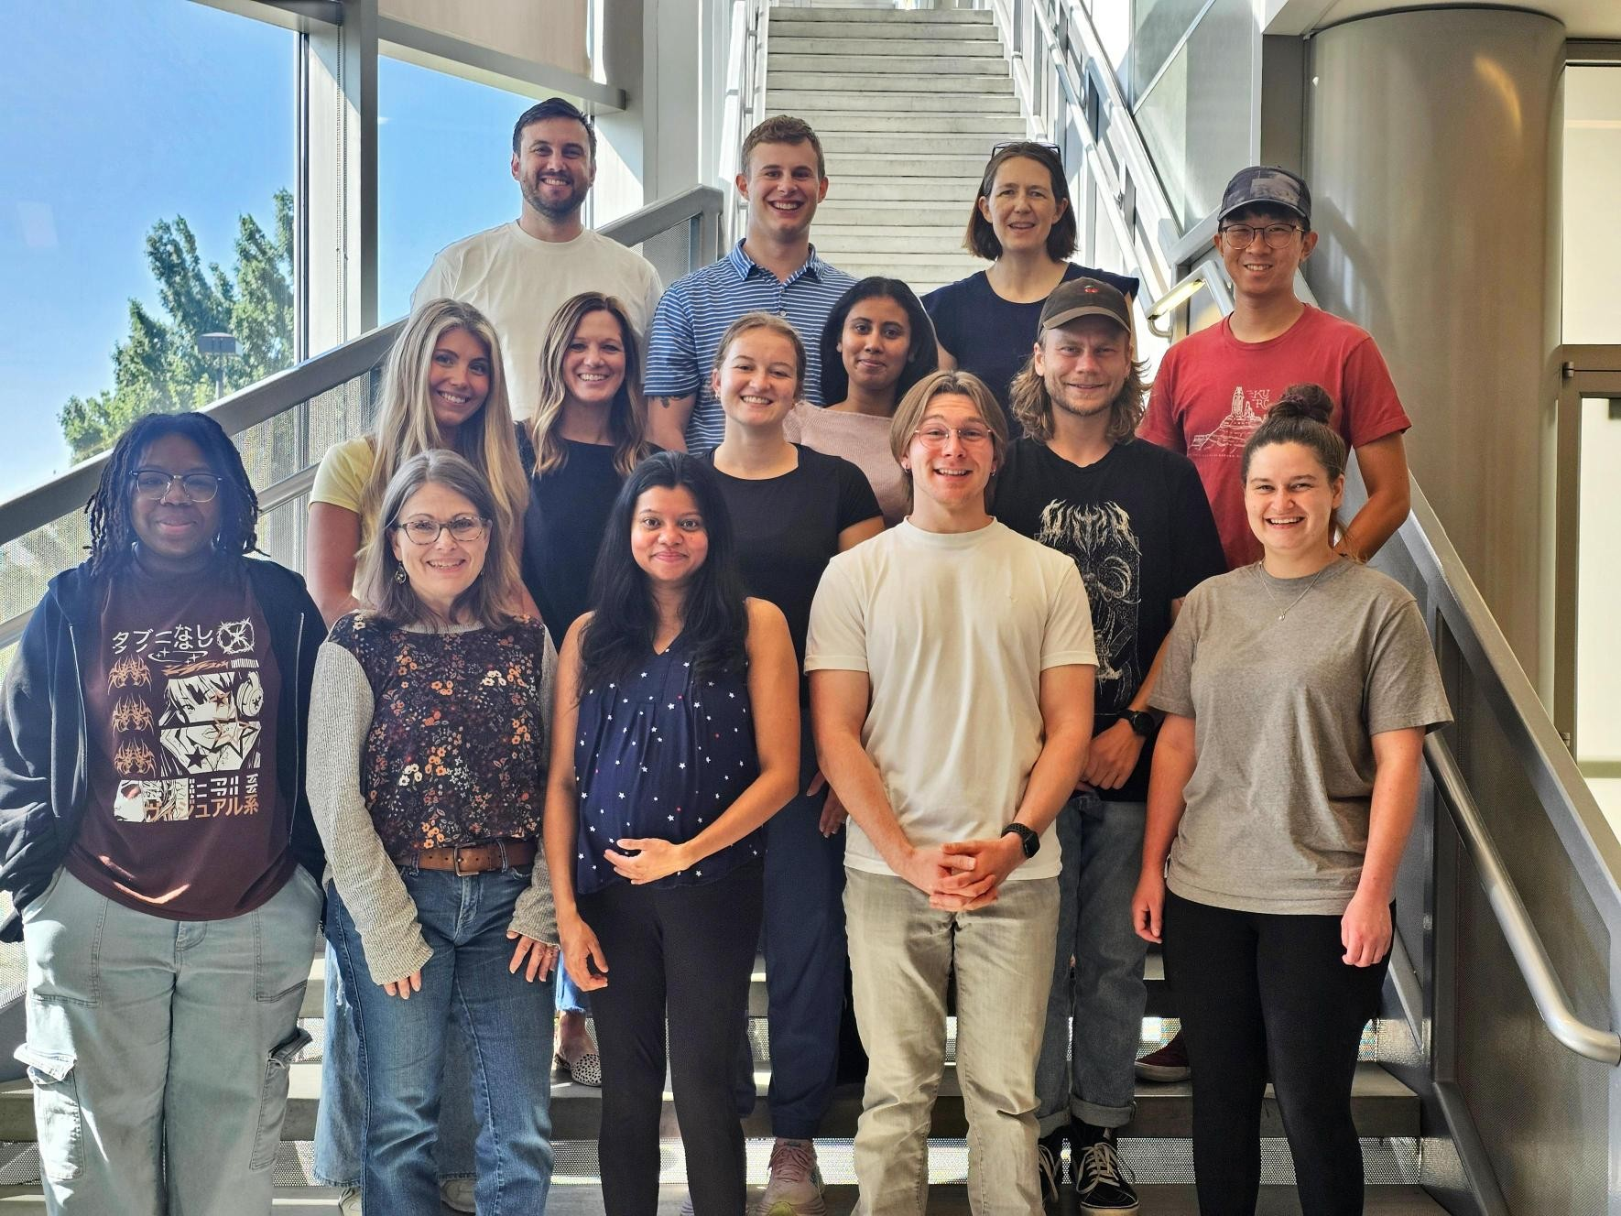

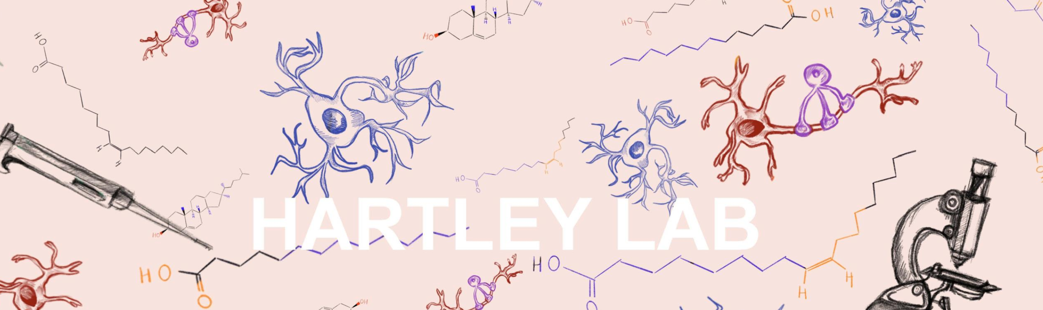


Slide 19
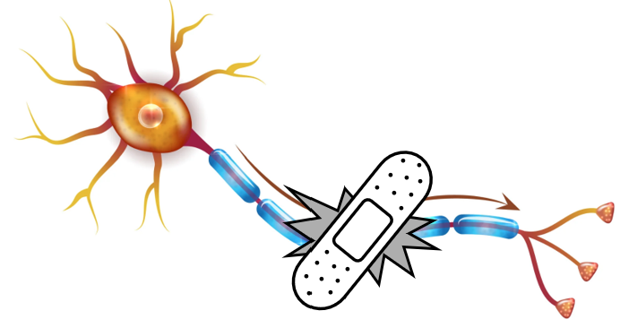
  Myelination
  Demyelination
  Remyelination

Slide 20
Phenomenon
Reflexes (hot stove)
How messages travel and are communicated to/from the brain/body
The importance of quick, efficient, and correct information
Challenge
Mimic the design of a neuron (axon with myelin) to engineer a quick and efficient pathway for a message to be sent.

Slide 21

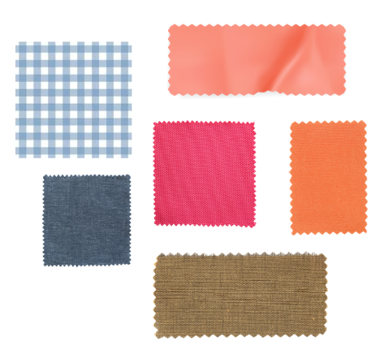
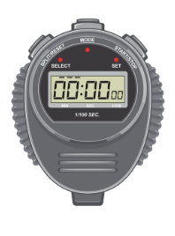


high and low friction material options = myelin
foam tube = axon
board (ramp) to keep tube at consistent angle
marble or wooden ball= message
time to nearest
tenth of a second

Slide 22
Explain first part of engineering challenge.
Pair students.
Pairs explore and test available myelin materials.
Pairs discuss and decide on material(s).
Pairs begin to add myelin to axon.
Day 2
* mix of high friction and low friction materials that are easy to cut and shape
40 minutes
burlap
aluminum foil
silicon mat
mylar
contact paper
plastic wrap
wax paper
sand paper
neoprene
felt
parchment paper
plastic sheet protector

Slide 23
Day 2
1.
2.
3.
4.
5.
6.
7.
8.
9.
10.
assigned partners

Slide 24


  Myelination
  Demyelination
  Remyelination
View and test out sample materials.
Cover the axon with myelin.
Conduct 5 timed trials.

Slide 25
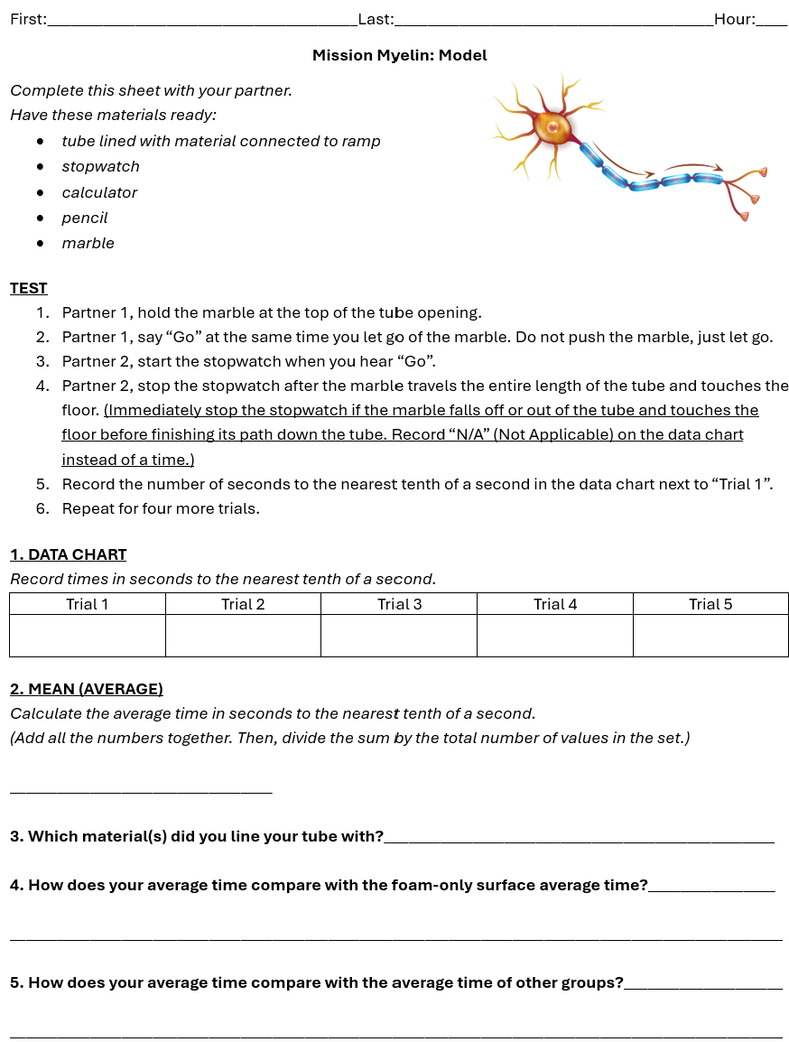
Day 3
40 minutes
Finish adding myelin to axon.
Affix axon to ramp.
“Model” – Myelination
Conduct 5 timed trials - time it takes
the message to move across the axon.
Calculate average.
compare to foam-only axon (no myelin) average
compare to other groups

Slide 26
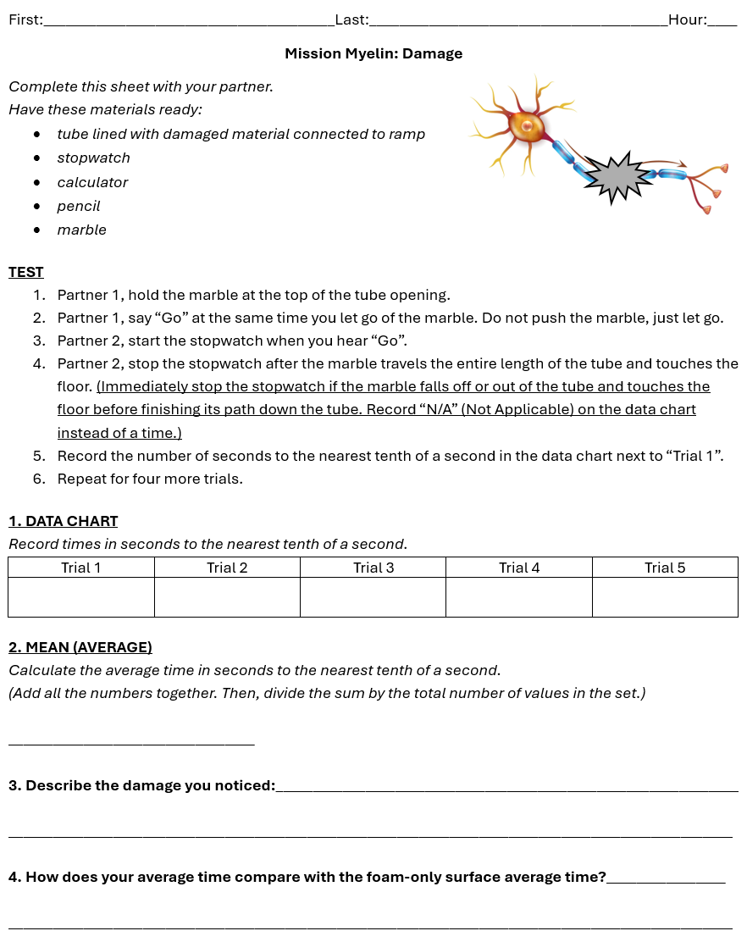
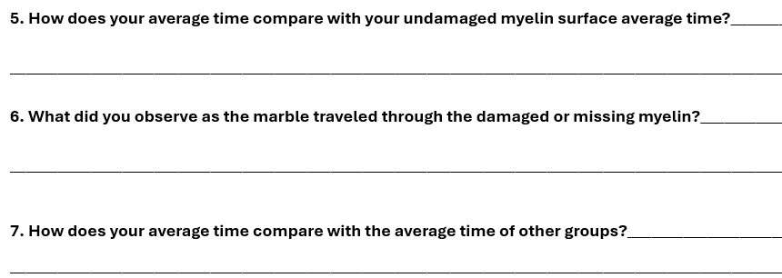
Day 4
40 minutes
“Damage” – Demyelination (SURPRISE!)
Observe and note damage.
Conduct 5 timed trials - time it takes
the message to move across the axon.
Calculate average.
Compare to foam-only axon (no myelin) average.
Compare to myelinated axon.
Compare to other groups.
Begin discussion about repairs.

Slide 27
  Myelination
  Demyelination
  Remyelination
Oh no! Damaged myelin discovery
Conduct 5 timed trials.
Compare to myelinated axon time.

Slide 28
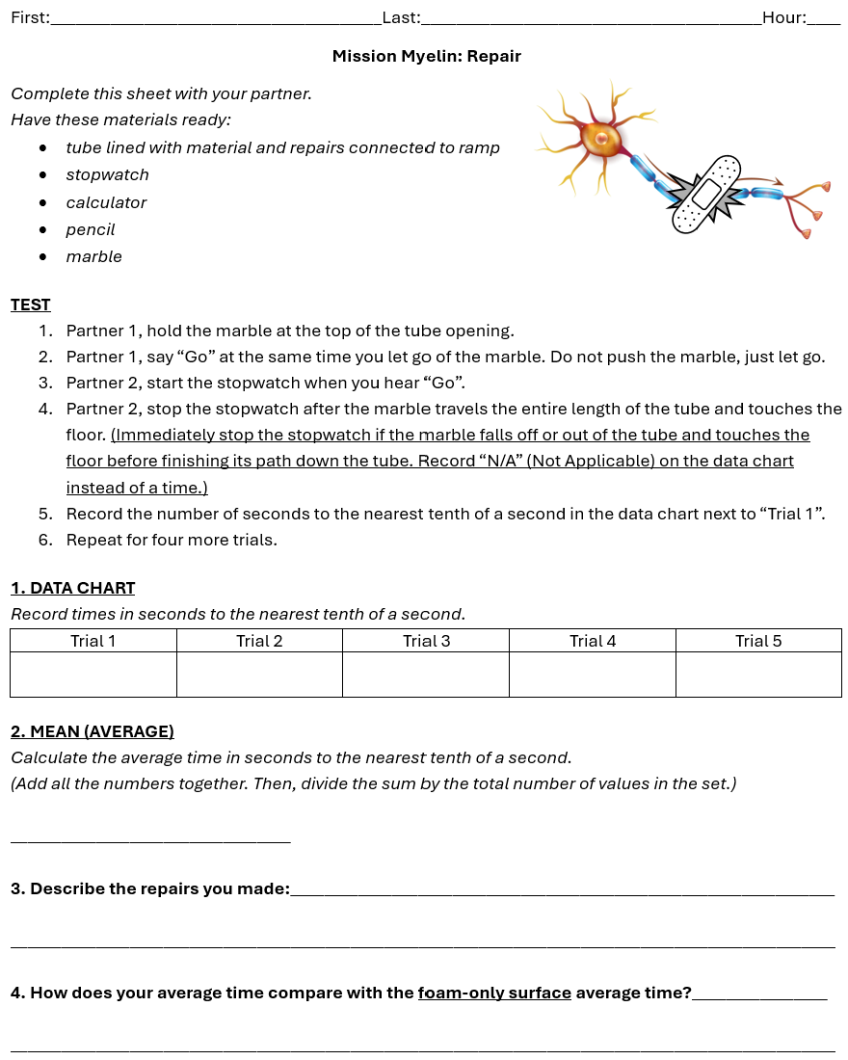
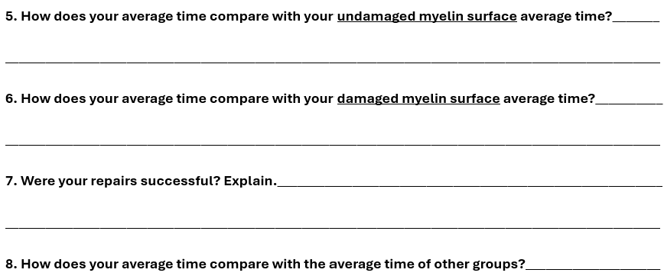
Day 5
TAPE: transparent, masking, painters, foil, duct, electrical, and double-sided
PLUS – access to all myelin materials
40 minutes
“Repair” – Remyelination
Discuss, plan, and perform repairs.
Goal: faster than demyelinated axon.
Conduct 5 timed trials - time it takes
the message to move across the axon.
Calculate average.
Compare to myelinated axon.
Compare to demyelinated axon.
Compare to other groups.

Slide 29
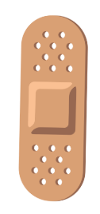
  Myelination
  Demyelination
  Remyelination
Repair myelin.
Conduct 5 timed trials.
Compare to myelinated axon time.
Compare to demyelinated axon time.

Slide 30
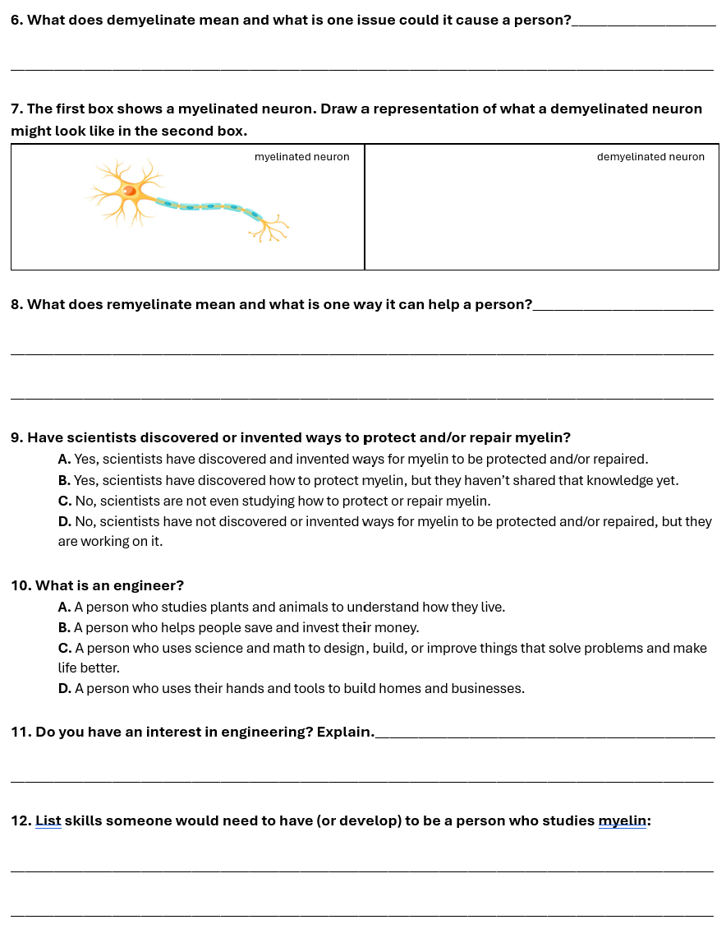
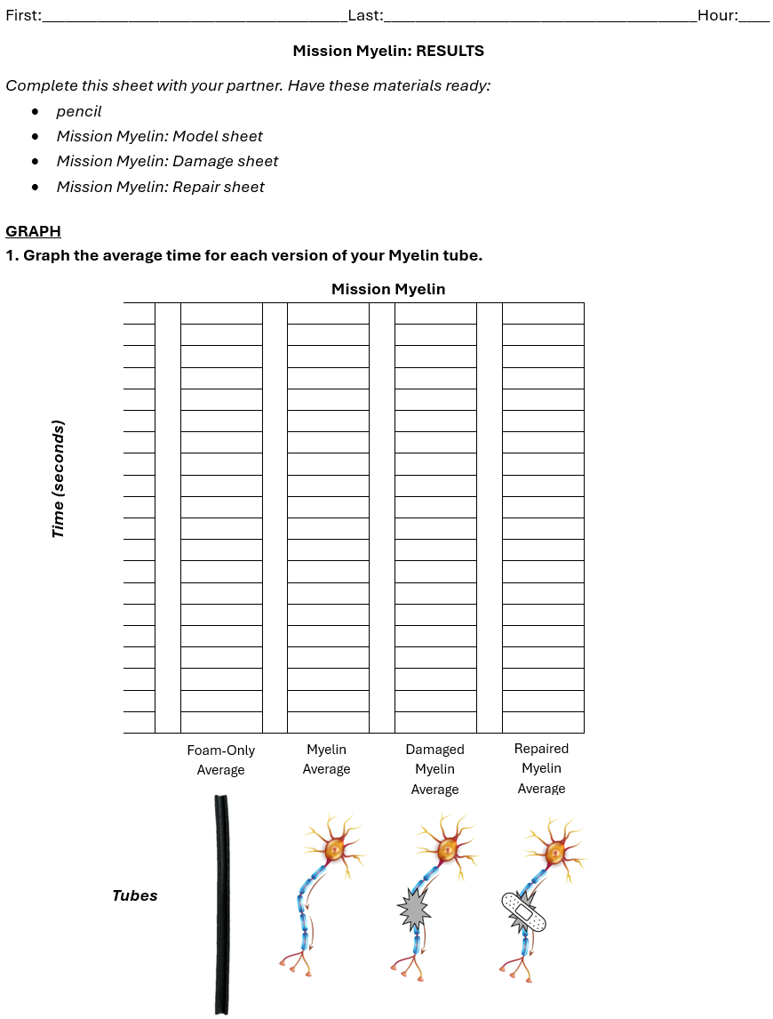
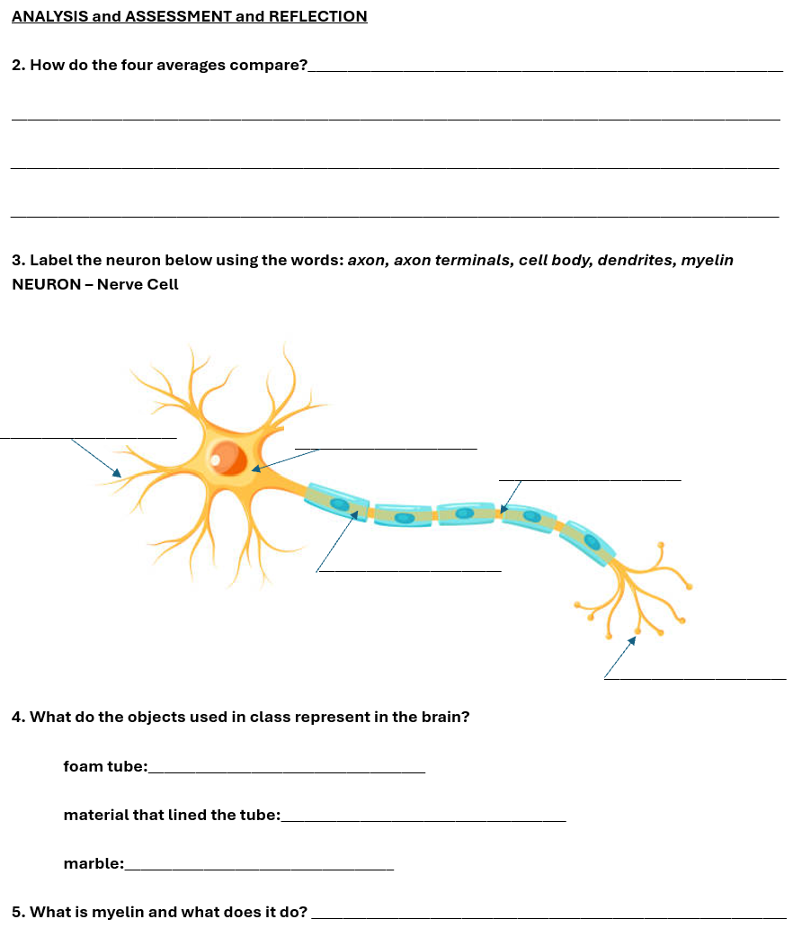
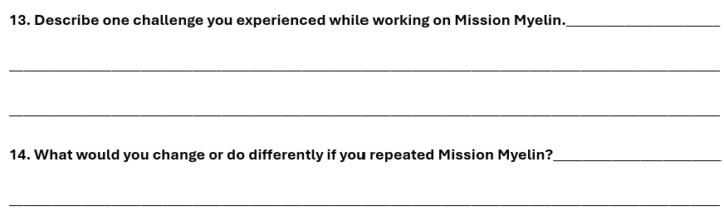
“RESULTS” (results, analysis, assessment, reflection)
Conduct a final discussion.
Compare results.
Revisit the connection to Hartley Lab, biochemistry, engineering, potential career pathway.
Day 6
40 minutes

