Slide 1
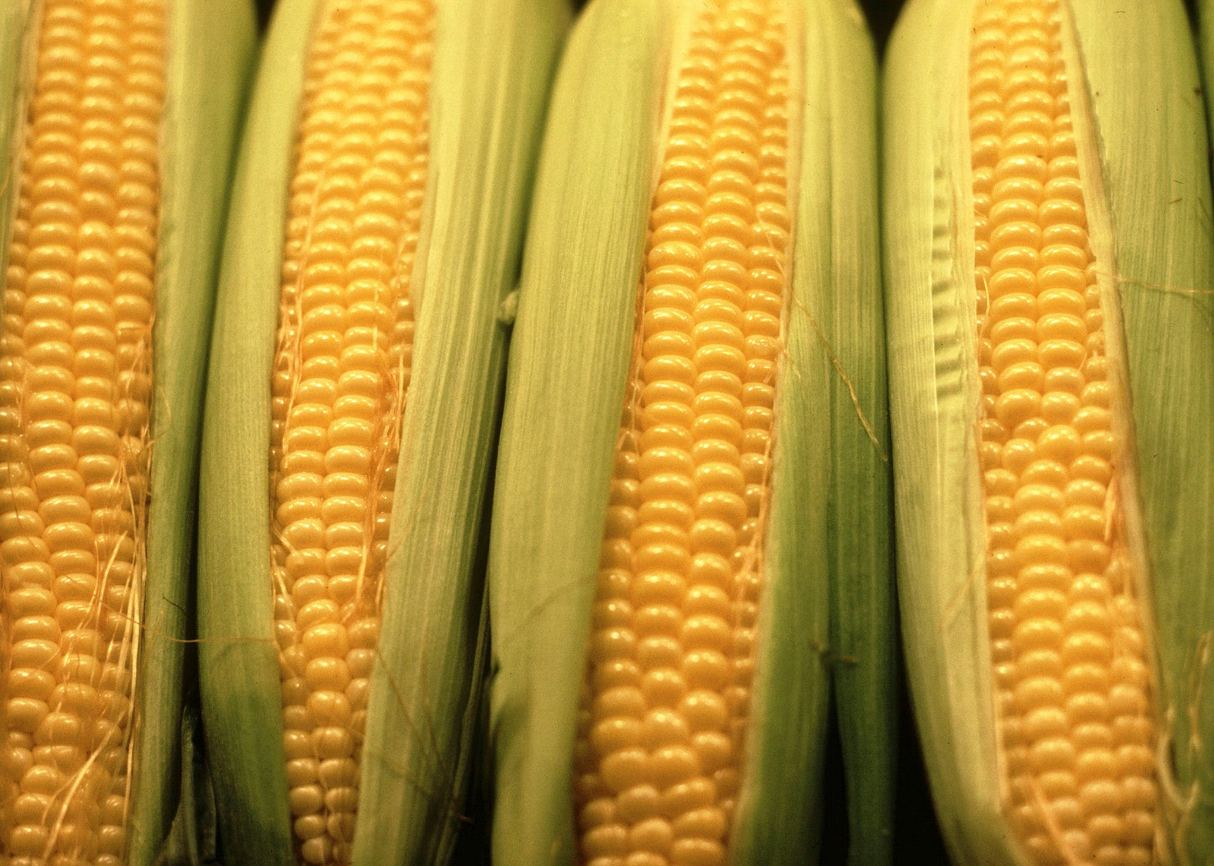
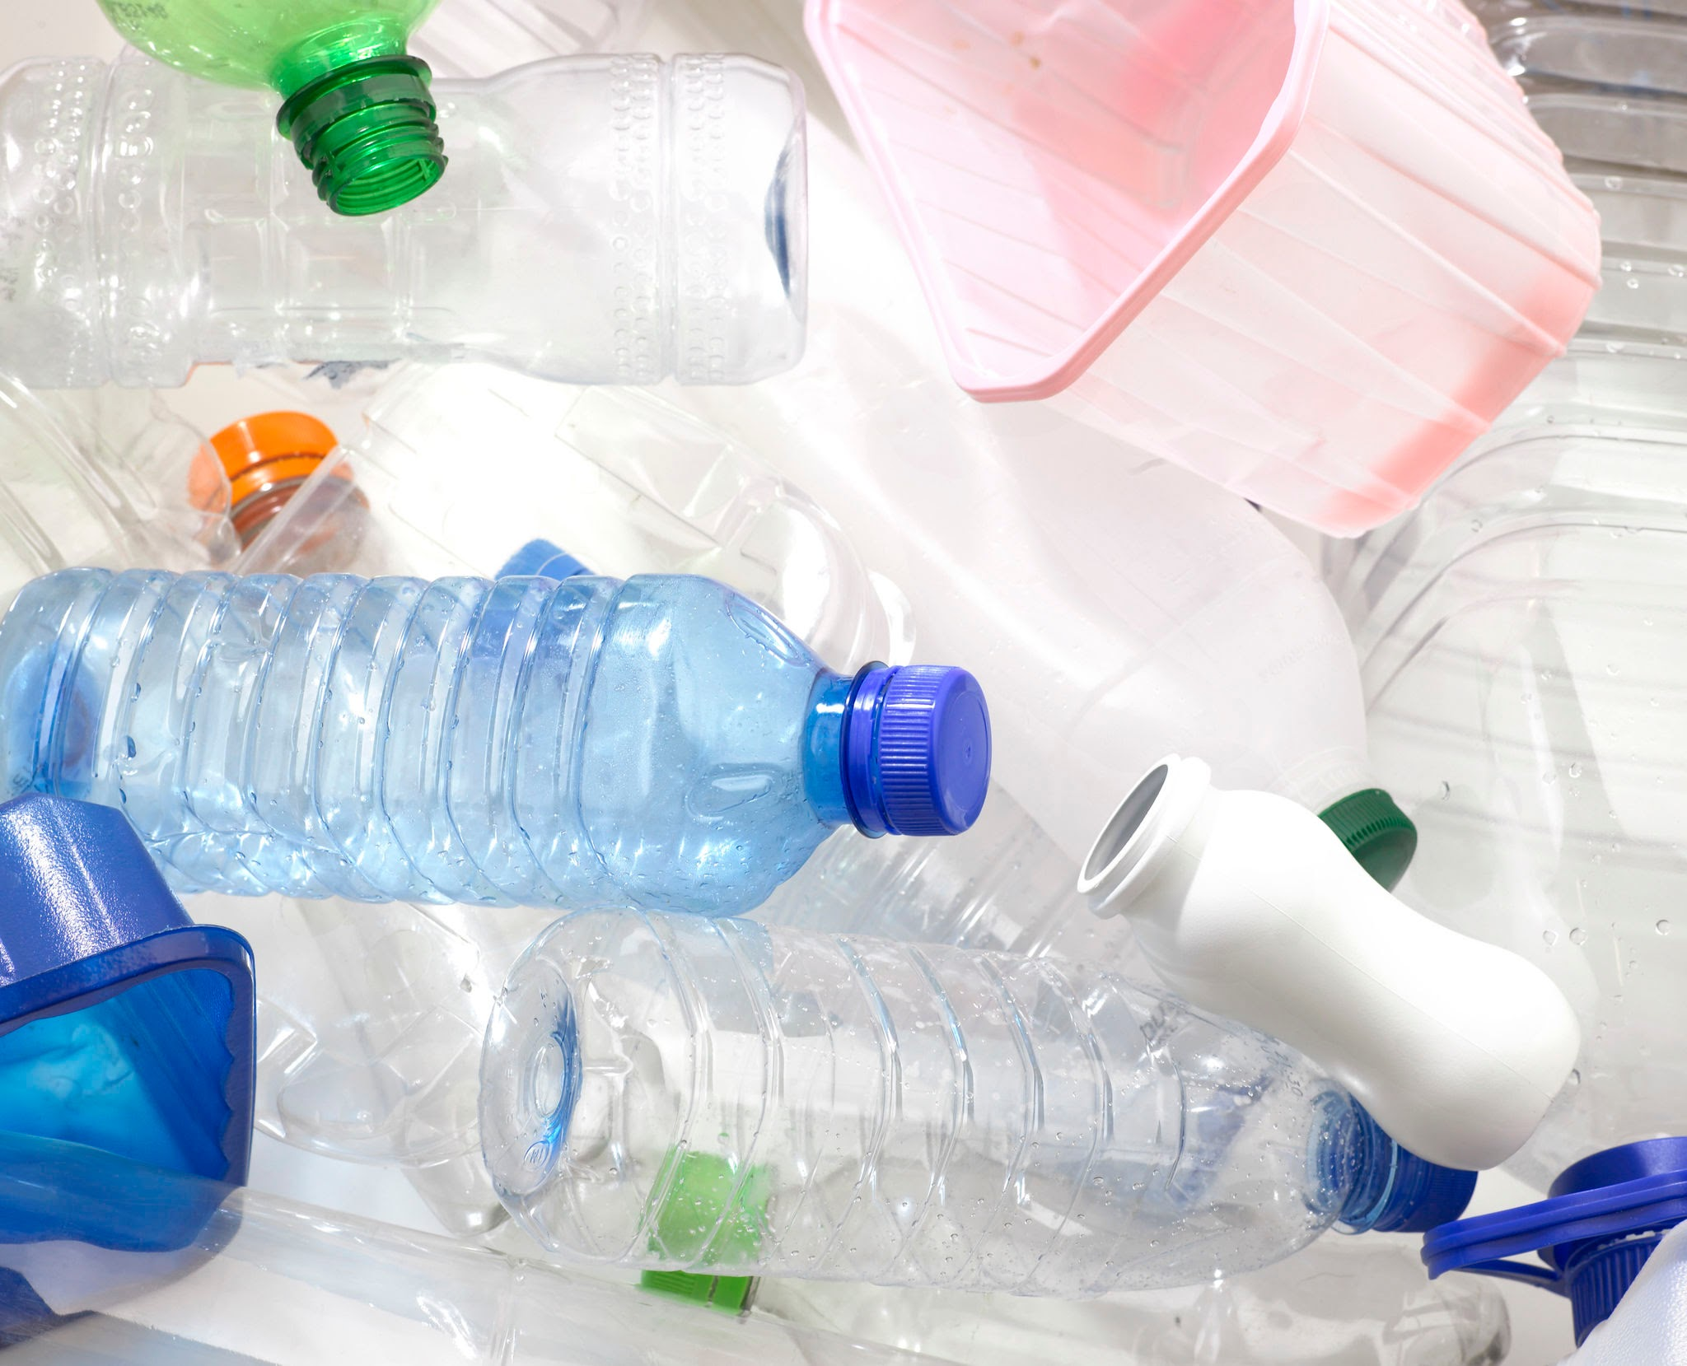
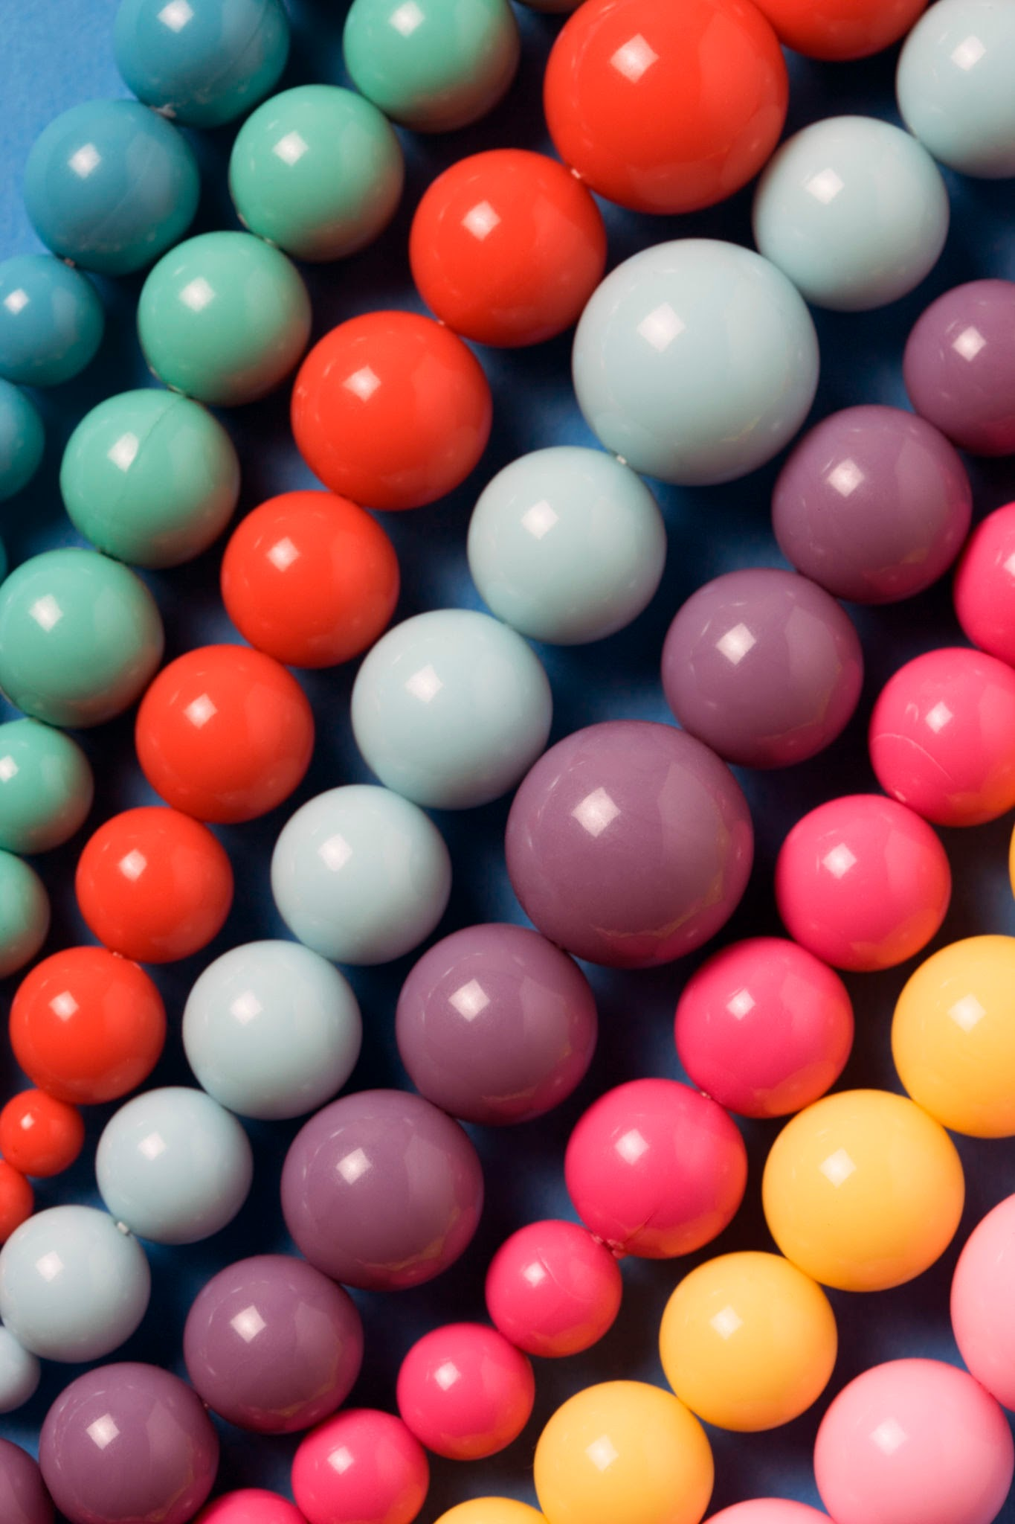
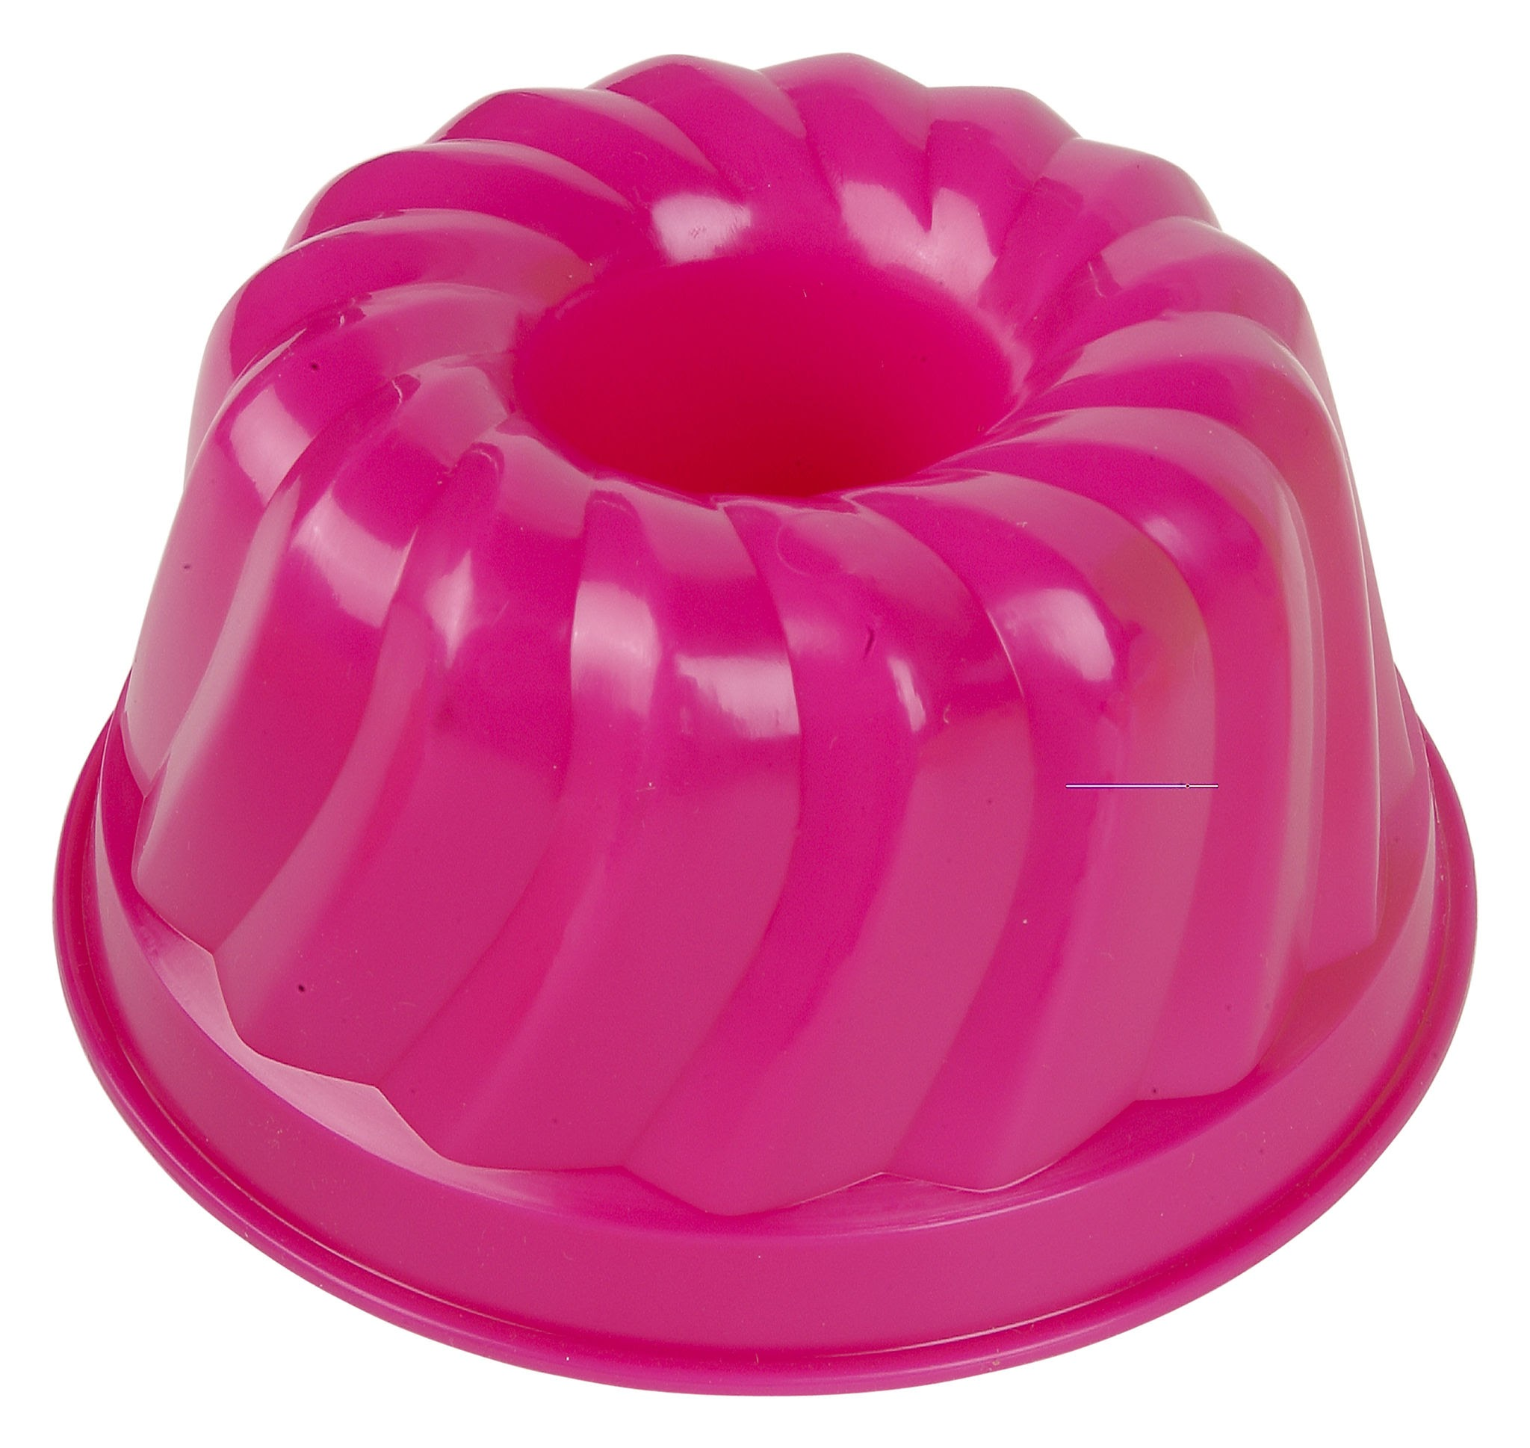


Polymers, Plastics, and Bioplastics
What’s the big deal?

Slide 2

Take 5 minutes to fill out the first page in your booklet.
Notes:
Only about 9% of plastics get recycled. The rest end up in landfills.
Engineers are working on fuel sources and trying to find ways to help with the issue of plastic waste. One way is by breaking plastic down into monomers, or the original building blocks, to then use them or turn them into something else.

Slide 3
The big questions we will look at in this activity:
What are polymers, and why are they important?
What is the difference between natural and synthetic polymers?
Could bioplastic be a possible solution for some of our plastic usage?

Slide 4


We are going to think like engineers and design a product that could help with the plastic usage problem!

Slide 5
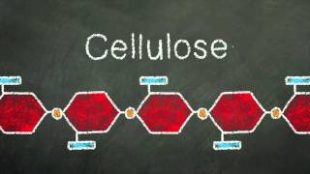
Polymers - long chains of repeating building blocks
Synthetic Natural

Slide 6
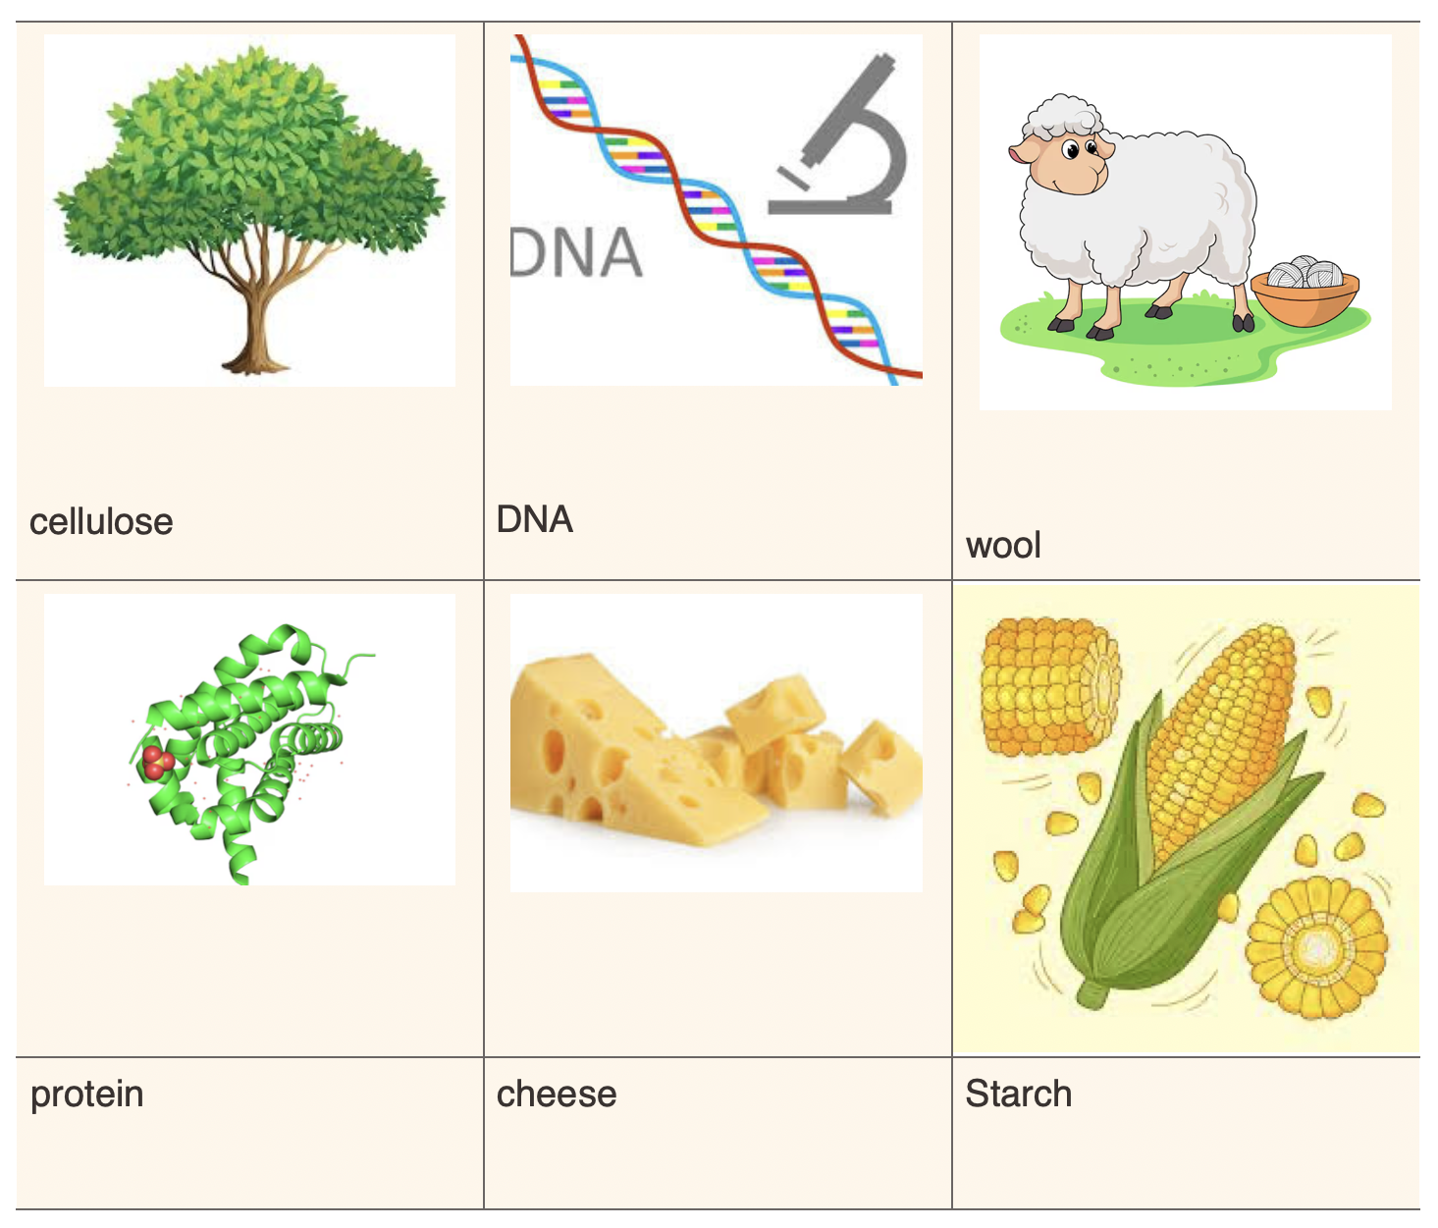
Natural Polymers
Plant cells have walls made from a polymer of glucose called cellulose.
DNA and RNA is a complex polymer. The sides are formed from chains of sugar, while the crosslinks are pairs of four monomers called nucleic acids.
Wool fiber is composed of keratin protein.
Protein polymer is found in muscles and other tissues and is made from polymers built out of monomers called amino acids.
Starch polymers are also formed from glucose chains.

Slide 7
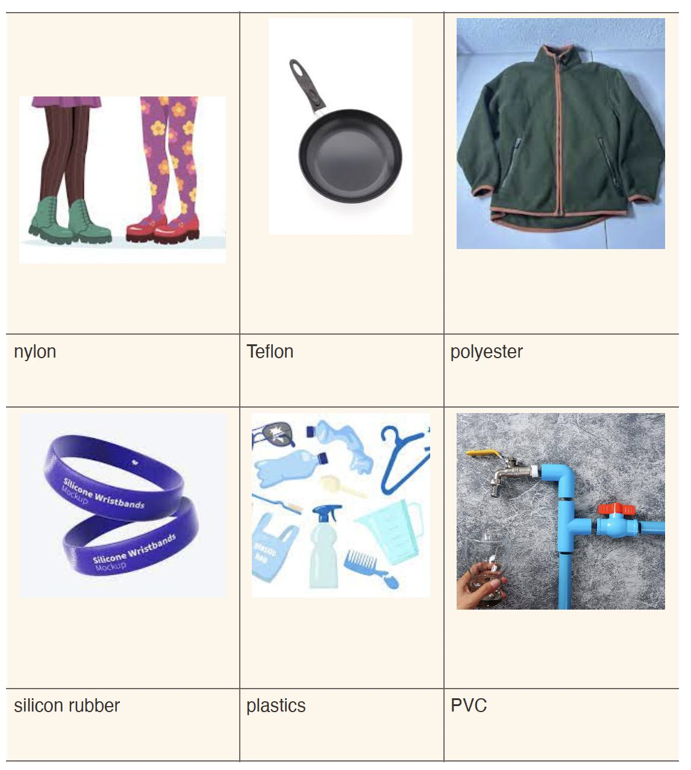
Synthetic Polymers
Synthetic materials are made from natural resources like petroleum.
Petroleum is a non-renewable resource.
Synthetic materials are made by chemically changing the starting substances to produce a material with different characteristics.
Most synthetic materials do not decompose easily.
Notes:
Polymerization (puh LI muh rye zay tion) - monomers react in a chemical reaction to form a polymer. Heat and pressure are used to make these reactions.

Slide 8
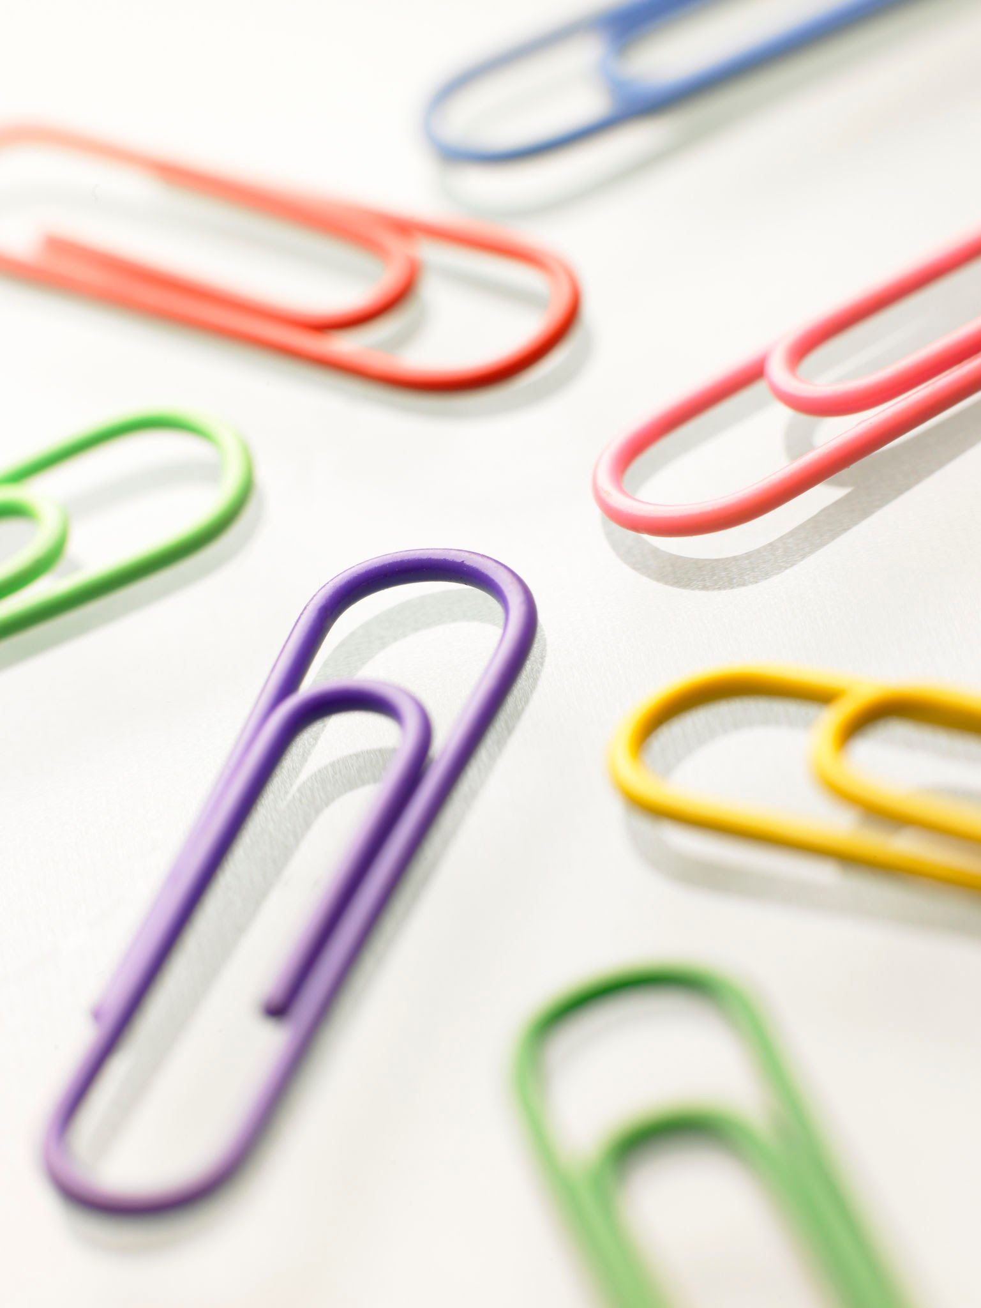
constructing polymers models
Each group will receive 30 paper clips.
You are constructing polymers.
Polymers are made up of monomers.
Each paper clip is considered a monomer.
Begin building chains and answer the questions on your worksheet as you design.

Slide 9
Constructing polymer models
WHAT DID YOU LEARN?
Let’s share some of your designs with the class and talk about what you did to change the shapes of your polymers. In what ways did the changes affect your polymer?
How does your polymer chain model real polymer behavior?
Why is it important for engineers to understand the shapes of polymers?
Notes:
Polymers are made of monomers linked together—just like your paper clip chains.
The structure of a polymer (how it’s linked) changes its function (how it acts).
Some polymers are natural (like starch and proteins) and others are synthetic (like plastics).

Slide 10
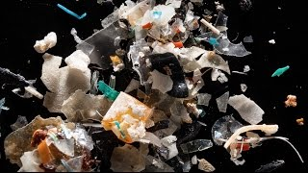
Next up: Bioplastics!
What if bioplastics could replace
some of the plastics we use?
BIOPLASTIC:
Environmentally friendly plastics that biodegrade and require less energy to make
Notes:
We’ve talked about natural polymers and synthetic polymers. We’ve heard about the majority of plastics not being recycled, about plastics taking a long time to degrade, and about how a lot of plastic is ending up in our water systems.

Slide 11
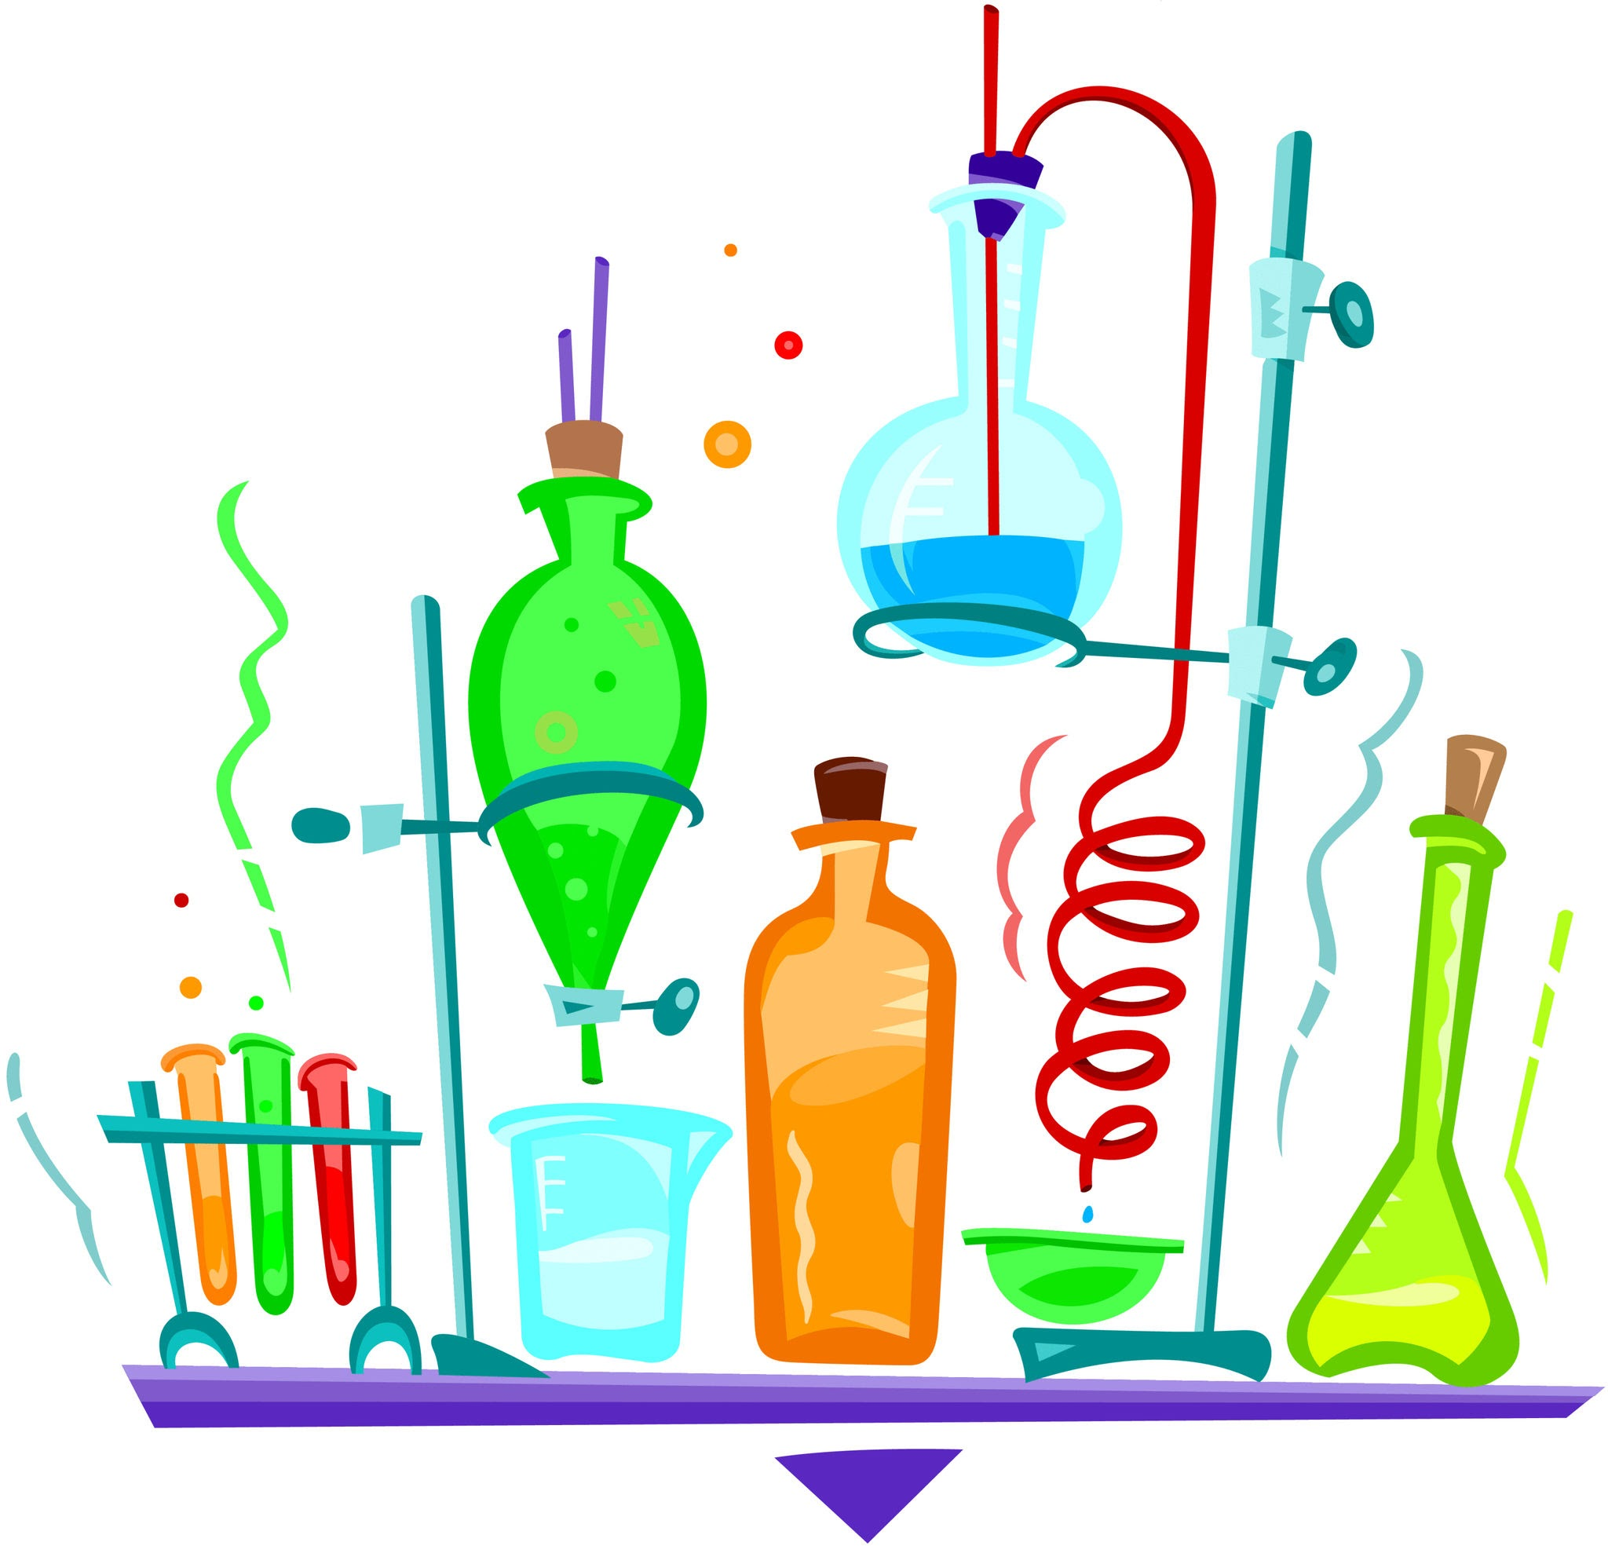
Let's get to know our lab ingredients…
We will take today to talk about the lab
ingredients and to take notes in your booklet.

Slide 12
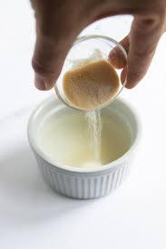
Gelatin is a protein polymer made from collagen (found in animals). When gelatin is heated with water, it forms a gel that cools into a solid. It helps the bioplastic become more stretchy and flexible.
Gelatin also binds everything together, making the bioplastic less likely to crack or break.
Notes:
Put in something to show the difference between how gelatin forms polymers and how cornstarch does.

Slide 13
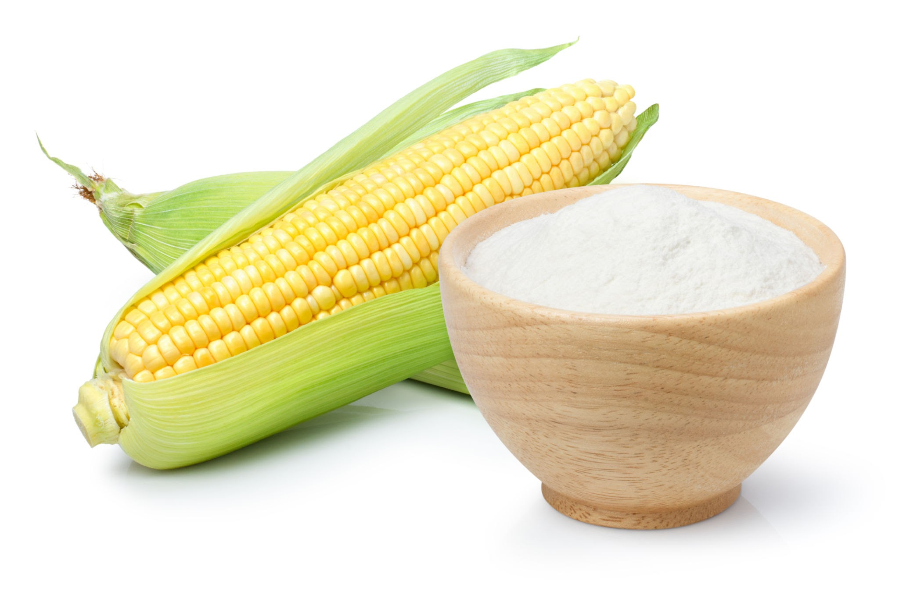
Cornstarch is made of natural polymers called polysaccharides (long chains of sugar molecules). When you heat cornstarch with water and an acid (like vinegar), the starch molecules open up and can link together, forming a plastic-like material. It helps the bioplastic become flexible but firm when it cools.

Slide 14
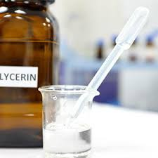
Glycerin comes from fats and oils found in plants and animals (like coconut oil, soybean oil). Glycerin makes the bioplastic soft, bendy, and flexible. Without glycerin, the bioplastic would turn out hard, stiff, and brittle (it might crack or break easily).
Glycerin sits between the polymer chains and helps them slide past each other a little bit, which creates flexibility.

Slide 15
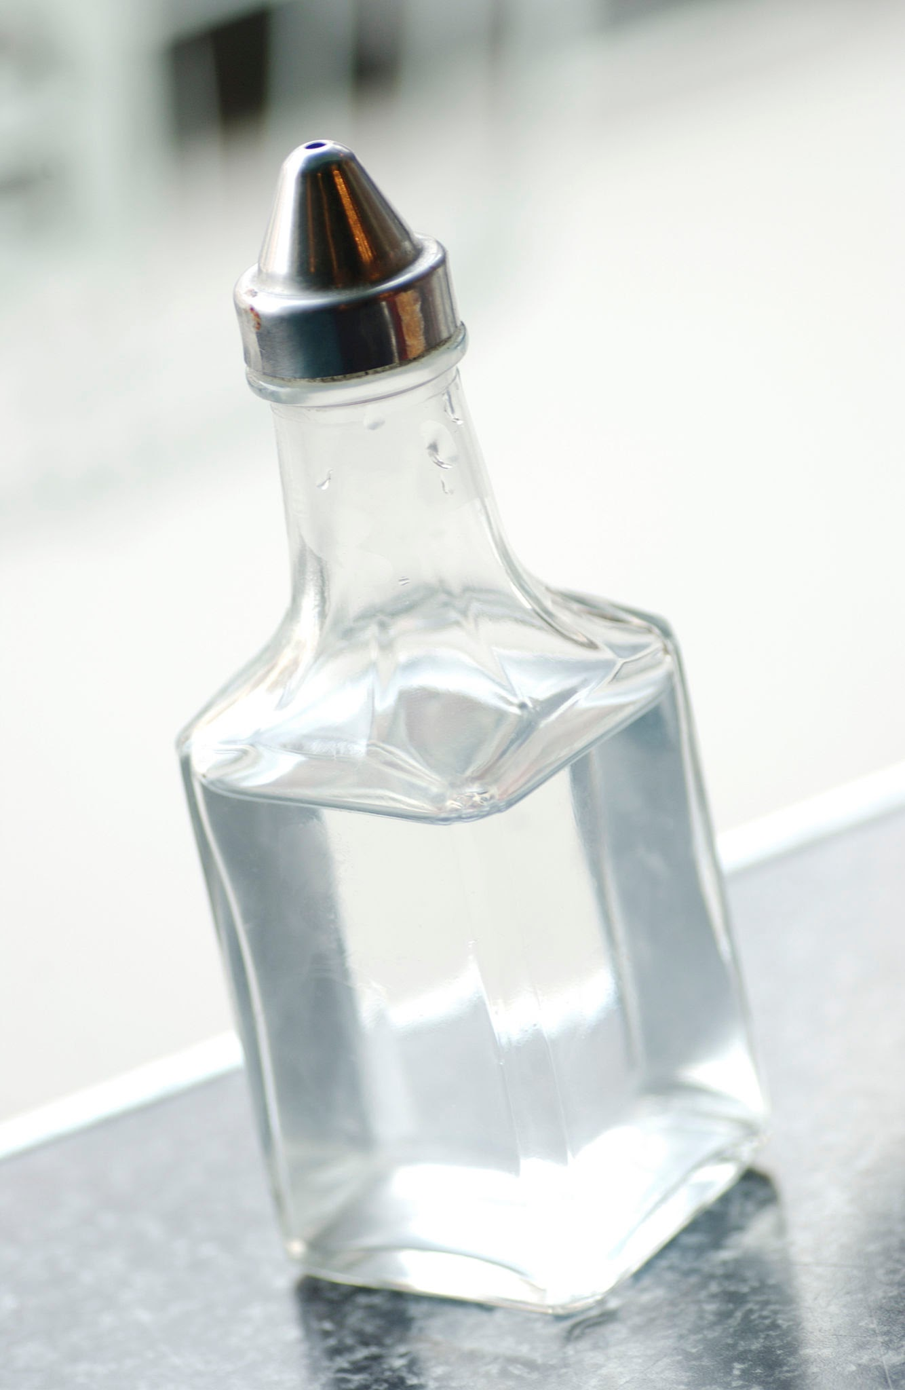
Vinegar plays a very important role in the chemical reaction! The acid in vinegar breaks some of the bonds in the cornstarch during heating. This helps the polymer chains rearrange and link together better, creating a smoother, more flexible plastic.

Slide 16
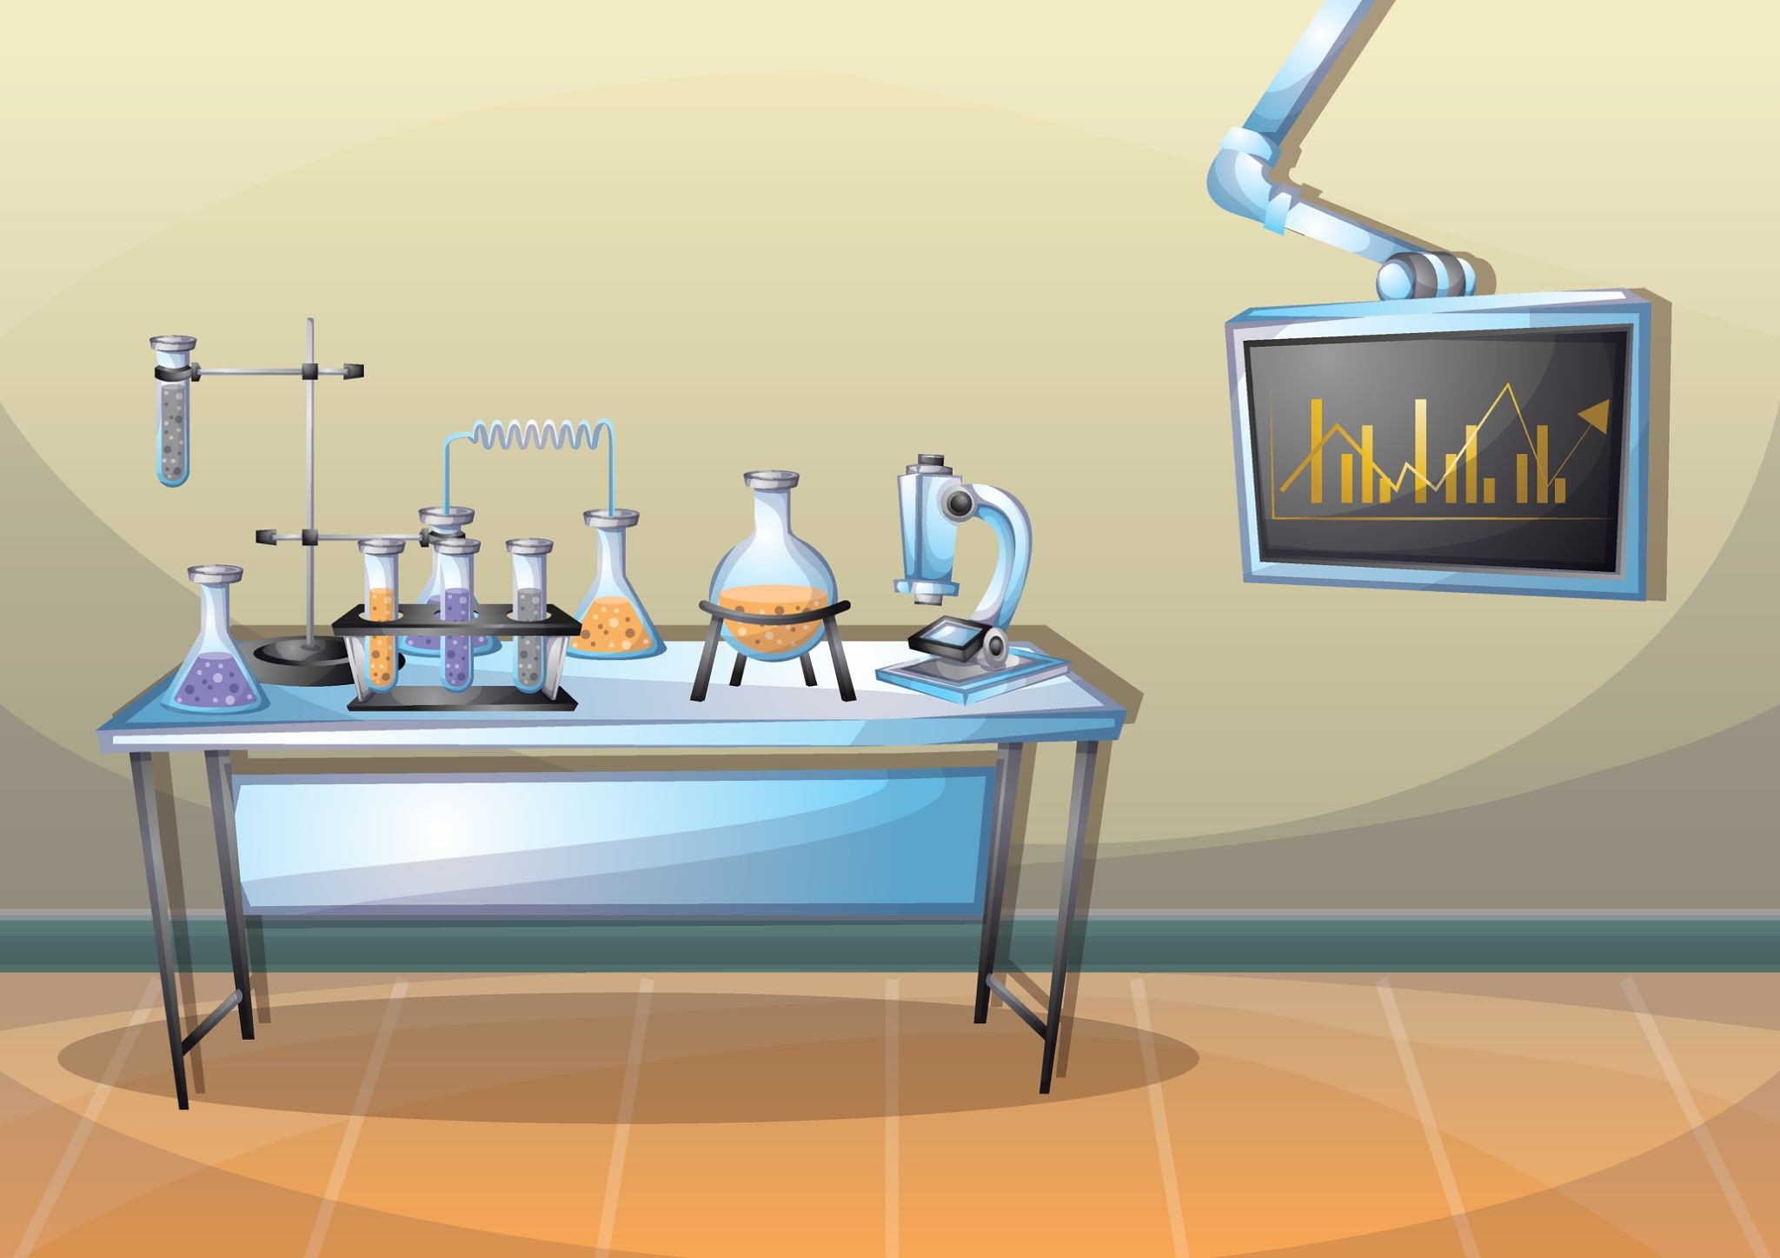

Now, begin reading through your
activity sheet and let’s get started!
Notes:
We will be looking at the shrinkage of the 2 batches. Also, we will compare flexibility and rigidity between the batches.

Slide 17
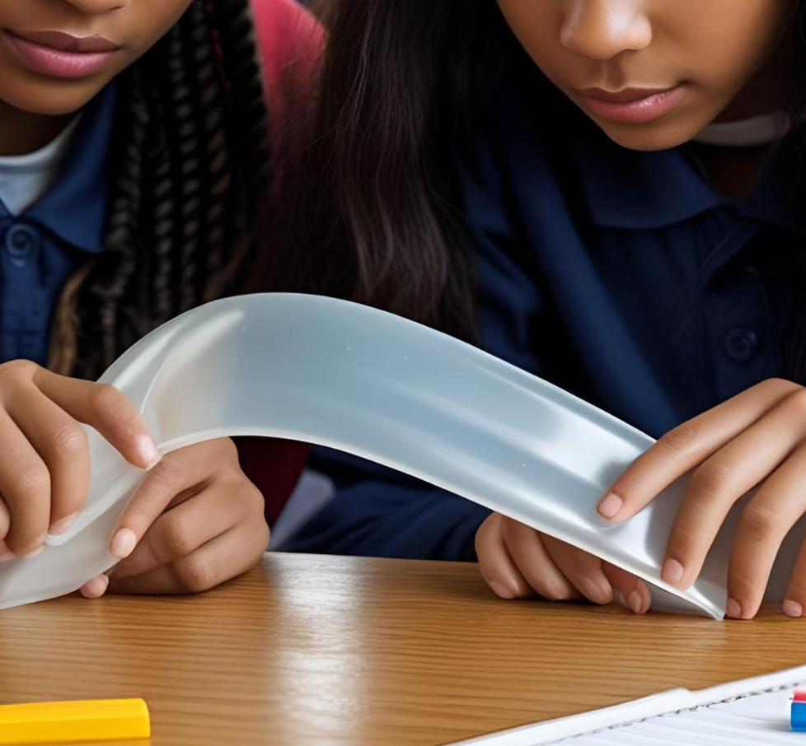
FLEXIBILITY TEST:
  Does it bend easily?
  Does it spring back to its shape (elastic)?
  Does it crack or break (brittle)?
RECORD YOUR RESULTS
in your booklet.

Slide 18
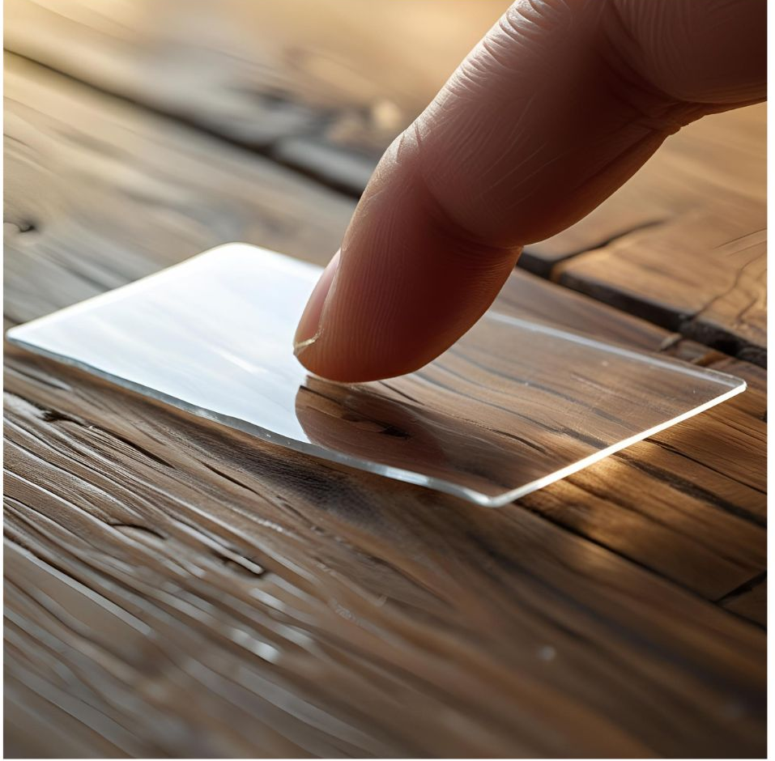
RIGIDITY TEST:
Place your bioplastic piece on your table.
Gently press down on the center.
RECORD YOUR RESULTS
in your booklet.

Slide 19
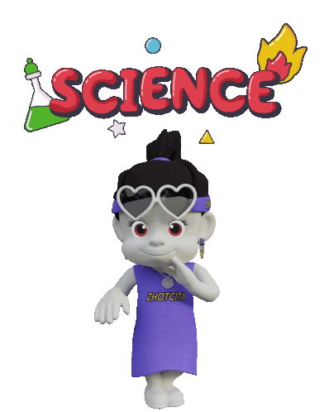
Today: Change a variable and rerun your lab!
Follow the instructions on Page 11. After you decide which variable you want to change in your recipe, rerun the lab.
DO NOT forget to change ONE variable!
You will run the activity exactly like you did before EXCEPT for the variable change.

Slide 20
Final Day of the Bioplastic Activity!
Take 5 minutes to check on your second bioplastic piece and record the data you need:
  Shrinkage
  Flexibility
  Rigidity
Bioplastic Activity Wrap-Up– Individually answer the Bioplastic Activity Wrap-Up questions.
When you finish, look back through your booklet and make sure you have everything filled out.
Quiz Time! - You may use your booklet.

