Slide 1
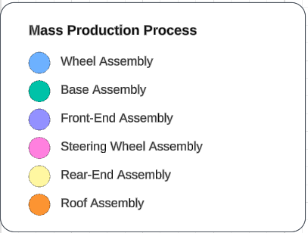

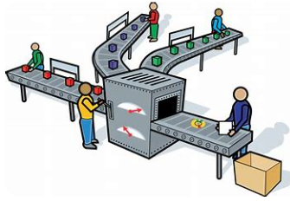


FAST TRACK FACTORY
Graphic
Assembly
Guide

Slide 2
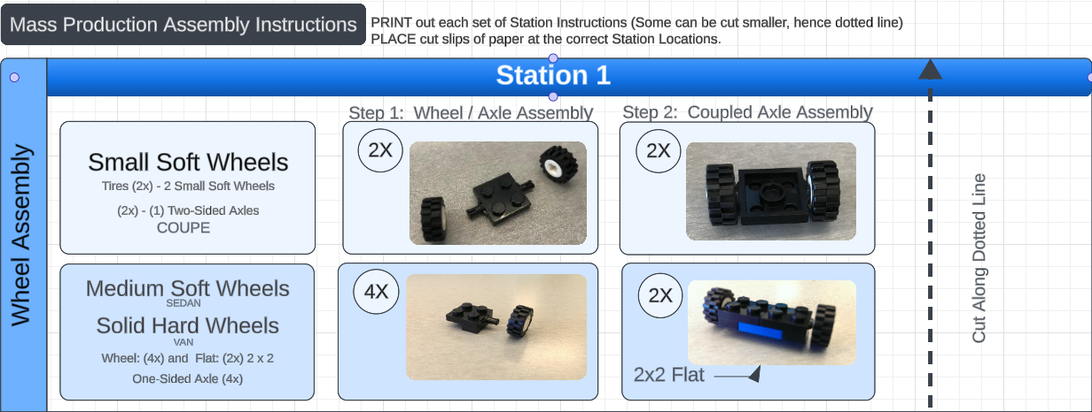
Print Packet for stations or cut individuals out for stations
Station Instructions for Assembly

Slide 3
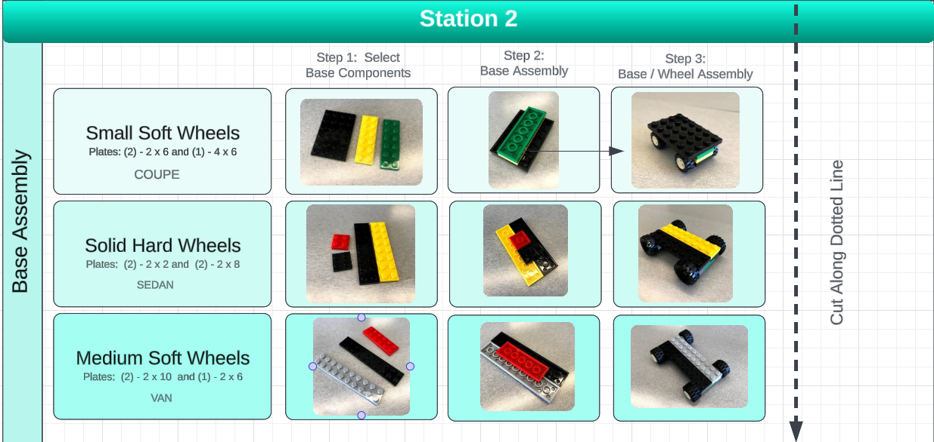

Slide 4
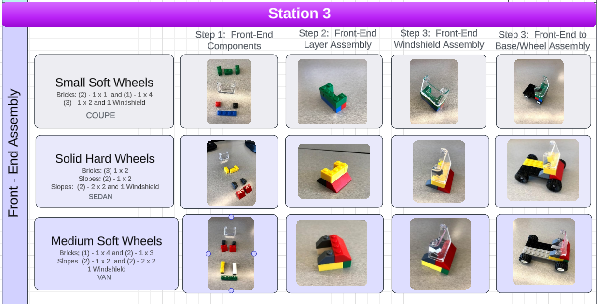

Slide 5
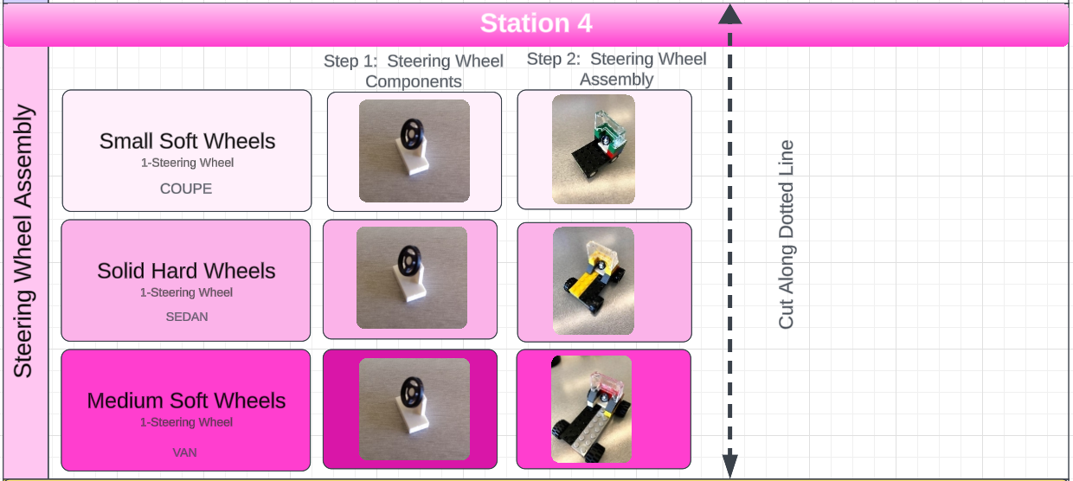

Slide 6
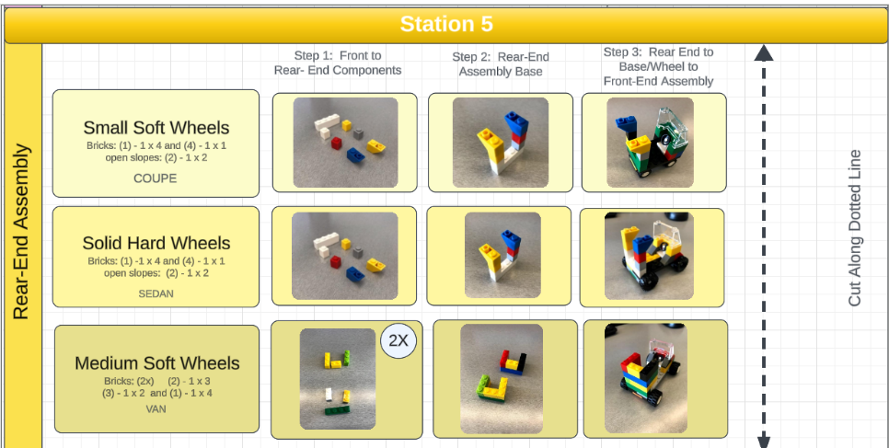

Slide 7
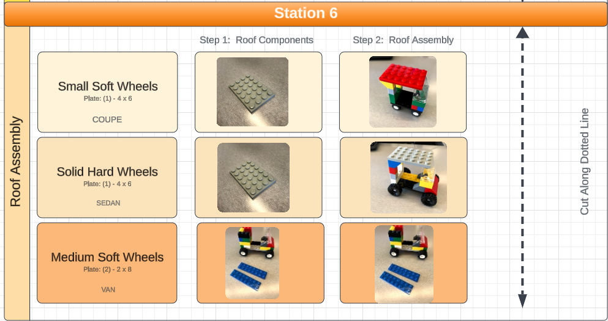

Slide 8
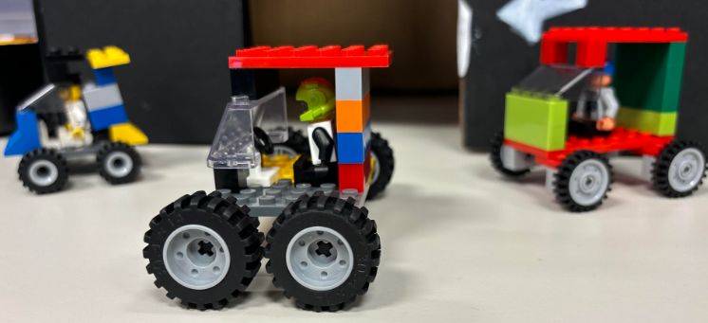
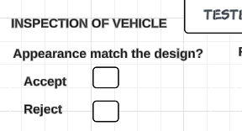
Quality Engineer: Initial Inspection Testing
Step 1:
Manufacturing engineers deliver the finished product.
Start Recording Time
Inspect the vehicle to see if it matches the design from this guide.
Mark Accept or Reject on the form.
If Accepted, send for further testing and DO NOT END TIME.
If Rejected, record end for inspection time and send car back to manufacturing engineer.
Step 2:

Slide 9
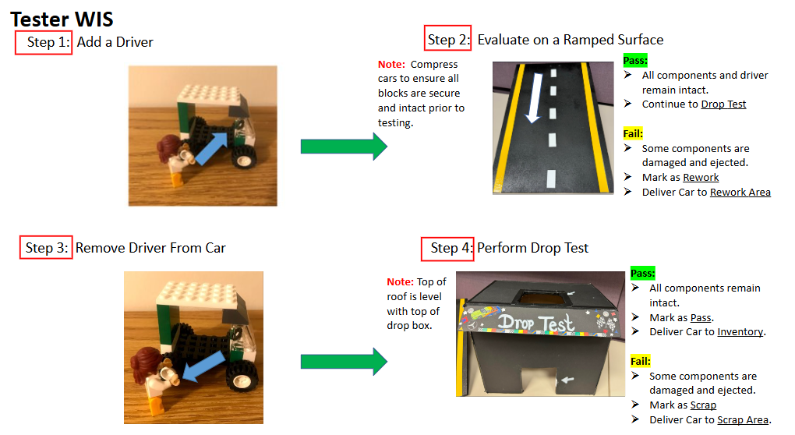
Quality Engineer: Testing Instructions if Vehicle passes Initial Inspection

